Slide 1
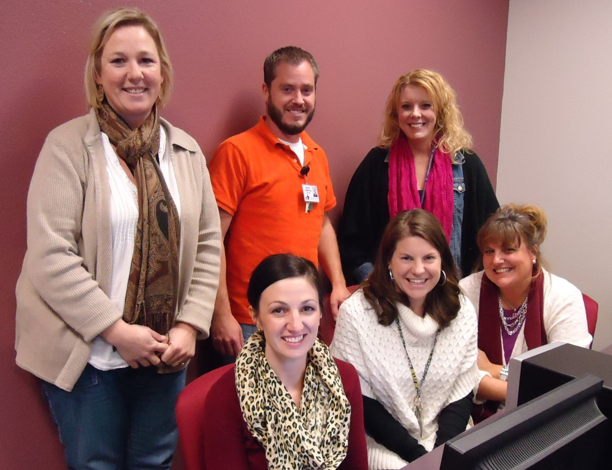
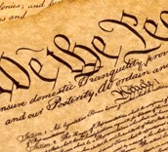
The People,
The Preamble,
and the Presidents
3rd Grade Unit 4
Planning Team
Susan Bush, David Vanston, Kristy Brown
Sarah Henry, Audrey King, Susan Huntington

Slide 3
The People,
The Preamble,
and the Presidents
Essential Question
How do my own experiences influence my point of view of a story?
How are pictures worth a thousand words?
What makes a good leader?
Notes:
JENNIFER
Read overview out loud-
Focusing on phonological awareness, students are challenged to listen for rhythm and rhyming words within the literature. Concepts are taught as students read poems on wall charts and in informational books. Descriptions of gathered objects and artworks highlight the secondary focus on color, encouraging rich descriptions, discussion in spoken language, and vocabulary development. In this early stage of writing, students use a combination of drawing, dictation, and writing to give opinions about favorite colors.

Slide 5
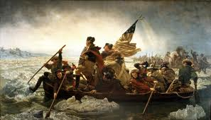
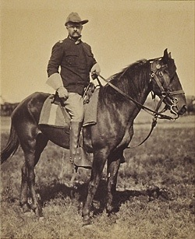
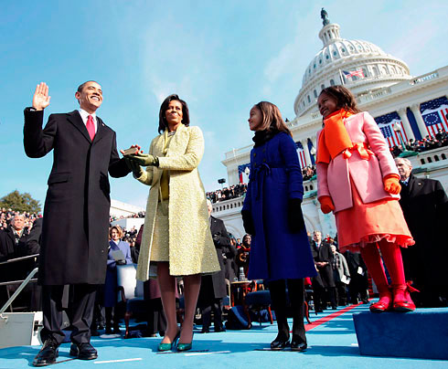
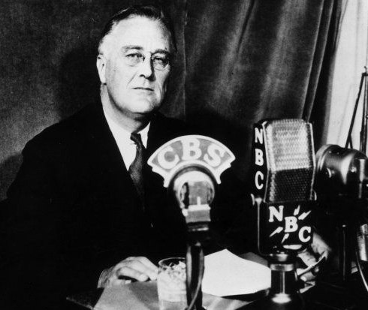
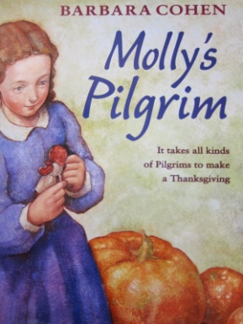
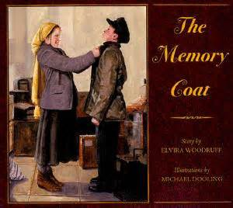
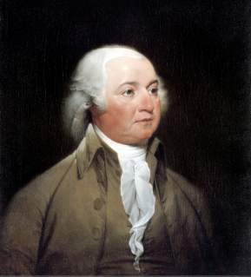
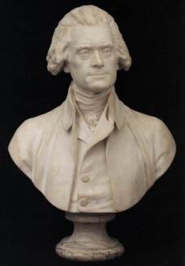
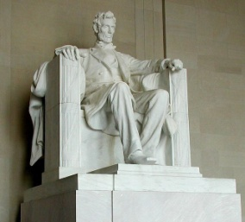
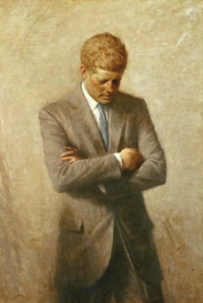
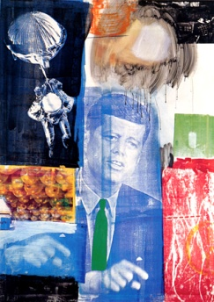
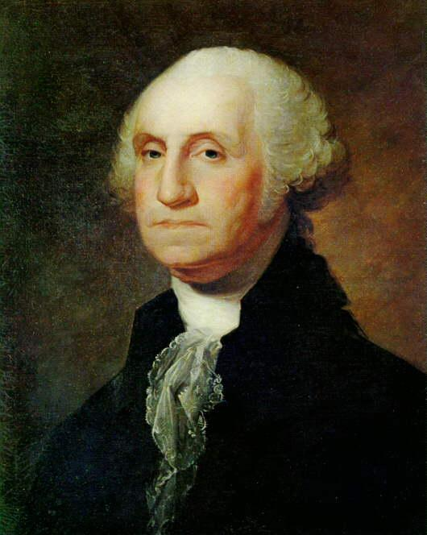
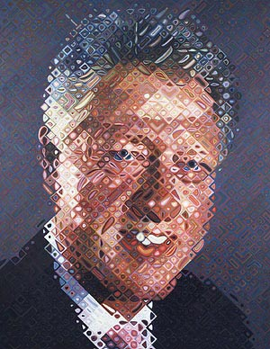
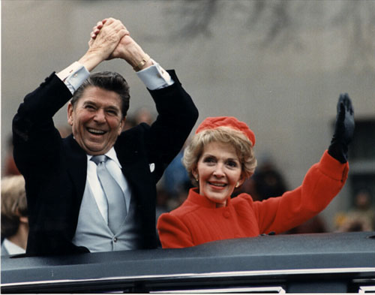
3rd Grade
Print Resources
Unit 4
Literature
Stories
7 copies
Art
25 Copies
Poems
(READ ALOUD)
“The Star-Spangled Banner”
“The Flag Goes By”
“George Washington”
“Washington Monument by Night”
“A Nation’s Strength”
Notes:
“We do not have any informational standards for this unit, but you can see on your handout that we have these informational texts by Ruth Heller that can be used to help teach language standards through writing. Has anyone used these texts in other ways effectively in their classroom?” Discuss
“We were not sure where to put the tooth book, has anyone used this text in an effective way?” Discuss
“What ways are you using the artwork effectively?” Discuss

Slide 6
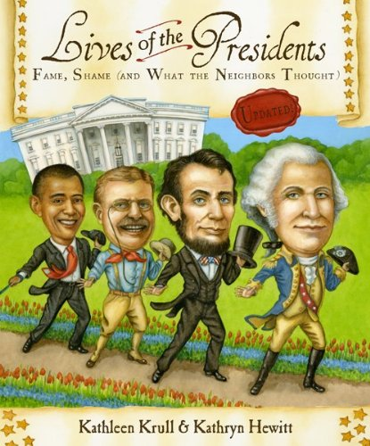
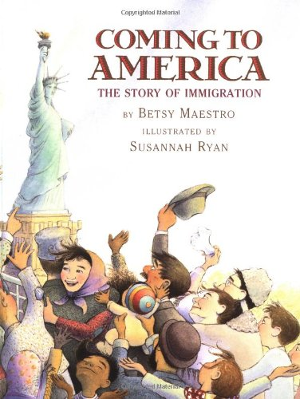
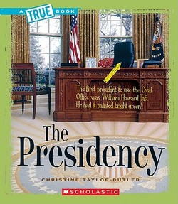
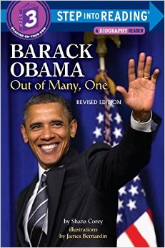
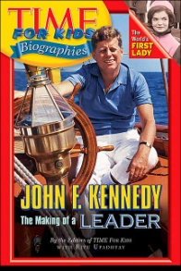
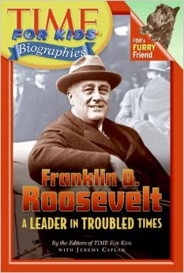
Informational Text
non-narrative
Read Aloud
non-narrative
narrative
narrative
5 Copies
Notes:
“We do not have any informational standards for this unit, but you can see on your handout that we have these informational texts by Ruth Heller that can be used to help teach language standards through writing. Has anyone used these texts in other ways effectively in their classroom?” Discuss
“We were not sure where to put the tooth book, has anyone used this text in an effective way?” Discuss
“What ways are you using the artwork effectively?” Discuss

Slide 7
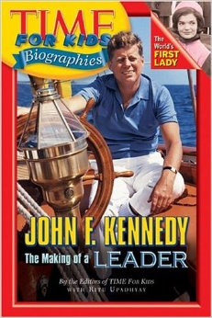
New Texts
5 copies each
Additional Texts
18 additional copies

Slide 8
Additional Art/Photographs (for weeks 5 and 6)

Slide 9
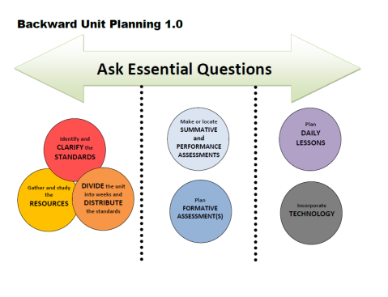
Week | Standards | Texts
1 | RL.3.4 Determine the meaning of words and phrases as they are used in a text, distinguishing literal from nonliteral language RL.3.7 Explain how specific aspects of a text’s illustrations contribute to what is conveyed by the words in a story (e.g., create mood, emphasize aspects of a character or setting) RI.3.4 Determine the meaning of general academic and domain-specific words and phrases in a text relevant to a grade 3 topic or subject area
DIVIDE the unit into weeks and DISTRIBUTE the standards

Slide 10
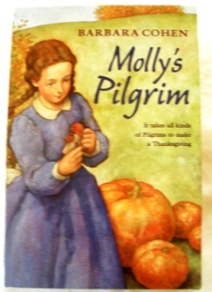
Week | Standards | Texts
2 | RL.3.3 Describe characters in a story (e.g., their traits, motivations, or feelings) and explain how their actions contribute to the sequence of events RL.3.4 Determine the meaning of words and phrases as they are used in a text, distinguishing literal from nonliteral language. RL.3.6 Distinguish their own point of view from that of the narrator or those of the characters RL.3.7 Explain how specific aspects of a text’s illustrations contribute to what is conveyed by the words in a story (e.g., create mood, emphasize aspects of a character or setting)
DIVIDE the unit into weeks and DISTRIBUTE the standards

Slide 11
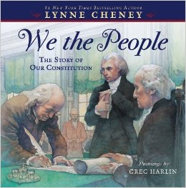
Week | Standards | Texts
3 | RI.3.3 Describe the relationship between a series of historical events, scientific ideas or concepts, or steps in technical procedures in a text, using language that pertains to time, sequence, and cause/effect. RI.3.4 Determine the meaning of general academic and domain-specific words and phrases in a text relevant to a grade 3 topic or subject area. RI.3.7 Use information gained from illustrations (e.g., maps, photographs) and the words in a text to demonstrate understanding of the text (e.g., where, when, why, and how key events occur). RI.3.8 Describe the logical connection between particular sentences and paragraphs in a text (e.g., comparison, cause/effect, first/second/third in a sequence).
DIVIDE the unit into weeks and DISTRIBUTE the standards

Slide 12
Week | Standards | Texts
4 | RI.3.4 Determine the meaning of general academic and domain-specific words and phrases in a text relevant to a grade 3 topic or subject area. RI.3.5 Use text features and search tools (e.g., key words, sidebars, hyperlinks) to locate information relevant to a given topic efficiently. RI.3.6 Distinguish their own point of view from that of the author of a text. RI.3.8 Describe the logical connection between particular sentences and paragraphs in a text (e.g., comparison, cause/effect, first/second/third in a sequence).
DIVIDE the unit into weeks and DISTRIBUTE the standards

Slide 13
Weeks | Standards | Texts
5 and 6 | RI.3.8 Describe the logical connection between particular sentences and paragraphs in a text (e.g., comparison, cause/effect, first/second/third in a sequence). RI.3.9 Compare and contrast the most important points and key details presented in two texts on the same topic. W.3.1 Write opinion pieces on topics or texts, supporting a point of view with reasons. W.3.7 Conduct short research projects that build knowledge about a topic. W.3.8 Recall information from experiences or gather information from print and digital sources; take brief notes on sources and sort evidence into provided categories
DIVIDE the unit into weeks and DISTRIBUTE the standards

Slide 14
Weeks | Standards | ART
5 and 6 | RI.3.8 Describe the logical connection between particular sentences and paragraphs in a text (e.g., comparison, cause/effect, first/second/third in a sequence). RI.3.9 Compare and contrast the most important points and key details presented in two texts on the same topic. W.3.1 Write opinion pieces on topics or texts, supporting a point of view with reasons. W.3.7 Conduct short research projects that build knowledge about a topic. W.3.8 Recall information from experiences or gather information from print and digital sources; take brief notes on sources and sort evidence into provided categories

Slide 15
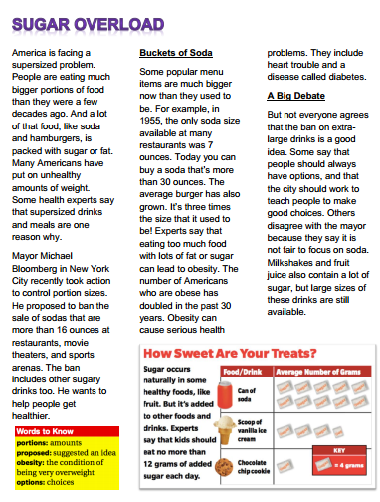
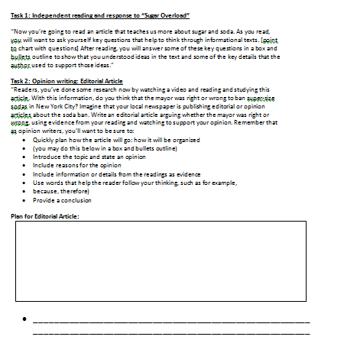
ASSSESSMENTS

Slide 16
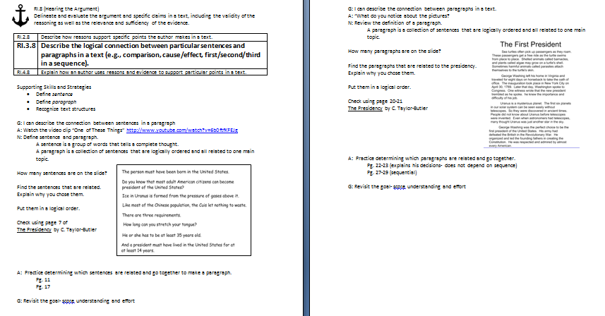
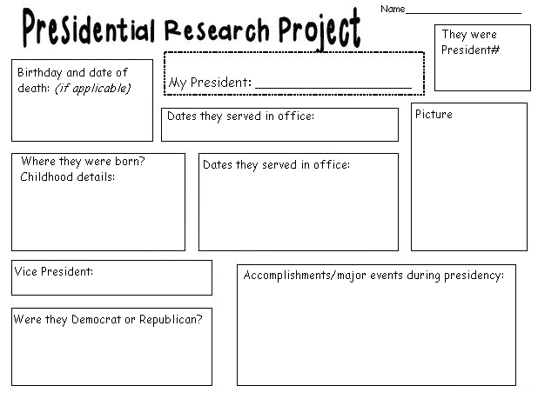
DAILY LESSON PLANS

Slide 17
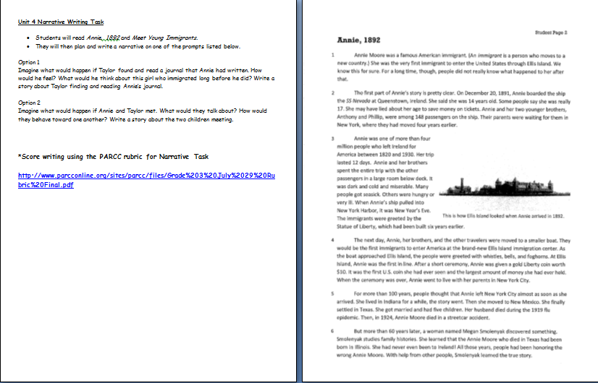
NARRATIVE WRITING TASK

Slide 18
RESOURCES
Susan Hensley
Elementary Curriculum Specialist
shensley@rps.k12.ar.us

