Slide 1
Fantastic Adventures with Dragons, Gods, and Giants
Third Grade, Common Core Unit 6
Essential Question: Why is it important to know mythology?
Notes:
This power point is in several sections and could be used during Unit 6. The essential question is referenced in this power point, and the culminating assignment is to write an essay in response to the question.

Slide 2
Meet some of the gods of Greek and Roman Mythology
For many years, children and young adults have enjoyed fantasy literature about the gods and goddesses of Greek, Roman, and Egyptian mythology.
Rick Riordan, author of the Percy Jackson Series of books writes about mythology. In the next slide, you will view introductions to four of the Greek gods from Percy Jackson and the Lightning Thief.

Slide 3
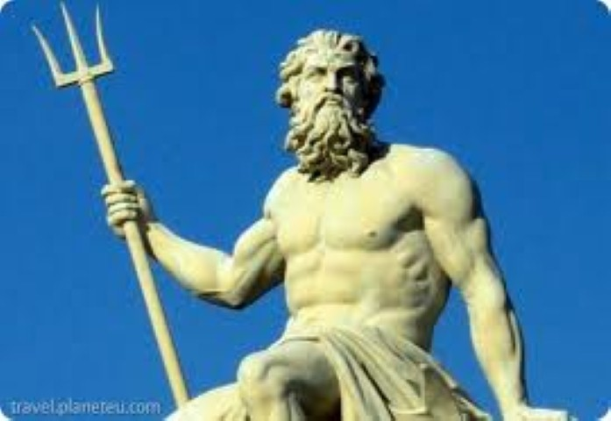
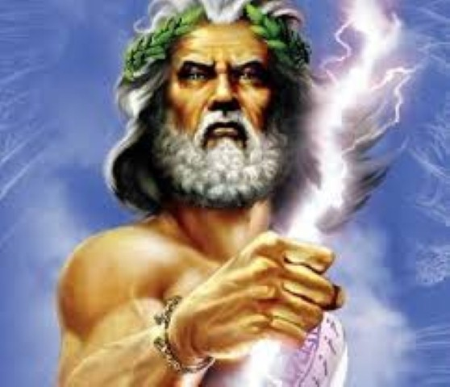
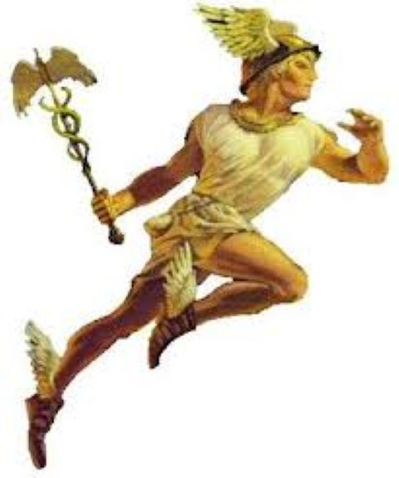
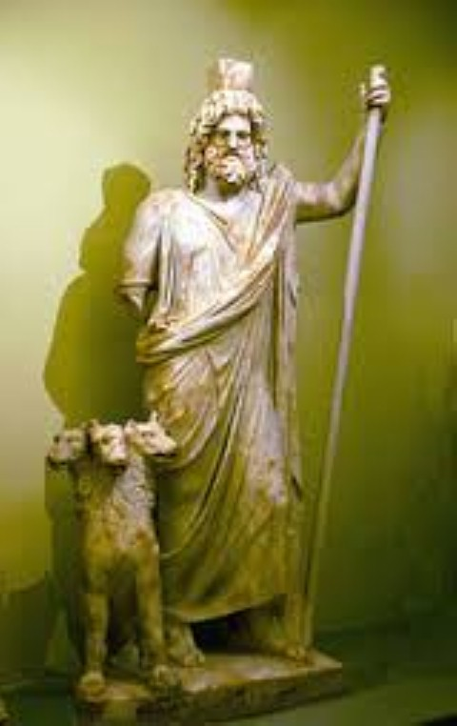
Notes:
These four gods are introduced via youtube videos (hyperlinks) from The Lightning Thief.

Slide 4
I - Why Is it important to know mythology?
Many of our planets are named after Greek or Roman Gods
Notes:
Each of the gods and goddesses have both a Greek and Roman name. Some of the names are the same in both cultures.

Slide 5
Greek name: ZEUS Roman name: JUPITER

Slide 6
THE PLANET JUPITER

Slide 7
Greek name: POSEIDON Roman name: NEPTUNE

Slide 8
THE PLANET NEPTUNE

Slide 9
Greek name: HADES Roman name: PLUTO

Slide 10
Pluto – a dwarf planet in our solar system.

Slide 11
Greek name: HERMES Roman name: MERCURY

Slide 12
The Planet Mercury

Slide 13
Greek name: ARES Roman name: MARS

Slide 14
The Planet Mars

Slide 15
II - Why is it important to know mythology?
The names of mythical creatures, gods and goddesses are used in advertising – the attributes of the god or creature are important to the message the advertiser wants to send to consumers.
Their names are also used to indentify the purpose of a group or place.
Notes:
Part II. Advertising references – if you don’t understand the reference, the advertisement does not make much sense.

Slide 16
Greek & Roman name: APOLLO The god of light, colonization, and questioning.

Slide 17
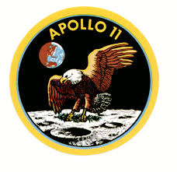
Exploration in Space: APOLLO SPACE PROGRAM
Notes:
How does the name of this program – the one that got the United States to the moon – connect to Apollo’s gift or purpose?

Slide 18
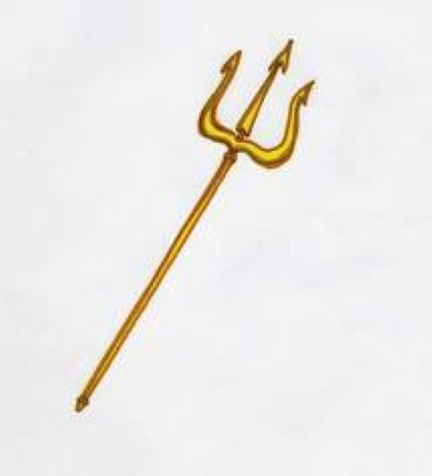
Greek name: POSEIDON Roman name: NEPTUNE The god of the sea.
Poseidon’s Trident is often used in advertising or naming of products.
Notes:
Trident – tri – three: dent – thorn Three pronged sword.

Slide 19
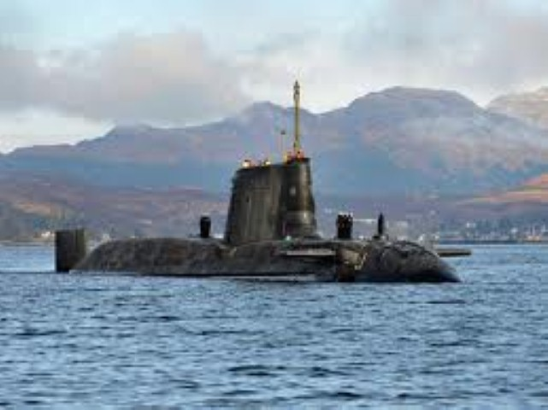
References to the Trident of POSEIDON/NEPTUNE.
Trident Submarine
Notes:
Why would a connection to the god of the sea be important?

Slide 20
Greek name: HERMES Roman name: MERCURY Messenger of the gods, and a protector.

Slide 21
HERMES/MERCURY SYMBOLS
The symbol of FTD, a company that delivers flowers.
A caduceus, the symbol of medicine
Notes:
What attributes of Hermes/Mercury are referenced by these two symbols?

Slide 22
Greek name: ATHENA Roman name: MINERVA The goddess of reason, thinking, arts, and literature.

Slide 23
The Athena Society for Women in San Diego, California
Members of this group strive to excel in technology, science, and health care.
Notes:
Why do you think this society chose the name “Athena”?

Slide 24
Greek name: ARTEMIS Roman name: DIANA Goddess of the heavenly world.

Slide 25
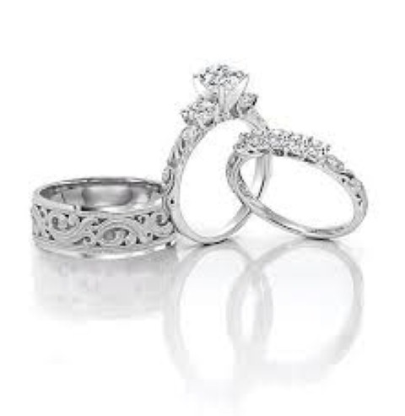
Diana© sells wedding rings.
Notes:
Why would the name “Diana” be a good reference here?

Slide 26
Greek and Roman name: ATALANTA Hunter, athlete, runner

Slide 27
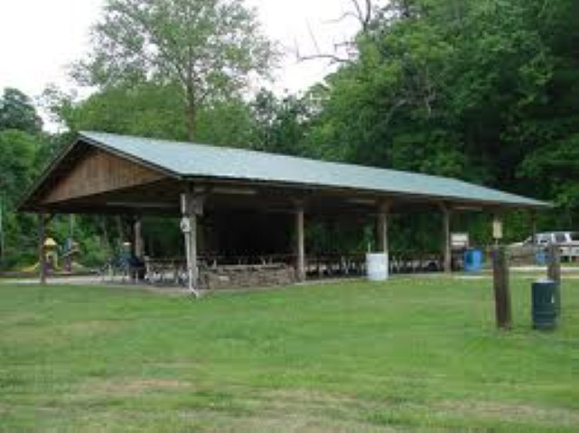
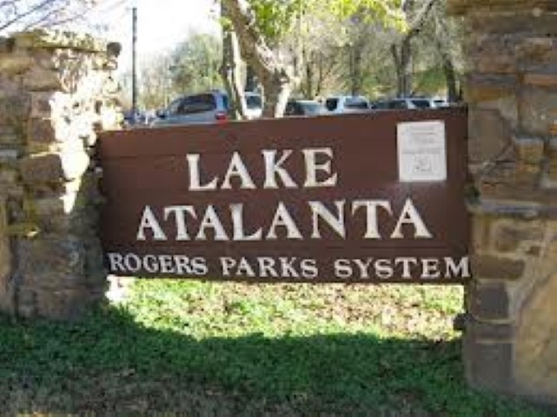
LAKE ATALANTA in Rogers
Notes:
What activities can be done at Lake Atalanta that might connect to Atalanta’s purpose?

Slide 28
II - Why is it important to know mythology?
There are many mythological references in our language in the form of figures of speech or the names of things or animals.
Notes:
This section of slides could be done one day at a time. The figure of speech referenced and the questions could be a stimulus for a quick write.

Slide 29
Figures of Speech
Several figures of speech come directly from Greek or Roman myths.
Read the following myths, then think about the questions on the slides.

Slide 30
Pandora’s Box
Read the myth of Pandora.
What is meant by the statement below?
“They opened a Pandora’s Box of trouble.”

Slide 31
King Midas
Read the myth of King Midas
What is the meaning of this statement?
“He has the Midas touch.”

Slide 32
Hercules
Read the myth of Hercules.
Read this statement:
“She was given a Herculean task.”
Explain what the speaker means.

Slide 33
Names of things or animals.
Read the following myths.
Think about the statements or questions about the myths on each slide.

Slide 34
The Labyrinth
Read the myth of the Minotaur and the Labyrinth.
Why might someone call a Corn Maze a “labyrinth”?

Slide 35
Arachne
Read the myth of Arachne.
What is an arachnid? How do you think this word came to be?

Slide 36
Why is it important to know mythology?
Write an essay explaining why knowing mythology is important.
Notes:
This is the culminating assignment – a chance for students to write an opinion piece with specific references to the things learned in this unit.

