Slide 1
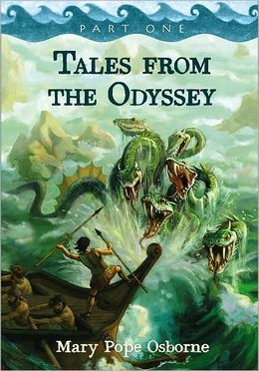
Tales From the Odyssey by Mary Pope Osborne

Slide 2
The One-Eyed Giant
This is a scary story...Beware! It's about a giant with one eye called a CYCLOPS who likes to eat people!

Slide 3
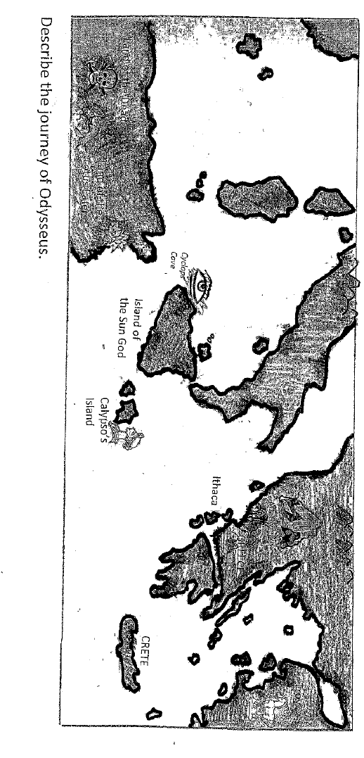
The One-Eyed Giant lives here.
Odysseus lives here.

Slide 4
Here are some words to know from each chapter. Turn and talk with a neighbor about what each means and take notes in your literacy notebook. Remember, notes can be words or quick pictures.

Slide 5
Chapter 1
desperately: with a sense of urgency or need
Pg.8-Odysseus glared at the man, trying desperately to think of some way to avoid leaving his family.

Slide 6
Chapter 2
mourned: felt very sad because of a great loss
pg. 13-He mourned the separation from his wife and felt terribly sad that he had missed seeing his son grow up.
bitterly: with anger
pg. 18-The Trojans argued bitterly about whether or not to trust the captive.

Slide 7
Chapter 3
bewildered: confused
pg. 23-As his men frantically fought the storm, Odysseus felt bewildered. Why was Zeus, god of the skies, hurling his thunderbolts at them?
valiantly: bravely
pg. 24-The Greeks struggled valiantly against the mighty wind and waves.

Slide 8
Chapter 4
lingered: slow to leave
pg. 33-All day, the Greeks lingered on the island, feasting on roasted meat and drinking sweet wine.
wafted: floated through air or water
pg. 34-The murmur of deep voices and the bleating of sheep wafted through the twilight.

Slide 9
Chapter 5
jutted: stuck out sharply
pg. 39-His monstrous head jutted from his body like a shaggy mountain peak.
ruthless: having no mercy or sympathy
pg. 40-The Cyclopes were ruthless creatures who were known to capture and devour any sailors who happened near their shores.

Slide 10
Chapter 6
heave: push or pull with great effort
pg. 47-Odysseus watched the Cyclops open his eye, then heave himself up from the ground.
distraught: very worried
pg. 50-His men were too distraught to think clearly, so Odysseus paced about the cave alone, searching for a way to destroy the giant.

Slide 11
Chapter 7
urged: persuaded, strongly encouraged
pg. 64-He silently urged them to hurry.
jeering: making fun of
pg. 67-As they moved far beyond the shore of the blind giant, Odysseus could not help jeering at the beast again.

Slide 12
Chapter 8
gleamed: glowed
pg. 72-A huge, bronze fortress gleamed beyond its shore.
yearning: deep desire or need
pg. 84- And he leaned toward the horizon, yearning for home.

