Slide 1
Frindle Day 3 Chapters 5 & 6
Notes:
Day 2

Slide 2
Goal
I can use words I learn from a text
Notes:
Day 2

Slide 3
Tell your partner about a new word you learned yesterday.

Slide 4
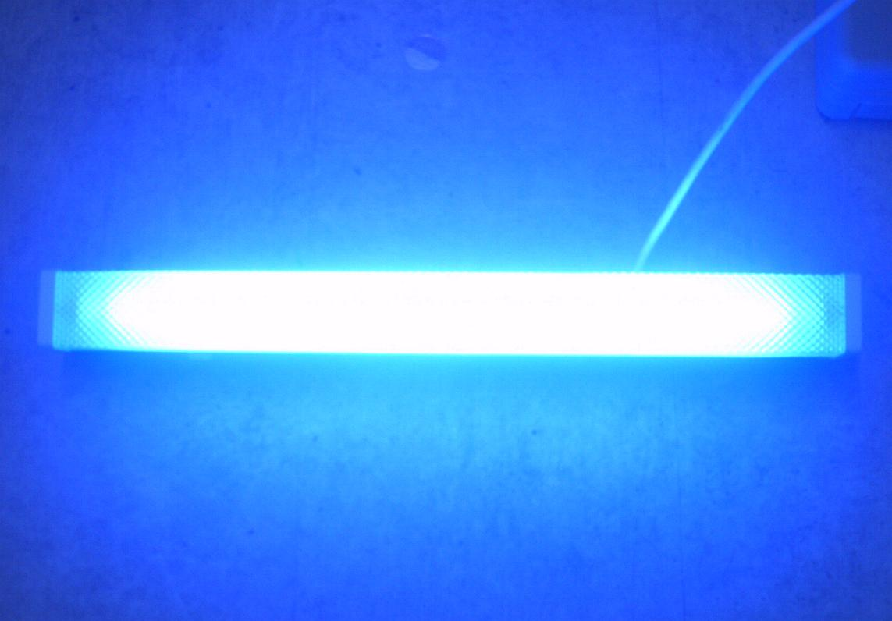
fluorescent
Definition- very bright
Notes:
Contextualize the word- Find it in the text
Say the word together

Slide 5
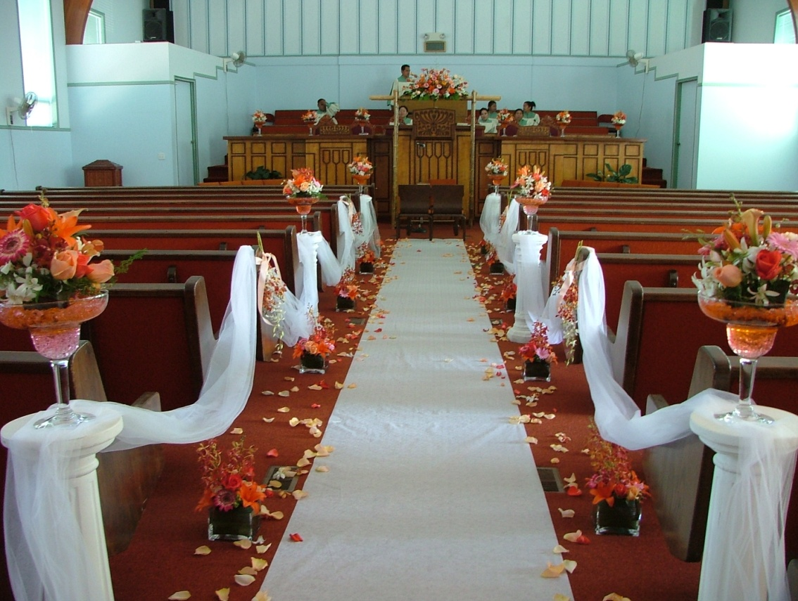
aisle
Definition- passage where people walk through
Notes:
Contextualize the word- Find it in the text
Say the word together

Slide 6
Write a sentence to show you know what each of these words mean.
The light was fluorescent because…
The aisle was narrow because…
Notes:
Application-
Students need an opportunity to use the words they just learned from the text.

Slide 7
Goal
I can use words I learn from a text
Notes:
Day 2

