Slide 1
The Memory Coat
Analyzing characters traits, motivations, and feelings

Slide 2
I can describe characters’ traits, motivations, and feelings. I can explain how their actions contribute to the sequence of events.
RL.3.3
4th Grade | 4 | Describe a character drawing on their thoughts, words and actions. Use key details to describe setting or events.
3rd Grade | 3 | Describe characters’ traits, motivations or feelings and explain how their actions contribute to the sequence of events.
2nd Grade | 2 | Describe how characters respond to major events and challenges.
1st Grade | 1 | Use key details to describe characters, settings, and major events in a story.
Notes:
Share the standards based rubric. Explain that students must meet both parts of the standard in order to score a 3:
-describe characters’ traits, motivations, and feelings
-explain how their actions contribute to the sequence of events in the story.
Students rate to the goal.

Slide 3
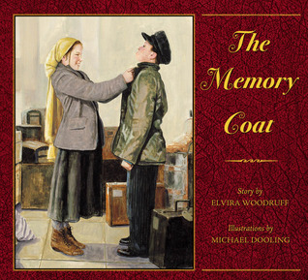
What do you remember about this story?
What do you know about
Rachel and Grisha?
Notes:
Ask the questions on this slide to access prior knowledge.

Slide 4
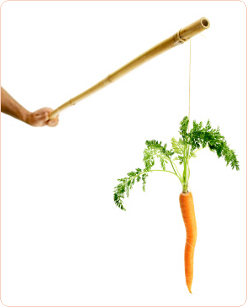
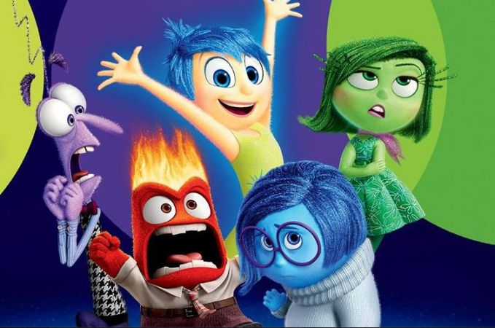
Different ways to describe characters:
TRAITS
A person’s personality or attitude
MOTIVATIONS
The reasons we act the way we do
FEELINGS
How we feel about things
Notes:
Use this slide as a review of traits, motivations, and feelings. Discuss with students to be sure they understand.

Slide 5
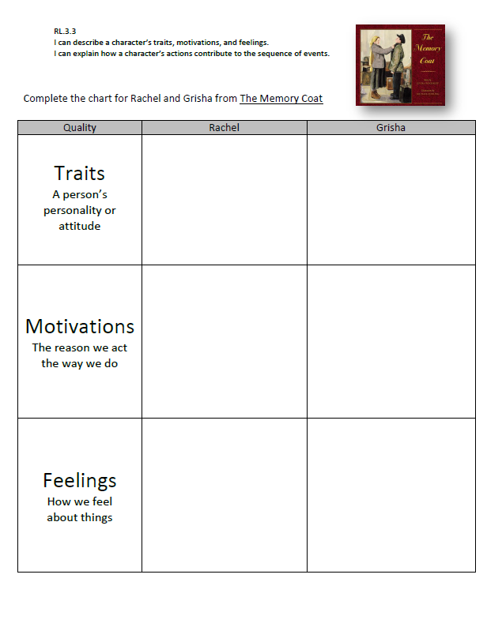
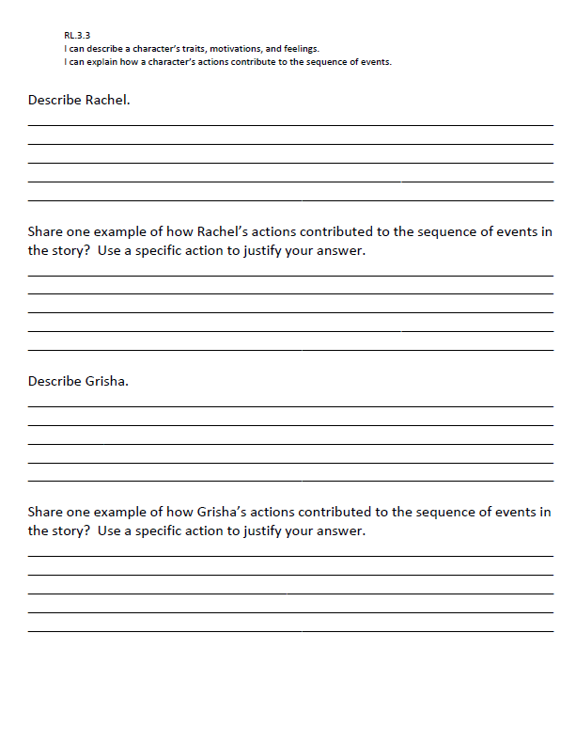
Notes:
Depending on your students’ needs, complete the organizer together or independently and discuss. Students will use the information on the organizer to help them answer the questions related to the standard.

Slide 6
Generalize the goal…
How can analyzing a character’s traits, motivations, and feelings help you when you read?
After today’s lesson, do you have a better understanding of each character and the part they played in the story?
Circle the trait, motivation, or feeling that you think helps describe Rachel and Grisha the most.
Notes:
Generalize the goal by asking the questions on the slide.

Slide 7
I can describe characters’ traits, motivations, and feelings. I can explain how their actions contribute to the sequence of events.
RL.3.3
4th Grade | 4 | Describe a character drawing on their thoughts, words and actions. Use key details to describe setting or events.
3rd Grade | 3 | Describe characters’ traits, motivations or feelings and explain how their actions contribute to the sequence of events.
2nd Grade | 2 | Describe how characters respond to major events and challenges.
1st Grade | 1 | Use key details to describe characters, settings, and major events in a story.
Notes:
Students rate to the goal.

