Slide 1
The story of Wilson Kimeli Naiyomah, an immigrant from Kenya
Written By, Carmen Agra Deedy
Illustrated by Thomas Gonzalez
Historical Fiction

Slide 2
Your Goal…
Determine the main idea of our text as it is read orally.
Notes:
Goal:
SL.3.2: determine the main ideas and supporting details of a text read aloud or information presented in diverse media and formats, including visually, quantitatively, and orally.

Slide 3
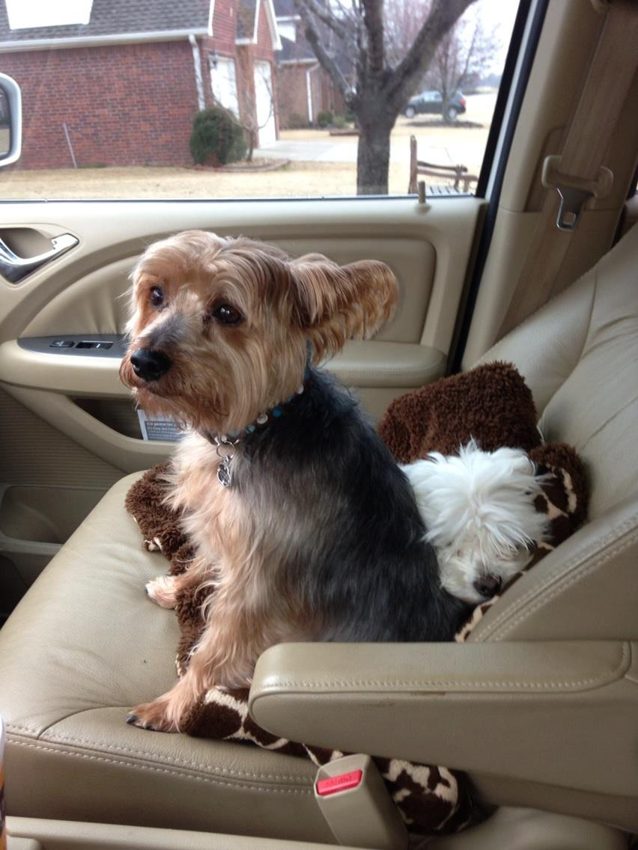
Do you have a pet? Or something that is very special to you?
If you have a pet:
What kind of pet do you have?
Why is your pet special to you?
If you do NOT have a pet:
What is something that is extra special to you?
Why is it so special?
Notes:
APK:
Tell the person next to you: if you have a pet, if so, why is your pet special; if you do not have a pet, what is something that is extra special to you?
Give students time to share about their pets. Insert your own picture of your pet and tell students why your pet is special.
Teacher note: this is to give the students some kind of connection to the importance of the Maasai people giving their cows to the U.S. Students have been learning about immigrants, and this story is of a current immigrant from Kenya.

Slide 4
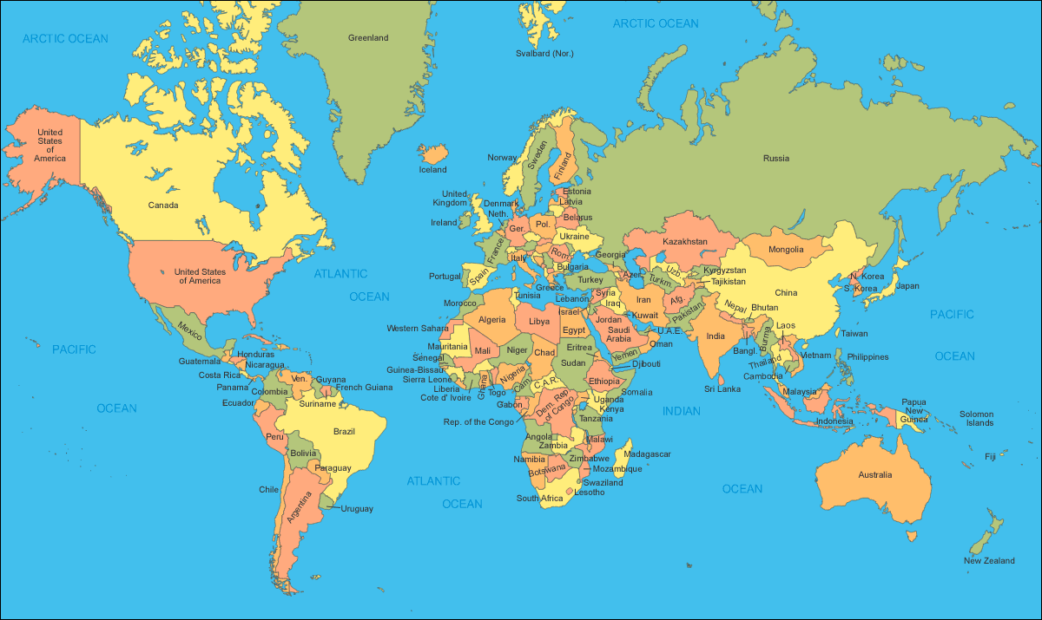
Where does this story take place?
Notes:
Build Background Knowledge:
Today, we are going to read about a tribe that lives in Kenya Africa.
An immigrant from Kenya, Wilson Kimeli Naiyomah, left his country to come to America and attend college.
Kimeli is from the Maasai tribe in Kenya.
After the 9/11 attack on the twin towers (make sure students know what this is), he returned to his village in Kenya for a visit.
It is important to “set up” the situation of this book before reading it to the kids. The whole basis of this book is on the act of kindness following 9/11, and how an immigrant in our country shared this experience with his tribe in Kenya; which in turn prompted them to give their prized possession to our country. (There is a quick video on the next slide)

Slide 5
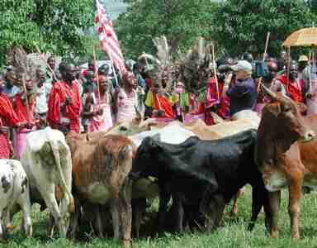
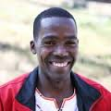
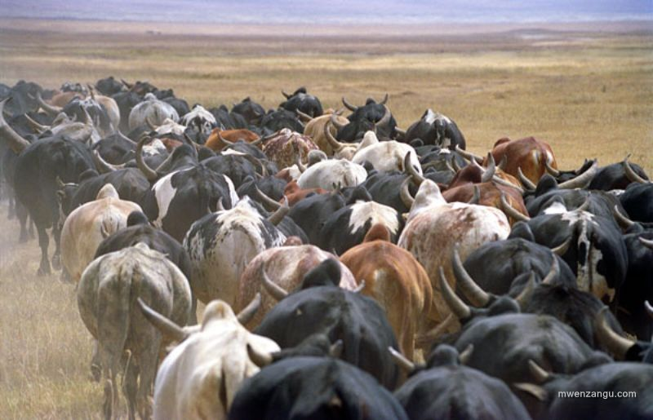
Maasai People
Notes:
Building Background Knowledge:
There is a video linked to the larger picture. This video clip shows the twin towers (briefly, 2 minutes) and gives a brief history on the 14 cows. The report is from Africa, so the accent of the reporter is quite heavy! Encourage students to put on their great listening ears!!

Slide 6
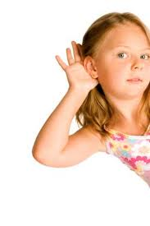
How to listen for the main idea…
Come ready to listen
Be respectful of noise
Think in your head:
What is this text about? Is it fiction or non-fiction?
Where does it take place?
When does it take place?
Why is it important? What is the purpose of it?
What is happening in the text?
Notes:
New information; (this is taken from Patricia Cunningham, Reading Teacher 1975, vol.29)
Teacher notes;
We have to teach kids how to listen; think about these steps in teaching kids how to listen for the main idea;
Set the purpose for listening ---in this lesson students are listening for what this story is mainly about
Students need to come ready to listen:
Respectful of noise and those around them
Be thinking, what is this story about? Where does it take place? When does it take place? Why is it important?
3. During the reading, stay focused on what is happening in the story.
Normally kids are reading a passage and then determining the main idea; being able to look back within the text; this standard asks them to determine the main idea from LISTENING and SPEAKING.

Slide 7
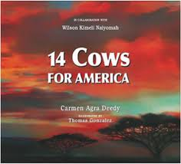
Reading of the story…
What is the setting of this story?
Who is in this story?
What is happening?
Why is this story important?
Notes:
Show the questions on this slide as a way to remind students what to think about while listening to the story. This will help with determining the main idea of the story.
Give students time to listen and take in what this story is about; don’t rush through the pictures (they are amazing).
A few words that may need explaining during the story.
Nomadic cattle herding (4th page of text): nomadic- moving from one place to another, taking care of cows
Elders (8th page of text): the older men of the tribe; they are considered wise and give guidance
Injustice (10th page of text): something done to a person or group of people that is unfair and wrong.

Slide 8
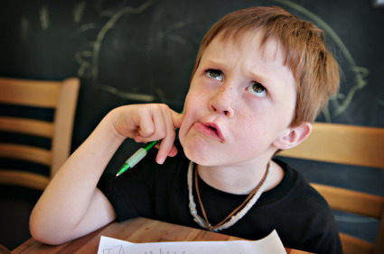
What is the main idea of this text?
Let’s think back to what we did during the reading:
Why is this story important?
What was the author trying to tell us? (purpose)
What was important about this text?
Notes:
Application:
Be intentional in how you have paired students for this application. This is a speaking and listening standard, and students need to LISTEN to their partner and determine if they can tell the main idea of the text.
Quickly go through the questions on this slide, ( 5min)

Slide 9
Talk to your partner…
What is the main idea of this story?
Choose one of these statements and support your answer:
Kimeli wanted to share the Twin Towers story with his people.
The Masaai tribe gives their favorite possession as a symbol of comfort and peace to the United States.
The Masaai tribe had a special ceremony with dancing and singing.
Notes:
Application:
Have students share orally with their partner what the main idea of the story is…
The story of 14 Cows is mainly about…
This part of the lesson is also from the Patricia Cunningham article from 1975
Let students choose the main idea with their partner and discuss why it is the main idea. You can tell each pair to have evidence to support their answer. Allow students to glance back at the book if needed.
(Answer: #2; when hearing the story of the twin towers, the illustrations show the people with downcast faces, looking serious;after the story is shared, the text says, “they are easily moved to kindness when they hear of suffering and injustice.” “what can we do for these poor people” “They give gladly”
When Scoring:
Give students time to talk to each other before scoring their answer.
Once students have shared with each other, allow students to share orally.
You will need to listen to responses, to make sure that students grasped the main idea of the story; pointing out that the story is not about all the details; but about the generosity of the tribe and their gift to the U.S.

Slide 10
Your Goal…
Determine the main idea of our text as it is read orally.
Notes:
Goal:
SL.3.2: determine the main ideas a supporting details of a text read aloud or information presented in diverse media and formats, including visually, quantitatively, and oral

