Slide 1
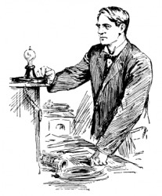
Creative, Inventive, and Notable People
Unit 3
How are the words creative and inventive similar?
How are they different?

Slide 2
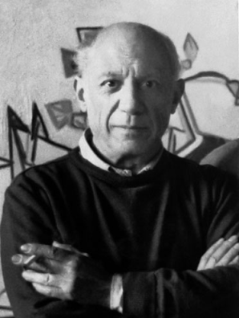
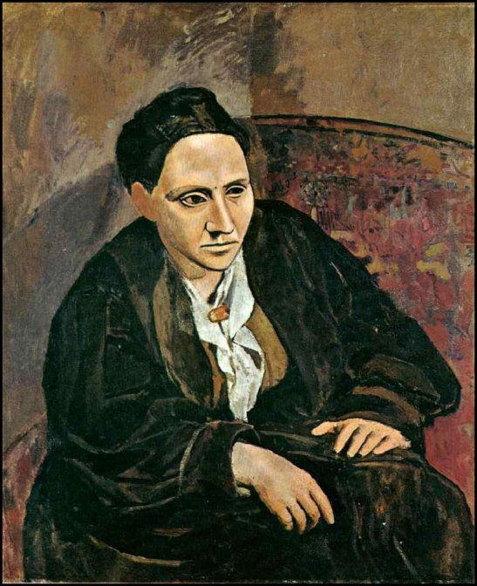
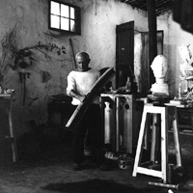
Pablo Picasso 1881-1973
Portrait of
Gertrude Stein
(1906)
Notes:
Pablo Picasso (Spanish pronunciation: [ˈpaβlo piˈkaso]), 25 October 1881 – 8 April 1973), was a Spanish painter, sculptor, printmaker, ceramicist, and stage designer. One of the greatest and most influential artists of the 20th century, he is widely known for co-founding the Cubist movement, the invention of constructed sculpture, [2][3] the co-invention of collage, and for the wide variety of styles that he helped develop and explore

Slide 3
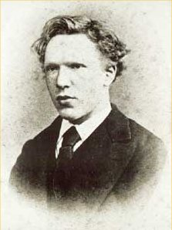
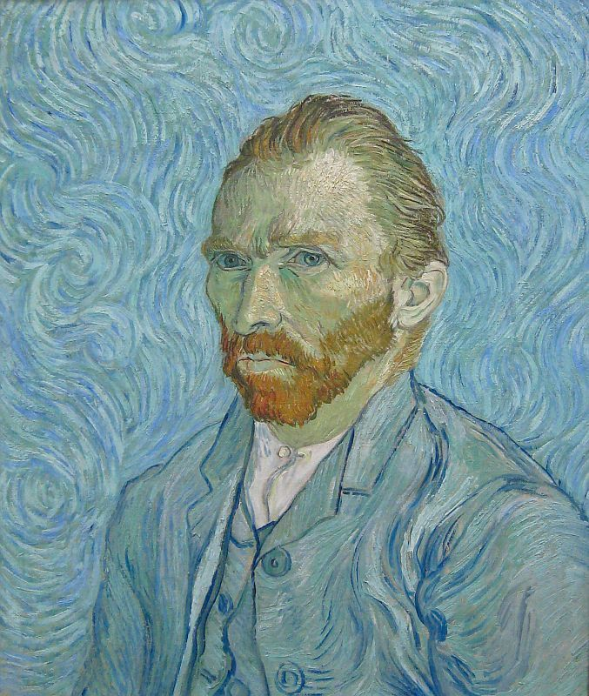
Vincent van Gogh 1853-1890
Self-Portrait
(1887-1888)
Notes:
Vincent Willem van Gogh (UK /ˌvæn ˈɡɒx/, US /ˌvæn ˈɡoʊ/;[note 1] Dutch: [vɑŋ ˈɣɔχ] ( listen); 30 March 1853 – 29 July 1890) was a Dutch post-Impressionist painter whose work, notable for its rough beauty, emotional honesty, and bold color, had a far-reaching influence on 20th-century art

Slide 4
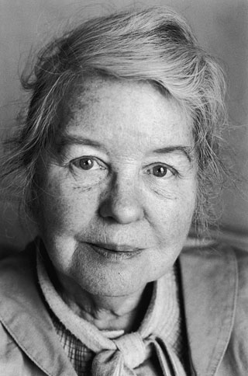
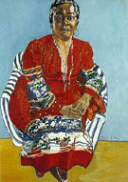
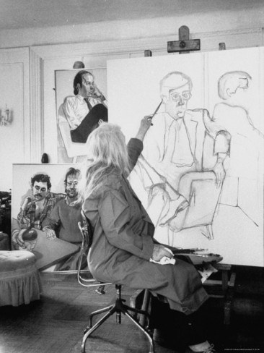
Alice Neel 1990 - 1984
Faith Ringgold
(1976)
Notes:
Alice Neel (January 28, 1900 – October 13, 1984) was an American artist known for her oil on canvas portraits of friends, family, lovers, poets, artists and strangers. Her paintings are notable for their expressionistic use of line and color, psychological acumen, and emotional intensity.

Slide 5
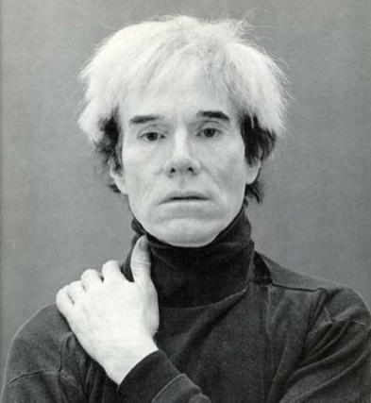
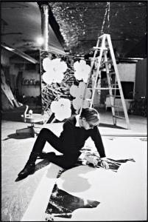
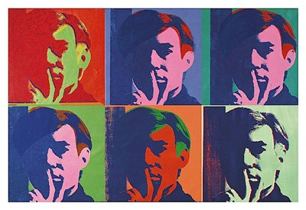
Andy Warhol 1928-1987
Self-Portrait
(1967)
Notes:
Andy Warhol (August 6, 1928 – February 22, 1987) was a leading figure in the visual art movement known as pop art

Slide 6
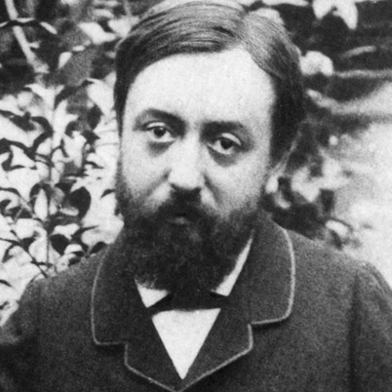
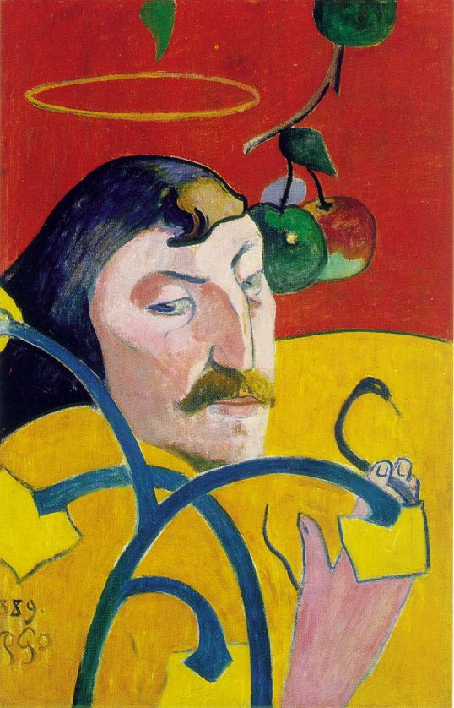
Paul Gauguin 1848-1903
Self-Portrait
(1889)
Notes:
Eugène Henri Paul Gauguin (French pronunciation: [øˈʒɛn ãˈʁi ˌpol ɡoˈɡɛ̃]; 7 June 1848 – 8 May 1903) was a leading French Post-Impressionist artist, who was not well appreciated until after his death. Gauguin was later recognized for his experimental use of colors and synthetist style that was distinguishably different from Impressionism

Slide 7
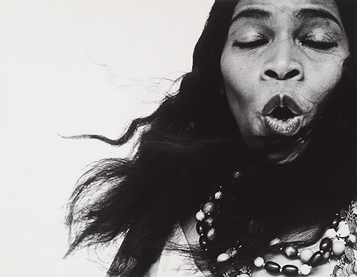
Notes:
Richard Avedon, Marian Anderson, Contralto, New York (1955)

Slide 8
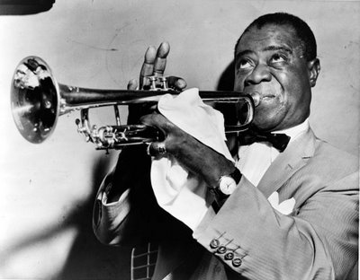
Notes:
World-Telegram staff photographer, Louis Armstrong (1953)

Slide 9
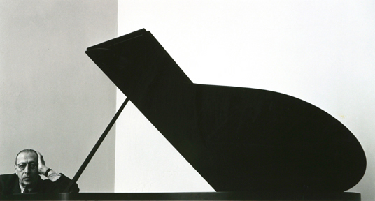
Notes:
Arnold Newman, Igor Stravinsky (1946)

Slide 10
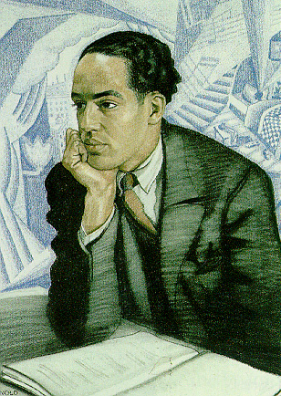
Notes:
Winold Reiss, Portrait of Langston Hughes (no date)

Slide 11
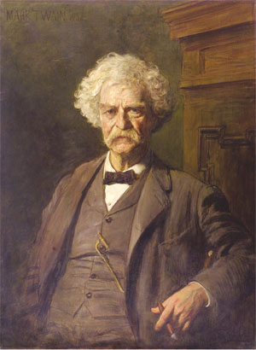
Notes:
Edoardo Gelli, The Last Portrait of Mark Twain (1904)

Slide 12
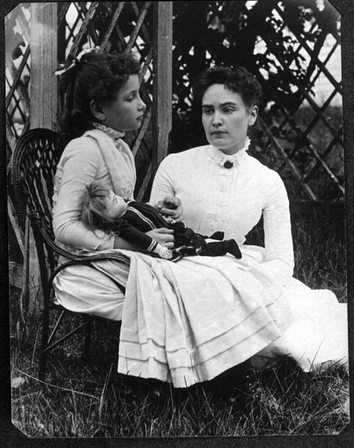
Notes:
Artist Unknown, Helen Keller with Anne Sullivan (1888) *I can’t guarantee this is the correct photo. -Renee

Slide 13
Images from Google
Artist information from Wikipedia

