Slide 1
3rd Grade
Text Talk
Unit 2

Slide 2
I can use words I learn from a text.
Notes:
Goal-
Students need to engage with the goal- read it, repeat it, write it, etc.

Slide 3
Tell your partner about a text talk word from Sarah, Plain and Tall.
Notes:
Access Prior Knowledge- (APK)
Turn and Talk

Slide 4
Notes:
New Information-
Read the book- provide a brief explanation of any words that may be new or unfamiliar to the students.

Slide 5
cluttered
Three of the walls were cluttered with sketches and stuffed fish and charts of the river.
Notes:
Contextualize the word- Find it in the text
Say the word together

Slide 6
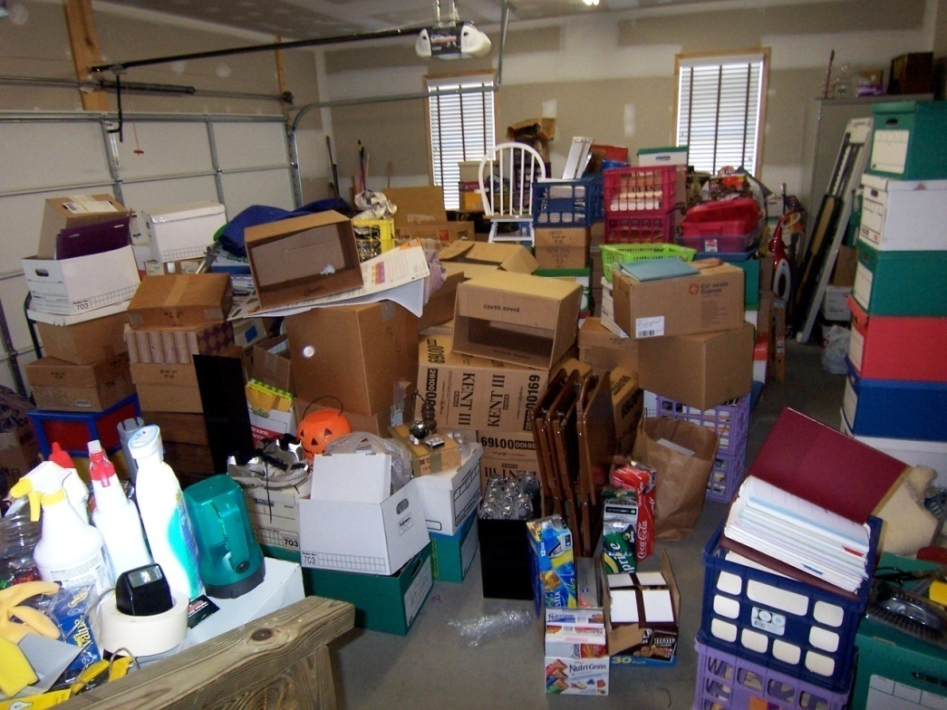
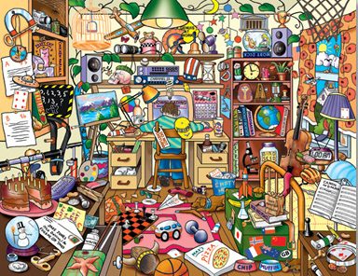
cluttered
to fill with a collection of things in an disorganized way
Synonyms: messy, jumbled
Notes:
Give student friendly definition
Use the word in other contexts

Slide 7
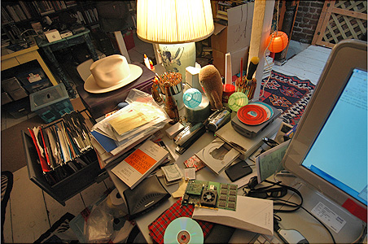
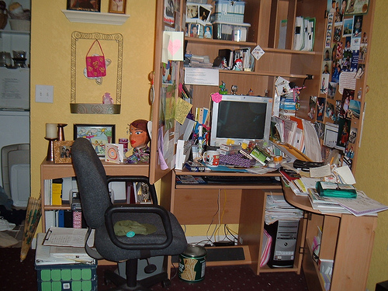
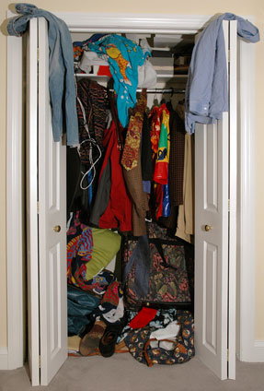
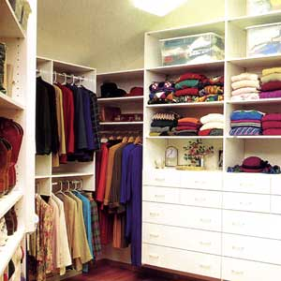
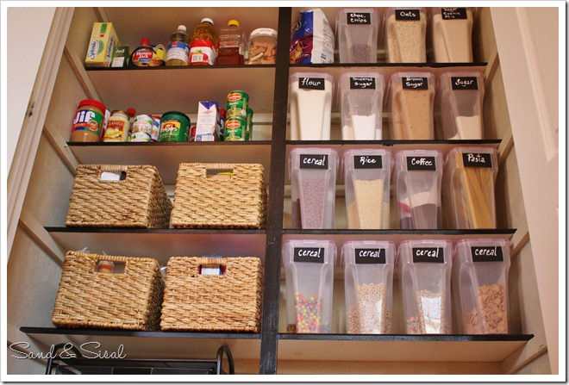
Which of these pictures shows a cluttered space?
Notes:
Engage the students with the word

Slide 8
disgusted
“There’s no fish in this stupid river,” I said out loud, disgusted.
Notes:
Contextualize the word- Find it in the text
Say the word together

Slide 9
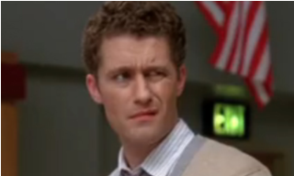
disgusted
to feel strong dislike or illness
Synonyms: fed up
Notes:
Give student friendly definition
Use the word in other contexts

Slide 10
Thumbs up, Thumbs down
Which of these would make you disgusted?
You have to eat a plate of Brussel sprouts.
Your teacher gave you 6 hours of homework.
Someone gives you a compliment.
A classmate cuts in front of you in line.
Notes:
Engage the students with the word

Slide 11
hovering
A flock of birds was moving toward me along the river, hovering over something floating on the water.
Notes:
Contextualize the word- Find it in the text
Say the word together

Slide 12
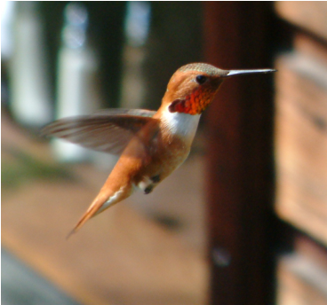
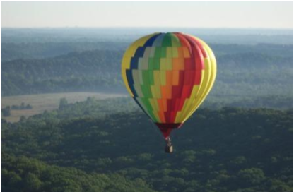
hovering
to hang suspended in the air
Synonyms: floating over, fluttering
Notes:
Contextualize the word- Find it in the text
Say the word together

Slide 13
Which of these things could be hovering?
a helicopter
a school bus
a kite
a bumblebee
a soccer ball
a frisbee
Notes:
Engage the students with the word

Slide 14
Who can use all 3 words in a sentence?
cluttered
disgusted
hovering
Notes:
Read all three words and see if you can use them in one sentence.

Slide 15
Finish each sentence to show you know what each of these words mean.
The bedroom was cluttered because…
She was disgusted because…
I saw a ______ hovering over _______.
Notes:
Application-
Students need an opportunity to use the words they just learned from the text.

Slide 16
I can use words I learn from a text.
Notes:
Goal-
Revisit the Goal

