Slide 1
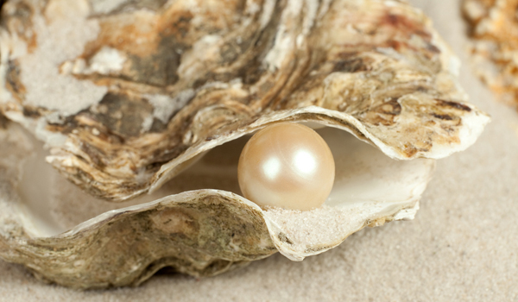
3rd Grade
Text Talk
Unit 2

Slide 2
I can use words I learn from a text.
Notes:
Goal-
Students need to engage with the goal- read it, repeat it, write it, etc.

Slide 3
Tell your partner about a new word you learned last week.
Notes:
Access Prior Knowledge- (APK)
Turn and Talk

Slide 4
Notes:
New Information-
Read the book- provide a brief explanation of any words that may be new or unfamiliar to the students.

Slide 5
raging
The storm is raging up above,
And waves are dashing high…
Notes:
Contextualize the word- Find it in the text
Say the word together

Slide 6
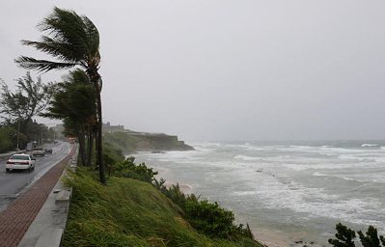
raging
1. Strong or damaging wind, waves, or fire
2. To be angry
synonyms: furious, roaring
Notes:
Give student friendly definition
Use the word in other contexts

Slide 7
Thumbs up, Thumbs down
Which of these would you describe as raging?
A tornado
A gentle rain shower
A wildfire spreading across a forest
A camp fire you are roasting marshmallows on
A very angry person
Notes:
Engage the students with the word

Slide 8
heedless
But down below in waters calm
The oyster sleeps away;
Quite heedless of the wind and waves…
Notes:
Contextualize the word- Find it in the text
Say the word together

Slide 9
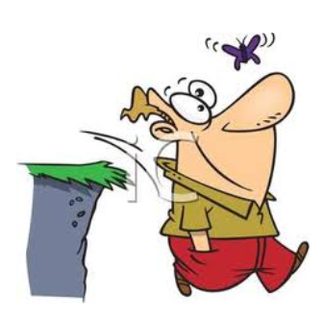
heedless
thoughtless, careless, unmindful
synonyms: uncaring, unconcerned
Notes:
Give student friendly definition
Use the word in other contexts

Slide 10
Creating Contexts
What would make a teacher say to a student…
You are acting heedless of my instructions!
What might happen if a child is heedless of a puddle under the water fountain?
Notes:
Engage the students with the word

Slide 11
rant
He does not shout and rant and rave…
Notes:
Contextualize the word- Find it in the text
Say the word together

Slide 12
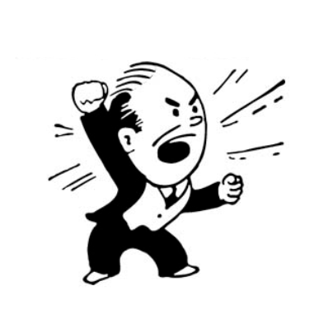
rant
to speak or complain loudly
synonyms: rave
Notes:
Contextualize the word- Find it in the text
Say the word together

Slide 13
If I say something that sounds like a person complaining loudly, say rant.
That’s not fair!
I would like some ice cream, please.
She cut me in line!
Let’s go outside to play!
I’m having pizza for lunch.
You cheated!
Notes:
Engage the students with the word

Slide 14
Who can use all 3 words in a sentence?
raging
heedless
rant
Notes:
Read all three words and see if you can use them in one sentence.

Slide 15
Write a sentence to show you know what each of these words mean.
raging
heedless
rant
Notes:
Application-
Students need an opportunity to use the words they just learned from the text.

Slide 16
I can use words I learn from a text.
Notes:
Goal-
Revisit the Goal

