Slide 1
3rd Grade
Text Talk
Unit 2

Slide 2
I can use words I learn from a text.
Notes:
Goal-
Students need to engage with the goal- read it, repeat it, write it, etc.

Slide 3
Tell your partner about a new word you learned last week.
Notes:
Access Prior Knowledge- (APK)
Turn and Talk

Slide 4
Notes:
New Information-
Read the book- provide a brief explanation of any words that may be new or unfamiliar to the students.

Slide 5
plain
Notes:
Contextualize the word- Find it in the text
Say the word together

Slide 6
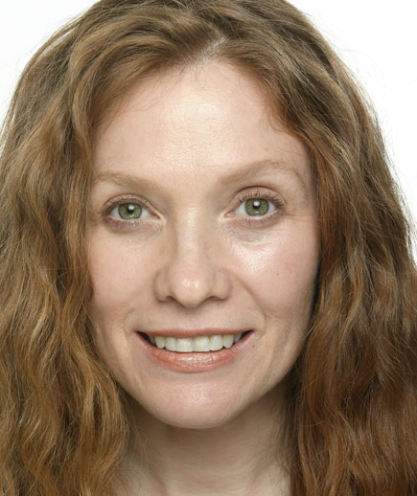
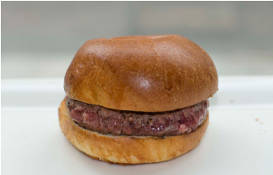
plain
not complicated or fancy, without anything extra
Synonyms: simple
Notes:
Give student friendly definition
Use the word in other contexts

Slide 7
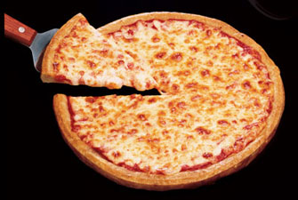
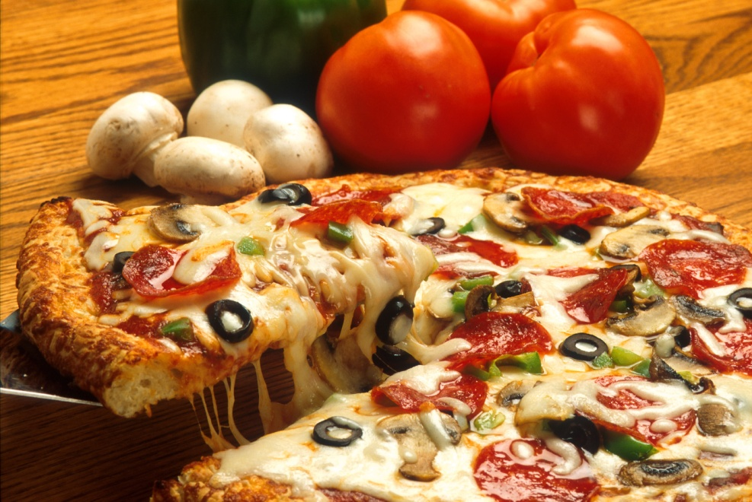
Which of these items is plain?
Notes:
Engage the students with the word

Slide 8
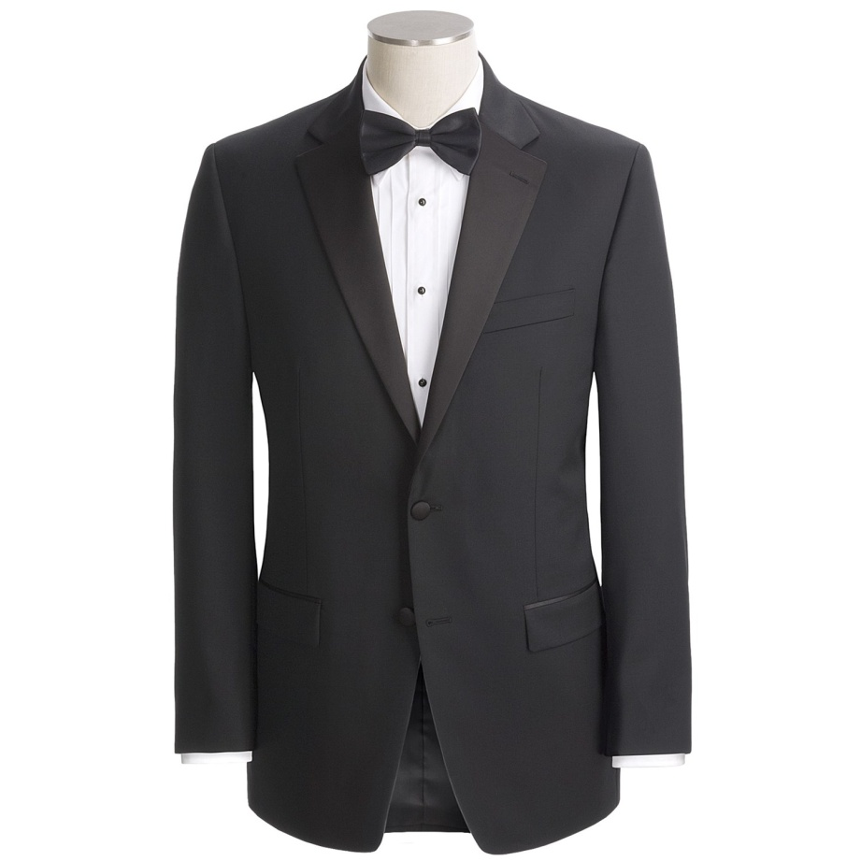
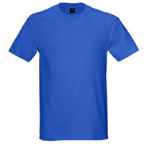
Which of these items is plain?
Notes:
Engage the students with the word

Slide 9
wretched
Notes:
Contextualize the word- Find it in the text
Say the word together

Slide 10
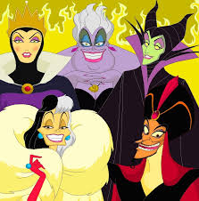
wretched
terrible, very bad, unpleasant
Notes:
Give student friendly definition
Use the word in other contexts

Slide 11
Thumbs up, Thumbs down
Which of these would you describe as wretched?
A day when the sun is shining
A day when it is pouring down rain
A dark, smelly basement
The sunset on a clear day
A child that is screaming and kicking
Notes:
Engage the students with the word

Slide 12
pesky
Notes:
Contextualize the word- Find it in the text
Say the word together

Slide 13
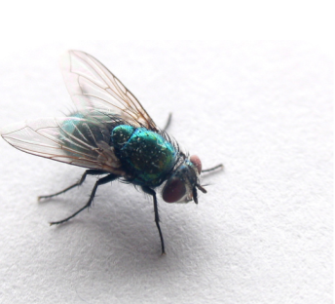
pesky
annoying, bothersome
Notes:
Contextualize the word- Find it in the text
Say the word together

Slide 14
Which of these things might be pesky?
a bowl of ice cream
a younger brother or sister
someone tapping a pencil on his desk
someone yawning
Notes:
Engage the students with the word

Slide 15
Who can use all 3 words in a sentence?
plain
wretched
pesky
Notes:
Read all three words and see if you can use them in one sentence.

Slide 16
Write a sentence to show you know what each of these words mean.
plain
wretched
pesky
Notes:
Application-
Students need an opportunity to use the words they just learned from the text.

Slide 17
I can use words I learn from a text.
Notes:
Goal-
Revisit the Goal

