Slide 1
Inspired by the Sea
In this six-week unit, we will read stories, poetry, and informational texts that are inspired by a love of or curiosity with the sea.

Slide 2

INSPIRE
To fill someone with the urge to do or feel something, especially to do something creative
To produce a feeling of creativity and motivation

Slide 3
I was inspired to become a firefighter. . .

Slide 4

MOTIVATION
  The reason or reasons one has for acting or behaving in a particular way.

Slide 5

MOTIVATION

Slide 6

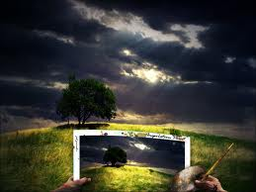
Which picture goes with inspire?

Slide 7
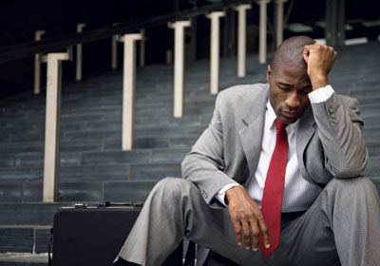
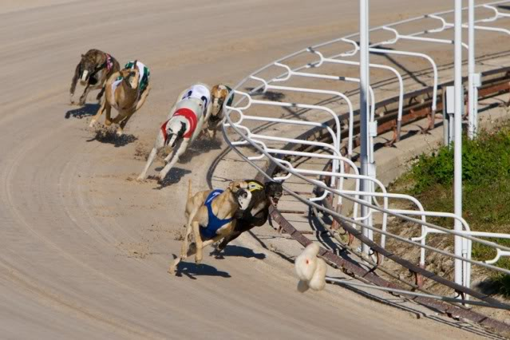
Which picture goes with motivation?

Slide 8
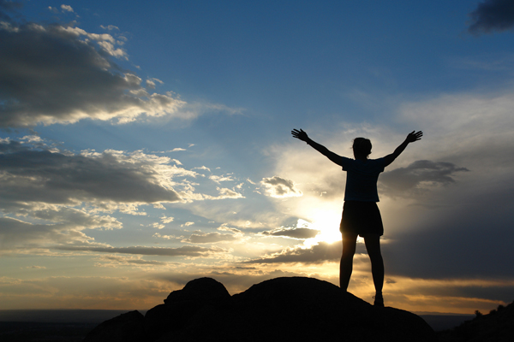
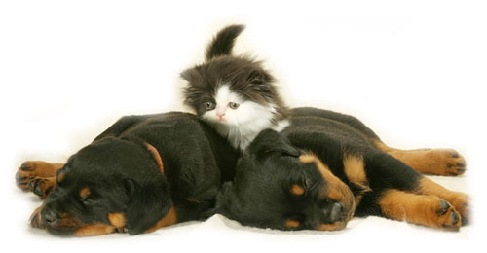
Which picture goes with inspire?

Slide 9
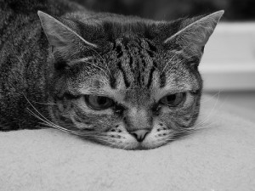
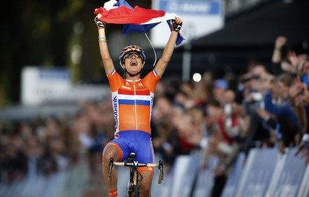
Which picture goes with motivation?

Slide 10
Essential Question:
Why does the sea inspire writers?

