Slide 1
3rd Grade
Text Talk
Unit 2

Slide 2
I can use words I learn from a text.
Notes:
Goal-
Students need to engage with the goal- read it, repeat it, write it, etc.

Slide 3
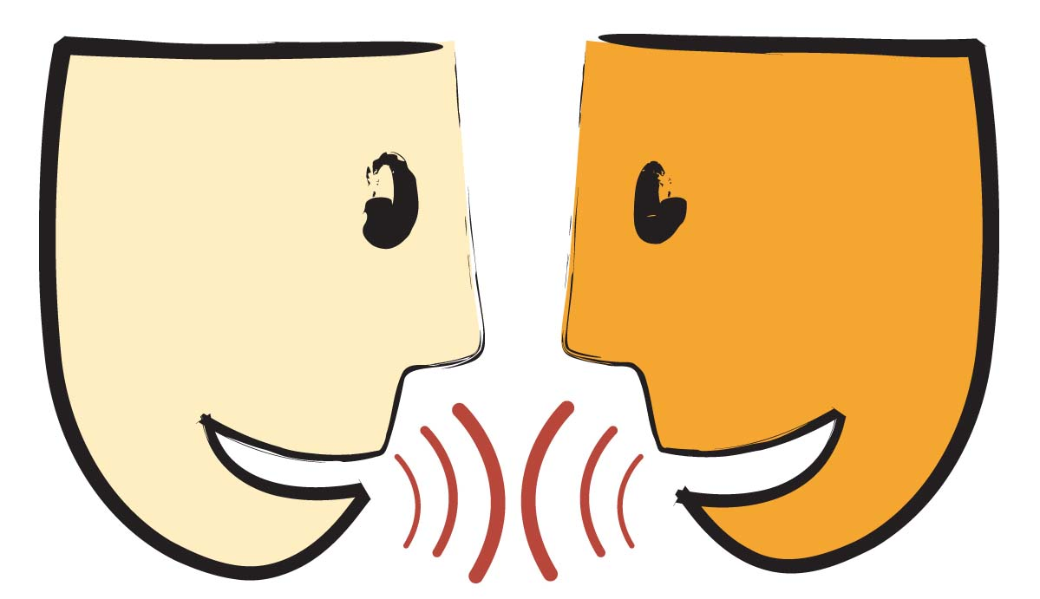
Tell your partner about a new word you learned last week.
Notes:
Access Prior Knowledge- (APK)
Turn and Talk

Slide 4
Notes:
New Information-
Read the book- provide a brief explanation of any words that may be new or unfamiliar to the students.

Slide 5
miserable
Notes:
Contextualize the word- Find it in the text
Say the word together

Slide 6
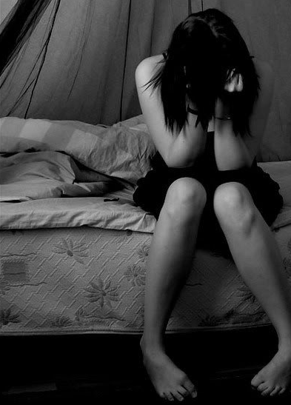
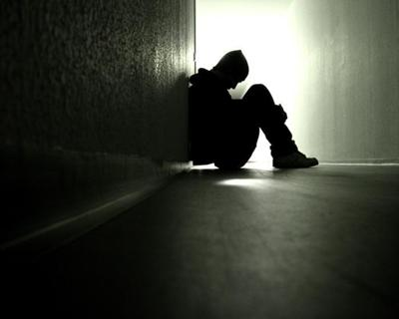
miserable
very unhappy, uncomfortable
Notes:
Give student friendly definition
Use the word in other contexts

Slide 7
Thumbs up, Thumbs down
Which of these would make you miserable?
Your gaming system broke.
Your teacher gave you extra recess.
You lost your favorite toy.
A tornado flattened your home.
Your best friend moved away.
Notes:
Engage the students with the word

Slide 8
ambitious
Notes:
Contextualize the word- Find it in the text
Say the word together

Slide 9
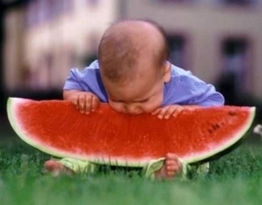
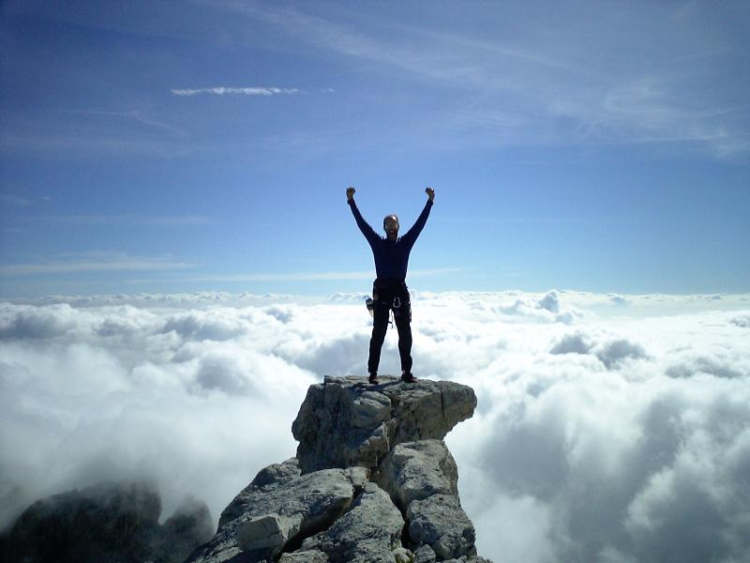
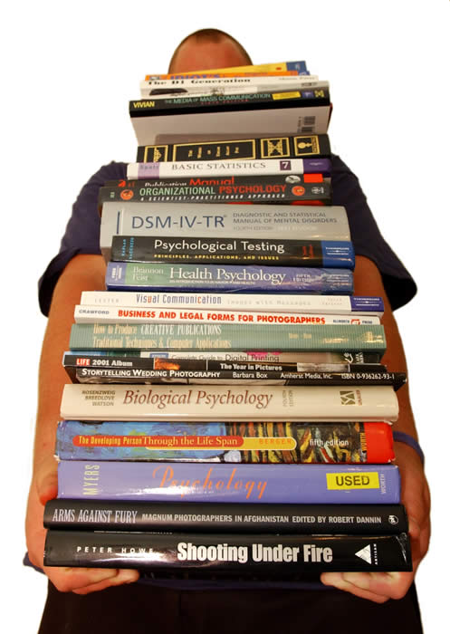
ambitious
a strong desire to do something
Notes:
Give student friendly definition
Use the word in other contexts

Slide 10
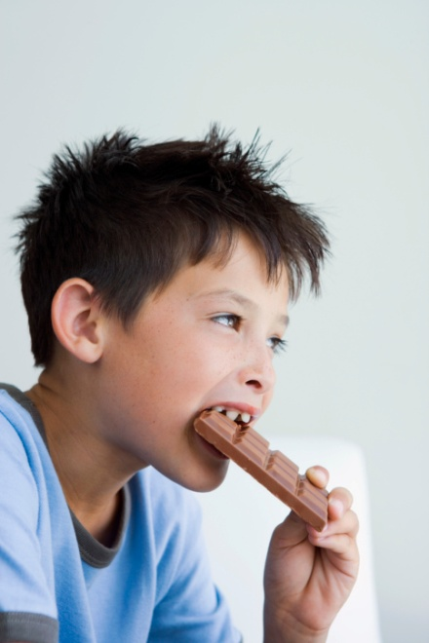
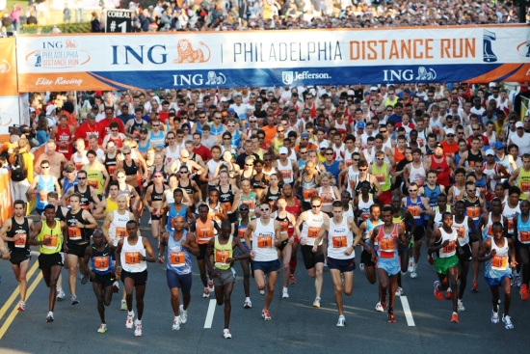
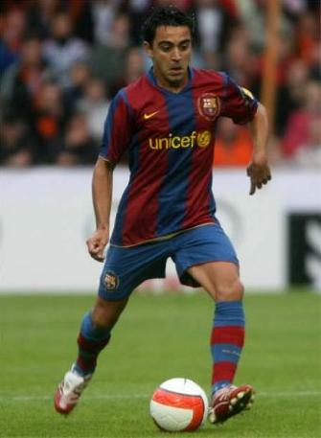
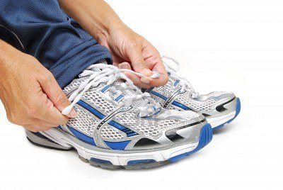
Which tasks would you need to be
ambitious to accomplish?
eat a chocolate bar
run a marathon
tie your shoe
read the whole series
become a professional
soccer player
Notes:
Engage the students with the word

Slide 11
leisurely
Notes:
Contextualize the word- Find it in the text
Say the word together

Slide 12
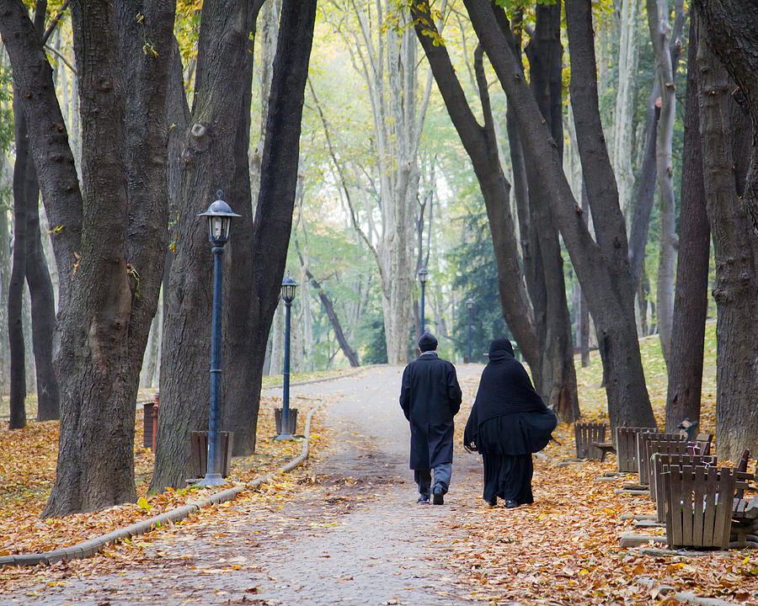
leisurely
unhurried, slow
Notes:
Contextualize the word- Find it in the text
Say the word together

Slide 13
Which of these things could you do leisurely ?
walk your dog
eat a hamburger
run a race
clean your room
take a timed test
Notes:
Engage the students with the word

Slide 14
Who can use all 3 words in a sentence?
miserable
ambitious
leisurely
Notes:
Read all three words and see if you can use them in one sentence.

Slide 15
Write a sentence to show you know what each of these words mean.
miserable
ambitious
leisurely
Notes:
Application-
Students need an opportunity to use the words they just learned from the text.

Slide 16
I can use words I learn from a text.
Notes:
Goal-
Revisit the Goal

