Slide 1
3rd Grade
Text Talk
Unit 2

Slide 2
I can use words I learn from a text.
Notes:
Goal-
Students need to engage with the goal- read it, repeat it, write it, etc.

Slide 3
Tell your partner about a new word you learned last week.
Notes:
Access Prior Knowledge- (APK)
Turn and Talk

Slide 4
Notes:
New Information-
Read the book- provide a brief explanation of any words that may be new or unfamiliar to the students.

Slide 5
enabled
It was the cod that enabled the Vikings to come to North America.
Notes:
Contextualize the word- Find it in the text
Say the word together

Slide 6
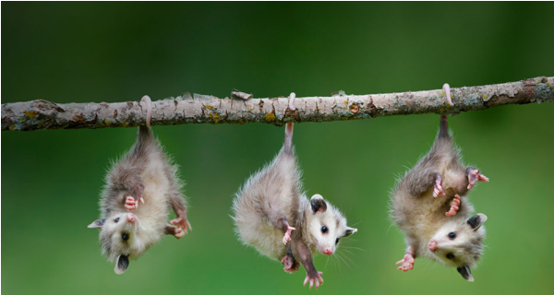
enabled
to make possible; to make able
Synonyms: allow, permit
Notes:
Give student friendly definition
Use the word in other contexts

Slide 7
Creating Situations
What enabled Boris to get back in the ocean?
What things might enable you to focus during class?
Notes:
Engage the students with the word

Slide 8
plentiful
Today, cod are no longer plentiful, and its threatened disappearance is a tragedy…
Notes:
Contextualize the word- Find it in the text
Say the word together

Slide 9
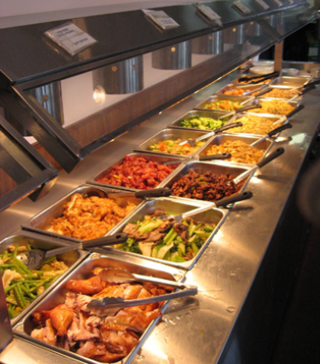
plentiful
more than enough
synonyms: abundant
Notes:
Give student friendly definition
Use the word in other contexts

Slide 10
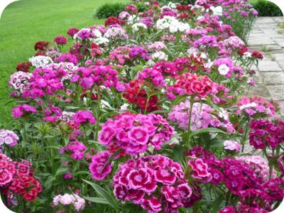
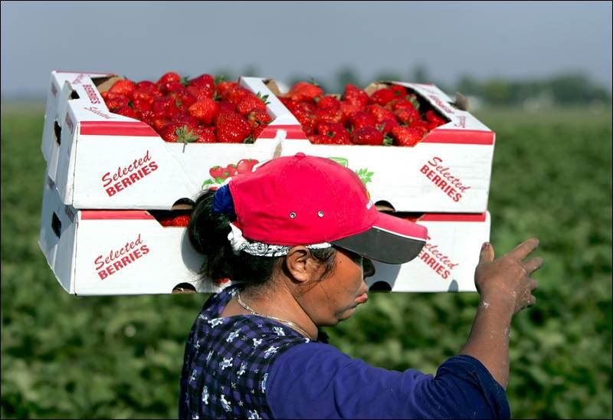
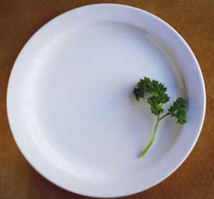
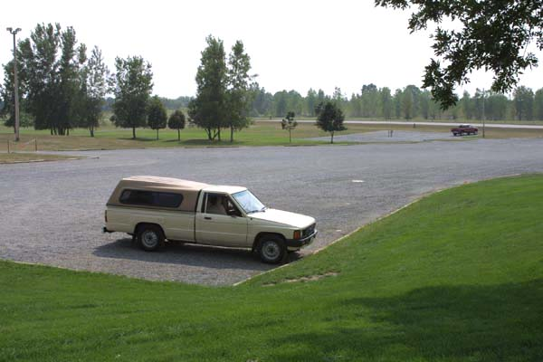
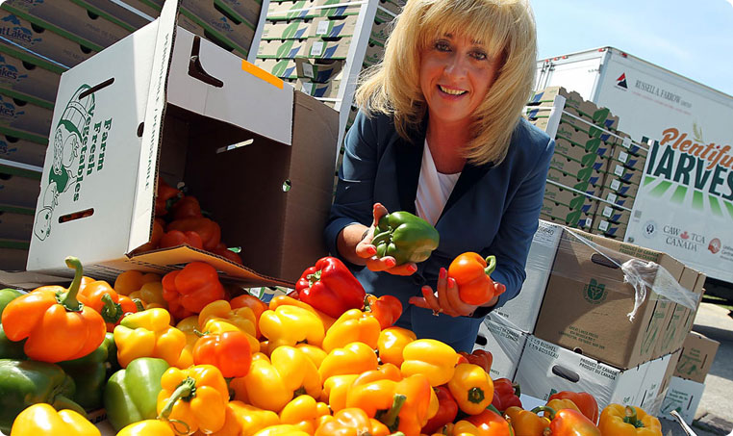
Which of these pictures shows something that is plentiful?
Notes:
Engage the students with the word

Slide 11
juvenile
They are called juveniles and are big enough to leave the dangerous surface of the ocean and dive to the bottom of the sea.
Notes:
Contextualize the word- Find it in the text
Say the word together

Slide 12
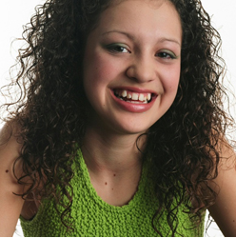
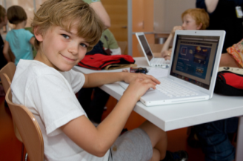
juvenile
A child, or acting like a child
Synonyms: adolescent
Notes:
Contextualize the word- Find it in the text
Say the word together

Slide 13
Which is more juvenile:
A picture book or a college textbook?
Screaming “That’s mine!” or offering to share?
Having a good attitude when something is hard or pouting and whining?
Notes:
Engage the students with the word

Slide 14
Who can use all 3 words in a sentence?
enabled
plentiful
juvenile
Notes:
Read all three words and see if you can use them in one sentence.

Slide 15
Write a sentence to show you know what each of these words mean.
enabled
plentiful
juvenile
Notes:
Application-
Students need an opportunity to use the words they just learned from the text.

Slide 16
I can use words I learn from a text.
Notes:
Goal-
Revisit the Goal

