Slide 1
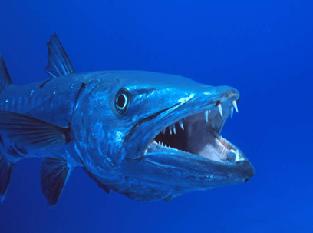
Point of View “Barracuda” By John Gardner

Slide 2
I can determine the point of view of the narrator and characters in a poem.
1-I am very lost.
2-I have heard of point of view, but I don’t know
what it means.
3-I can identify points of view in a story or poem.
4-I can identify the point of view, and I can teach it to
a friend.

Slide 3
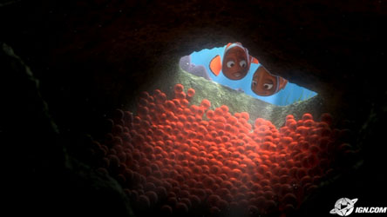
What happened to the eggs? What’s the name of the “villain” from this video?

Slide 4
Point of View in literature
How someone sees something…their side of the story
Point of View: the perspective from which the story is told.
The narrator is the person telling the story
Character inside the story (first person)
Narrator outside of the story (third person)

Slide 5
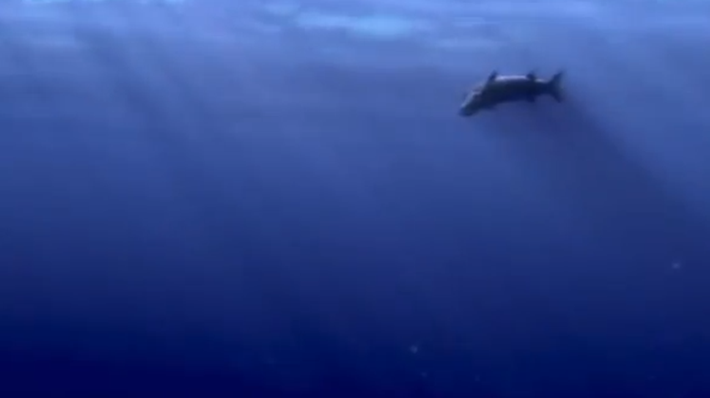
Marlin or Coral…we see the Barracuda through a character’s eyes
Notes:
In this part of the clip, we see the Barracuda coming towards the reef. Whose point of view is this? Through whose eyes do we see the barracuda coming closer? Yes…it’s either Marlin or Coral. We don’t know which one, and it really doesn’t matter. All that matters is that we are looking through the eyes of a character.

Slide 6
Whose Point of View is this?
A narrator… someone outside the story
Notes:
Who’s point of view is this? Is it through the eyes of a character or a narrator? How do you know?
Yes, this time we get an outside view of the barracuda coming closer to the reef.

Slide 7
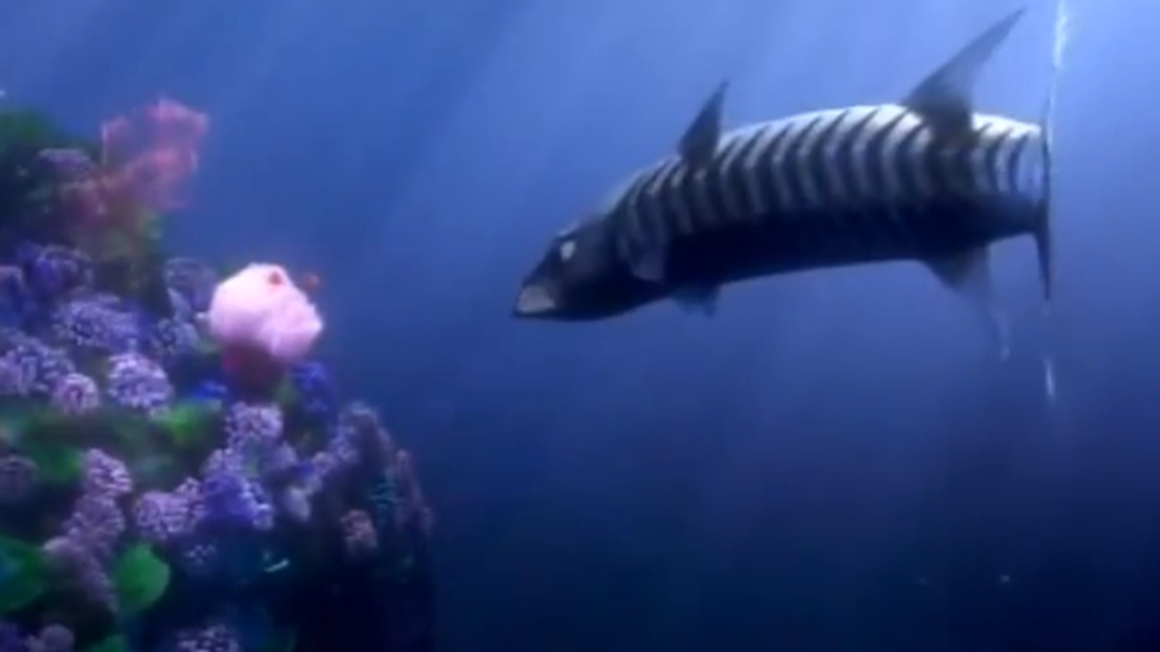
Notes:
When we look at these two pictures side by side, which one makes a stronger impact? Which one tells the story better? Use evidence in the picture to support your response?

Slide 8
Whose Point of View… a narrator or a character?
Notes:
Whose point of view is this? How do you know?

Slide 9
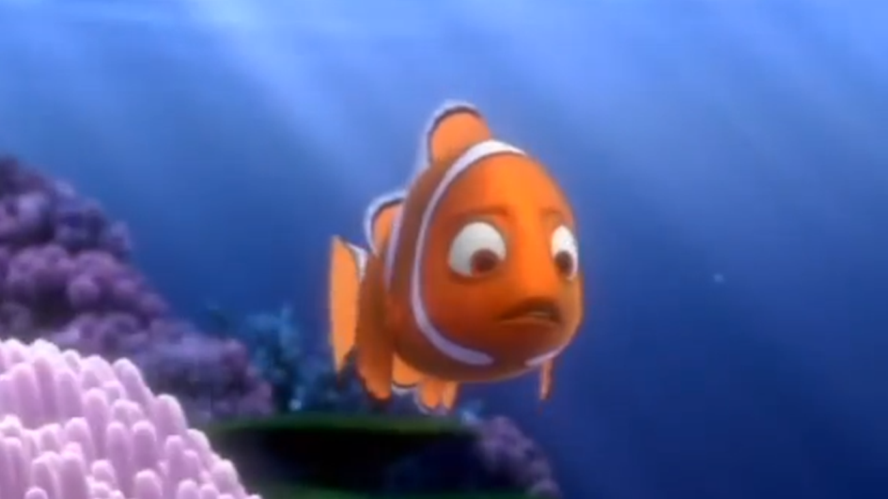
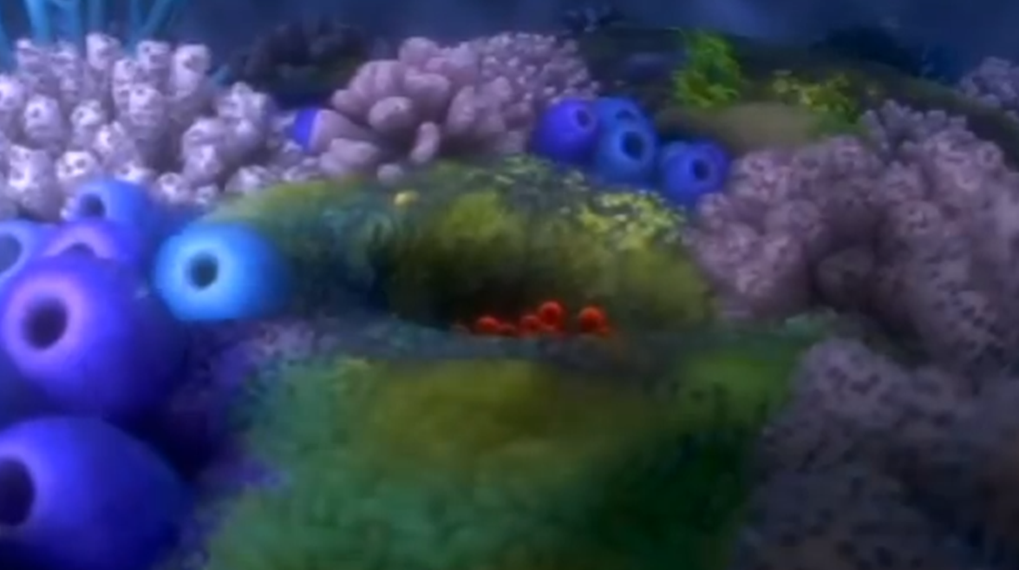
Whose Point of View… a narrator or a character?
Notes:
Whose point of view is this?
This is how Coral saw the eggs. Why would the illustrators choose to let us see the eggs through Coral’s eyes?

Slide 10
Notes:
When we read, we sometimes get so caught up in the story that we forget to stop and think about some things. Stopping to figure out the point of view…who is telling the story…can help us to more deeply understand our characters. It can help us figure out why they do some of the things they do. It also helps us figure out why authors do some of the things they do. Let’s practice this together using one of our poems from this unit.

Slide 11
The Barracuda
Slowly, slowly, he cruises And slowly, slowly, he chooses Which kind of fish he prefers to take this morning; Then without warning The Barracuda opens his jaws, teeth flashing, And with a horrible, horrible grinding and gnashing, Devours a hundred poor creatures and feels no remorse. It’s no wonder, of course, That he really ought, perhaps, to change his ways. “But,” (as he says With an evil grin) “It’s actually not my fault, you see: I’ve nothing to do with the tragedy; I open my mouth for a yawn and —ah me!— They all swim in.”
Identify the Point of View:
Who is the speaker? Is it a character in the poem or is it a narrator? How do you know?
What other character(s) are in the poem?

Slide 12
The Barracuda
Slowly, slowly, he cruises And slowly, slowly, he chooses Which kind of fish he prefers to take this morning; Then without warning The Barracuda opens his jaws, teeth flashing, And with a horrible, horrible grinding and gnashing, Devours a hundred poor creatures and feels no remorse. It’s no wonder, of course, That he really ought, perhaps, to change his ways. “But,” (as he says With an evil grin) “It’s actually not my fault, you see: I’ve nothing to do with the tragedy; I open my mouth for a yawn and —ah me!— They all swim in.”
How does this shape the story?
How does the narrator feel about the barracuda? Which words and phrases help you to know that?

Slide 13
The Barracuda
Slowly, slowly, he cruises And slowly, slowly, he chooses Which kind of fish he prefers to take this morning; Then without warning The Barracuda opens his jaws, teeth flashing, And with a horrible, horrible grinding and gnashing, Devours a hundred poor creatures and feels no remorse. It’s no wonder, of course, That he really ought, perhaps, to change his ways. “But,” (as he says With an evil grin) “It’s actually not my fault, you see: I’ve nothing to do with the tragedy; I open my mouth for a yawn and —ah me!— They all swim in.”
Why did the author make this choice?
How would it have been different if the entire poem was told from the barracuda’s point of view?

Slide 15
Your Turn!!!
Give the fish a Point of View…what would they say if given the chance?

Slide 16
I can determine the point of view of the narrator and characters in a poem.
1-I am very lost.
2-I have heard of point of view, but I don’t know
what it means.
3-I can identify points of view in a story or poem.
4-I can identify the point of view, and I can teach it to
a friend.

