Slide 1
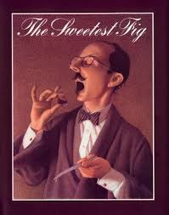

Slide 2
Admiring
Gaze
Furious

Slide 3
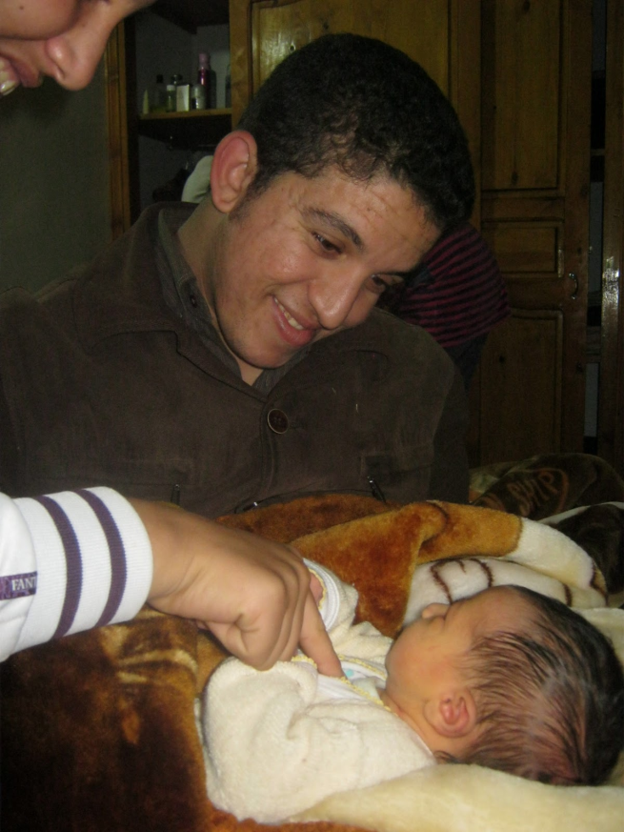
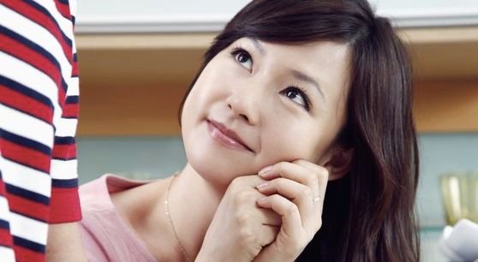
“They are admiring my suit.”
Admiring - to look up to something; to think highly of someone
I admire all the hard work of my students!

Slide 4
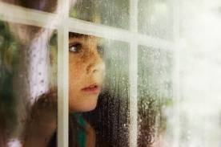
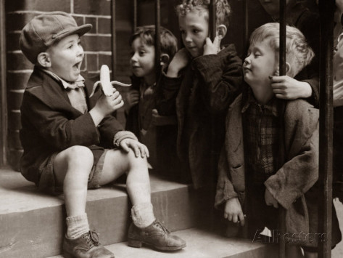
“Each night before he went to sleep, he gazed into the mirror.”
Gazed - a look steadily at something with great curiosity or pleasure
Martin gazed longingly at the scrumptious chocolate cake.

Slide 5
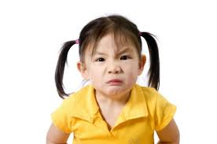
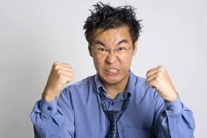
“Bilbot was furious!”
Furious – full of anger
After cheating on his test, Logan’s mother was furious!

Slide 6
Admiring
Gaze
Furious

