Slide 1
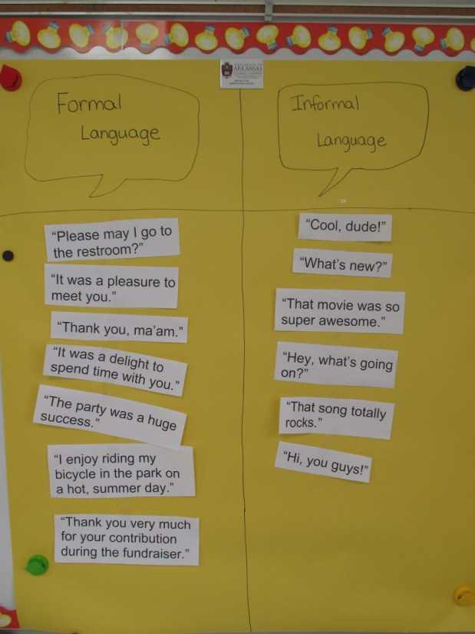
L.2.3.a Compare Formal and Informal Uses of Language
Bonnie Grimes Elementary
Krista Roth

Slide 2
APK: What do you notice about the way the characters are speaking to each other?
Language Example 1
Language Example 2

Slide 3
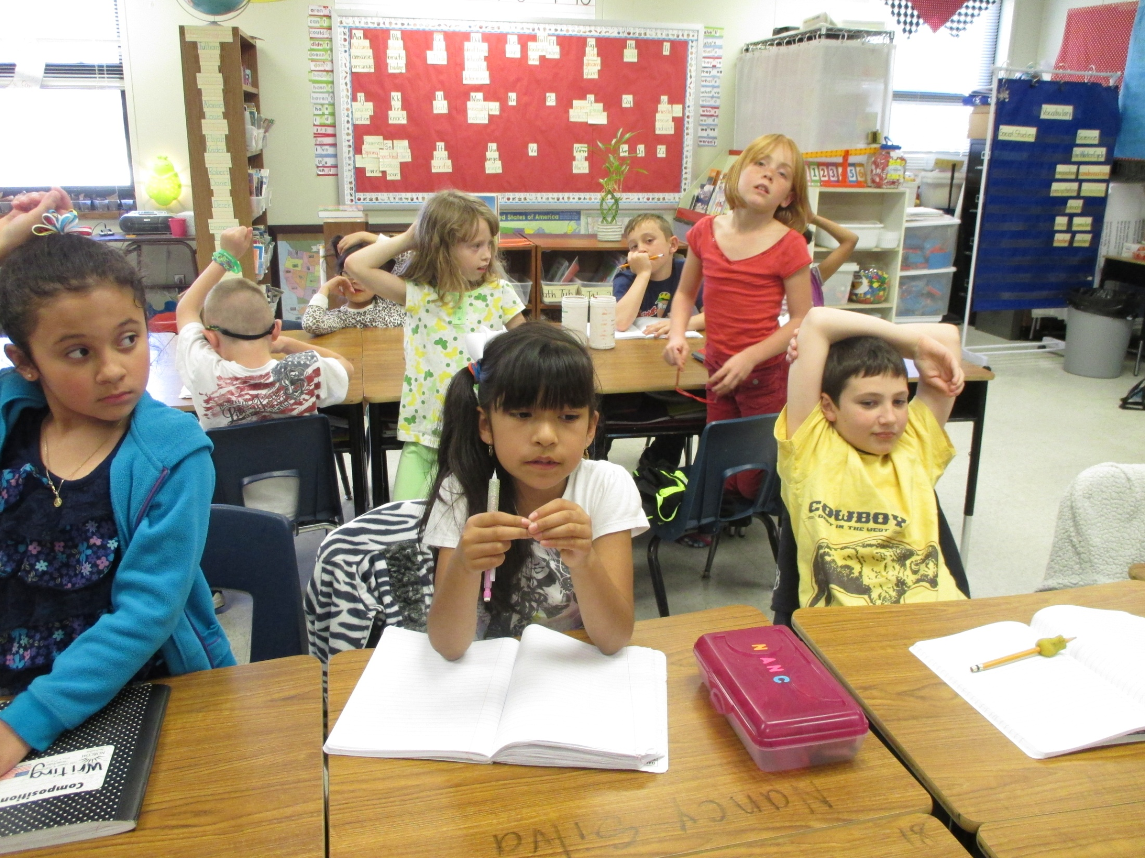

Slide 4
GOAL: I can compare the formal and informal uses of English. **Rate yourself.

Slide 5
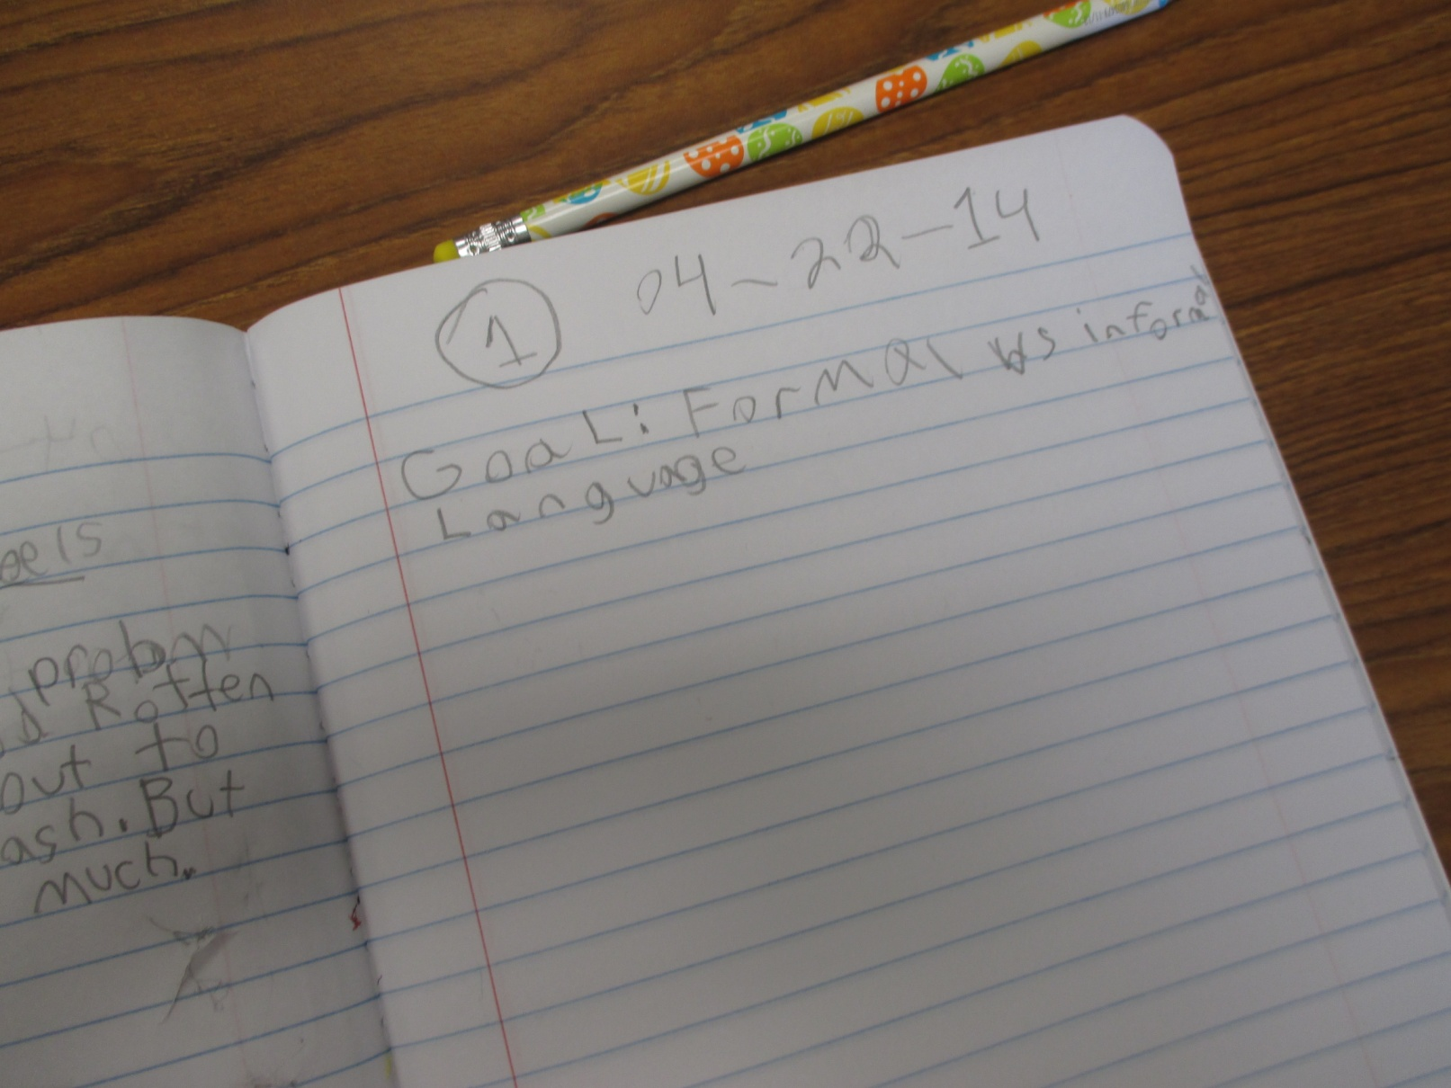

Slide 6
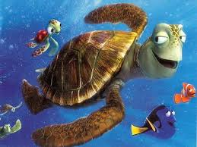
Informal Uses of English Language Example 1

Slide 7
Informal Language You use Informal Language when you are talking with your friends or adults that you are very close with. Informal English may include slang or shorter phrases and you may not speak in complete sentences.

Slide 8
Examples of Informal Language “Hey!” “How are ya?” “That’s so super cool!” “I totally love that sweater!”

Slide 9
People You May Use Informal Language with… * friends * students on the playground * students on the school bus * brothers or sisters * cousins * maybe even your parents

Slide 10
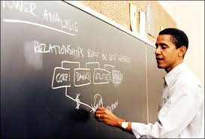
Formal Uses of English
Language Example 2

Slide 11
Formal Language You use Formal Language when you are talking with your teachers or adults that you respect. Formal English may be referred to as “proper English” and may include longer words and sentences. Formal language is more traditional and doesn’t include any slang.

Slide 12
Examples of Formal Language “Hello. How are you?” “I am very excited about the party this upcoming weekend.” “I really love that blue and green sweater you are wearing.” “May I please go to the library to check out a book to read?”

Slide 13
People You May Use Formal Language with… * teachers * principal * firemen * police officers * doctor * adults at church

Slide 14
Application: Place your sentence or phrase on the Formal/Informal T-chart.

Slide 15
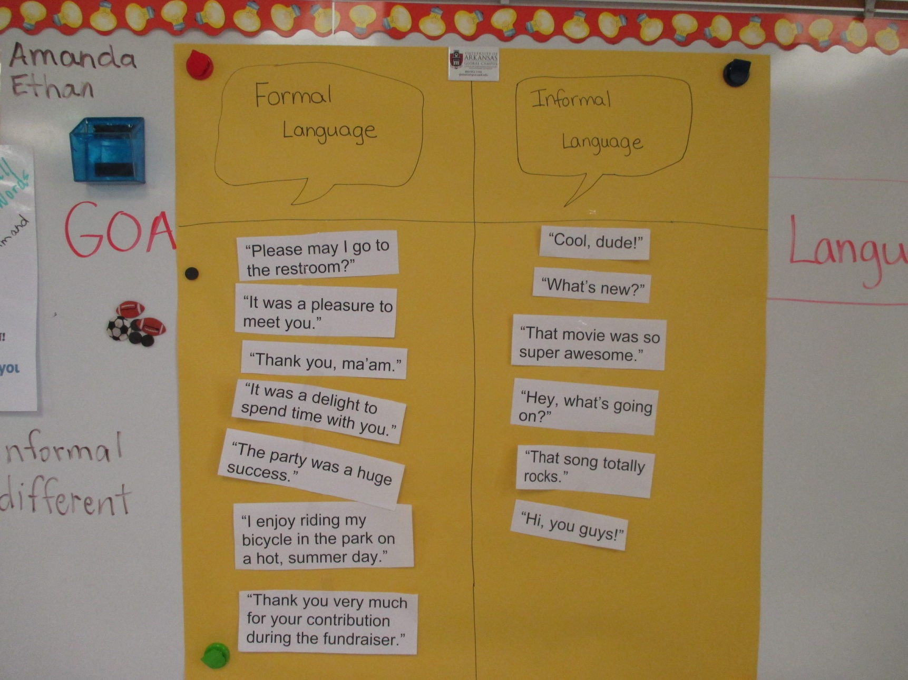

Slide 16
Write a sentence that tells one difference between the use of formal and informal language.

Slide 17
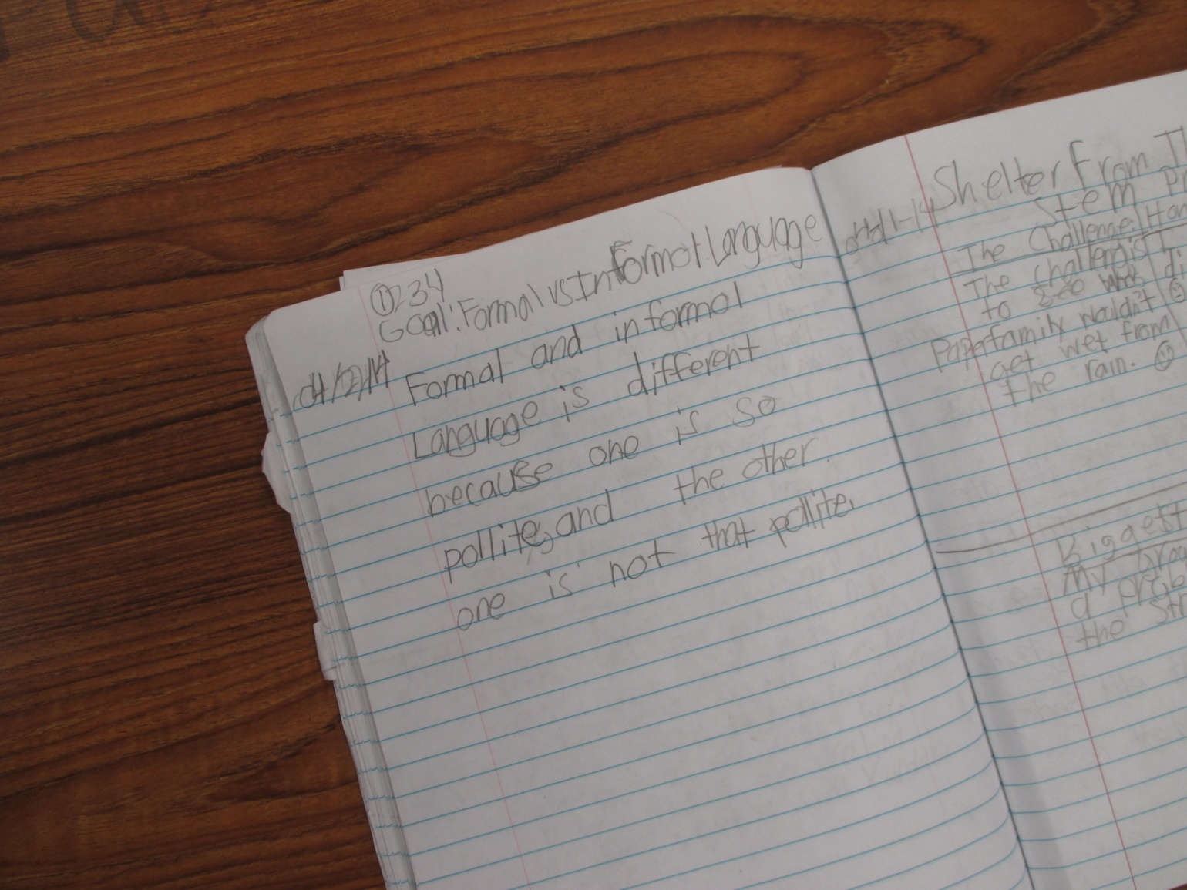

Slide 18
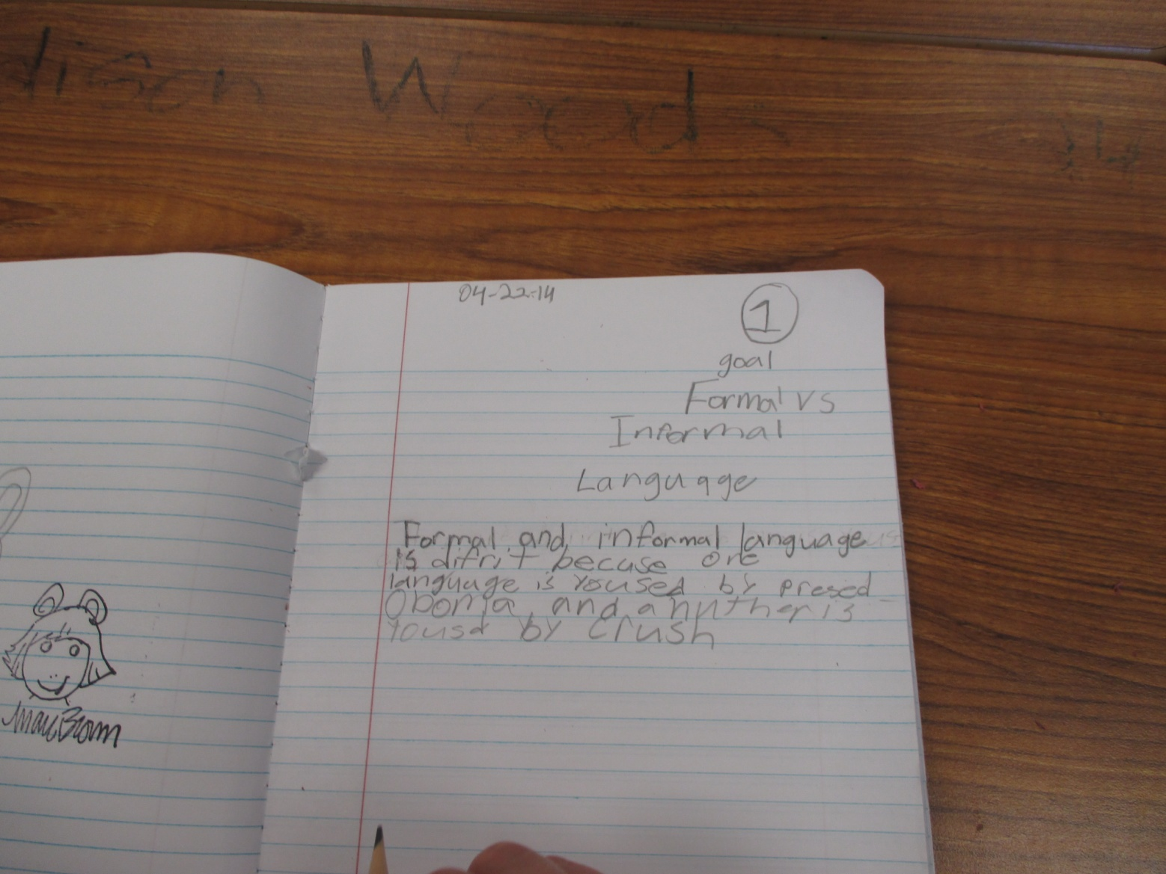

Slide 19
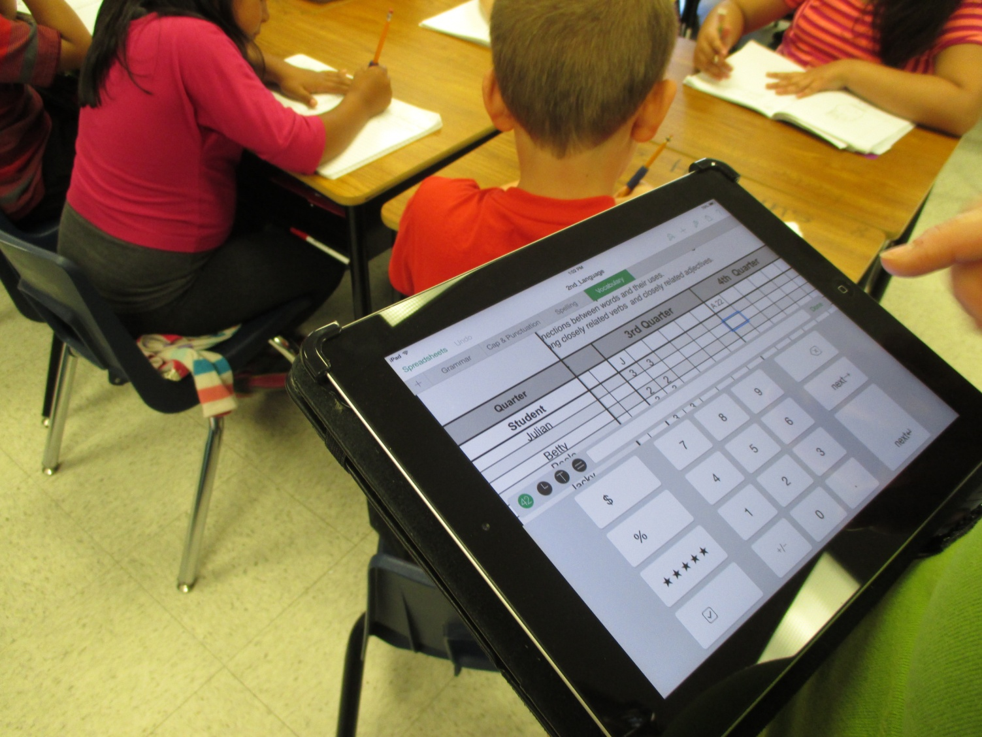
We scored using the scoring guide on the iPad.

Slide 20
Restate the GOAL: I can compare the formal and informal uses of English. **Rate yourself after the lesson and score your effort.

