Slide 1
Day 1

Slide 2
Cuckoo

Slide 3
I can determine the meaning of unknown words.
Notes:
Goal- Students need to engage with the goal- read it, repeat it, write it, etc.

Slide 4
flickered
“As she dipped down to her branch, something red flickered through the trees.”
Notes:
New Information-
Contextualize the word- Find it in the text
“She took raisins, candies, and nuts and gave him two bright eyes, a laughing mouth, and a cowboy vest with fringe.”
Say the word together

Slide 5
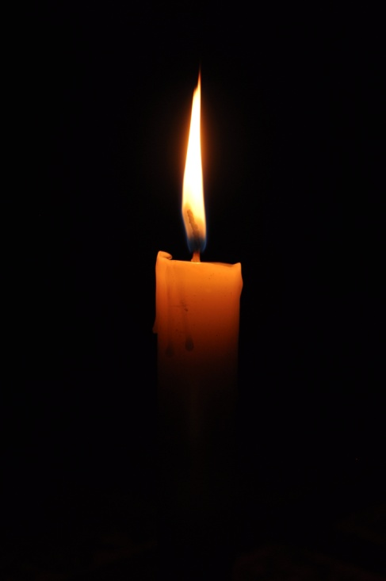
flickered
Fluttered or moved to and fro
Synonym: flit
(Click the flame to see a flickering fire)
Notes:
Give student friendly definition
Use the word in other contexts

Slide 6
scorched
“Her rainbow feathers became scorched from fire...”
Notes:
Contextualize the word- Find it in the text
… “until he met some hungry cowboys riding the range. The cowboys yelled, ‘Stampede!’ They wanted gingerbread too. “
Say the word together

Slide 7
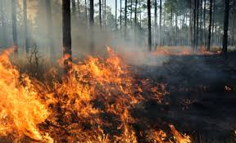
scorched
Partly burned
Synonym: burned
Notes:
Give student friendly definition
Use the word in other contexts

Slide 8
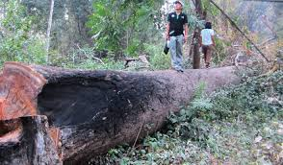
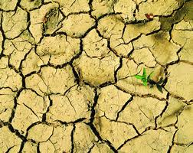
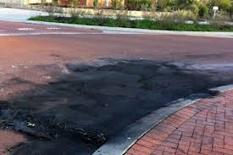
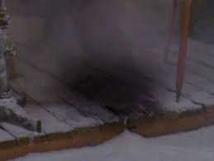
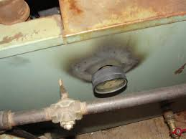
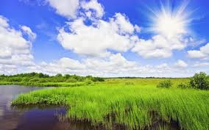
Thumbs up, Thumbs down
Notes:
Engage the students with the word
Thumbs up if this item might have fringe. Thumbs down if not likely.

Slide 9
raspy
“The birds woke up to Cuckoo’s raspy cry.”
Notes:
Contextualize the word- Find it in the text
“He turned down a canyon and raced away as fast as his boots could carry him.”
Say the word together

Slide 10
Raspy
A rough, harsh sound
Synonym: hoarse
Notes:
Give student friendly definition
Use the word in other contexts

Slide 11
Turn and tell your partner the words and what they mean.
flickered
scorched
raspy
Notes:
Read all three words and see if you can use them in one sentence.

Slide 12
Draw a picture or write a sentence to show you know what these words mean.
flickered
scorched
raspy
Notes:
Application-
Students need an opportunity to use the words they just learned from the text.

Slide 13
I can determine the meaning of unknown words.
Notes:
Goal-
Revisit the Goal

Slide 14
Day 2

Slide 15
I can determine the meaning of unknown words.
Notes:
Goal- Students need to engage with the goal- read it, repeat it, write it, etc.

Slide 16
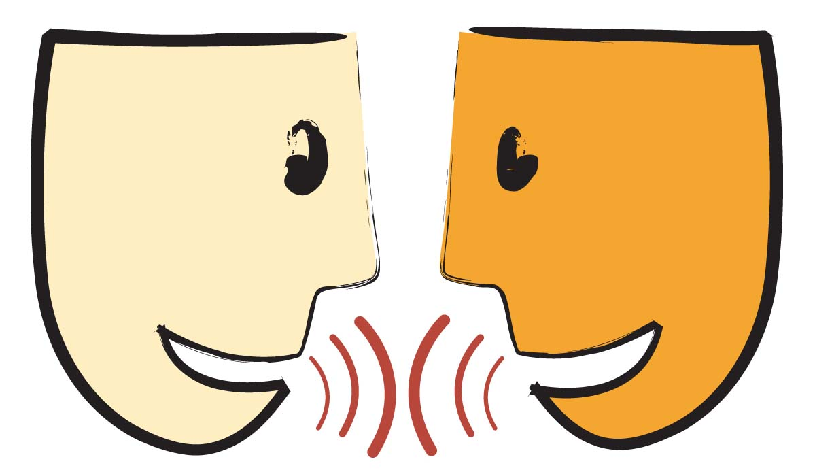
Tell your partner about a new word you learned yesterday.
Notes:
Access Prior Knowledge- (APK)
Turn and Talk
Review 3 words and definitions

Slide 17
Word Association
Which word goes with moving to and fro?
Which word is a synonym for hoarse?
Which word goes with being burned?
flickered
scorched
raspy
Notes:
Application
Word Association
Have students explain their thinking

Slide 18
I can determine the meaning of unknown words.
Notes:
Goal- Students need to engage with the goal- read it, repeat it, write it, etc.

Slide 19
Day 3

Slide 20
I can determine the meaning of unknown words.
Notes:
Goal- Students need to engage with the goal- read it, repeat it, write it, etc.

Slide 21
Describe a time when…
You heard a raspy voice
You saw something flicker
You saw something that was scorched

Slide 22
I can determine the meaning of unknown words.
Notes:
Goal- Students need to engage with the goal- read it, repeat it, write it, etc.

