Slide 1
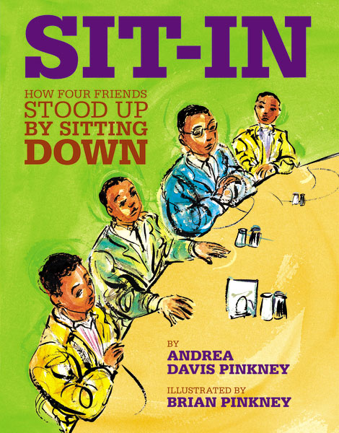
2nd Grade Text Talk
Unit 4

Slide 2
I can make real-life connections to new words.
L.2.5.a
Notes:
Goal-
Students need to engage with the goal- read it, repeat it, write it, etc.

Slide 3
Tell your partner about a new word you learned last week.
Notes:
Access Prior Knowledge- (APK)
Turn and Talk

Slide 4
budge
Notes:
Contextualize the word- Find it in the text
Say the word together

Slide 5
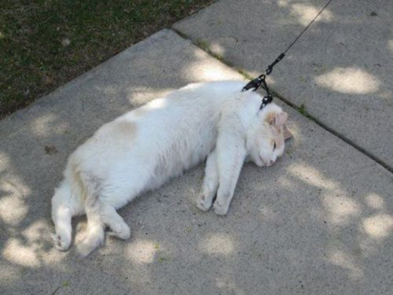
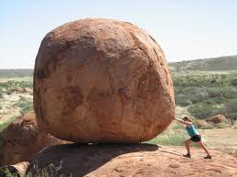
budge
to move a little
Notes:
Give student friendly definition
Use the word in other contexts

Slide 6
Describe something that would be hard to budge.
It would be hard to budge a _________ because ___________.
Notes:
Engage the students with the word

Slide 7
protest
Notes:
Contextualize the word- Find it in the text
Say the word together

Slide 8
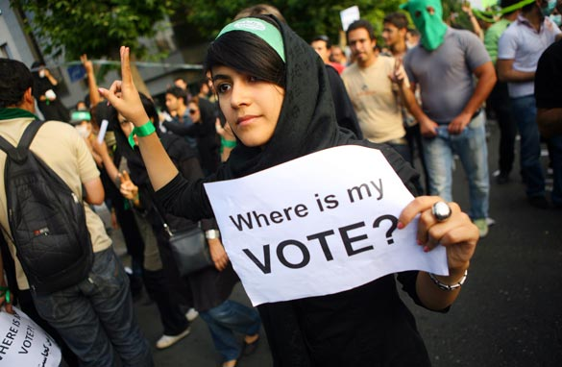
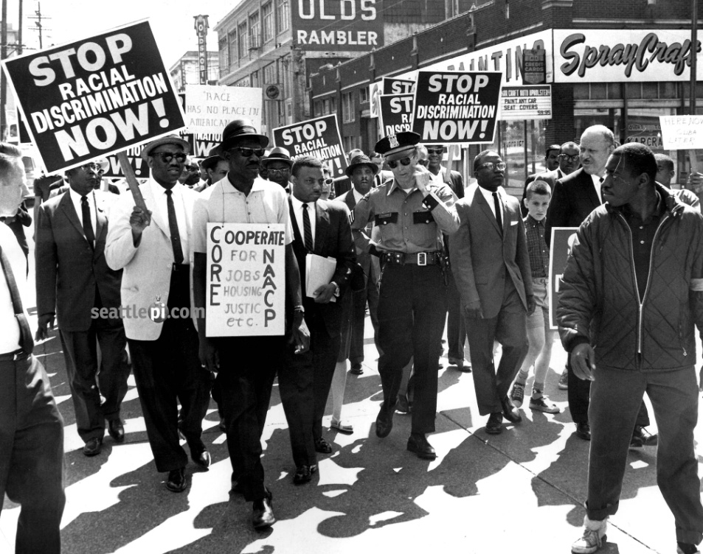
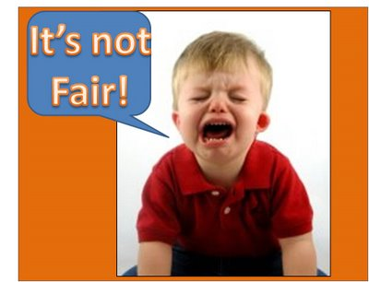
protest
to object or complain that something is unfair
Notes:
Give student friendly definition
Use the word in other contexts

Slide 9
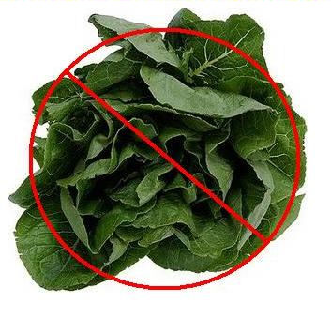
Which ideas would you protest?
Notes:
Engage the students with the word

Slide 10
motivated
Notes:
Contextualize the word- Find it in the text
Say the word together

Slide 11
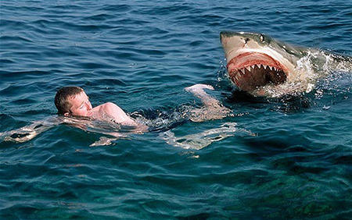
motivated
to give a reason to do something
Notes:
Contextualize the word- Find it in the text
Say the word together

Slide 12
Fill in the blank
I am motivated to ______.
Notes:
Engage the students with the word

Slide 13
Who can use all 3 words/phrases in a sentence?
budge
protests
motivated
Notes:
Read all three words and see if you can use them in one sentence.

Slide 14
I can make real-life connections to new words.
Notes:
Goal-
Revisit the Goal

