Slide 1
2nd Grade Text Talk
Unit 4

Slide 2
I can make real-life connections to new words.
L.2.5.a
Notes:
Goal-
Students need to engage with the goal- read it, repeat it, write it, etc.

Slide 3
Tell your partner about a new word you learned last week.
Notes:
Access Prior Knowledge- (APK)
Turn and Talk

Slide 4
haven
Notes:
Contextualize the word- Find it in the text
Say the word together

Slide 5
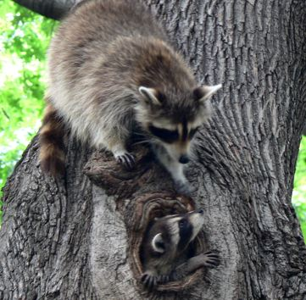
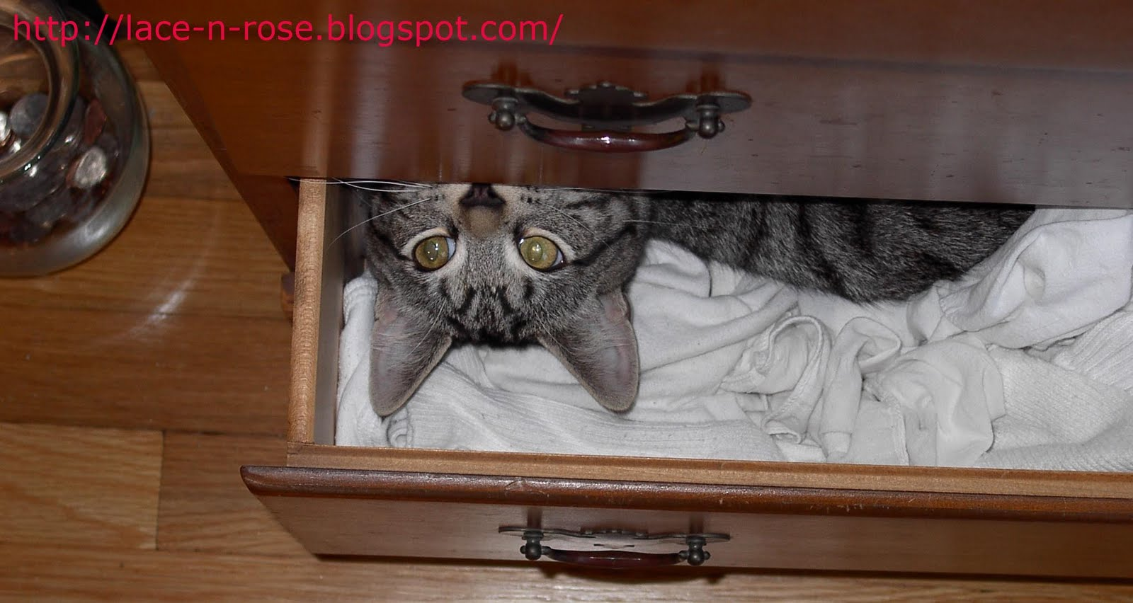
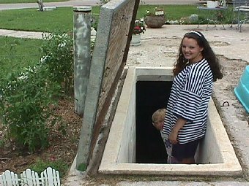
haven
a place of safety
Notes:
Give student friendly definition
Use the word in other contexts

Slide 6
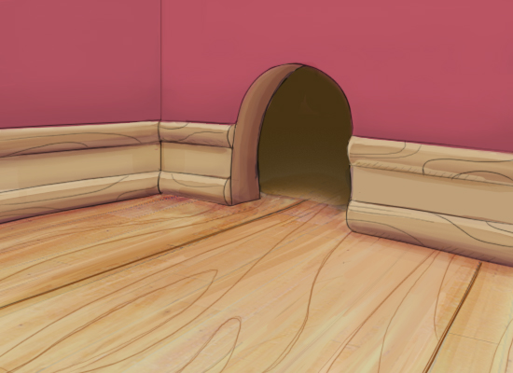
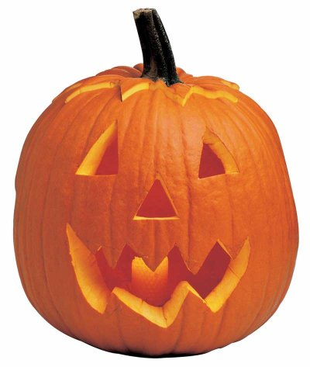
Pretend you are a mouse.
If a cat were chasing me, a ___________ would be a haven because ____________.
Notes:
Engage the students with the word

Slide 7
shun
Notes:
Contextualize the word- Find it in the text
Say the word together

Slide 8
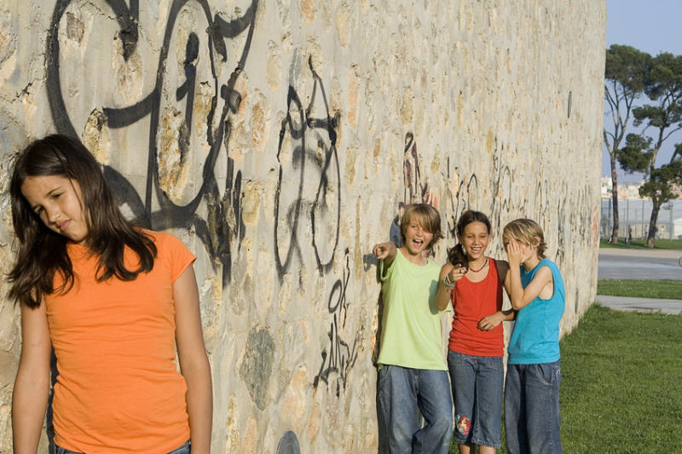
shun
to stay away from, avoid
Notes:
Give student friendly definition
Use the word in other contexts

Slide 9
Which words go with shun?
stay away
avoid
hug
keep away
join
Notes:
Engage the students with the word

Slide 10
woes
Notes:
Contextualize the word- Find it in the text
Say the word together

Slide 11
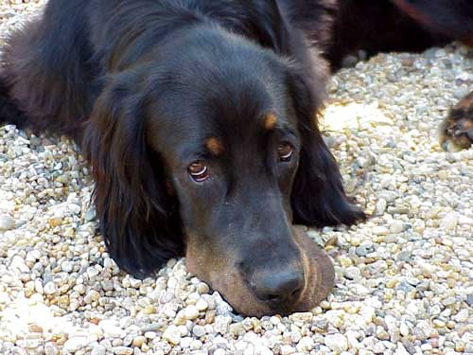
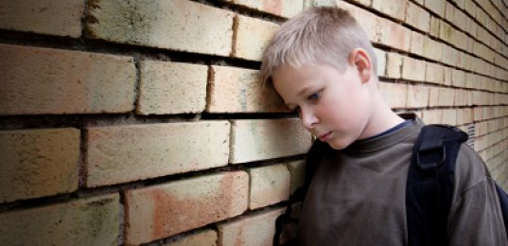
woe
-great suffering from loss
-problems or hardships
Notes:
Contextualize the word- Find it in the text
Say the word together

Slide 12
Which would cause you woes?
Clap zero times for none
Clap one time for sometimes
Clap two times for always
You have no food to eat.
You just found $100.
Your family’s only car is wrecked.
You just won a vacation to Hawaii.
You were grounded for something you didn’t do.
Notes:
Engage the students with the word

Slide 13
Who can use all 3 words/phrases in a sentence?
haven
shun
woes
Notes:
Read all three words and see if you can use them in one sentence.

Slide 14
I can make real-life connections to new words.
Notes:
Goal-
Revisit the Goal

