Slide 1
2nd Grade Unit 4 Art

Slide 2
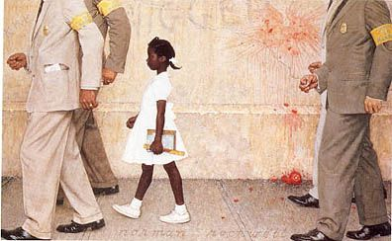
The Problem We All Live With by Norman Rockwell

