Slide 1
Day 1

Slide 2
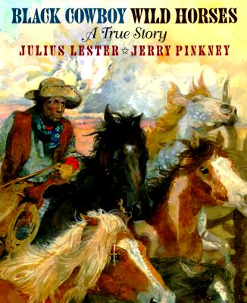
Black Cowboy Wild Horses

Slide 3
I can determine the meaning of unknown words.
Notes:
Goal- Students need to engage with the goal- read it, repeat it, write it, etc.

Slide 4
Notes:
Access Prior Knowledge (APK)-
Read the book again- provide a brief explanation of any words that may be new or unfamiliar to the students.

Slide 5
intently
“he let the horse trot for a while, then slowed him and began peering intently at the ground...”
Notes:
New Information-
Contextualize the word- Find it in the text
“She took raisins, candies, and nuts and gave him two bright eyes, a laughing mouth, and a cowboy vest with fringe.”
Say the word together

Slide 6
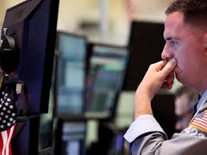
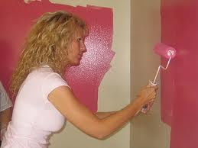
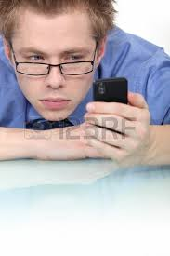
intently
Having the mind fixed on something
Notes:
Give student friendly definition
Use the word in other contexts

Slide 7
Thumbs up, Thumbs down
Concentrating for a test
Fancy curtains
Playing a video game
Reading a book
Notes:
Engage the students with the word
Thumbs up if this item might have fringe. Thumbs down if not likely.

Slide 8
remorse
“Then the rain came as hard and stinging as remorse. “
Notes:
Contextualize the word- Find it in the text
… “until he met some hungry cowboys riding the range. The cowboys yelled, ‘Stampede!’ They wanted gingerbread too. “
Say the word together

Slide 9
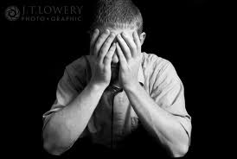
remorse
Being very sorry
(Click on the picture to see a stampede)
Notes:
Give student friendly definition
Use the word in other contexts

Slide 10
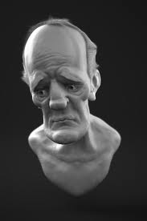
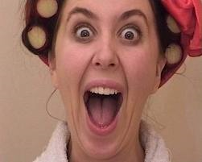
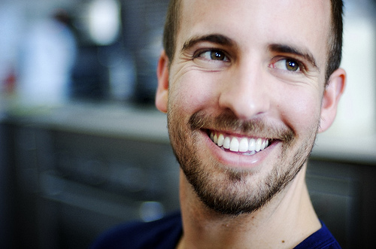
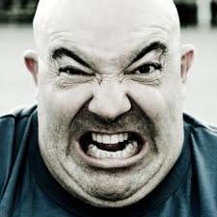
Which pictures show remorse?
Notes:
Engage the students with the word

Slide 11
aimlessly
“The mustangs milled aimlessly.”
Notes:
Contextualize the word- Find it in the text
“He turned down a canyon and raced away as fast as his boots could carry him.”
Say the word together

Slide 12
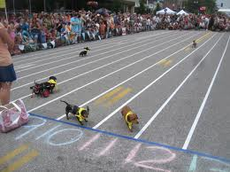
aimlessly
Not having a goal or a purpose
Notes:
Give student friendly definition
Use the word in other contexts

Slide 13
Turn and tell your shoulder partner what you could do aimlessly.
Notes:
Engage the students with the word

Slide 14
Who can use all 3 words in a sentence?
intently
remorse
aimlessly
Notes:
Read all three words and see if you can use them in one sentence.

Slide 15
Draw a picture or write a sentence to show you know what these words mean.
intently
remorse
aimlessly
Notes:
Application-
Students need an opportunity to use the words they just learned from the text.

Slide 16
I can determine the meaning of unknown words.
Notes:
Goal-
Revisit the Goal

Slide 17
Day 2

Slide 18
I can determine the meaning of unknown words.
Notes:
Goal- Students need to engage with the goal- read it, repeat it, write it, etc.

Slide 19
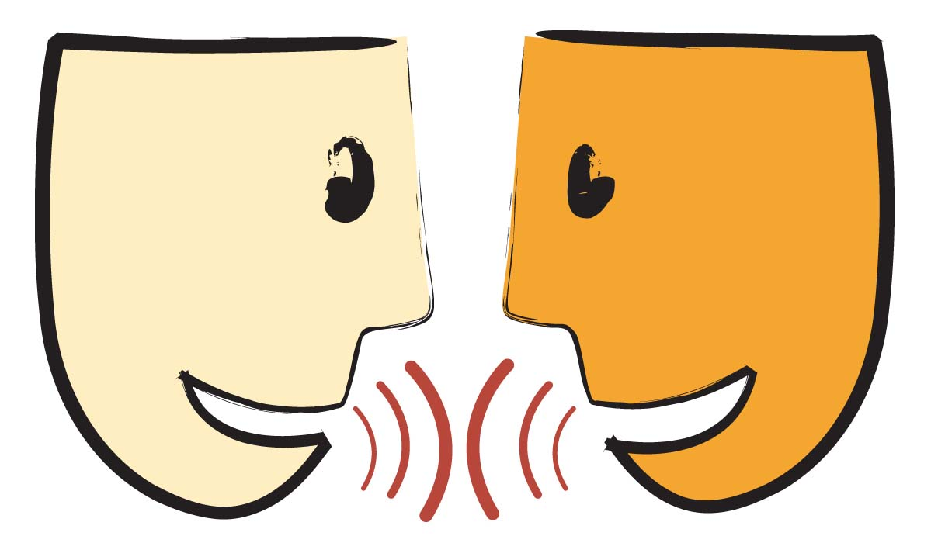
Tell your partner about a new word you learned yesterday.
Notes:
Access Prior Knowledge- (APK)
Turn and Talk
Review 3 words and definitions

Slide 20
Word Association
Which word goes with feeling sorry?
Which word goes with not having a goal?
Which word goes with having your mind set on something?
aimlessly
remorse
intently
Notes:
Application
Word Association
Have students explain their thinking

Slide 21
I can determine the meaning of unknown words.
Notes:
Goal- Students need to engage with the goal- read it, repeat it, write it, etc.

Slide 22
Day 3

Slide 23
I can determine the meaning of unknown words.
Notes:
Goal- Students need to engage with the goal- read it, repeat it, write it, etc.

Slide 24
Tell your partner what remorse feels like.
Notes:
Access Prior Knowledge- (APK)
Turn and Talk
Review 3 words and definitions

Slide 25
Describe a time when…
you did something aimlessly
you did something intently
you felt remorse

Slide 26
I can determine the meaning of unknown words.
Notes:
Goal- Students need to engage with the goal- read it, repeat it, write it, etc.

Slide 27
Day 4

Slide 28
I can determine the meaning of unknown words.
Notes:
Goal- Students need to engage with the goal- read it, repeat it, write it, etc.

Slide 29
Tell your partner what all of these pictures have in common.
Notes:
Access Prior Knowledge- (APK)
Turn and Talk
Review 3 words and definitions

Slide 30
Tell your partner what all of these pictures have in common

Slide 31
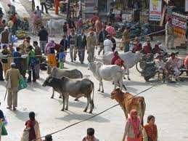
Tell your partner what all of these pictures have in common

Slide 32
I can determine the meaning of unknown words.
Notes:
Goal- Students need to engage with the goal- read it, repeat it, write it, etc.

