Slide 1
Text Talk
Day 1-Monday, read the book aloud
Day 2-Tuesday, introduce all 3 words
review all 3 words each day before going through the new activities on PowerPoint
Day 3-Wednesday
Day 4-Thursday
Day 5-Friday, assess

Slide 2
Day 1
Notes:
Monday

Slide 3
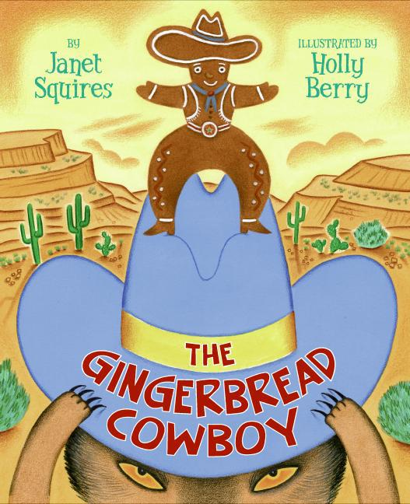
The Gingerbread Cowboy
Notes:
Monday-Read book aloud
Provide a brief explanation of any of the words that may be new or unfamiliar to the students.

Slide 4
Day 2
Notes:
Tuesday

Slide 5
I can determine the meaning of unknown words.
Notes:
Goal- Students need to engage with the goal- read it, repeat it, write it, etc.

Slide 6
Notes:
Access Prior Knowledge (APK)-
Turn and talk to your shoulder partner about the book you read yesterday. Tell your partner 2 things you remember about The Gingerbread Cowboy.

Slide 7
fringe
“She took raisins, candies, and nuts and gave him two bright eyes, a laughing mouth, and a cowboy vest with fringe.”
Notes:
New Information-
Contextualize the word- Find it in the text
Say the word together

Slide 8
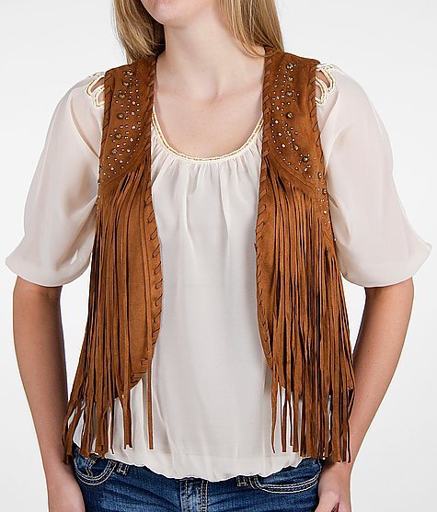
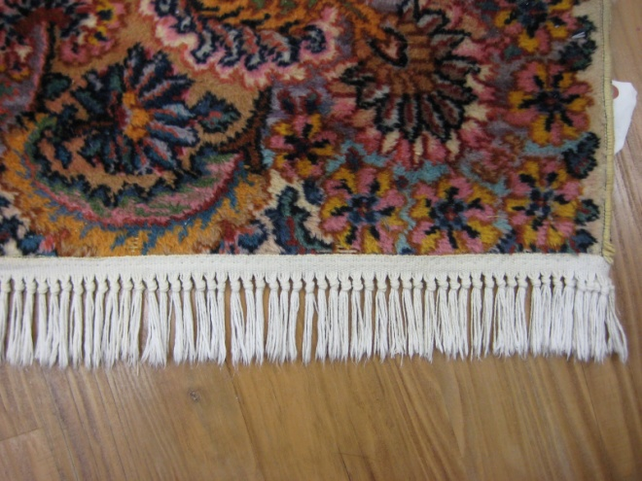
fringe
Hanging threads used to decorate the edge of something
clothes
rugs
curtains
Notes:
Give student friendly definition
Use the word in other contexts

Slide 9
Thumbs up, Thumbs down
A Cowboy vest
Ballet shoes
Fancy curtains
Rug
A book
Notes:
Engage the students with the word
Thumbs up if this item might have fringe. Thumbs down if not likely.

Slide 10
stampede
… “until he met some hungry cowboys riding the range. The cowboys yelled, ‘Stampede!’ They wanted gingerbread too. “
Notes:
Contextualize the word- Find it in the text
Say the word together

Slide 11
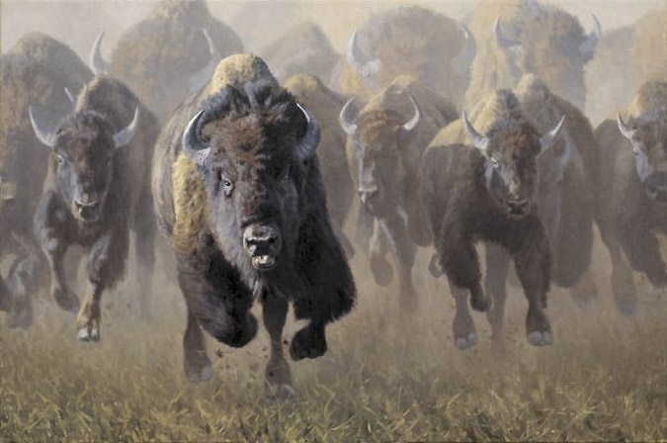
stampede
A sudden rush of frightened animals
(Click on the picture to see a stampede)
Notes:
Give student friendly definition
Use the word in other contexts

Slide 12
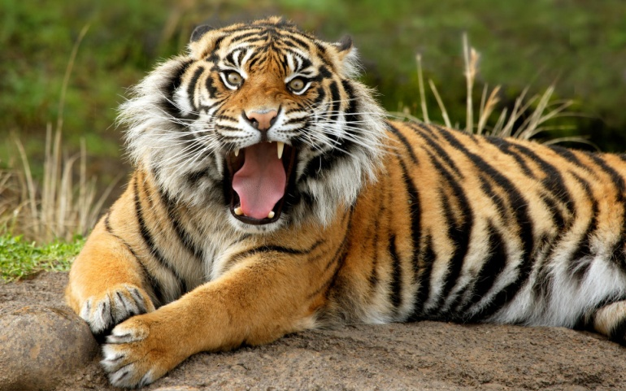
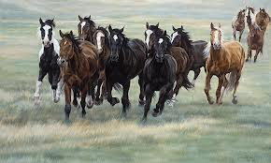
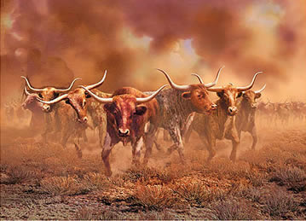
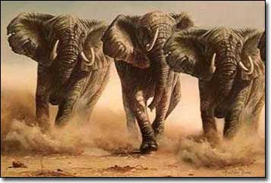
Which animals are stampeding?
Notes:
Engage the students with the word
Turn and tell shoulder partner which animals are stampeding.

Slide 13
canyon
“He turned down a canyon and raced away as fast as his boots could carry him.”
Notes:
Contextualize the word- Find it in the text
Say the word together

Slide 14
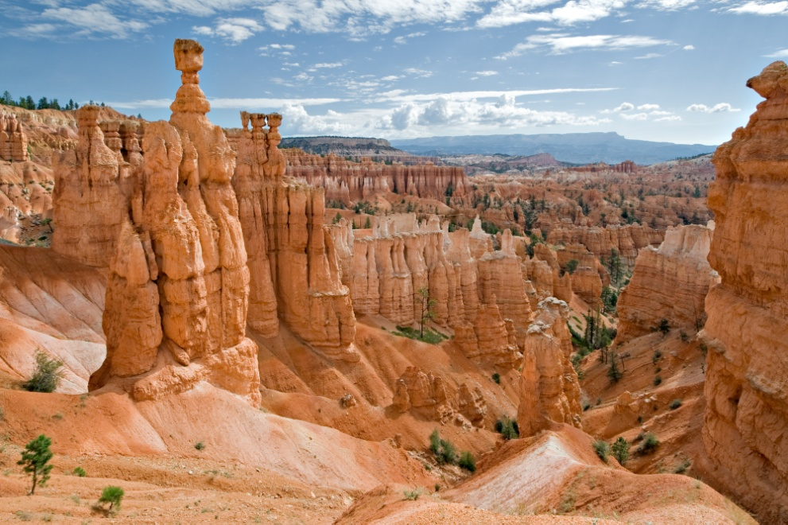
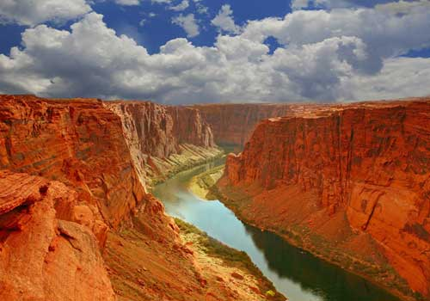
canyon
a deep valley with steep sides; usually with water at the bottom
Notes:
Give student friendly definition
Use the word in other contexts

Slide 15
Turn and tell your shoulder partner what a canyon is.
Notes:
Engage the students with the word

Slide 16
Who can use all 3 words in a sentence?
fringe
stampede
canyon
Notes:
Read all three words and see if you can use them in one sentence.

Slide 17
Draw a picture or write a sentence to show you know what these words mean.
fringe
stampede
canyon
Notes:
Application-
Students need an opportunity to use the words they just learned from the text.

Slide 18
I can determine the meaning of unknown words.
Notes:
Goal-
Revisit the Goal

Slide 19
Day 3
Notes:
Wednesday

Slide 20
I can determine the meaning of unknown words.
Notes:
Goal- Students need to engage with the goal- read it, repeat it, write it, etc.

Slide 21
Tell your partner about a new word you learned yesterday.
Notes:
Access Prior Knowledge- (APK)
Turn and Talk
Review 3 words and definitions

Slide 22
Word Association
Which word goes with running animals?
Which word goes with clothes?
Which word goes with steep sides?
Fringe
Stampede
Canyon
Notes:
Application
Word Association
Have students explain their thinking

Slide 23
I can determine the meaning of unknown words.
Notes:
Goal- Students need to engage with the goal- read it, repeat it, write it, etc.

Slide 24
Day 4
Notes:
Thursday

Slide 25
I can determine the meaning of unknown words.
Notes:
Goal- Students need to engage with the goal- read it, repeat it, write it, etc.

Slide 26
Tell your partner what animals do when they stampede.
Notes:
Access Prior Knowledge- (APK)
Turn and Talk
Review 3 words and definitions

Slide 27
Describe a time when…
you saw fringe on something
you saw a canyon (in real life, a book, or a picture)
you might see a stampede (where would you be? What would you do?)

Slide 28
I can determine the meaning of unknown words.
Notes:
Goal- Students need to engage with the goal- read it, repeat it, write it, etc.

Slide 29
Day 5
Notes:
Friday

Slide 30
I can determine the meaning of unknown words.
Notes:
Goal- Students need to engage with the goal- read it, repeat it, write it, etc.

Slide 31
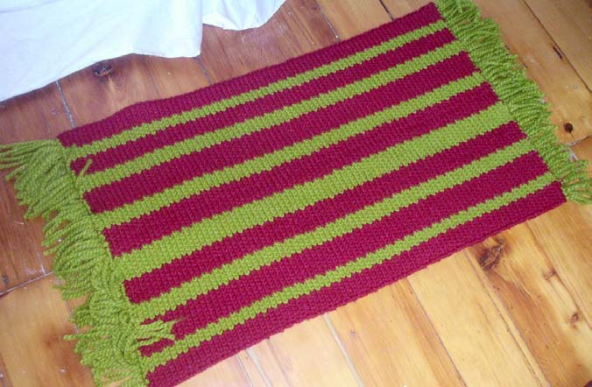
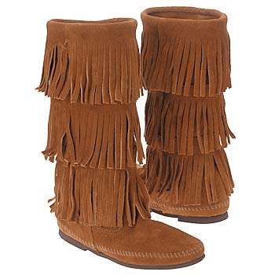
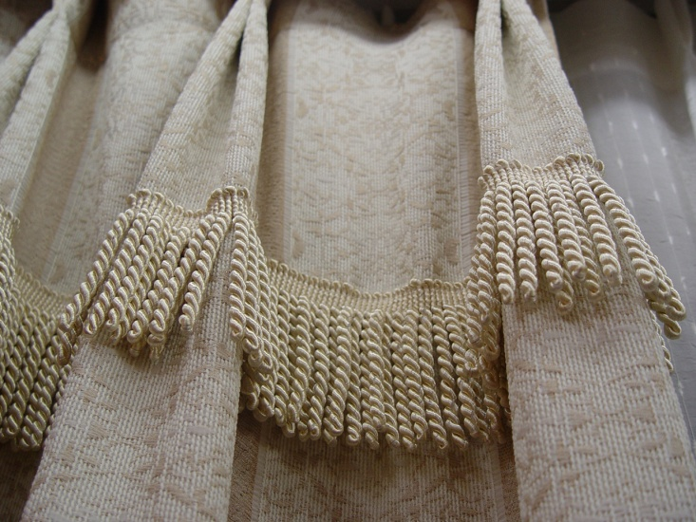
Tell your partner what all of these pictures have in common.
Notes:
Access Prior Knowledge- (APK)
Turn and Talk
Review 3 words and definitions

Slide 32
Making Choices
If I say something that might have fringe, say fringe. If I say something that would not have fringe, don’t say anything.
Crayons
Curtains
Vest
Shoes
Rug

Slide 33
Making Choices
If I say an animal that might stampede, pat your legs to make a stampede sound. If I say an animal that would not stampede, don’t do anything.
Horses
Fish
Ants
Cows
Elephants

Slide 34
Making Choices
If I say something that you might see at a canyon, touch your nose. If I say something that would not be at a canyon, don’t do anything.
Water
Hotel
Dirt
Steep Walls
Mall

Slide 35
I can determine the meaning of unknown words.
Notes:
Goal- Students need to engage with the goal- read it, repeat it, write it, etc.

