Slide 1
Unit 1 Seasons
Poetry

Slide 2
Summer

Slide 3
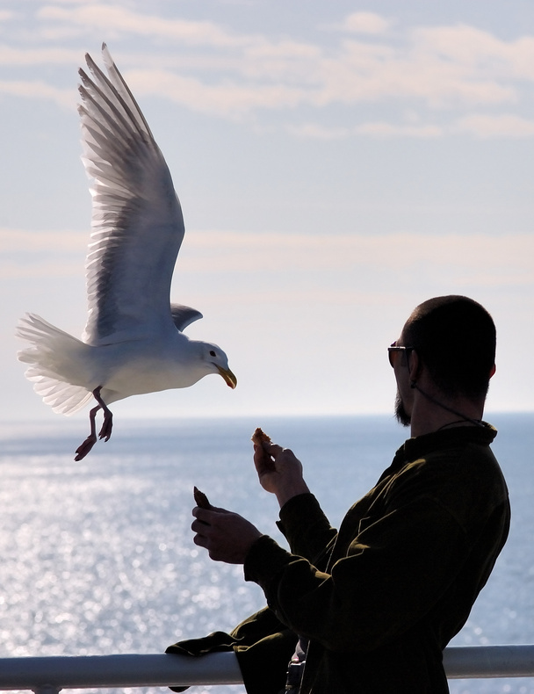
Summer Song by John Ciardi
By the sand between my toes,
By the waves behind my ears,
By the sunburn on my nose,
By the salty little tears
That make rainbows in the sun
When I squeeze my eyes and run,
By the way the seagulls screech,
Guess where I am? At the.........!
By the way the children shout
Guess what happened? School is......!
By the way I sing this song
Guess if summer lasts too long;
You must answer Right or.......!

Slide 4
Knoxville Tennessee by Nikki Giovanni
I always like summer Best you can eat fresh corn From daddy's garden And okra And greens And cabbage And lots of Barbeque And buttermilk And homemade ice-cream At the church picnic And listen to Gospel music Outside At the church Homecoming And go to the mountains with Your grandmother And go barefooted And be warm All the time Not only when you go to bed And sleep

Slide 5
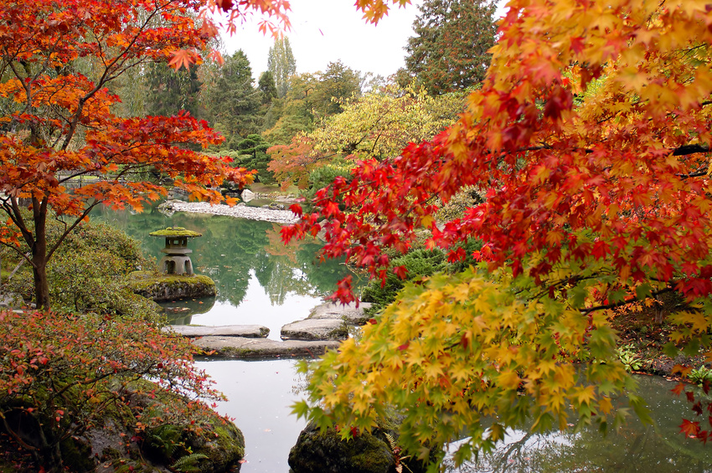
Fall/Autumn

Slide 6
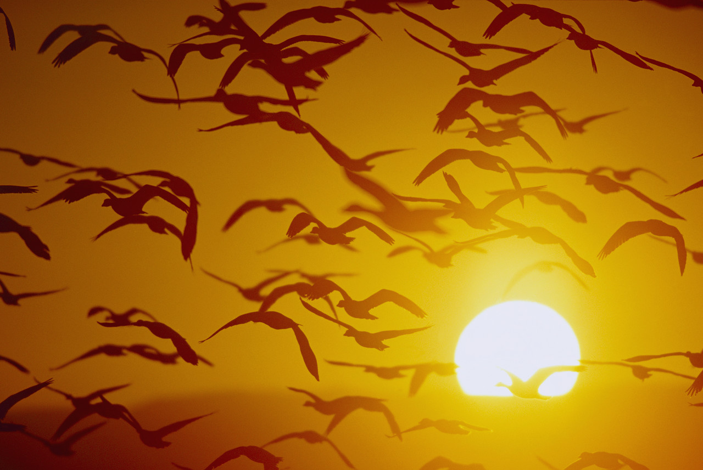
Something Told the Wild Geese by Rachel Field
Something told the wild geese It was time to go, Though the fields lay golden Something whispered, "snow." Leaves were green and stirring, Berries, luster-glossed, But beneath warm feathers Something cautioned, "frost." All the sagging orchards Steamed with amber spice, But each wild breast stiffened At remembered ice. Something told the wild geese It was time to fly, Summer sun was on their wings, Winter in their cry.

Slide 7
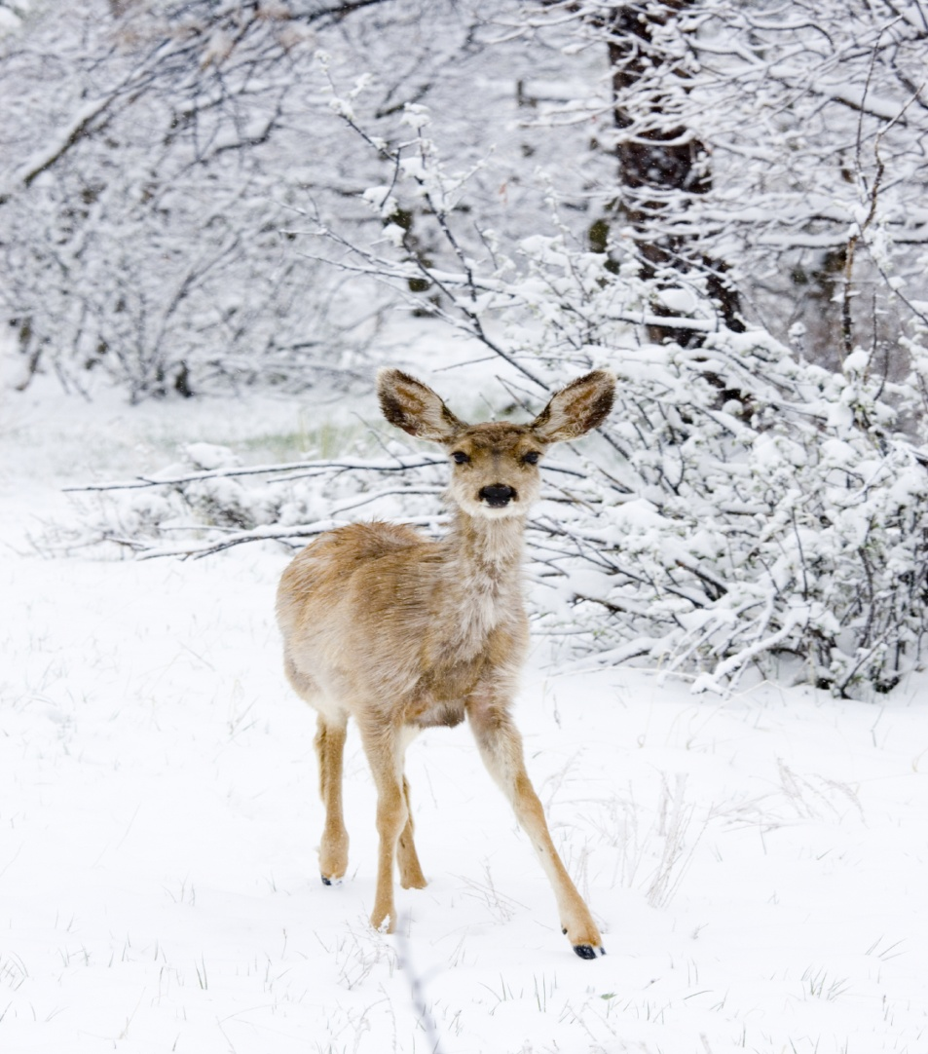
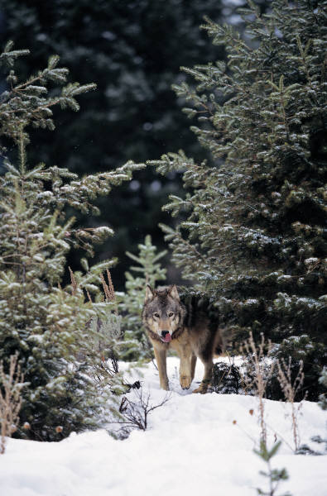
Winter

Slide 8
Velvet Shoes by Elinor Wylie
Let us walk in the white snow
In a soundless space;
With footsteps quiet and slow,
At a tranquil pace,
Under veils of white lace.
I shall go shod in silk,
And you in wool,
White as white cow's milk,
More beautiful
Than the breast of a gull.
We shall walk through the still town
In a windless peace;
We shall step upon white down,
Upon silver fleece,
Upon softer than these.
We shall walk in velvet shoes:
Wherever we go
Silence will fall like dews
On white silence below.
We shall walk in the snow.

Slide 9
Stopping By Woods on a Snowy Evening by Robert Frost
Whose woods these are I think I know. His house is in the village though; He will not see me stopping here To watch his woods fill up with snow. My little horse must think it queer To stop without a farmhouse near Between the woods and frozen lake The darkest evening of the year. He gives his harness bells a shake To ask if there is some mistake. The only other sound's the sweep Of easy wind and downy flake. The woods are lovely, dark and deep. But I have promises to keep, And miles to go before I sleep, And miles to go before I sleep.

Slide 10
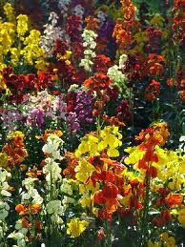
Spring

Slide 11
WHO HAS SEEN THE WIND ? BY: CHRISTINA ROSSETTI
Who has seen the wind?
Neither I nor you:
But when the leaves hang trembling
The wind is passing thro'
Who has seen the wind?
Neither you nor I:
But when the trees bow down their heads
The wind is passing by.

Slide 12
Weather by Eve Merriam
Dot a dot dot dot a dot dot Spotting the windowpane. Spack a spack speck flick a flack fleck Freckling the windowpane. A spatter a scatter a wet cat a clatter A splatter a rumble outside. Umbrella umbrella umbrella umbrella Bumbershoot barrel of rain. Slosh a galosh slosh a galosh Slither and slather a glide A puddle a jump a puddle a jump A puddle a jump puddle splosh A juddle a pump a luddle a dump A pudmuddle jump in and slide!

