Slide 1
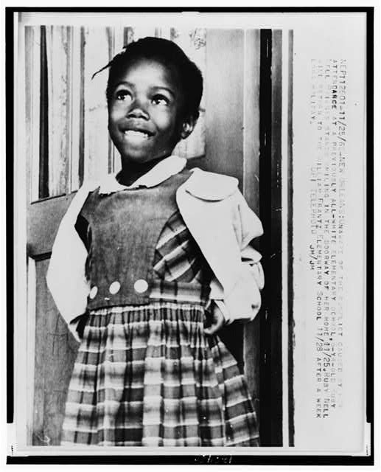
Ruby Bridges
Comparing Two Books
Mrs. Olguin’s 2nd Grade Class
Reagan Elementary

Slide 2
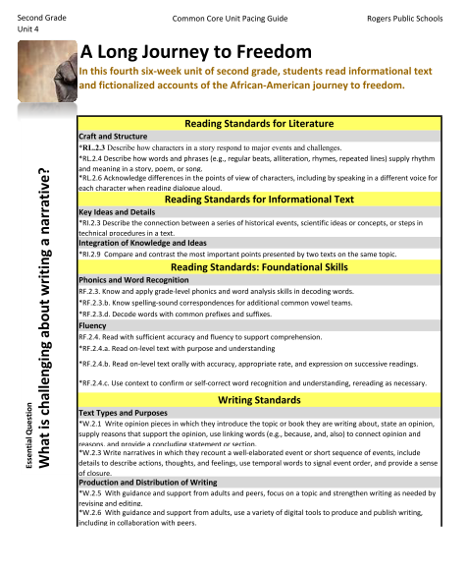
RI.2.9
Compare and contrast the most important points presented by two texts on the same topic.

Slide 3
Mrs. Olguin broke this standard into 4 lessons:
Day 1- Learn the steps of comparing
Day 2- Identify the most important points in The Story of Ruby Bridges
Day 3- Identify the most important points in Ruby Bridges Goes to School
Day 4- Compare the most important parts from both stories
RI.2.9
Compare and contrast the most important points presented by two texts on the same topic.

Slide 4
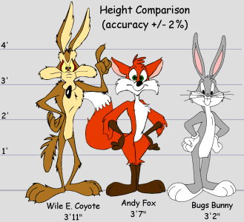
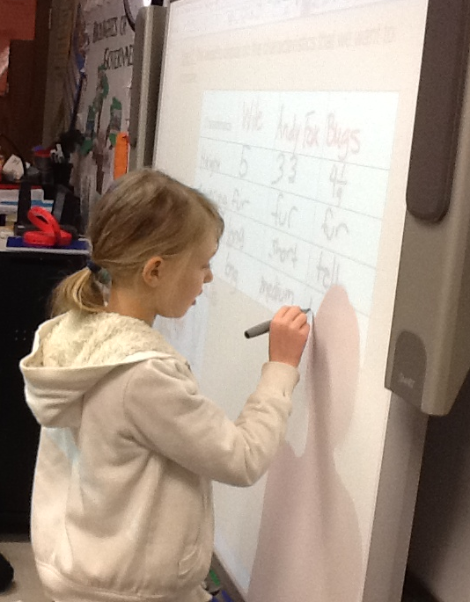
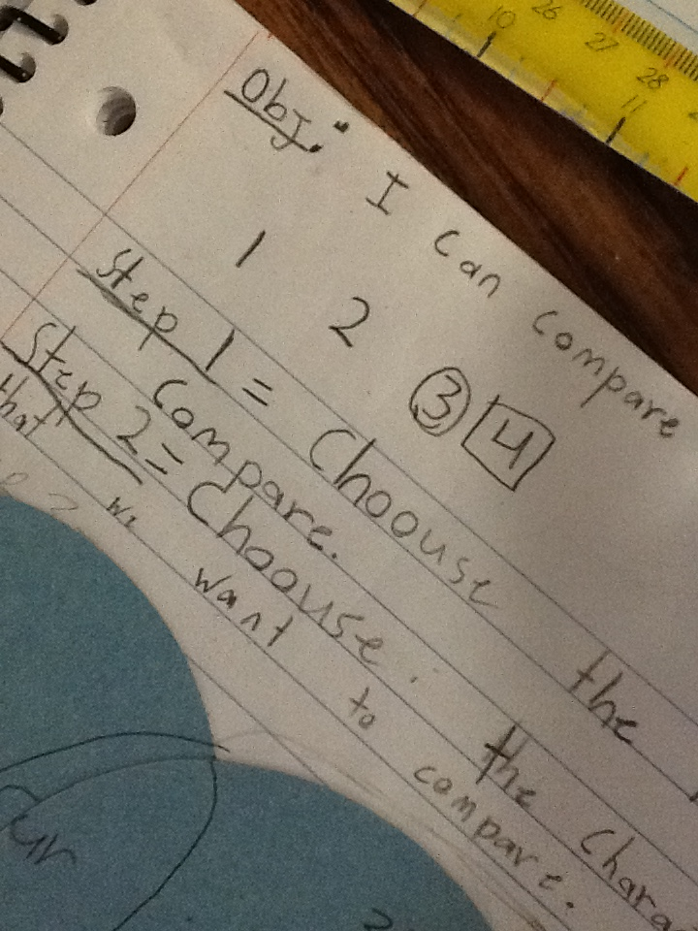
Day 1- Learning to Compare

Slide 5
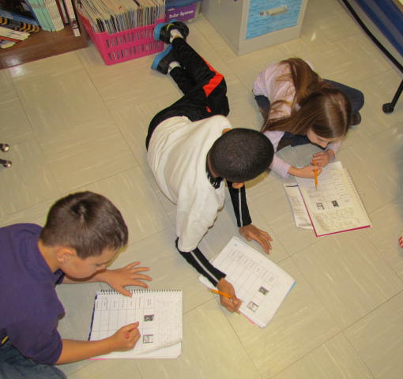
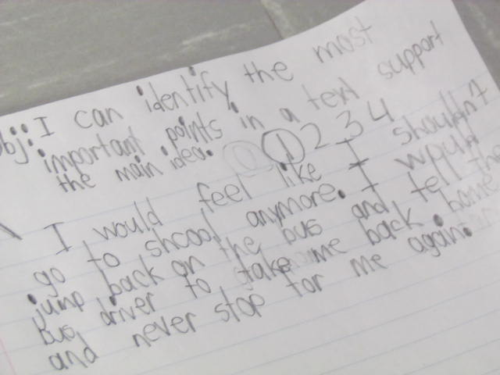
Day 2- The Story of Ruby Bridges
Identifying the most important parts of

Slide 6
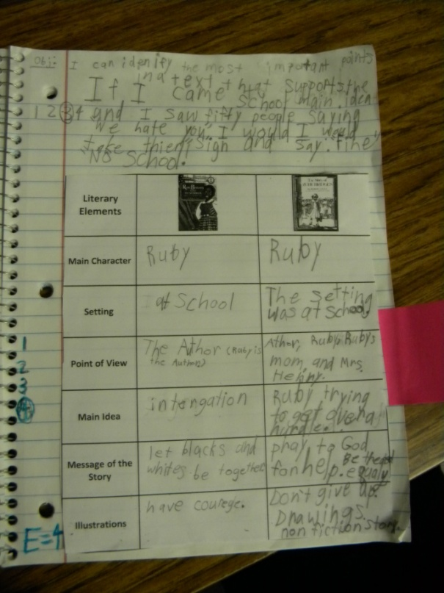
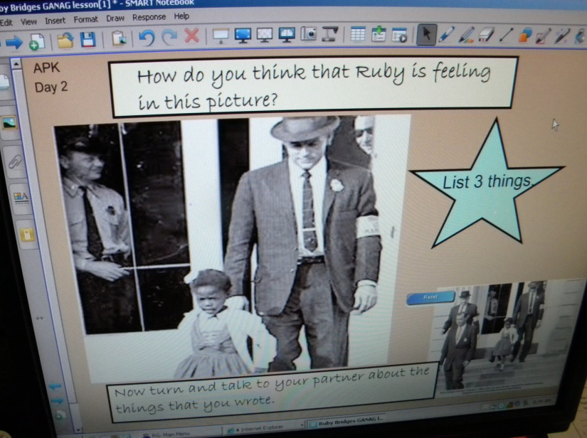
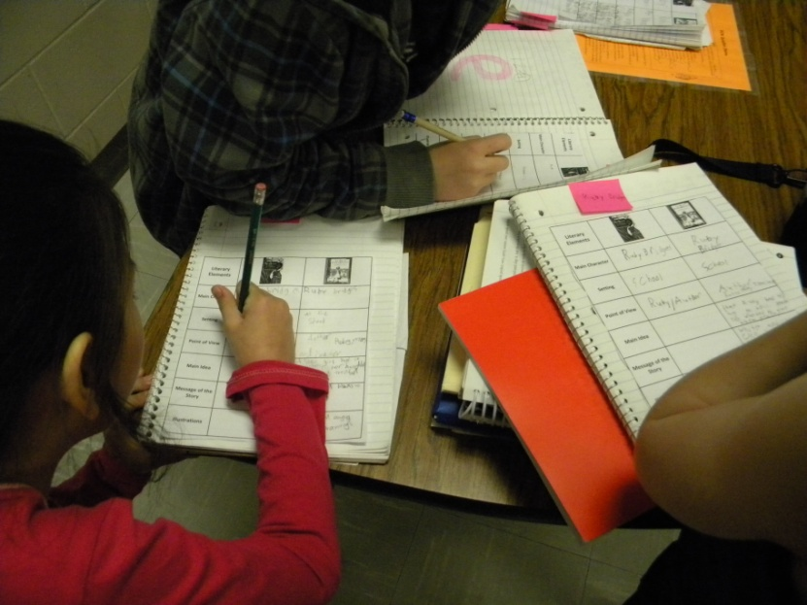
Day 3- Ruby Bridges Goes to School
Identifying the most important parts of

Slide 7
Day 4- Compare the most important parts of two texts on the same topic.

Slide 8
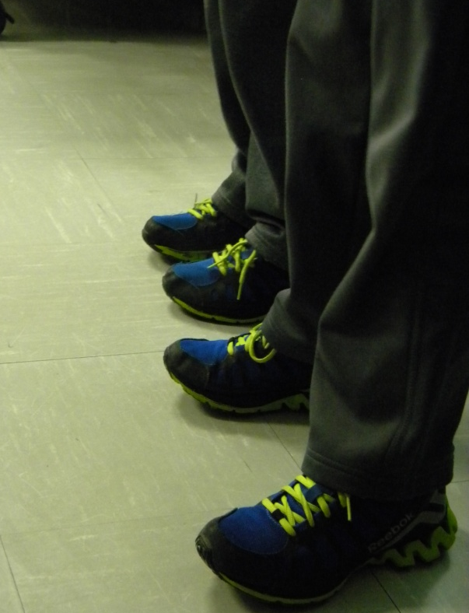
Access Prior Knowledge
“What is the same and what is different about these two students?”

Slide 9
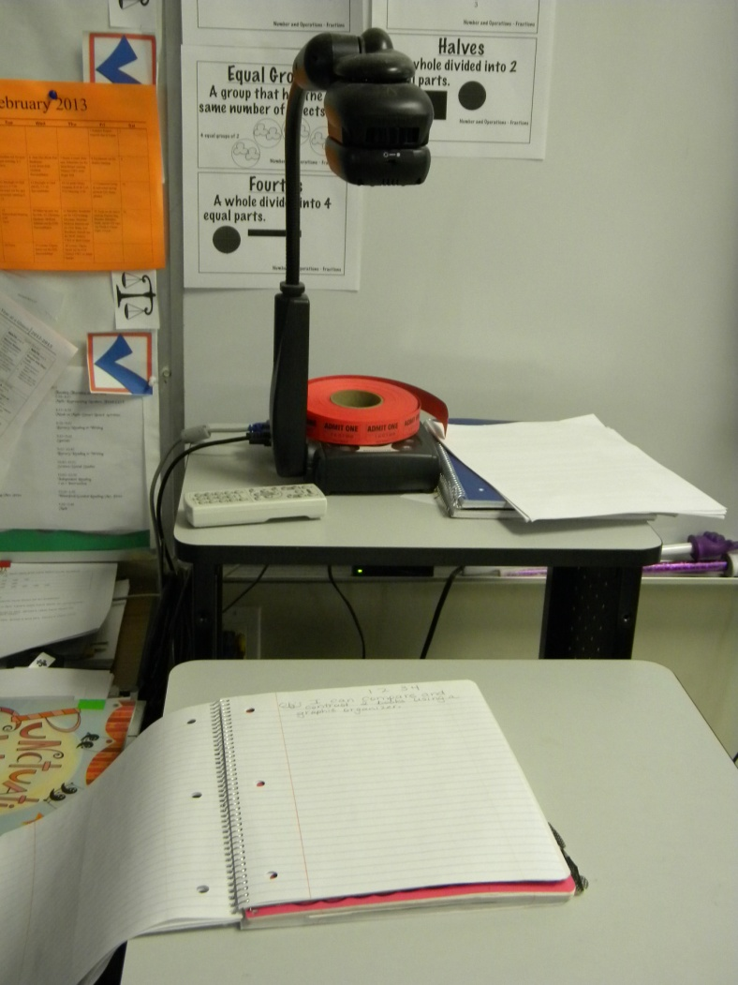
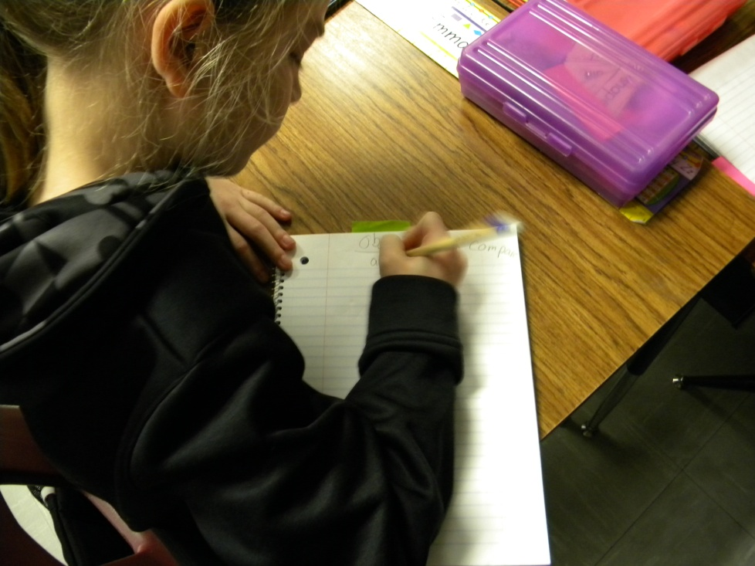
Goal

Slide 10
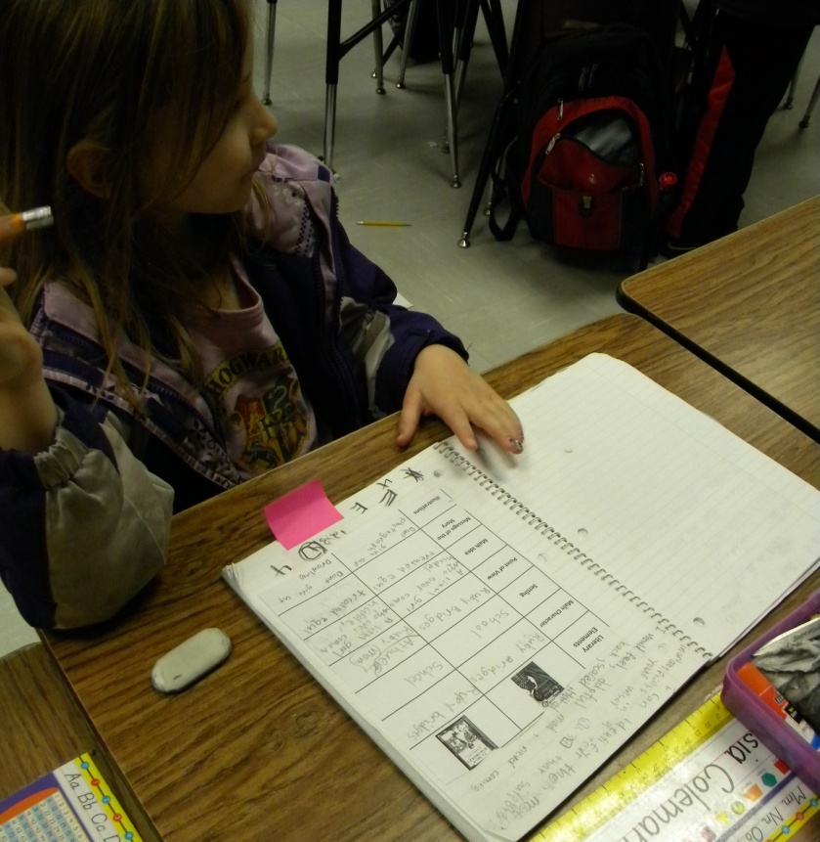
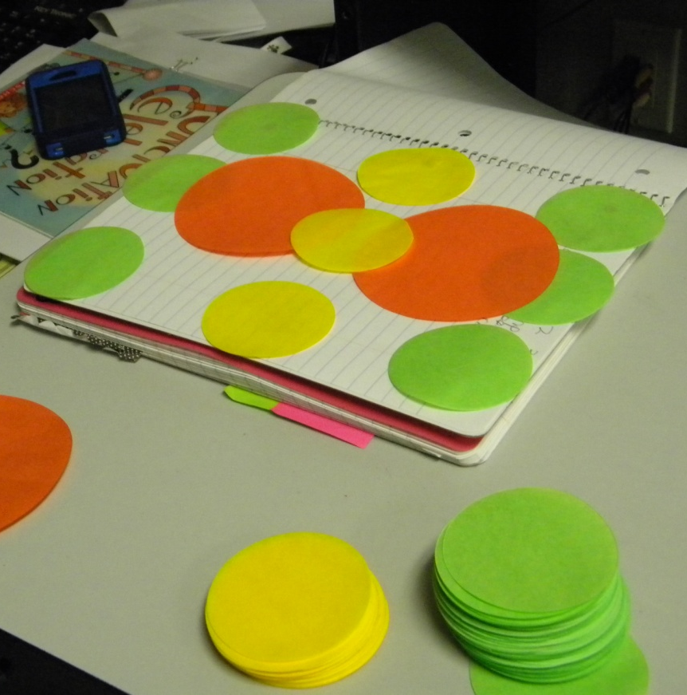
New Information
The class found the Ruby Bridges matrix in their notebooks .
They reviewed their notes.
Mrs. Olguin showed the class how to use the circles to build a Double Bubble organizer.

Slide 11
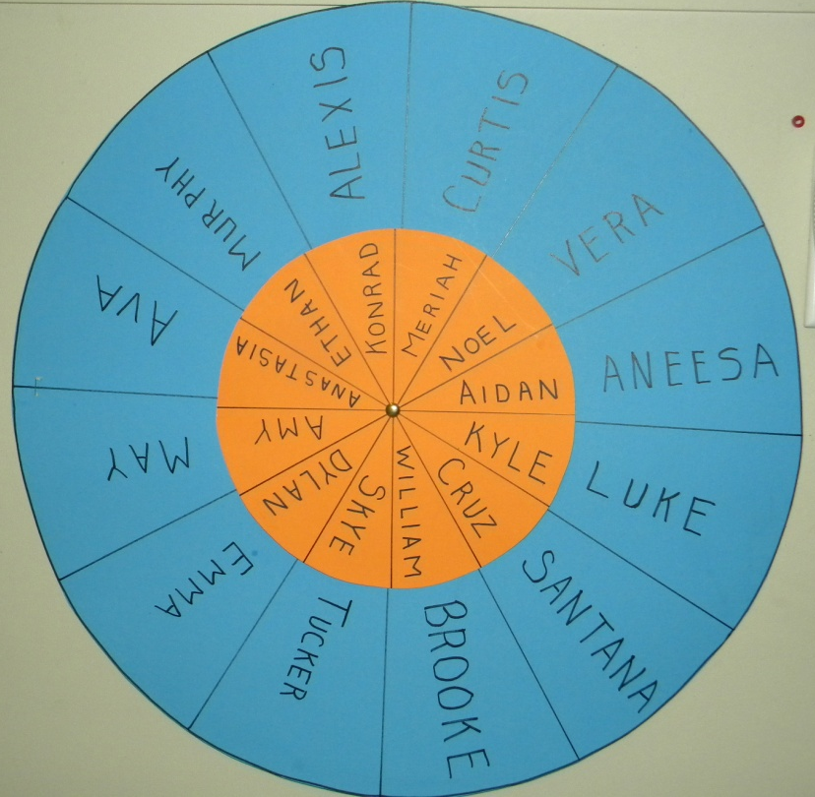
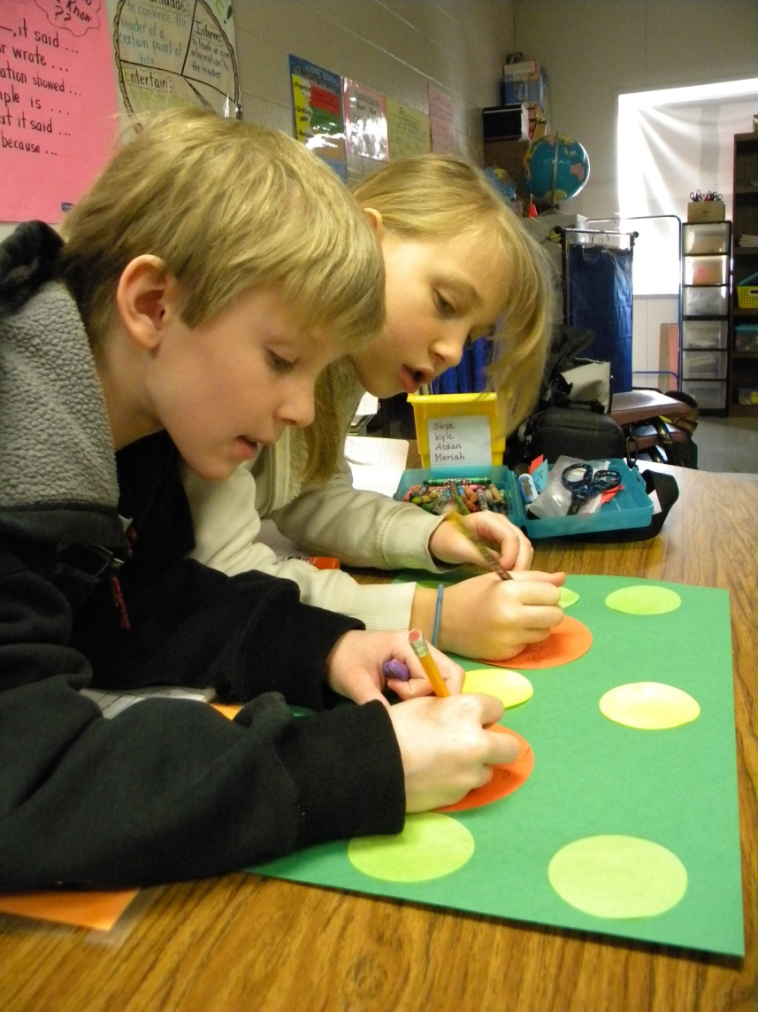
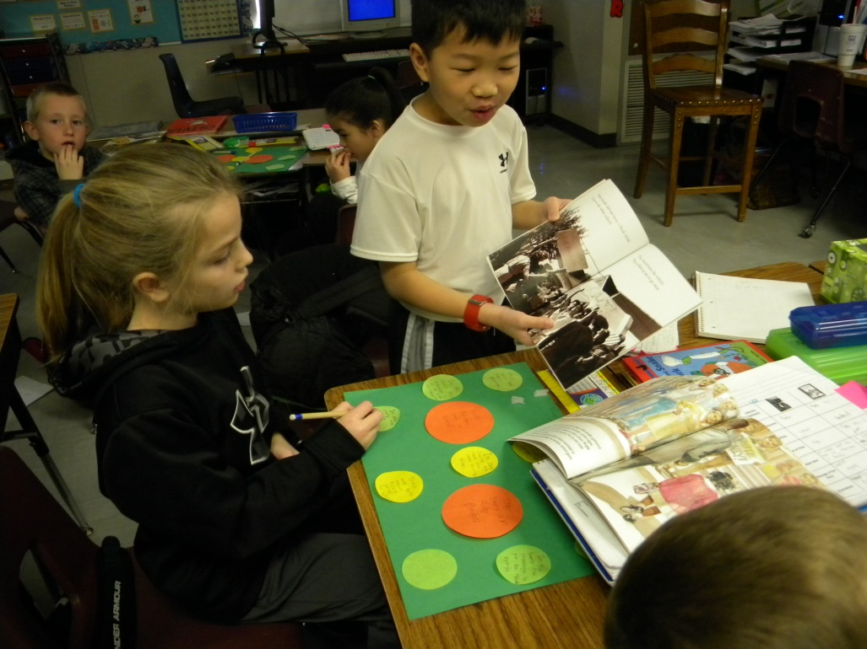
Application
Partner Wheel
The students worked in pairs and used the graphic organizer to help them identify similarities and differences.

Slide 12
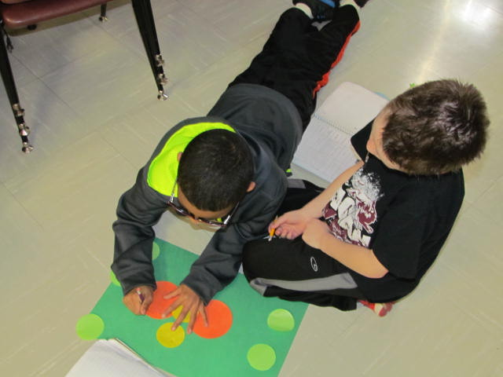
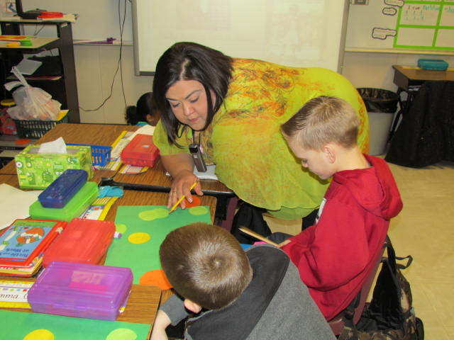
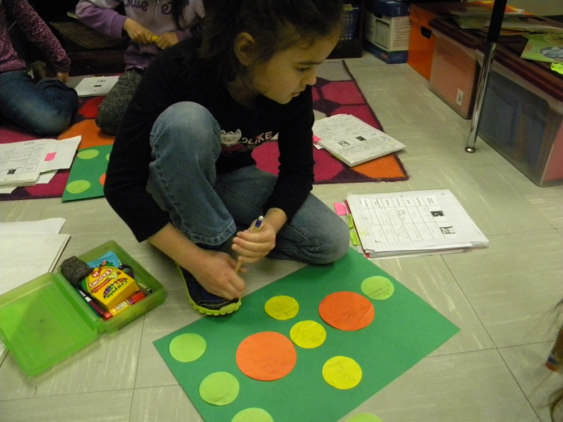

Slide 13
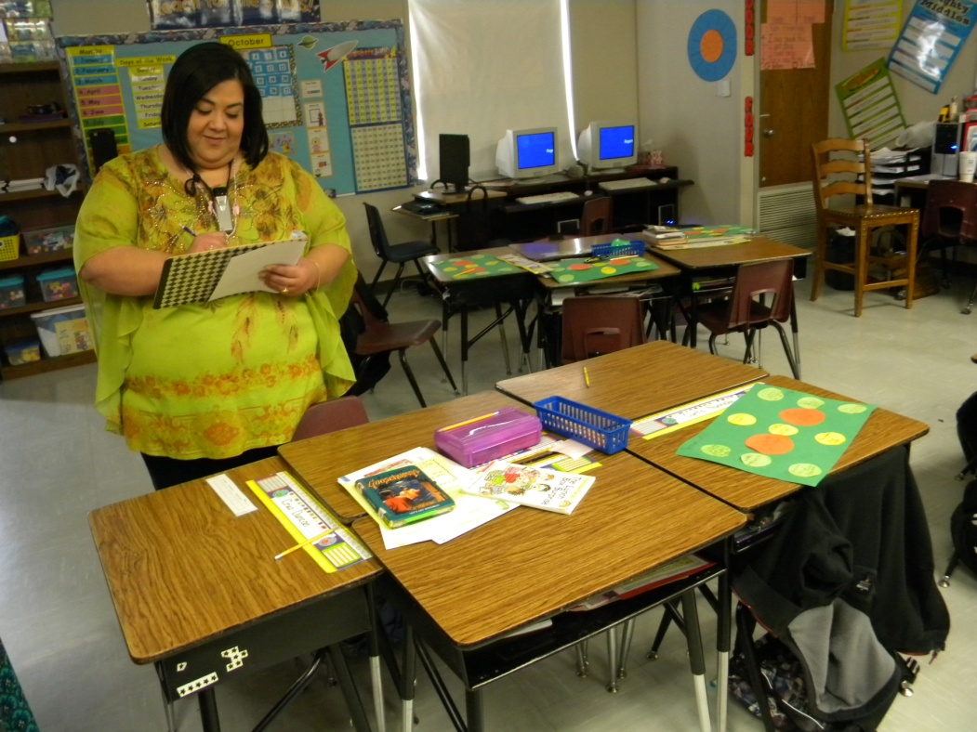
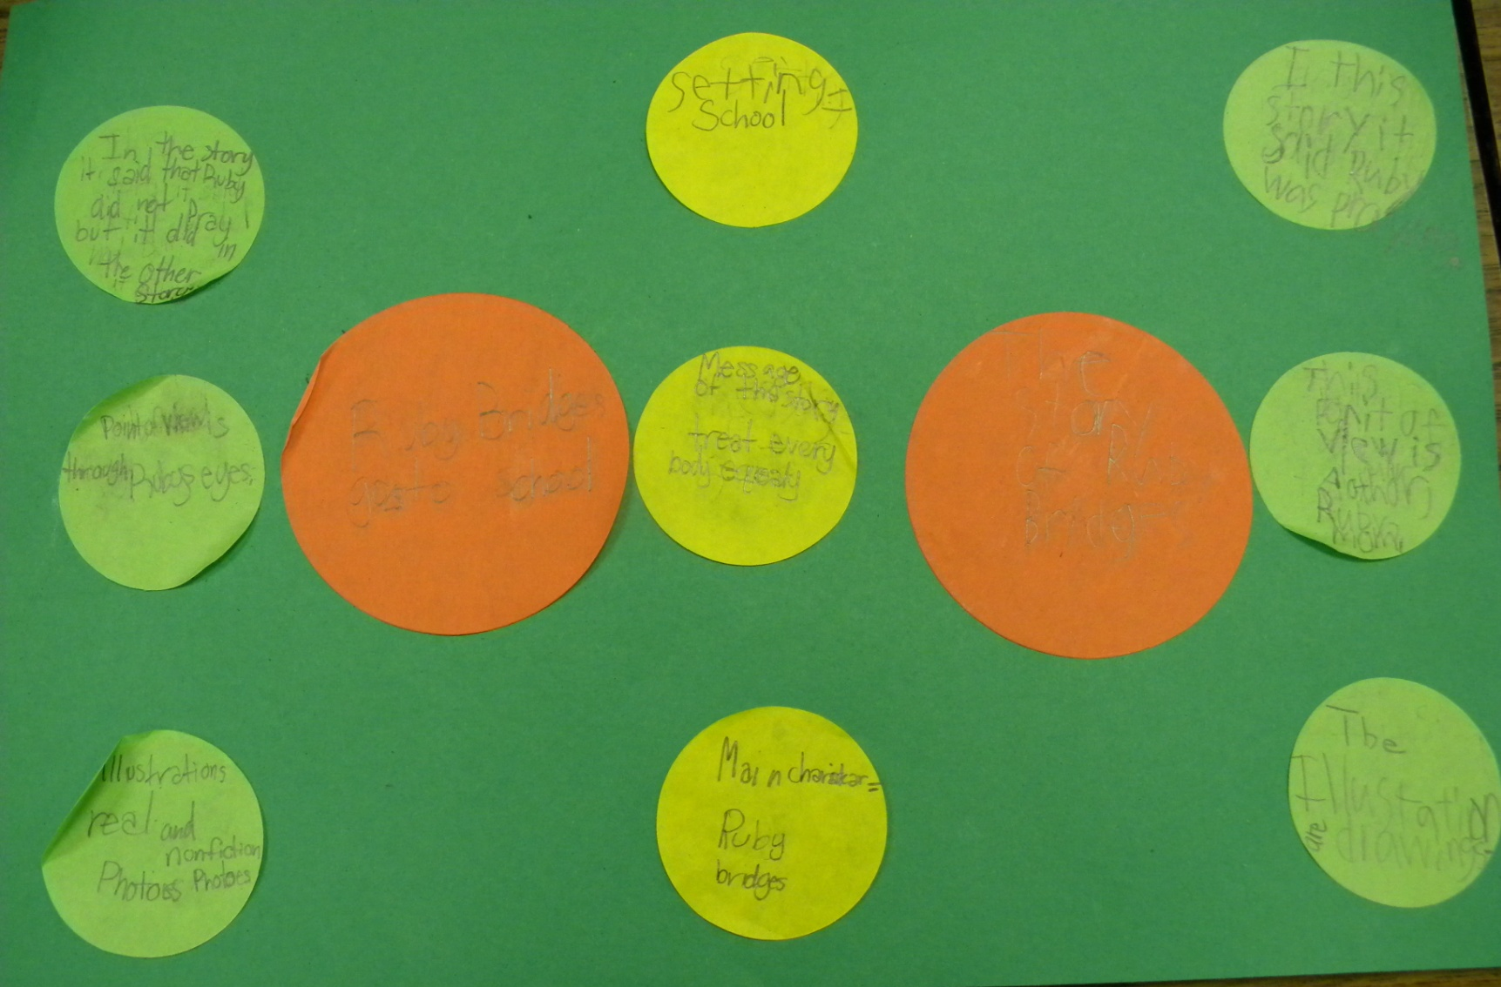
Scoring to the Standards

Slide 14
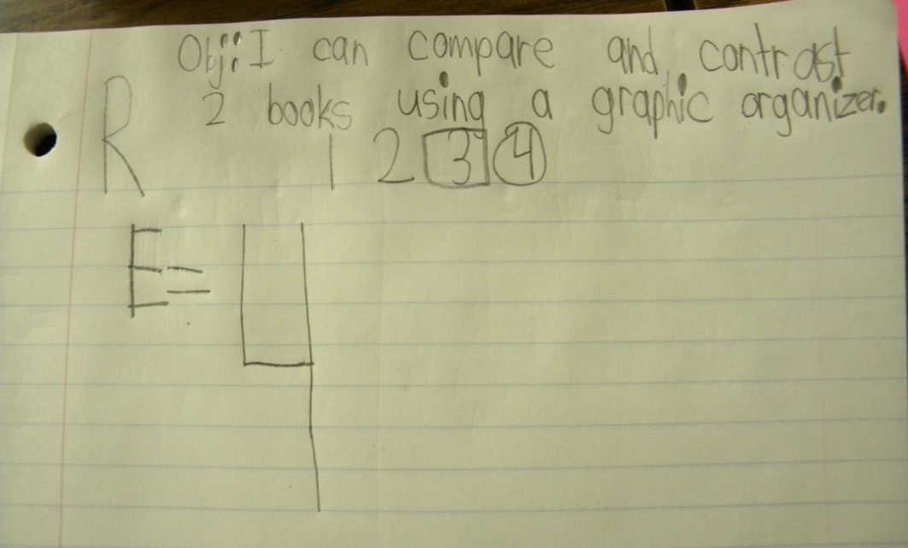
Revisit the Goal

