Slide 1
How Do Characters Respond to Challenges?
Mrs. Eide’s
2nd Grade Class
Renee Simpson Literacy Facilitator
Mathias Elementary
Rogers, AR
December 7, 2011

Slide 2
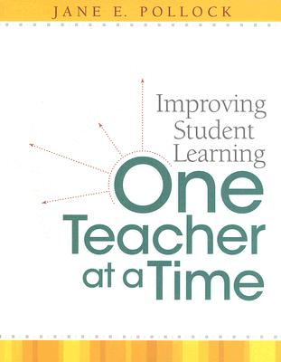
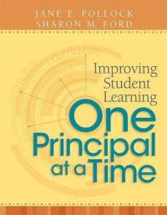
GANAG is a lesson structure that allows teachers to plan for student use of research based instructional strategies.
G= goal
A= access prior knowledge
N= new information
A= application
G= generalize the goal

Slide 3
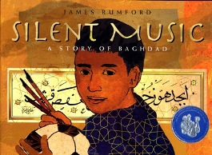
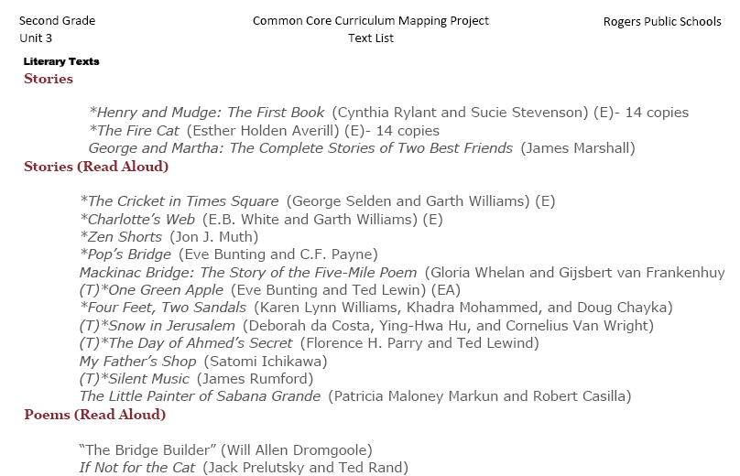
Mrs. Eide began her planning with the pacing guide. She selected a standard.
Standard RL.2.3.
Describe how characters in a story respond to major events and challenges.
Next she selected a text from the suggested works listed in Unit 3.

Slide 4
Purpose of the GANAG Structure
To give students the opportunity to actively use the nine high-yield strategies:
(2) Identifying Similarities and Differences
(7) Cooperative Learning
(8) Setting Objectives and Providing Feedback
(3) Summarizing and Note Taking
(4) Reinforcing Effort and Providing Recognition
(9) Generating and Testing Hypotheses
(5) Homework and Practice
(10) Cues, Questions and Advance Organizers
(6) Nonlinguistic Representations

Slide 5
Describe how characters in a story respond to major events and challenges.
G=Set the Goal
1-I don’t understand how characters in a story respond to challenges.
2- I understand about characters and challenges but I’m not quite sure how they fit together.
3- I understand what Mrs. Eide is talking about when she talks about how characters respond to challenges.
4- I can explain to Mrs. Eide in my own words how characters respond to challenges in a story.
Students “secret score” under their chin.

Slide 6
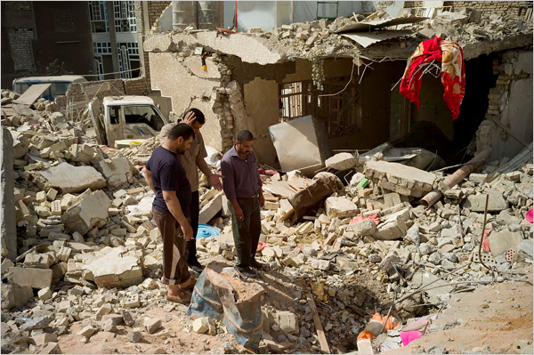
A=Access Prior Knowledge
YouTube video clip-How would you feel if you walked outside and saw this? What would you hear? What would you see? Turn and talk-then report out

Slide 7
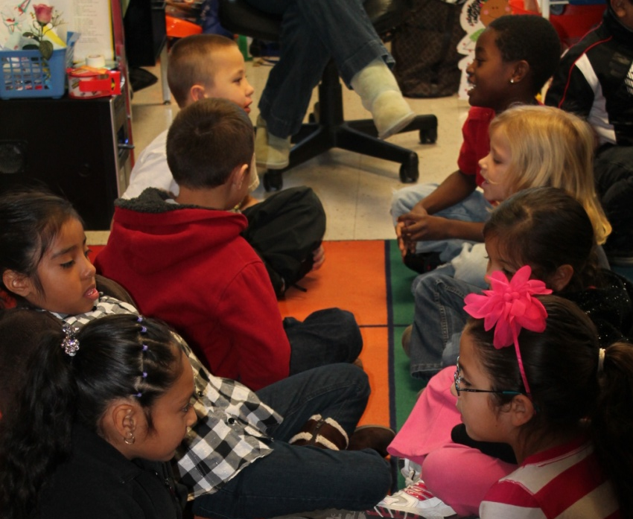
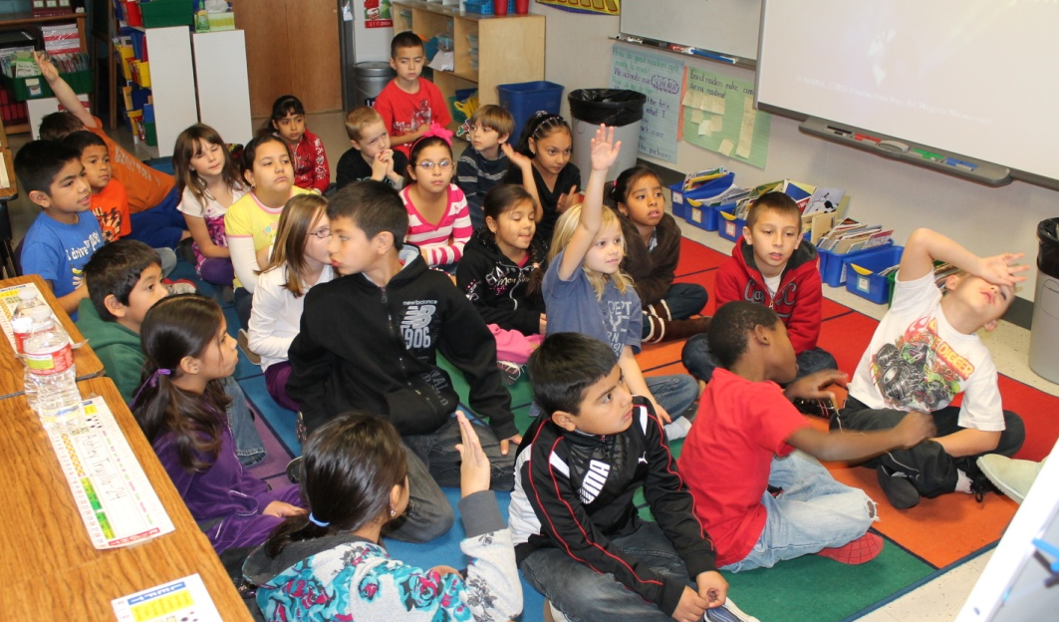
A=Access Prior Knowledge

Slide 8
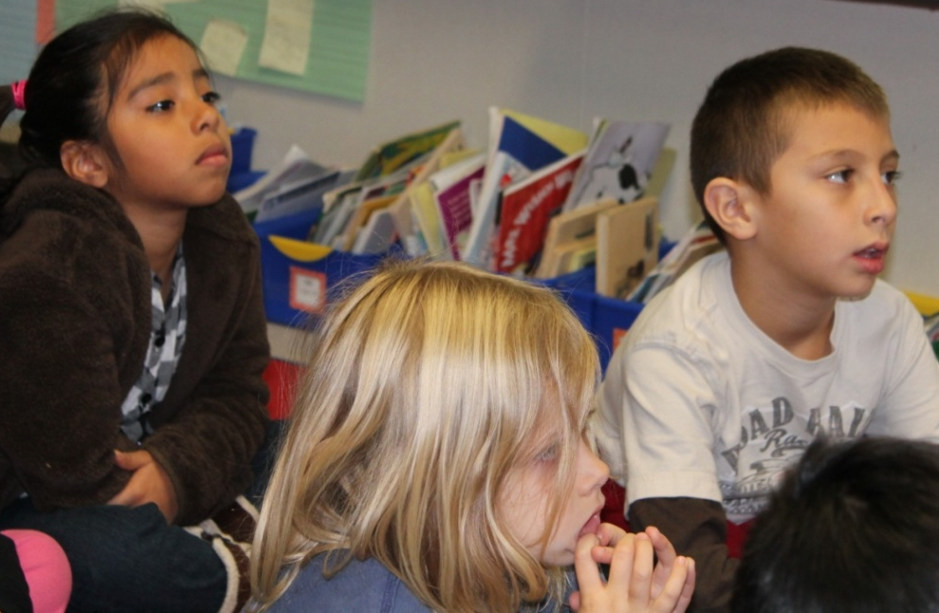
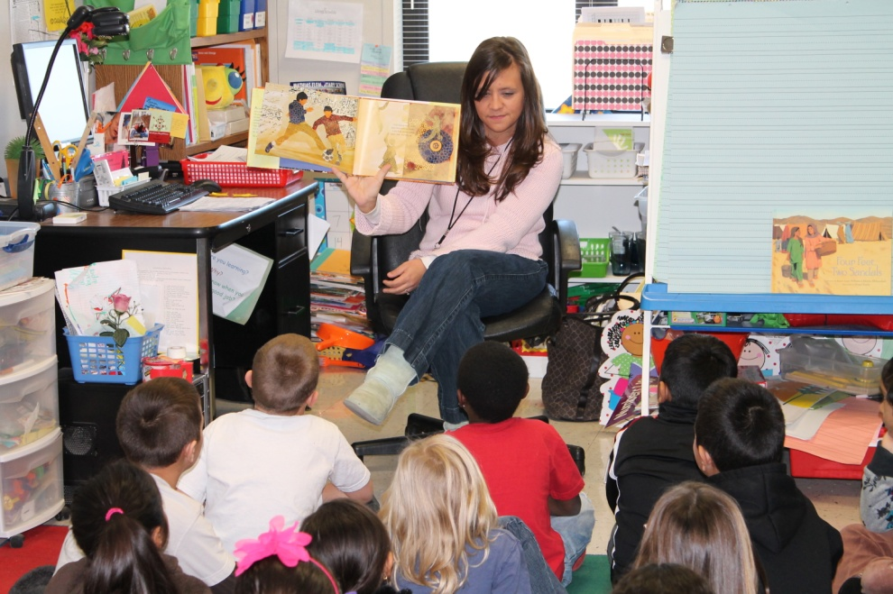
N= New Information
Read Silent Music by James Rumford
Before beginning to read, Mrs. Eide told the students that “calligraphy” is a kind of fancy writing. “It is the art of drawing letters.” She showed them a picture from the text.
Silent Music is about a boy named Ali.
Ali writes in calligraphy to escape from the war that is going on all around him.

Slide 9
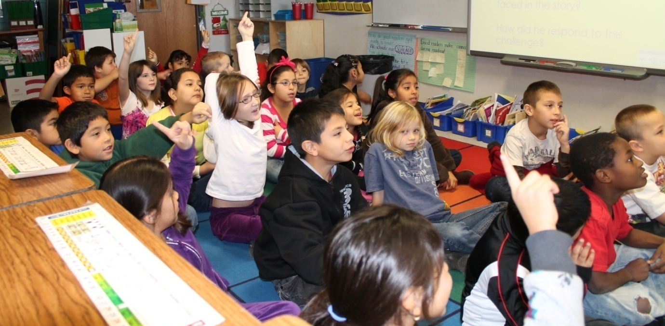
N= New Information
Many of the students had their “light bulbs” going off throughout the story. When they hear a text talk, a simile, or other skills they have studied, the students raise one finger next to the side of their head…this a visible cue to Mrs. Eide that the students are thinking.
One student let Mrs. Eide know that he made a connection. After the story, Ms. Simpson asked about his connection. “Ali has wars going on around him just like the girls in Four Feet, Two Sandals.”

Slide 10
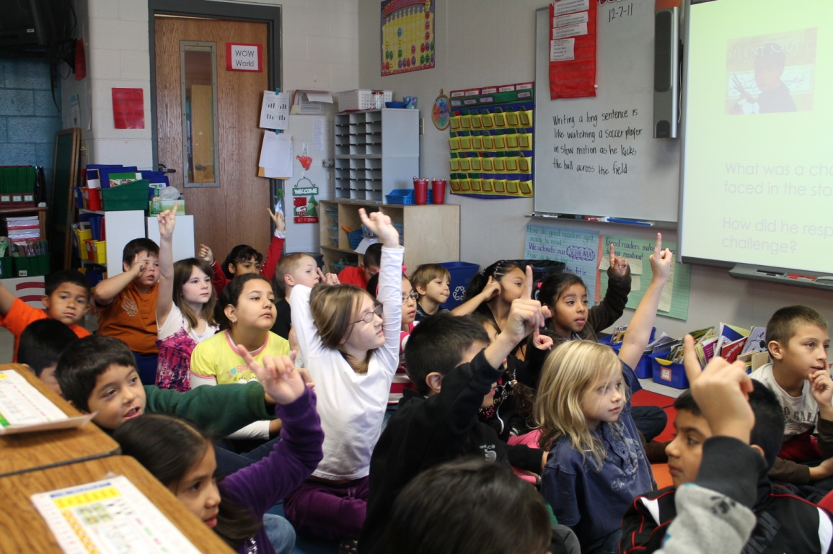
N= New Information
Many “light bulbs” went off when the students realized that their Morning Mentor Sentence was from Silent Music.
Each morning, the students study a “Mentor Sentence.” This is a strong sentence from any text they have been reading. The students copy the sentence from the board, and then as a class, they tell all of the things they “notice” about the sentence. They are hunting for strong vocabulary, vivid verbs, similes, etc.

Slide 11
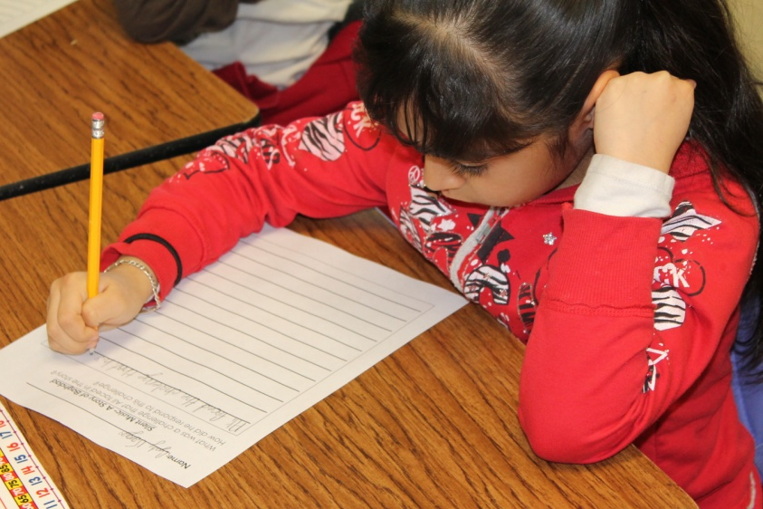
A= Apply Knowledge
The students were asked to answer one of two different open response style questions…

Slide 12
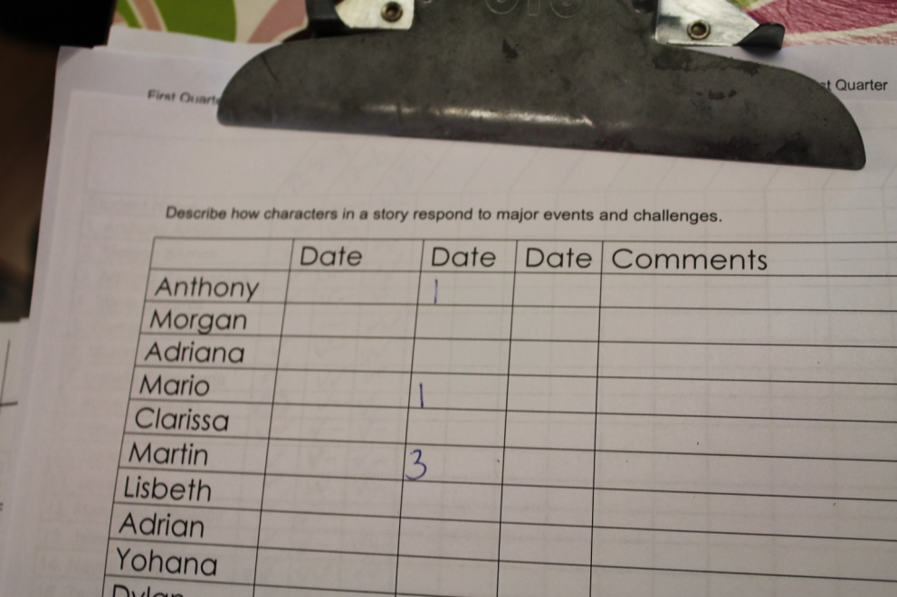
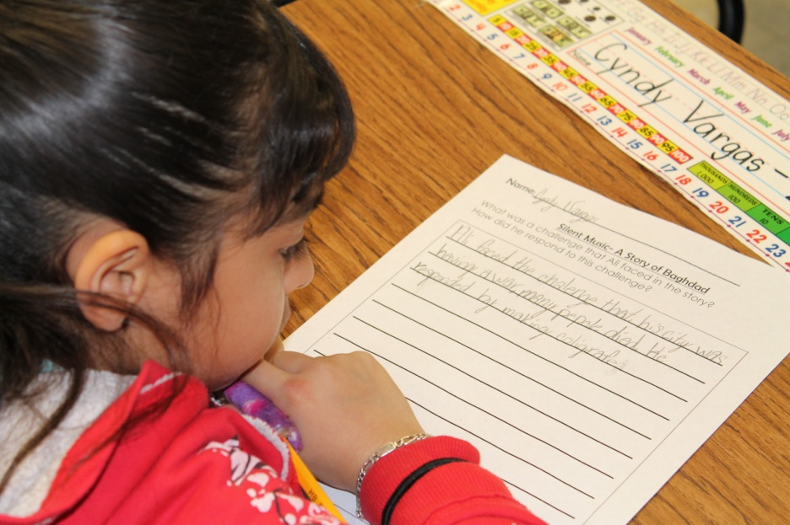
A= Apply Knowledge
As the students worked, Mrs. Eide roamed the room with her scoring guide.

Slide 13
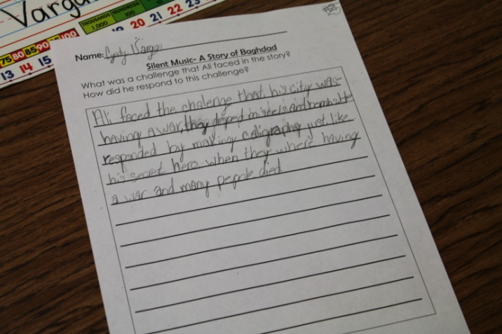
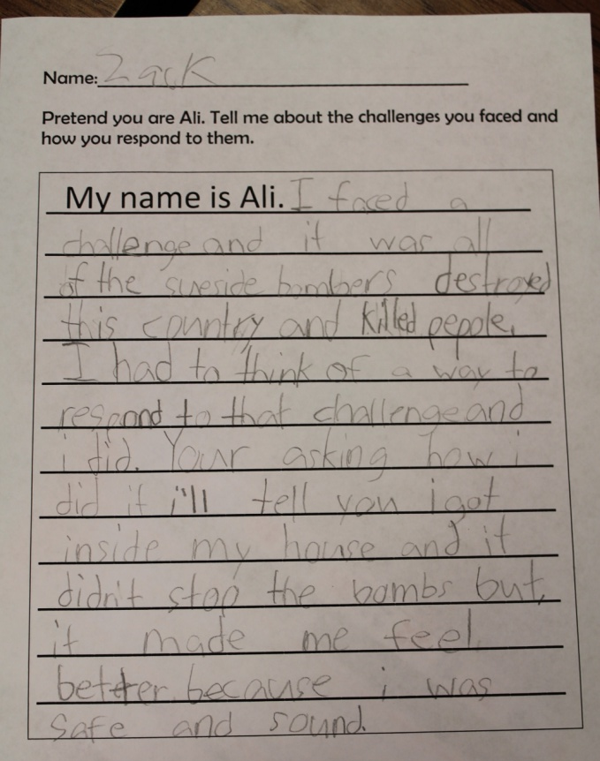
A= Apply Knowledge
“My name is Ali. I faced a challenge and it was all the suicide bombers destroyed this country and killed people. I had to think of a way to respond to that challenge, and I did. You’re asking how I did it. I’ll tell you. I got inside my house and it didn’t stop the bombs, but it made me feel better because I was safe and sound.”
“Ali faced the challenge that his city was having a war. The dropped missiles and bombs. He responded by making calligraphy just like his secret hero when they were having a war and many people died.”

Slide 14
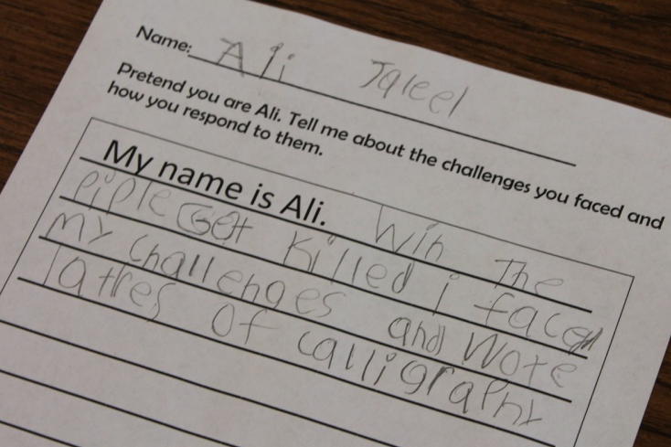
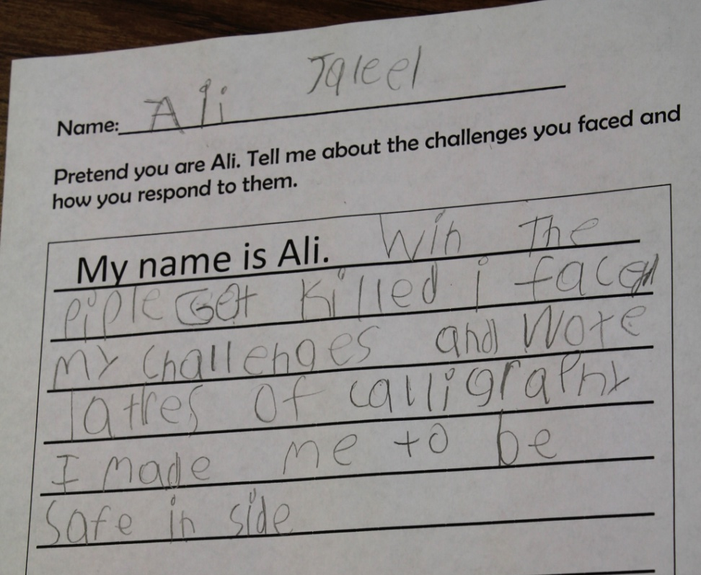
A= Apply Knowledge
As the students worked, Mrs. Eide and Ms. Simpson walked around the room to score back to the standard. When asked how Ali felt when he wrote his calligraphy, the student said that it made him feel safe inside. This moved the student’s score from a “3” to a “4.”
“My name is Ali. When the people got killed, I faced my challenges and wrote letters of calligraphy.”
“My name is Ali. When the people got killed, I faced my challenges and wrote letters of calligraphy. It made me to be safe inside.”

Slide 15
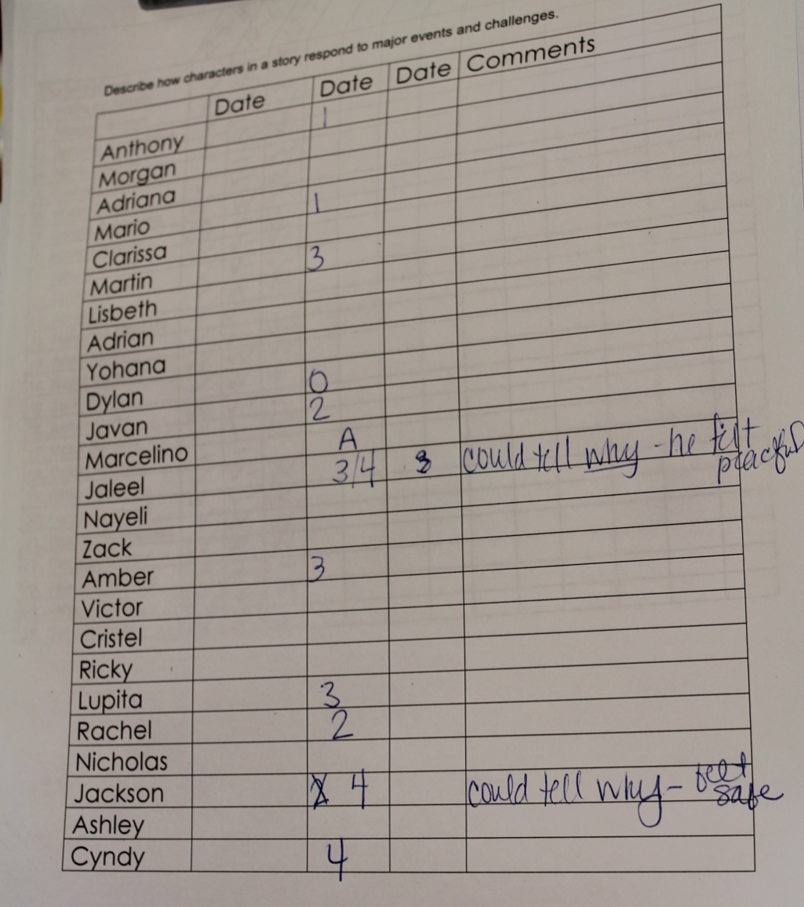
A= Apply Knowledge
By the end of the lesson, Mrs. Eide scored 12 students on this skill.
Students were scored on their ability to answer the question either verbally or in written form.

Slide 16
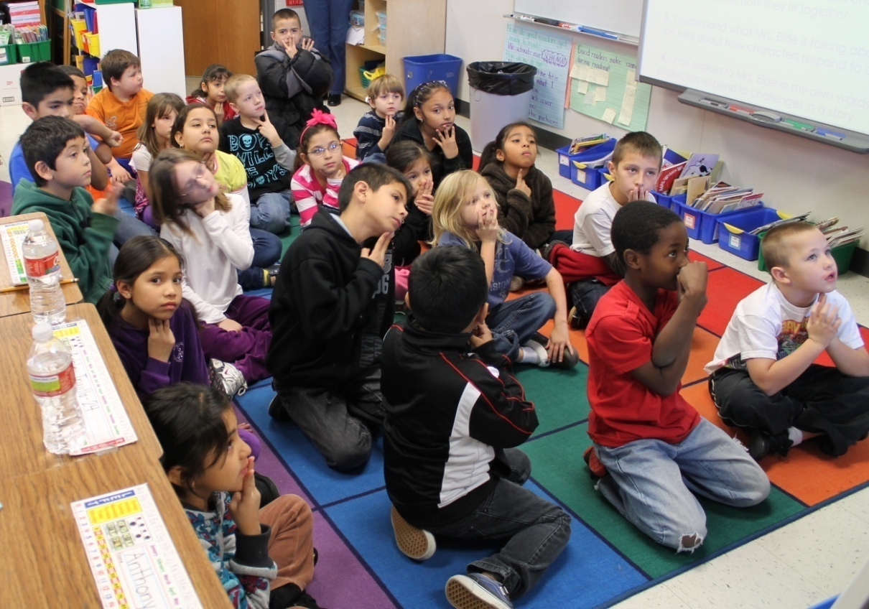
G= Generalize the Goal
Turn and talk-
“Today we learned about how characters respond to major challenges in a story. How does this help you to be a better reader?”
Score yourself on how well you can describe how characters respond to major challenges.
1-I don’t understand how characters in a story respond to challenges.
2- I understand about characters and challenges but I’m not quite sure how they fit together.
3- I understand what Mrs. Eide is talking about when she talks about how characters respond to challenges.
4- I can explain to Mrs. Eide in my own words how characters respond to challenges in a story.

Slide 17
G
A
N
A
G
Student Use of the High Yield Strategies

Slide 18
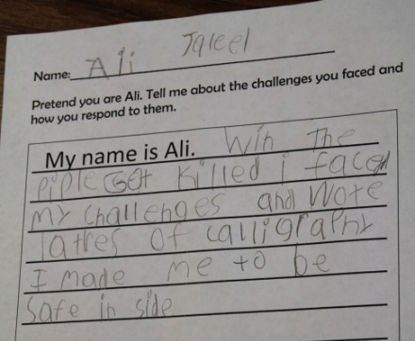
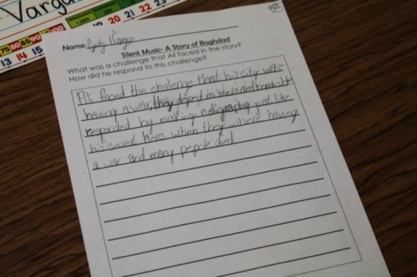
Ms. Eide’s Reflections
(3) Summarizing and Note Taking
(4) Reinforcing Effort and Providing Recognition
Student “light bulbs” going off.
(5) Homework and Practice

Slide 19
(6) Nonlinguistic Representations
(8) Setting Objectives and Providing Feedback
Posted objective and secret show
(10) Cues, Questions and Advance Organizers
Specifically planned questions:
How would you feel if you walked outside and saw this? What would you hear? What would you see?

Slide 20
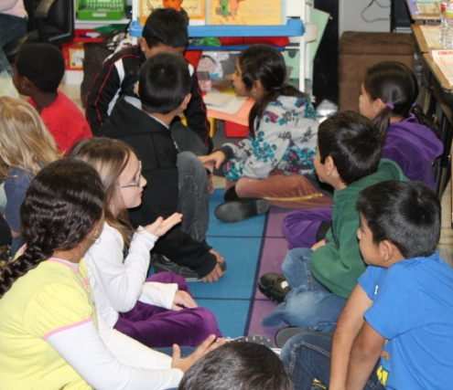
(2) Identifying Similarities and Differences
(7) Cooperative Learning
Several opportunities to Turn and Talk
(9) Generating and Testing Hypotheses
“Today we learned about how characters respond to major challenges in a story. How does this help you to be a better reader?”

Slide 21
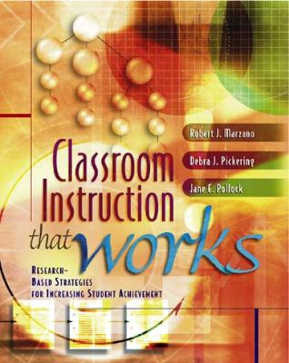
Marzano, R. J., Pickering, D. J., & Pollock, J. E. (2001). Classroom instruction that works: Research-based strategies for increasing student achievement. Alexandria, VA: Association for Supervision and Curriculum Development.
Pollock, J. E. (2007). Improving student learning one teacher at a time. Alexandria, VA: Association for Supervision and Curriculum Development.
Pollock, J. E., & Ford, Sharon M. (2009). Improving student learning one principal at a time. Alexandria, VA: Association for Supervision and Curriculum Development.

