Slide 1
Using information from the illustrations and text to better understand the characters in a story.
Mrs. Allison Smith’s 2nd Grade
Westside Elementary
Rogers, Arkansas
December 2, 2011

Slide 2
GANAG is a lesson structure that allows teachers to plan for student use of research based instructional strategies.
G= goal
A= access prior knowledge
N= new information
A= application
G= generalize the goal

Slide 3
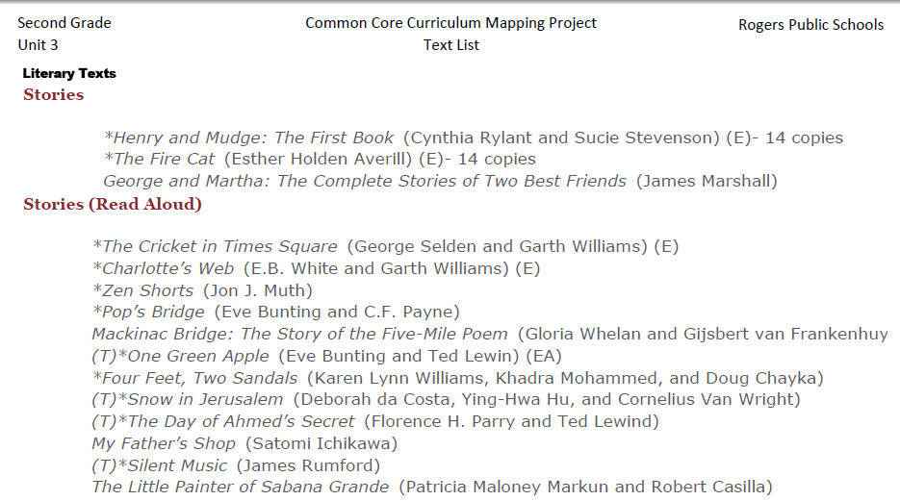
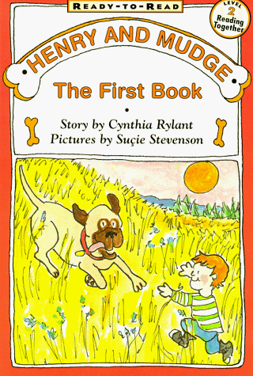
Mrs. Smith began her planning with the pacing guide.
RI.2.7
Use information gained from the illustrations and words in a print or digital text to demonstrate understanding of its characters, setting or plot.
She selected the standard.
Then she selected a text from the text list that would engage the students in performance of the standard.

Slide 4
The purpose of the GANAG structure
To give students the opportunity to actively use the nine high-yield strategies:
(2) Identifying Similarities and Differences
(7) Cooperative Learning
(8) Setting Objectives and Providing Feedback
(3) Summarizing and Note Taking
(4) Reinforcing Effort and Providing Recognition
(9) Generating and Testing Hypotheses
(5) Homework and Practice
(10) Cues, Questions and Advance Organizers
(6) Nonlinguistic Representations

Slide 5
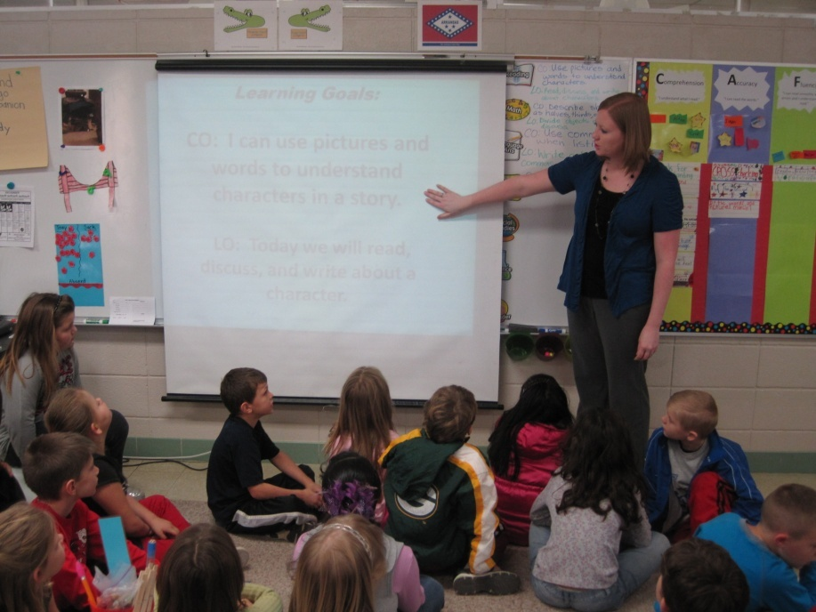
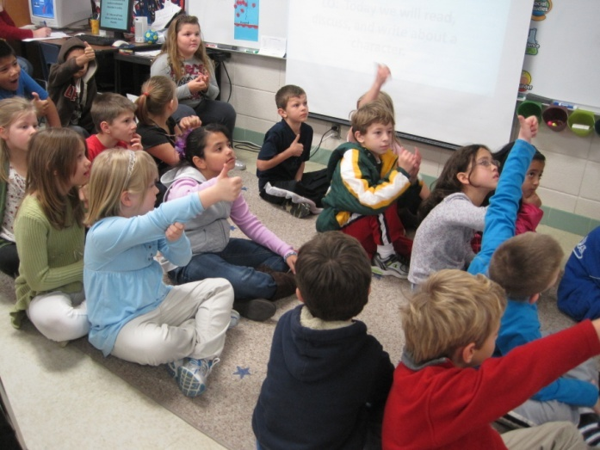
Goal: I can use pictures and words to understand characters in a story.
I can do this by myself.
Students score themselves to the goal.
I am not sure I can do this.
I need help.
(8) Setting Objectives and Providing Feedback

Slide 6
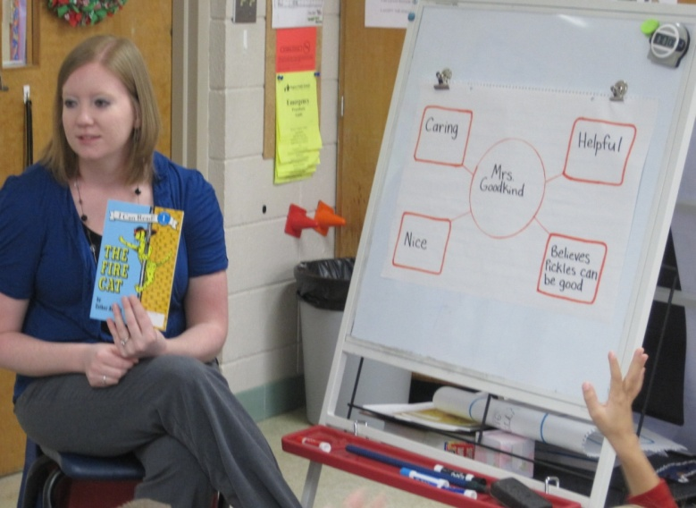
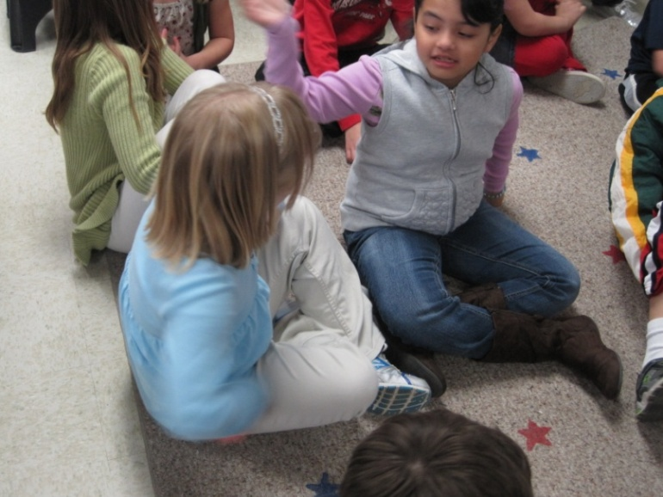
Access Prior Knowledge:
Review previous lesson – Character Web
Review the character map about Mrs. Goodkind from the story The Fire Cat.
Students told a partner one thing they know about the character.
(10) Cues, Questions and Advance Organizers

Slide 7
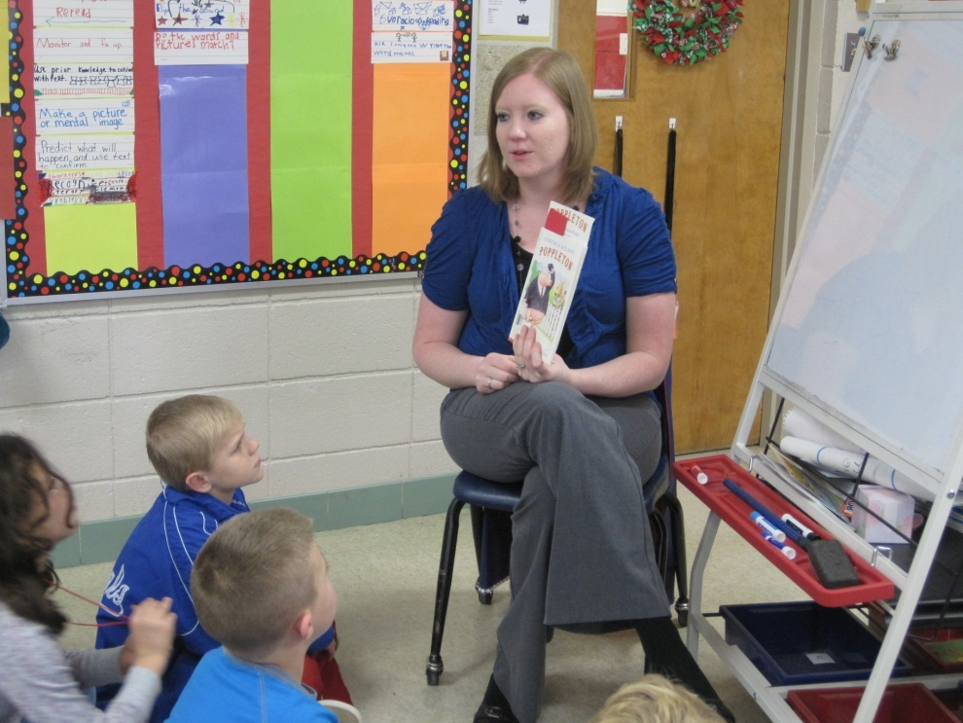
New Information - Modeling
Mrs. Smith read p. 10-11 in Poppleton. The class had a discussion about the character Cherry Sue.
(10) Cues, Questions and Advance Organizers

Slide 8
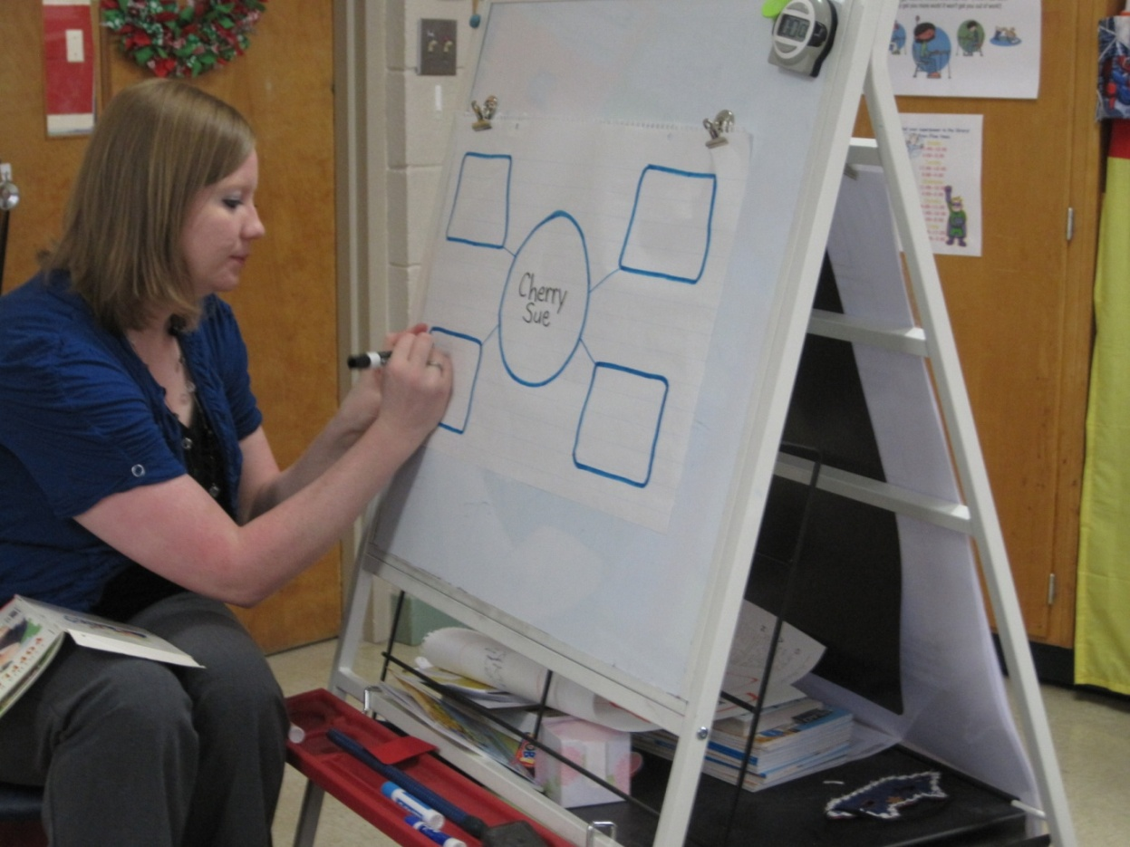
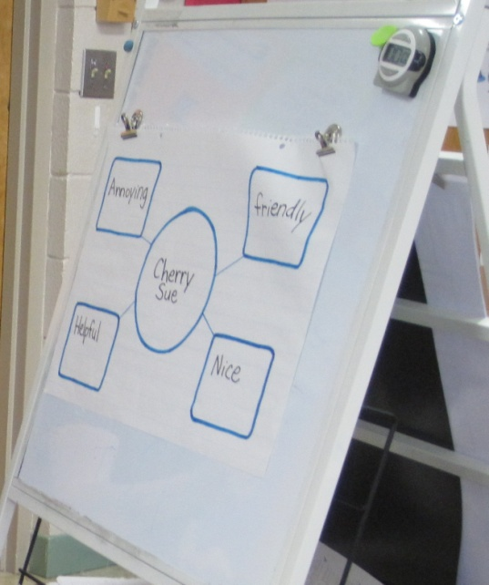
Mrs. Smith modeled using the character web. The class worked together using the pictures and words in the book to fill in the character web about Cherry Sue.
(6) Nonlinguistic Representations

Slide 9
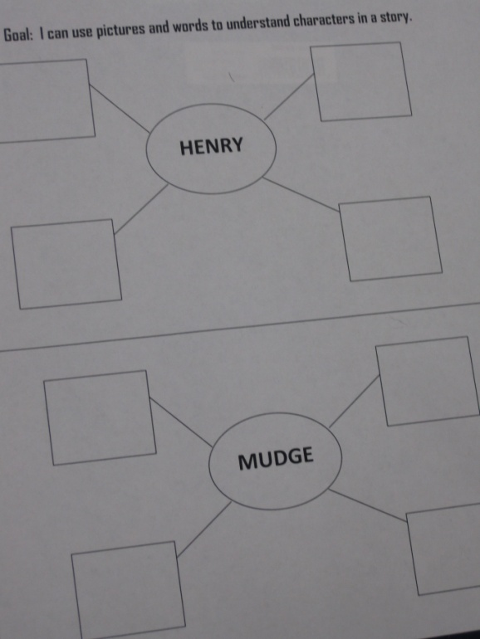
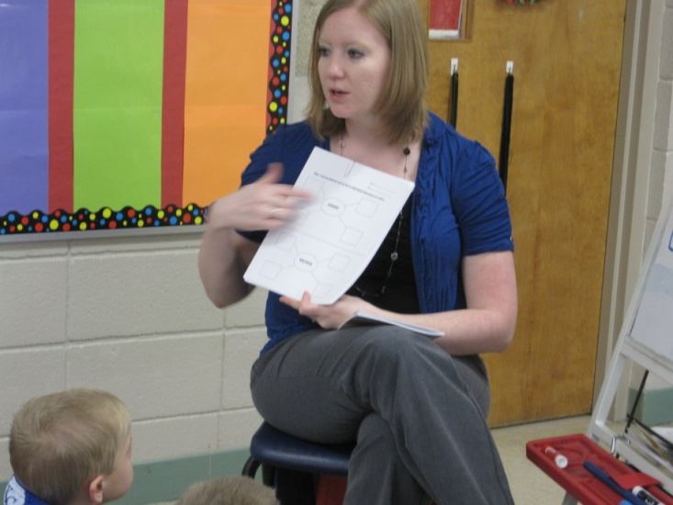
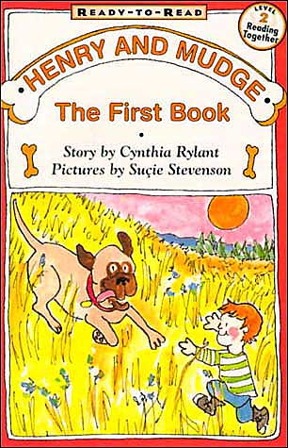
Application
Students worked in groups of three. One student read p. 10-17 in the familiar book Henry and Mudge. Students then worked together to complete a character map for the characters Henry and Mudge.

Slide 10
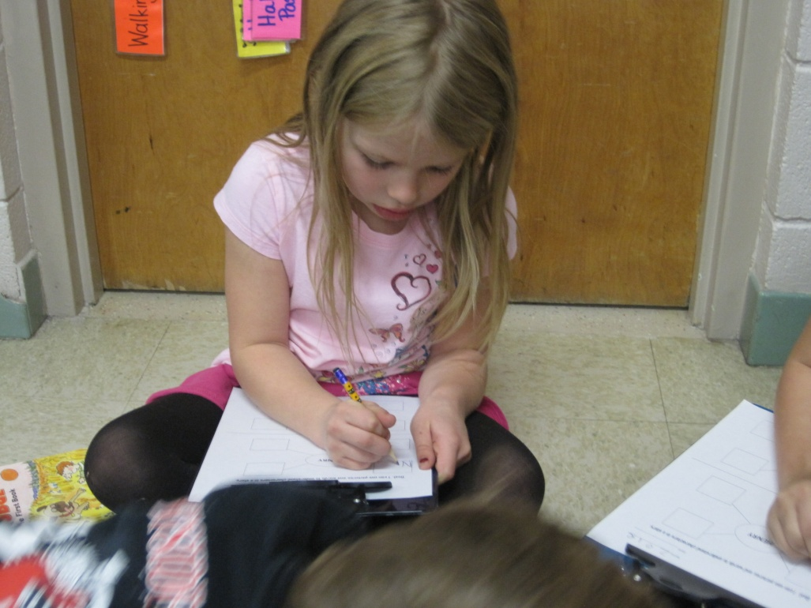
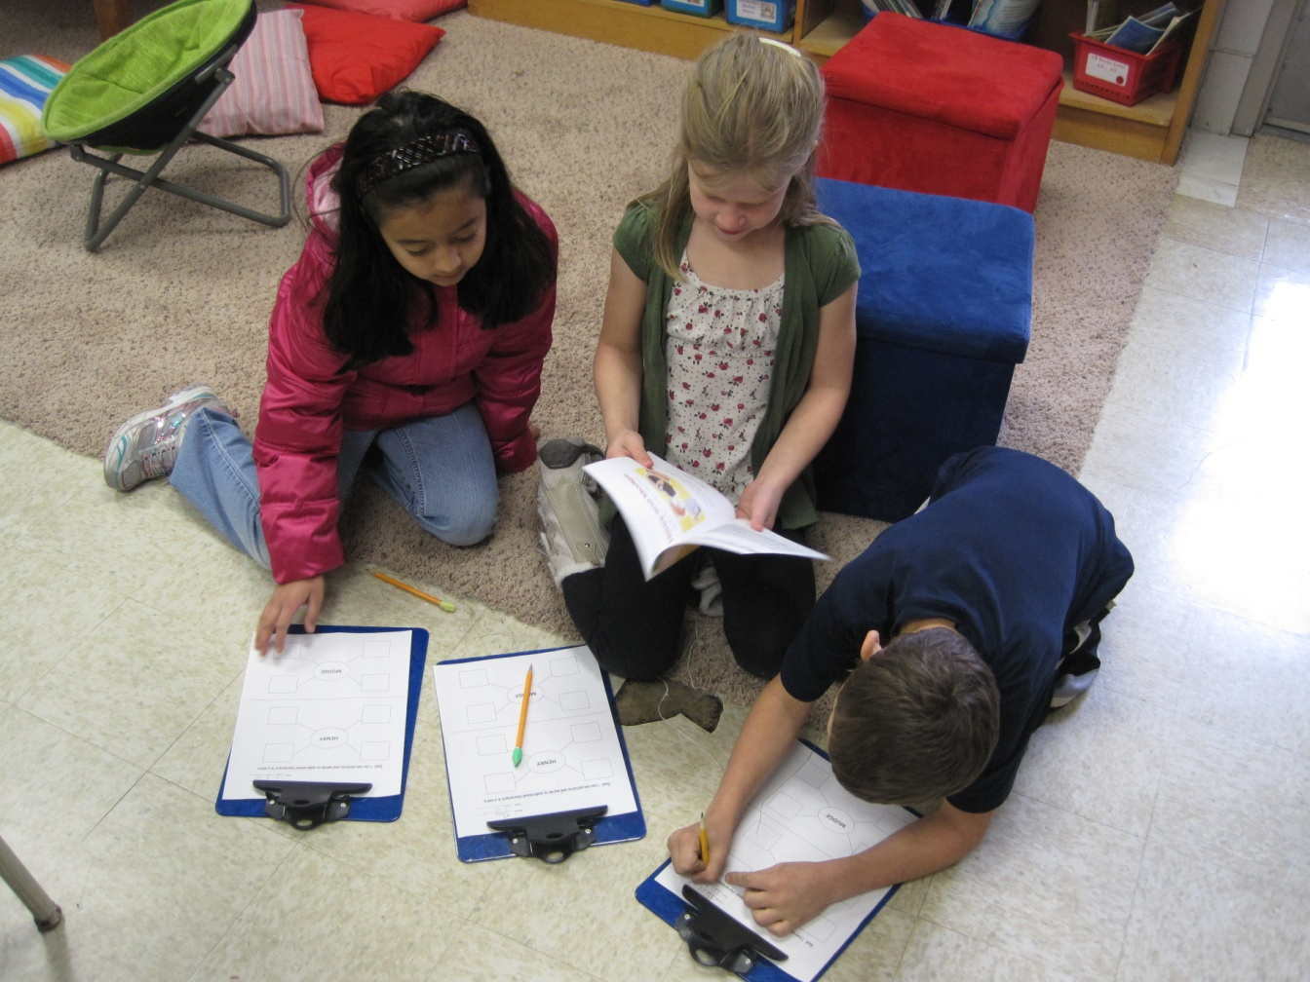
(7) Cooperative Learning
(5) Homework and Practice

Slide 11
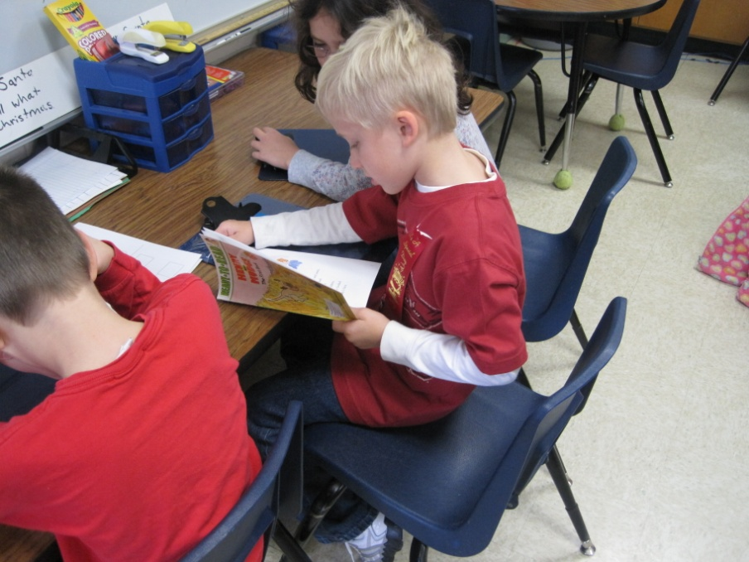
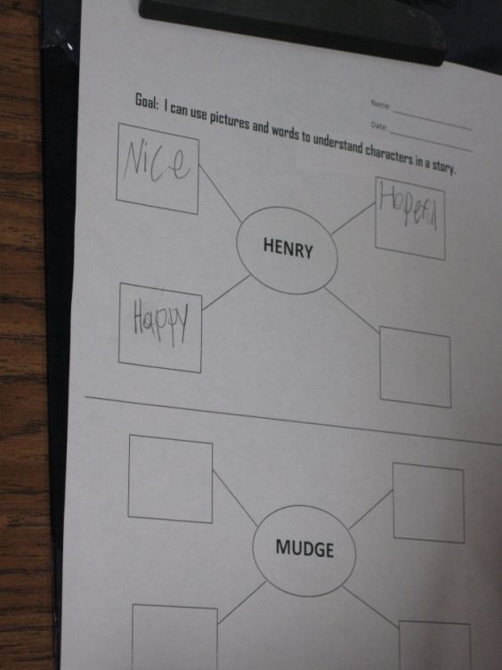
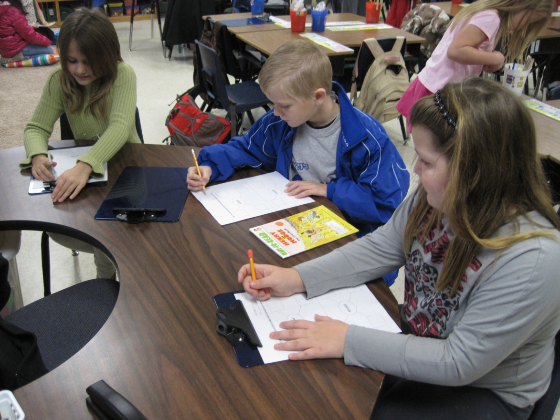
(7) Cooperative Learning
(5) Homework and Practice

Slide 12
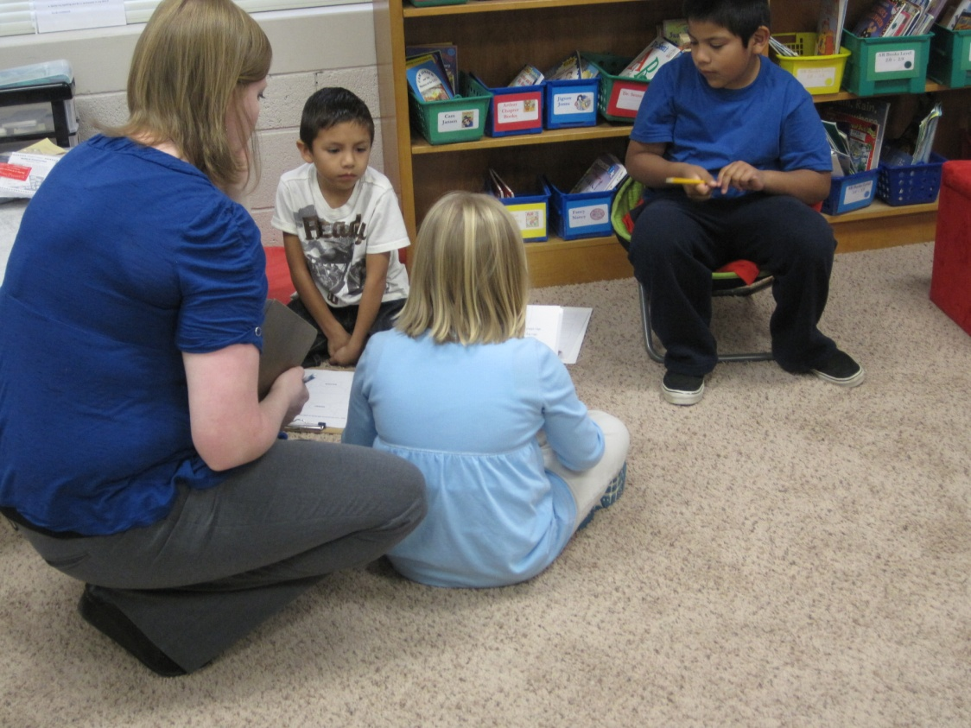
(4) Reinforcing Effort and Providing Recognition

Slide 13
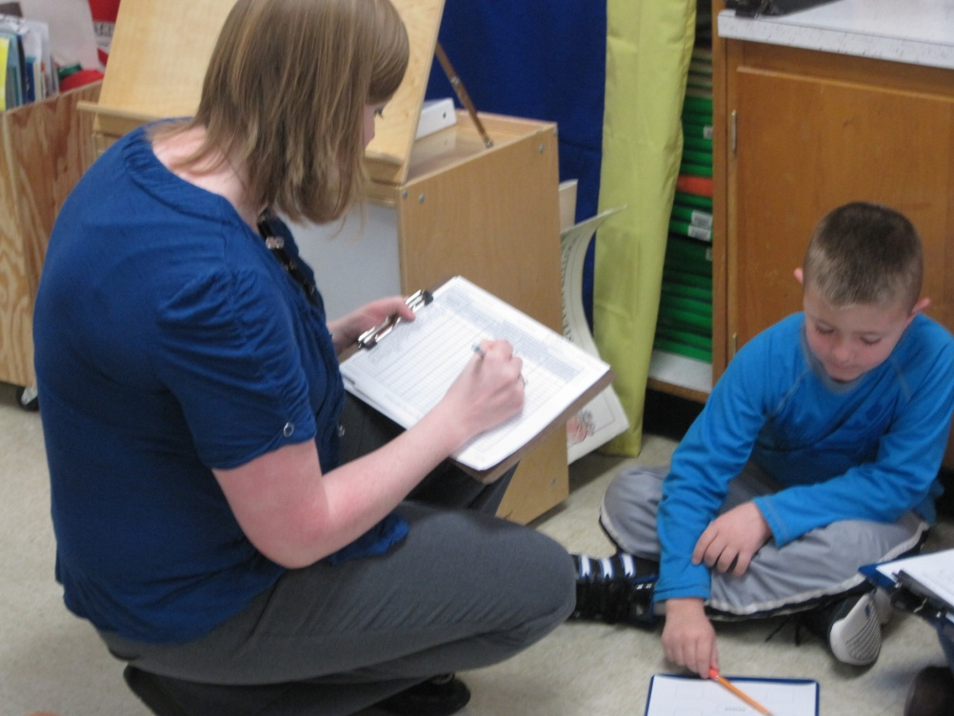
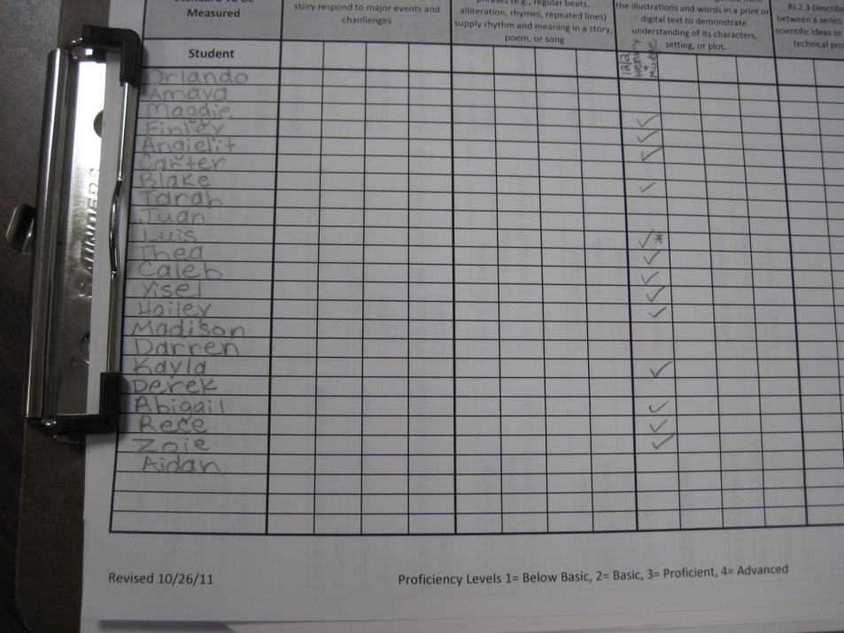
Scoring to the Standards

Slide 14
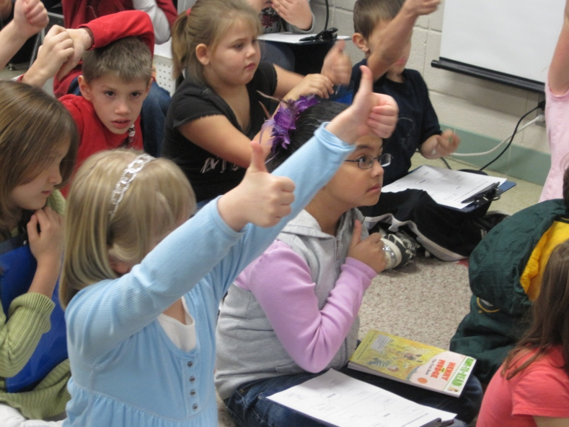
Generalize the Goal:
Revisit the Goal – Score Yourself Again
(8) Setting Objectives and Providing Feedback

Slide 15
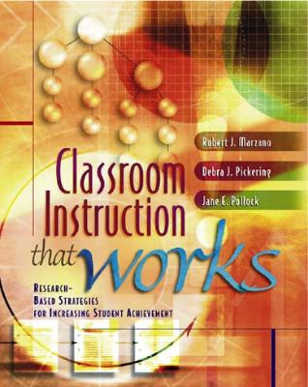
Marzano, R. J., Pickering, D. J., & Pollock, J. E. (2001). Classroom instruction that works: Research-based strategies for increasing student achievement. Alexandria, VA: Association for Supervision and Curriculum Development.
Pollock, J. E. (2007). Improving student learning one teacher at a time. Alexandria, VA: Association for Supervision and Curriculum Development.
Pollock, J. E., & Ford, Sharon M. (2009). Improving student learning one principal at a time. Alexandria, VA: Association for Supervision and Curriculum Development.

