Slide 1
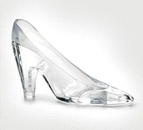
Around the World with a Glass Slipper
First Grade Unit 6
Planning Team
Amy Johnson, Anne Saullo, Mandy Oyler, Kristy Brown, Barbara Jackson, and intern Chelsea Albright
Notes:
Always keep in mind this is one team’s interpretation of the standards and how to use the texts and resources from our district. The team that worked together to plan unit 6 was made up of 1st grade teachers: Amy, Mandy, Barbara, Chelsea (intern) and literacy facilitators: Anne and Kristy.

Slide 2
Notes:
We followed this guideline to plan the this unit. We first looked at the essential question in the CAT book and decided to use a broader essential question to better fit the standards.
Then we clarified some common misconceptions with a few standards. After dividing the books throughout the unit we then distributed the standards over 6 weeks. We created several assessments to use throughout the unit and developed a plan for a culminating activity for the last 2 weeks. Finally, we planned daily lessons and linked several opportunities to incorporate technology.

Slide 3
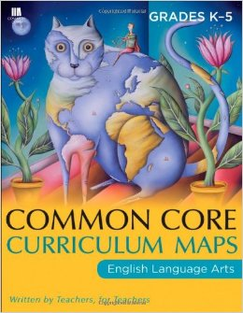
Around the World
with a Glass Slipper
Essential Question
How do words and illustrations help us understand different cultures?
Notes:
We decided to change the essential question:
FROM “What can versions of the same story teach us about different cultures?”
TO “How do words and illustrations help us understand different cultures?”
We felt like our new essential question could be integrated into our unit as we study different cultures.

Slide 4
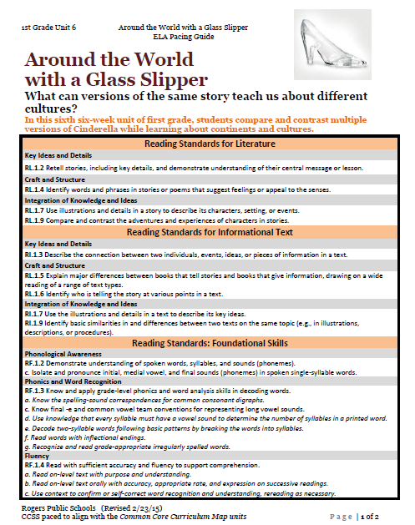
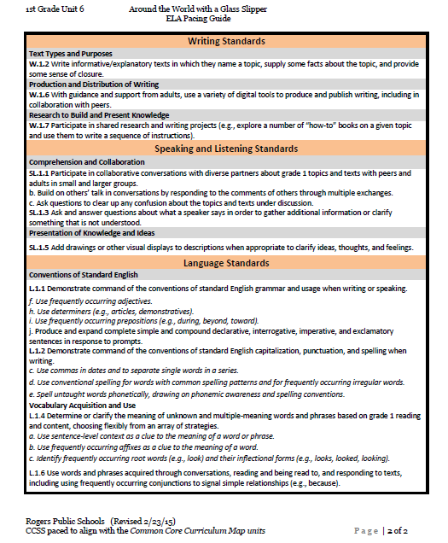
Notes:
Many of the standards we included in this unit have already been explicitly taught during your year. This unit will be an opportunity to assess many of these standards.

Slide 5
A Deeper Look Into the Literature Standards
RL.1.3
RL.1.7
ANALYZE:
Describe character actions, identify the setting, identify what
problem is causing the character’s behavior to change.
*surface level knowledge*
EVALUATE:
How words and illustra-
tions connect
What role do the words play
in describing the characters?
-How do the details and illustra-
tions help me understand?
INTEGRATE:
Here are the key details and how does this help me understand the text. (Take what you know about characters and the illustrations and now ANALYZE what I know from the details.
characters
setting
key details
EXAMPLE: describe the character and provide words from text that describe
EXAMPLE: copy a page of text, have students highlight the details
–OR- Have students mark similarities b/t text
and illustrations
Notes:
Next, we clarified some standards. You will notice a focus around 2 standards during this unit. We broke down RL.1.7 and RI.1.7 to clarify common misconceptions. The key understanding for the literature standards is that RL1.3 is more surface level knowledge about the story whereas, RL1.7 places the focus on the illustrations and how they relate to the words. We made several organizers to help facilitate the transition from 1.3 to 1.7.

Slide 6
A Deeper Look Into the Informational Standards
RI.1.3
RI.1.7
ANALYZE:
EVALUATE AND
INTEGRATE
PICTURES ONLY
What key details do the
illustrations provide that the
words DON’T?
What types of details can the
author describe better in illustra-
tions.
*A picture is worth a thousand
words.
Connection b/t individuals and events within ONE text
How is the text organized? Focus on 1 feature.
How does the title/illustrations/bolded words…. help me understand the book?
text features
analyzing illustrations
EXAMPLE: Copy table of contents- ask questions like… “what information can you find on pg….”
EXAMPLE: MAPS: Tell me more about what you know from the illustrations. Use pictures to tell me more about the topic
Notes:
Similar to the literature standards RI.1.3 is focused on analyzing aspects of the text such as text features. RI.1.7 is all about the illustrations and how they provide information to the reader that words do not.

Slide 7
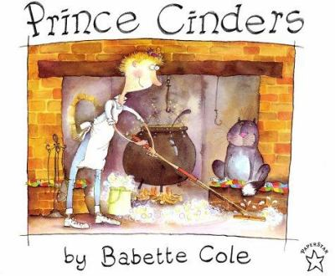
New Texts
Notes:
We requested 2 new text. We felt like we needed another Cinderella story to help hook some of the boys. Prince Cinders is a humorous story about a boy who finds love. We also requested Look What Came From Mexico to help us study Mexican culture and connect it to some Cinderella stories.

Slide 8
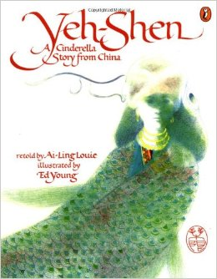
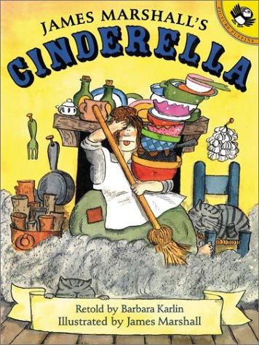
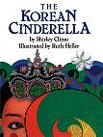
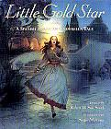
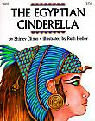
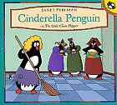
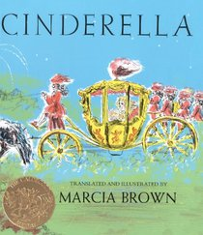
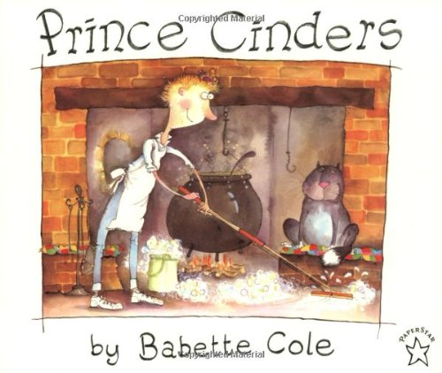
Poem
“Star Light, Star Bright”
1st Grade
Print Resources
Unit 6
Literature
Read Aloud

Slide 9
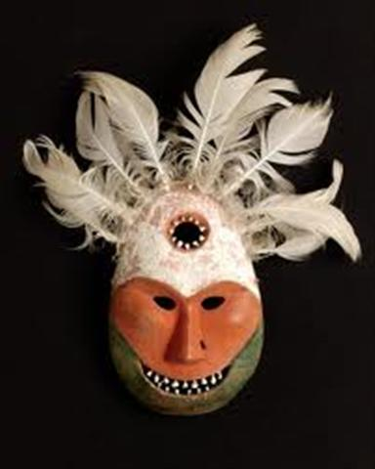
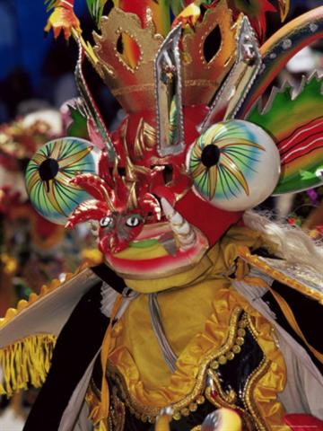
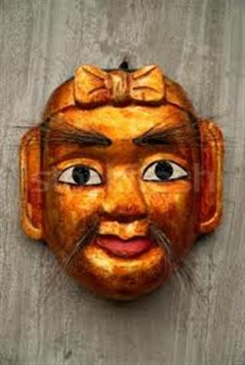
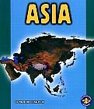
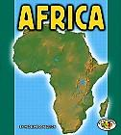
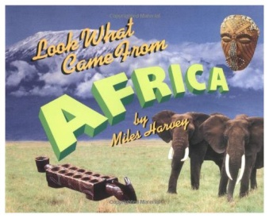
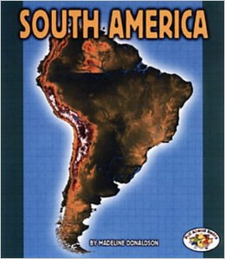
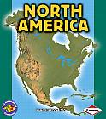
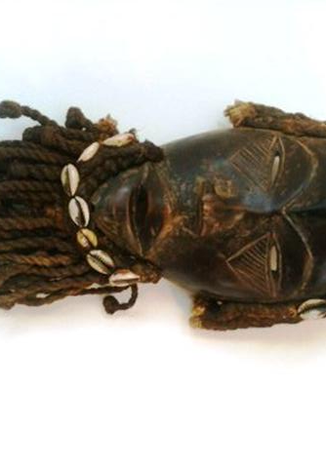
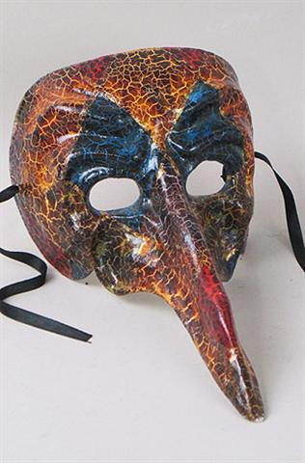
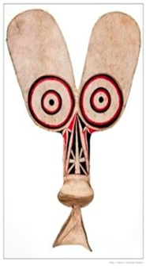
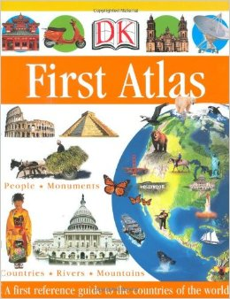
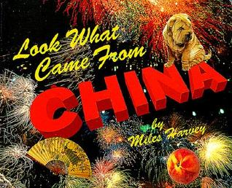
Informational Text
Art
Read Aloud
Shaman’s Mask
Devil Dance Mask
Captain Scaramouche
Asian Puppet Mask
Australian Display Mask
African Mask

Slide 10
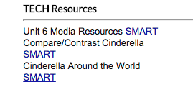
Fluency Practice ☺
-Readers Theater
-Cinderella Poems
-Continent Poems
*all linked*
Cinderella:
Prince Cinders- Youtube (movie)
Prince Cinders- Youtube (eBook)
Cinderella Penguin- Youtube (eBook)
Yeh Shen- Youtube (movie)
James Marshall's Cinderella- Learn360 (movie)
Draw Me a Story: Cinderella- Learn360
Mufaro's Beautiful Daughters- Reading Rainbow- Learn360 (eBook)
Continents:
Teacher Created Resources has several great links!
Notes:
We did not include these resources in the Unit plan but wanted to let everyone know about all the online resources. There are several movie versions of the Cinderella stories on Youtube and Learn360. There is also a great Smartboard already linked to Teacher Created Resources that has great videos organized by country. Check it out if you haven’t already!

Slide 11
Week | Standards | Texts | Suggested Activities
1 | RL.1.2 Retell stories, including key details, and demonstrate understanding of their central message or lesson. RL.1.4 Identify words and phrases in stories or poems that suggest feelings or appeal to the senses. RL.1.7 Use illustrations and details in a story to describe its characters, setting, or events. RL.1.9 Compare and contrast the adventures and experiences of characters in stories. L.1.1. f. Use frequently occurring adjectives. (ex magnificent golden horse, six white mice,…. James Marshal) L.1.1.g. Use frequently occurring conjunctions (e.g., and, but, or, so, because). *All 3 books are available online. Prince Cinders- Youtube (movie version) Prince Cinders- Youtube (eBook version) Cinderella Penguin- Youtube James Marshall's Cinderella- Learn360 | New Text ☺ | *Introduce EQ * Tell kids that we will be comparing the stories we read to learn more about how words and illustrations help us learn more about different culture. Day 1: RL.1.7- Prince Cinders- Talk about the different information provided by the illustrations vs. the words. *Organizer linked Day 2: RL.1.4- Cinderella Penguin-Identify feel words throughout book. *Organizer linked Day 3: RL.1.2- Cinderella- discuss how characters change throughout the story. Talk about how the problem and resolution helps change the character. *Organizer linked Day 4: Text Talk & L.1.1.f- Review favorite book. Use highlighter tape to mark adjectives Day 5: RL.1.9: Compare all 3 books using matrix. This standard is repeated for several weeks. Each time the matrix gets a little more difficult. *Organizer linked
Text Talk
Text Talk
Notes:
We thought it would be helpful to provide you a sample scope and sequence for each week. We paired the standards with certain books and provide a glimpse of what the lesson could look like. For week 1 we started with some funny Cinderella stories to hook the students. This is a good time to introduce the essential question and to tell kids that we will be comparing the stories we read to learn more about how words and illustrations help us learn more about different culture. The essential question will mean more to students as we start studying different countries and Cinderella stories from that region.

Slide 12
Week | Standards | Texts | Suggested Activity
2 | RL.1.7 Use illustrations and details in a story to describe its characters, setting, or events. “How do the illustrations tell me more?” RL.1.9: Compare and contrast the adventures and experiences of characters in stories. RI.1.7: Use the illustrations and details in a text to describe its key ideas. W.1.6: With guidance and support from adults, use a variety of digital tools to produce and publish writing, including in collaboration with peers. L.1.1. f. Use frequently occurring adjectives. (Lots of them in Cinderella Books!) L.1.1.g. Use frequently occurring conjunctions (e.g., and, but, or, so, because). (Yeh Shen) |  | *Introduce the 2 Cinderella from Asia. Connect to the stories read last week. Tell students we will be reading new stories from Asia. Day 1: RI.1.7- Look What Came From China- Key questions to ask while reading- “What details do the illustrations provide that the words do not?” “How do the words describe key details on this page?” *Organizer Linked Day 2: RI.1.2 & W.1.6- Asia- Take notes while reading. After reading about Asia- model how to color code facts that go together. *note taking Day 3: RL.1.7 - The Korean Cinderella : *long book*. Key point “How do the illustrations tell me more?” We suggest writing in response to the story since the book is so long. This standard is assessed at other times in the unit. Day 4: RL.1.7 & L.1.1.g- Yeh-Shen *long book* same as the previous door. (Talk about frequently occurring conjunctions) Day 5: RL.1.9- Compare both books. A matrix and a double bubble are linked. *Organizer Linked
Text Talk
Text Talk
***First Atlas “We are going to learn about Cinderella stories from around the World” Introduce Atlas briefly, show students the gist of how it works and how much information it provides. Do not go into details.
Notes:
We decided to start each week by learning about the country or continent of focus then read the corresponding Cinderella story. You will notice this pattern repeating itself throughout most of the unit. Both of the Cinderella stories for this week are pretty long. We talked about how in the past we would spend 2 days on each of these books. After mapping out the unit we realized there isn’t enough time for that. So we decided to just model how to use the illustrations to tell the story while reading and for students to write in response to the story. Then on day 5 the students will compare and contrast the 2 stories. There will be other opportunities to assess RL.1.7. As for writing, we were talking about interactive writing for this week. The teacher will model how to take notes and show students how to take notes and transform them into writing. Then you can type it out, attach a picture. You will basically be taking the students through the writing and publishing process.

Slide 13
Week | Standards | Texts | Suggested Activity
3 | RI.1.6 Distinguish between information provided by pictures or other illustrations and information provided by the words in a text. “How do I know?” “Where did I get the information from?” RL.1.7 Use illustrations and details in a story to describe its characters, setting, or events. “How do the illustrations tell me more?” RI.1.7 Use the illustrations and details in a text to describe its key ideas. “How do the illustrations tell me more?” RL.1.9 Compare and contrast the adventures and experiences of characters in stories. compare Cinderella stories RI. 1.9 Identify basic similarities in and differences between two texts on the same topic (e.g., in illustrations, descriptions, or procedures). compare continents W.1.2 informative **comparison matrix and sentence frames L.1.1. f. Use frequently occurring adjectives. (Lots of them in Cinderella Books!) L.1.1.g. Use frequently occurring conjunctions (e.g., and, but, or, so, because). | New Text ☺ | Day 1: RI.1.7: Look What Came From Mexico- Key questions to ask while reading- “What details do the illustrations provide that the words do not?” “How do the words describe key details on this page?” *Organizer Linked Day 2: RI.1.6- South America- Add to organizer to RI.1.9 (finish on Day 3) **Students will identify where they find information (pictures/ words) on a page copies from text *Organizer Linked Day 3: RI.1.9- North America- After completing organizer have students identify similarities and differences. Then they will respond to the prompt (W.1.2) *Organizer Linked Day 4: RL.1.7-The Rough-Face Girl- Talk about illustration “How do the illustrations tell me more about the character, setting, or events?” *Organizer Linked Day 5: RL.1.9-Little Gold Star- After reading both stories have students identify similarities then complete comparison matrix *Organizer Linked
Text Talk
Notes:
Week 3 begins with RI.1.7. After looking through all the book we thought the Look What Came From… books provided a great opportunity to talk about the details the illustrations provide that the words do not. Day 2 & day 3 will use the same organizer to take notes on North and South America. On day 2 the main focus is on RI.1.6, identifying where you find information (pictures or words). On day 3 students will complete the organizer then write about similarities and differences. On day 4 & 5 we shift back to literature. We talked about starting with RL.1.7 and use the illustrations in The Rough-Faced Girl to talk about how the illustrations tell me more about the character, setting, and main events. On day 5 the students will identify similarities and differences in the 2 stories.

Slide 14
Week | Standards | Texts | Suggested Activity
4 | L.1.1. f. Use frequently occurring adjectives. (Lots of them in Cinderella Books!) RL.1.2: Retell stories, including key details, and demonstrate understanding of their central message or lesson. RL.1.7 Use illustrations and details in a story to describe its characters, setting, or events. “How do the illustrations tell me more?” RI.1.3 Describe the connection between two individuals, events, ideas, or pieces of information in a text. RI.1.7 Use the illustrations and details in a text to describe its key ideas. “How do the illustrations tell me more?” (wk4) W1.2 Write informative/explanatory texts in which they name a topic, supply some facts about the topic, and provide some sense of closure. **Writing comes from text dependent questions. **Mentor Text- Use the little books for mentor introductory and conclusion sentences. |  | Week 4: Day 1: RI.1.3- Look What Came from Africa- While reading talk about how pieces of information connects (food is to culture…) “How does the information in each section relate to the section title and the main topic of the whole text?” *note taking Day 2: RI.1.7-Africa- Key questions to ask while reading- “What details do the illustrations provide that the words do not?” “How do the words describe key details on this page?” *Organizer Linked Day 3: RI.1.3- Look What Came from Egypt- While reading talk about how pieces of information connects (food is to culture…) “How does the information in each section relate to the section title and the main topic of the whole text?” *note taking Day 4: RL.1.2- The Egyptian Cinderella - discuss how characters change throughout the story. Talk about how the problem and resolution helps change the character. *organizer linked Day 5: RL.1.2- Mufaro’s Beautiful Daughters (same as previous day) *organizer linked
Text Talk
Notes:
Once again we are focusing on RI.1.3 and R1.7 so the focus is, how do text features help us better understand what we are reading and how do the illustrations tell me more. Since these standards repeat themselves we thought it would be nice to gradually release how much scaffolding we provide. This week would be a good time to expect the students to guide the discussion while you read the books. The key understanding for RI.1.3 on day 1& day 3 is that you are showing students how information in each section relate to the section title and the main topic of the whole text. Students can take notes and model how to color code information to the corresponding title/ main topic so they can see how it all fits together. On day 2 we are focusing on RI.1.7 again. This is the 3rd week in a row for this standard and the next 2 weeks we are changing gears a bit so, use the organizer as an assessment this week. For day 4 & day 5 the students will be retelling again. They have been doing this all year. We talked about having the students retell while focusing on how Cinderella changed throughout the story, the problem and resolution.

Slide 15
Week | Standards | Texts | Suggested Activity
5 and 6 | RL.1.7 Use illustrations and details in a story to describe its characters, setting, or events. “How do the illustrations tell me more?” W.1.6: With guidance and support from adults, use a variety of digital tools to produce and publish writing, including in collaboration with peers. W.1.7: Participate in shared research and writing projects RI.1.5 Know and use various text features (e.g., headings, tables of contents, glossaries, electronic menus, icons) to locate key facts or information in a text. L.1.1. f. Use frequently occurring adjectives. (Lots of them in Cinderella Books!) | Continent Research **Look What Came From…..** -Table of Contents: Food, Art, Fashion, and musical instruments **Use District Art Pieces** *** Borrow Kindergarten Unit 5 books for more resources *** | Week 5: -Day 1: RL.1.7 - Review Cinderella stories from unit. Read last book. Give summative assessment *Assessment Linked -Day 2-5: Shared Research Week 6: Shared Research Project W.1.6, W.1.7, R.1.5 -Group students and decide which continents you would like your students to research. -Students will use the CCSS books, notebooks, CCSS art work and masks from around the world. -They are to use a graphic organizer to gather information then present their project. They will also write an informative chapter book on their topic. -Students can…. -create/use CCSS mask for their continent -draw pictures/ use internet - use maps -make a poster -use text feature *then students will write a mini book *Organizer Linked *Mini Book Linked
Text Talk
summative assessment
Notes:
We end this unit and the school year with a shared research project. Before we jump into the research project the students we have 1 more Cinderella story to read. We talked about using the last book as a summative assessment for RL.1.7. Week 5 and 6- The students will work in small groups to study the continents or countries, take notes, write informatively, then create a visual aid to share with the class. We talked about borrowing Kindergarten Unit 5 books to provide more resources for your kids to get their hands on. Now is the time for students to use the essential question, illustrations and words to help others understand about different cultures.

Slide 16
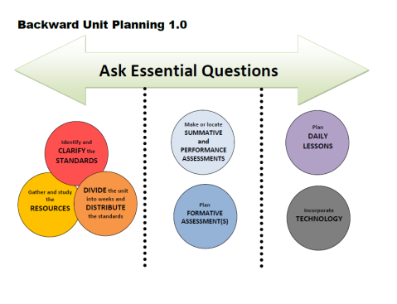
Week | Standards | Essential Questions
1 |  | EQ: How do words and illustrations help us understand different cultures? *Introduce EQ to give kids an idea about what will be happening. * Tell kids that we will be comparing the stories we read to learn more about how
2 |  | Continue to touch on EQ throughout the unit. Discuss connections between cultural aspects from story books and informational books.
3
4
5
6 |  | This is the time for children to come back and write in response to the essential question. At this time the EQ has been addressed several times during the unit.

Slide 17
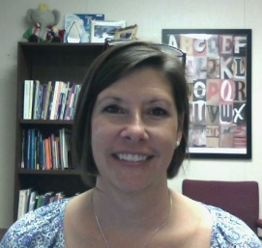
RESOURCES
Susan Hensley
Elementary Curriculum Specialist
shensley@rps.k12.ar.us

