Slide 1
1st Grade Text Talk
Unit 6

Slide 2
I can use words I learn from a text.
Notes:
Goal-
Students need to engage with the goal- read it, repeat it, write it, etc.

Slide 3
Tell your partner about a new word you learned last week.
Notes:
Access Prior Knowledge- (APK)
Turn and Talk

Slide 4
Notes:
New Information-
Read the book- provide a brief explanation of any words that may be new or unfamiliar to the students.

Slide 5
crafty
Notes:
Contextualize the word- Find it in the text
Say the word together

Slide 6
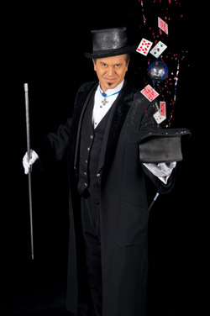
crafty
Good at tricking people
Notes:
Give student friendly definition
Use the word in other contexts

Slide 7
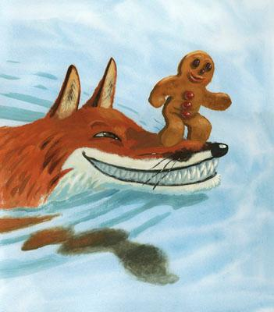
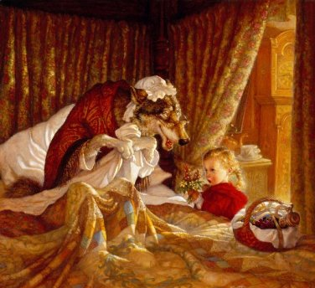
How are these characters crafty?
The Fox
The Wolf
Notes:
Engage the students with the word

Slide 8
filthy
Notes:
Contextualize the word- Find it in the text
Say the word together

Slide 9
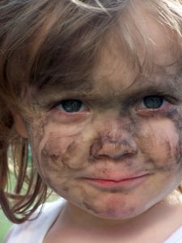
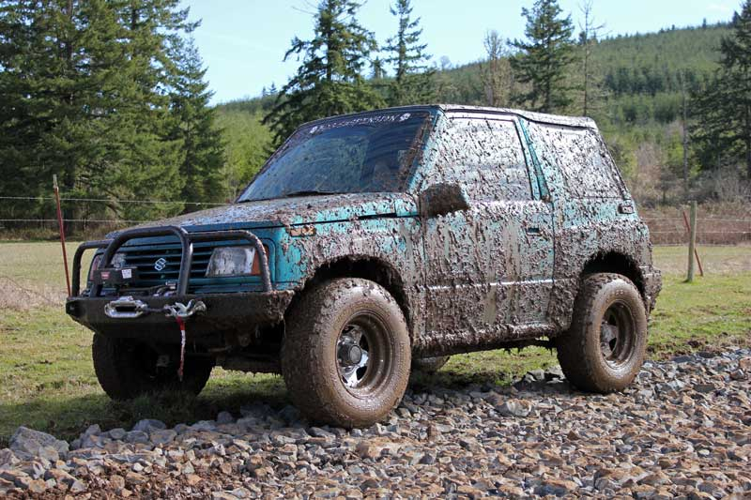
filthy
dirty
Notes:
Give student friendly definition
Use the word in other contexts

Slide 10
Thumbs up if this is an example of filthy.
Thumbs down if not.
The children played in the mud puddle. Their faces and clothes were covered with mud!
The men worked all day and all night in the coal mines. When they returned home their clothes were black from coal and it was hard to see their faces.
The children, dressed in their finest new clothes, went to the party.
Notes:
Engage the students with the word

Slide 11
tattered
Notes:
Contextualize the word- Find it in the text
Say the word together

Slide 12
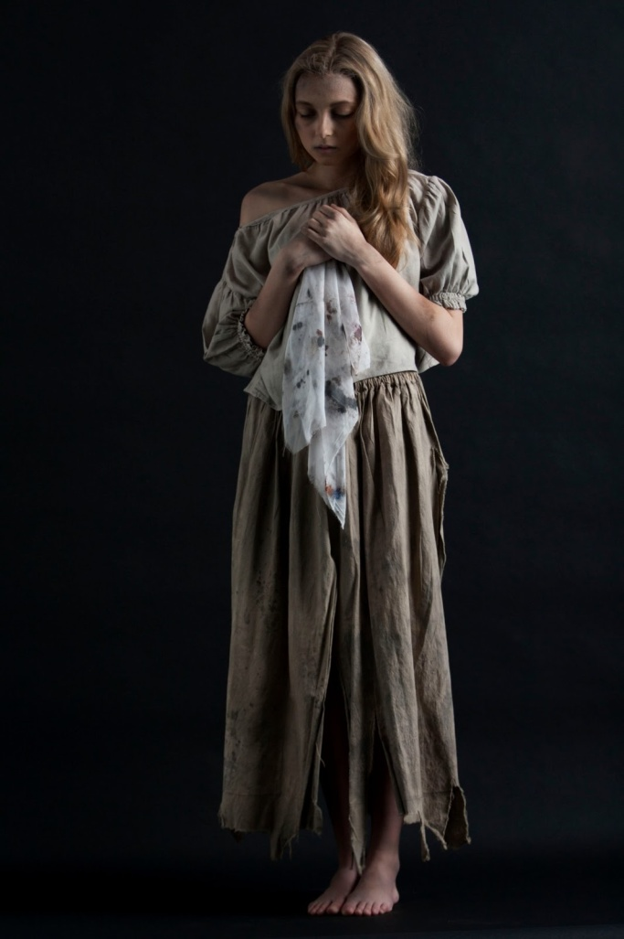
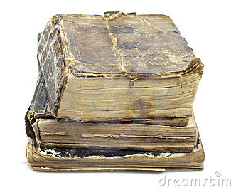
tattered
Torn in shreds or pieces
Notes:
Give student friendly definition
Use the word in other contexts

Slide 13
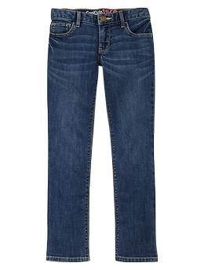
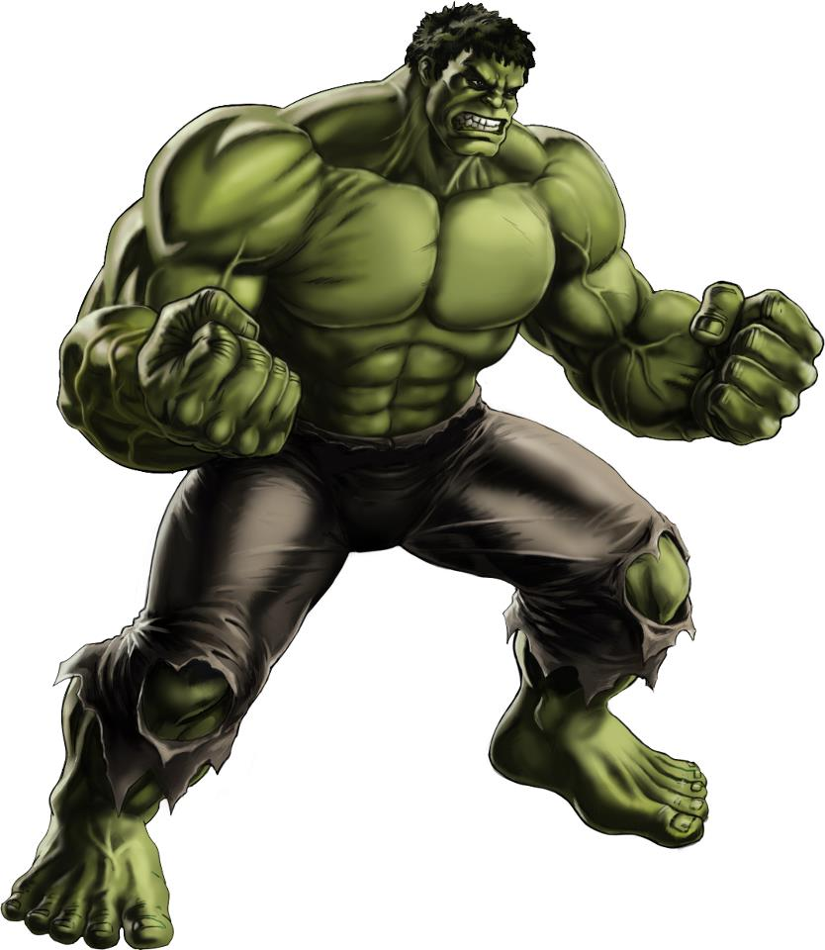
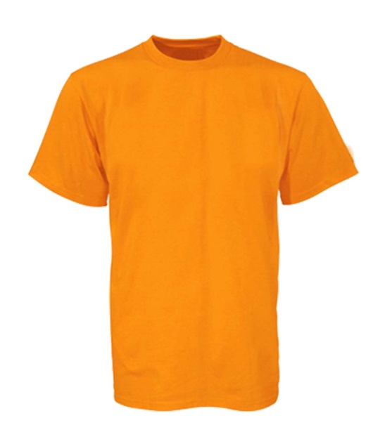
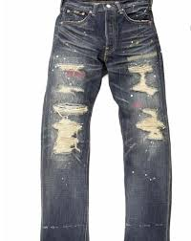
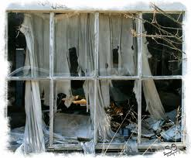
Which pictures show something tattered?
Notes:
Engage the students with the word

Slide 14
Who can use all 3 words in a sentence?
crafty
filthy
tattered
Notes:
Read all three words and see if you can use them in one sentence.

Slide 15
Draw a picture to show you know what these words mean.
crafty
filthy
tattered
Notes:
Application-
Students need an opportunity to use the words they just learned from the text.

Slide 16
I can use words I learn from a text.
Notes:
Goal-
Revisit the Goal

