Slide 1
1st Grade Text Talk
Unit 6

Slide 2
I can use words I learn from a text.
Notes:
Goal-
Students need to engage with the goal- read it, repeat it, write it, etc.

Slide 3
Tell your partner about a new word you learned last week.
Notes:
Access Prior Knowledge- (APK)
Turn and Talk

Slide 4
Notes:
New Information-
Read the book- provide a brief explanation of any words that may be new or unfamiliar to the students.

Slide 5
cozy
Notes:
Contextualize the word- Find it in the text
Say the word together

Slide 6
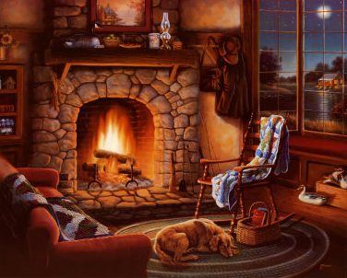
cozy
Warm, friendly, and comfortable
Notes:
Give student friendly definition
Use the word in other contexts

Slide 7
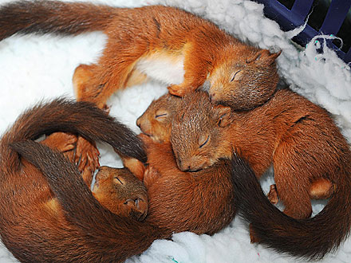
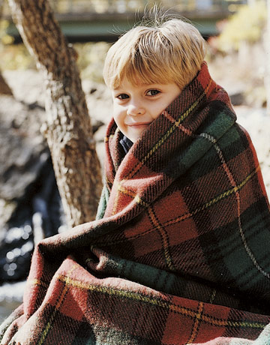
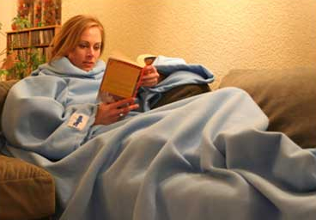
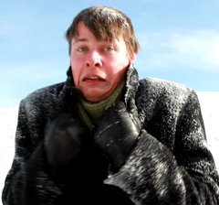
Which pictures illustrate cozy?
Notes:
Engage the students with the word

Slide 8
shabby
Notes:
Contextualize the word- Find it in the text
Say the word together

Slide 9
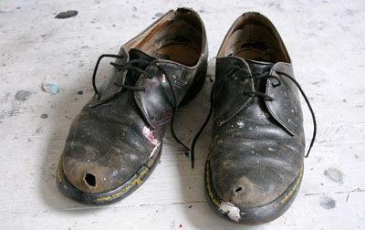
shabby
Old, worn out, and not clean
Notes:
Give student friendly definition
Use the word in other contexts

Slide 10
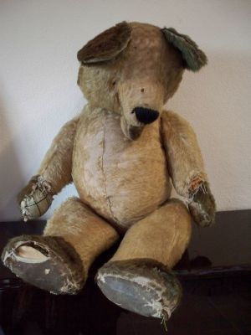
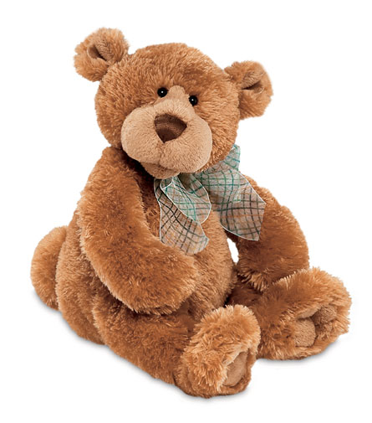
Which teddy bear is shabby?
Explain your thinking.
Notes:
Engage the students with the word

Slide 11
delicate
Notes:
Contextualize the word- Find it in the text
Say the word together

Slide 12
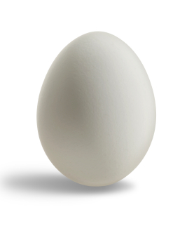
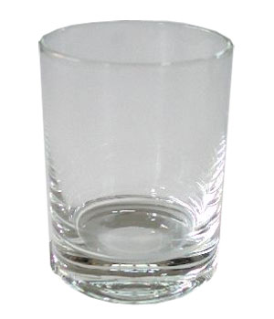
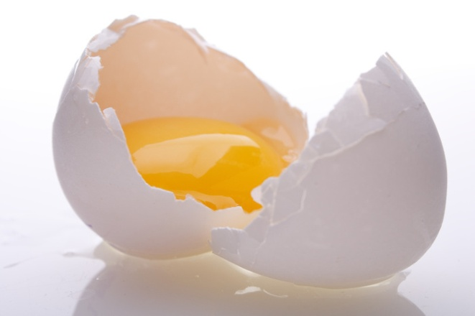
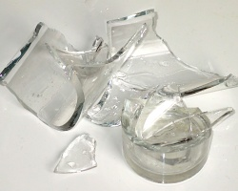
delicate
Easily broken
Notes:
Give student friendly definition
Use the word in other contexts

Slide 13
Thumbs up if this is something delicate.
Thumbs down if not.
Glass
Baseball
Rock
Mirror
Flower
Notes:
Engage the students with the word

Slide 14
Who can use all 3 words in a sentence?
cozy
shabby
delicate
Notes:
Read all three words and see if you can use them in one sentence.

Slide 15
Draw a picture to show you know what these words mean.
cozy
shabby
delicate
Notes:
Application-
Students need an opportunity to use the words they just learned from the text.

Slide 16
I can use words I learn from a text.
Notes:
Goal-
Revisit the Goal

