Slide 1
Retold through frozen pictures by Mrs. Kinney’s class.

Slide 2
We first collaborated about our Tableau and wrote our sentences.

Slide 3
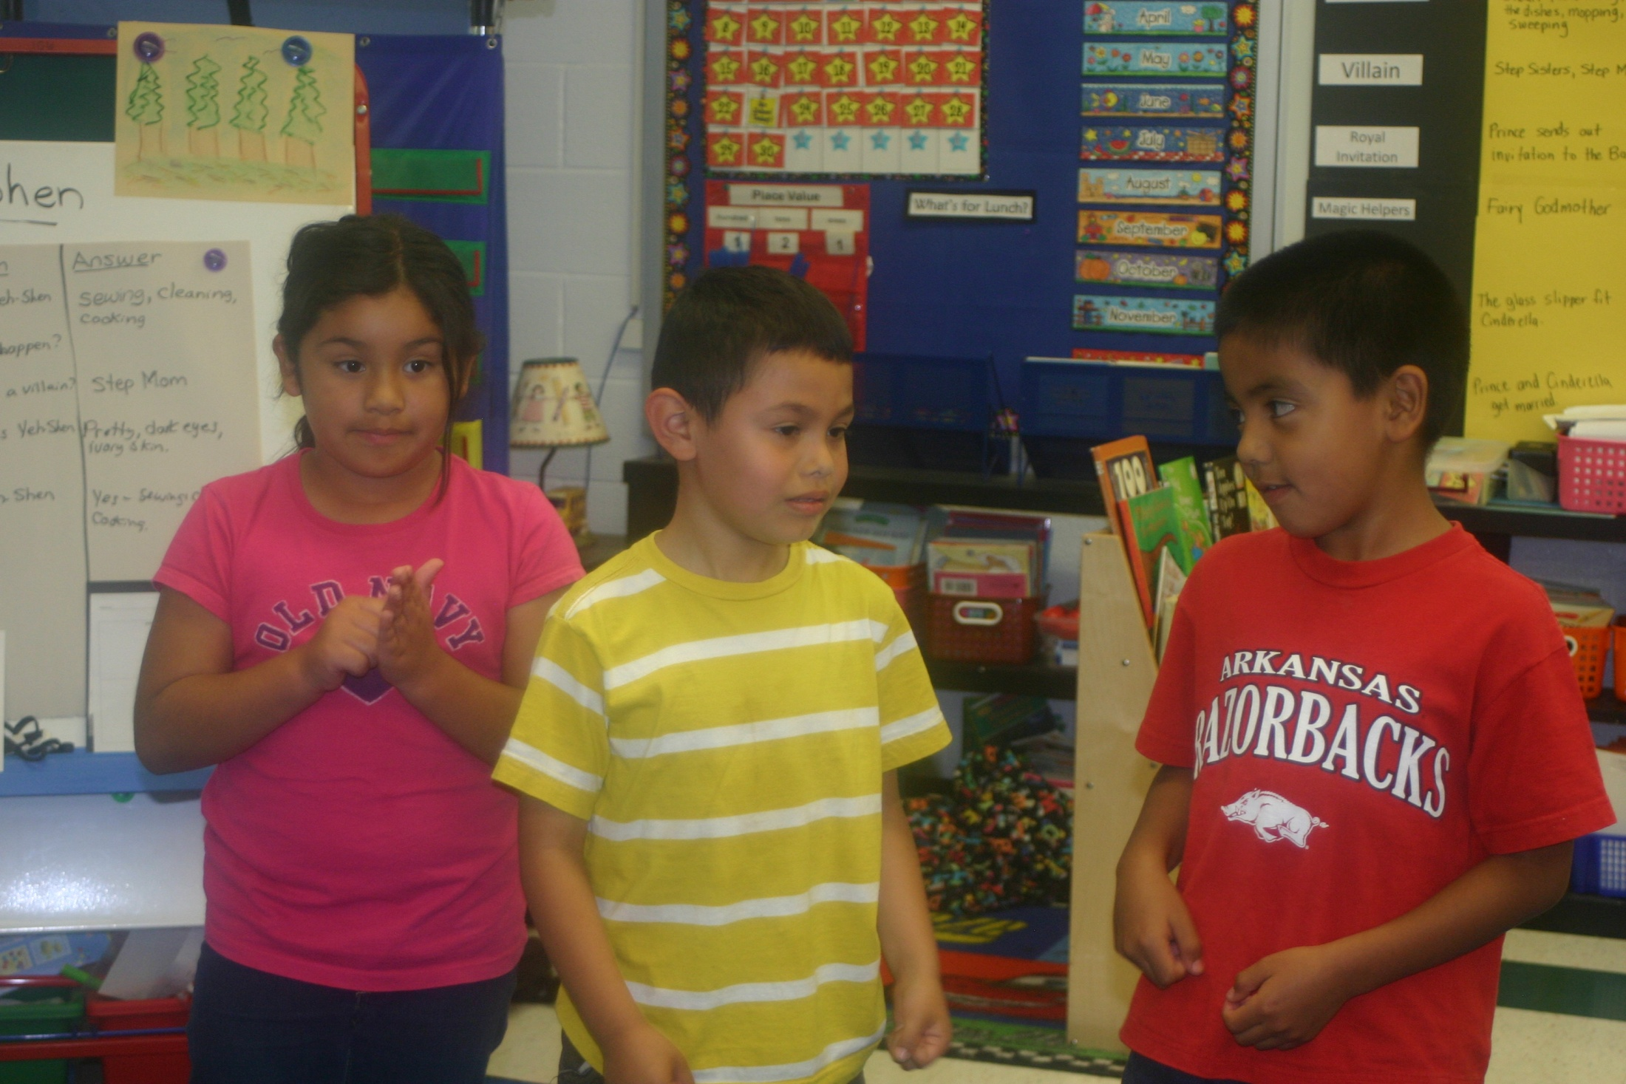
Yeh-Shen cooked, cleaned, washed dishes, and did all the sewing for her stepmother and stepsister.
Washing Dishes
Sweeping
Sewing

Slide 4
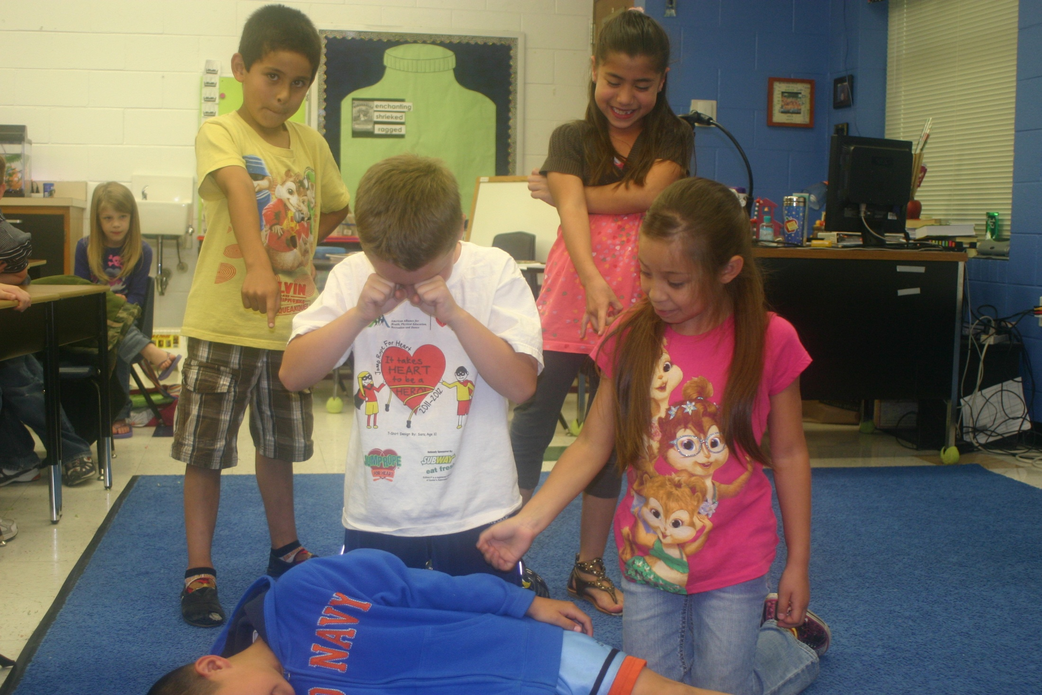
Yeh-Shen
The Stepmom killed
Yeh-Shen’s fish.
Yeh-Shen was so sad.
Step Mother
Stepsister
Magic Fish

Slide 5
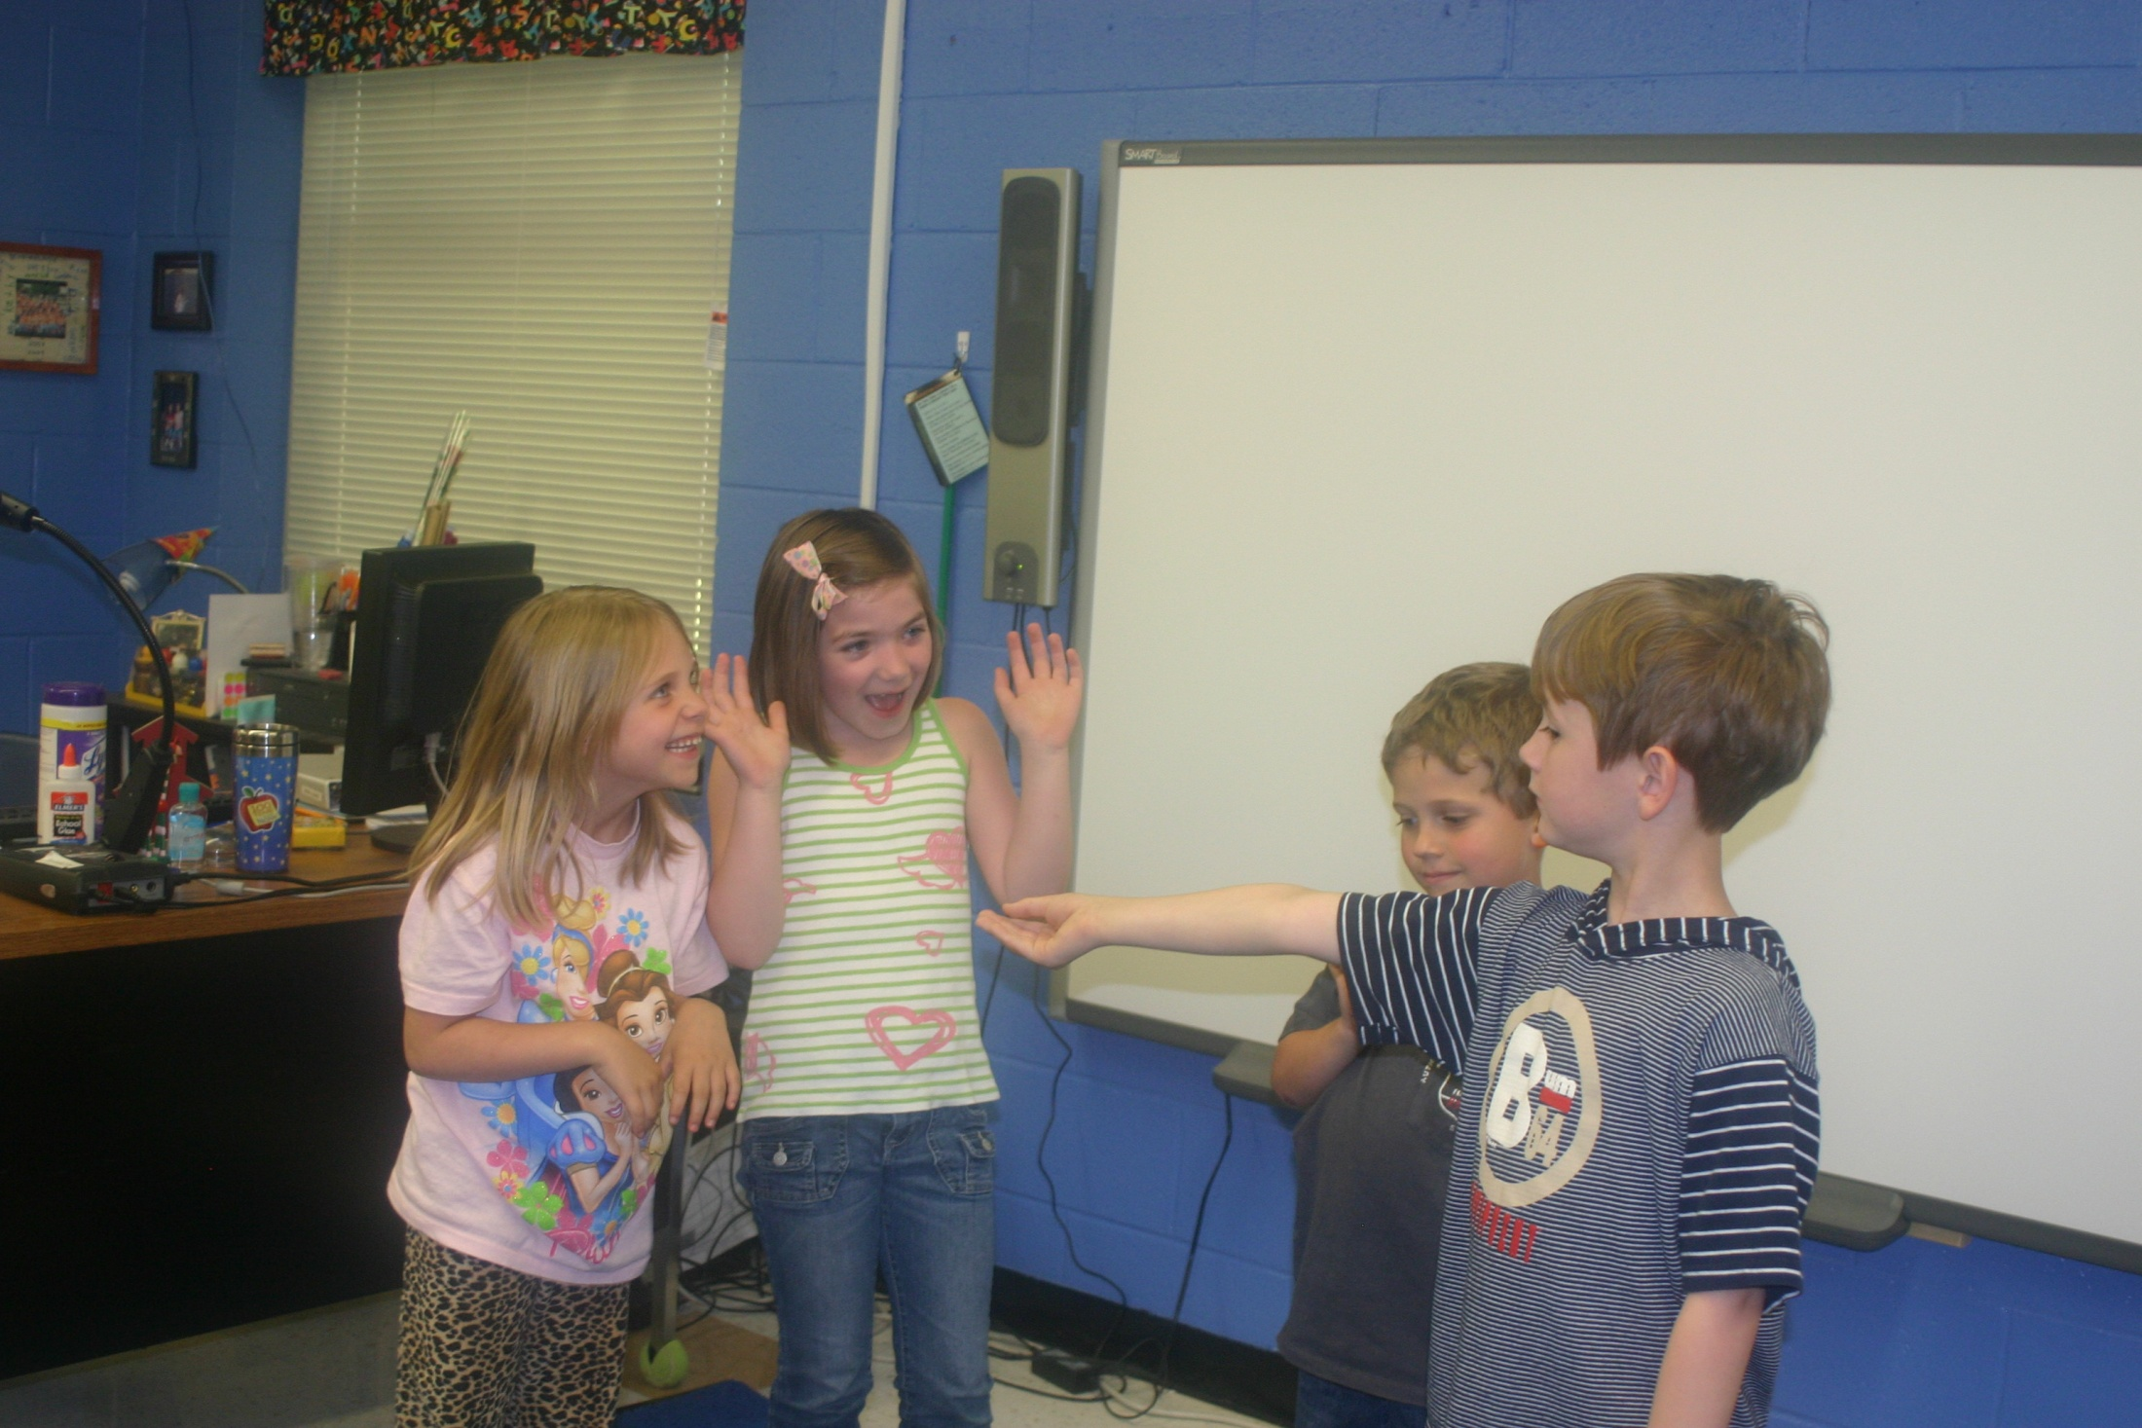
The King gave an invitation to the Step Mom and Stepsister. They got excited and screamed.
Invitation to the Festival
Step Sister
Step Mom
Musician

Slide 6
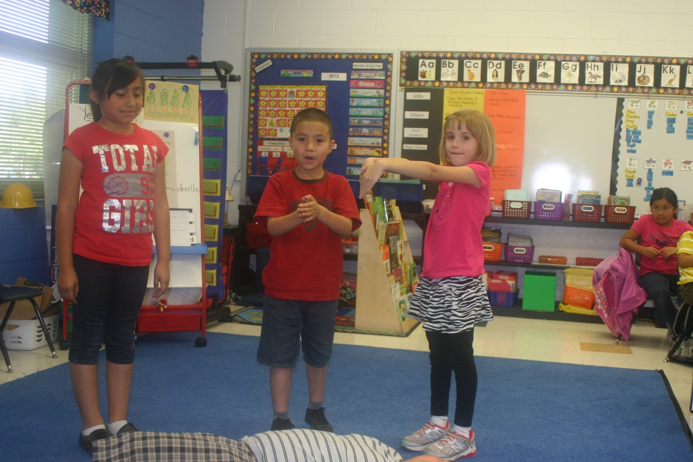
The magic helper was the Magic Fish and his bones.
Step Mom
Magic Fish
Water
Bones

Slide 7
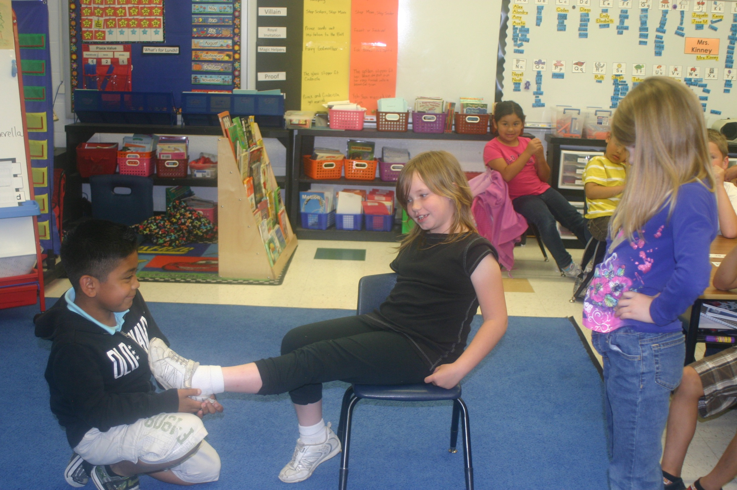
Everyone tried on the golden slipper but no ones foot fit the shoe, except for Yeh-Shen.
Stepmother
Yeh-Shen
The King

Slide 8
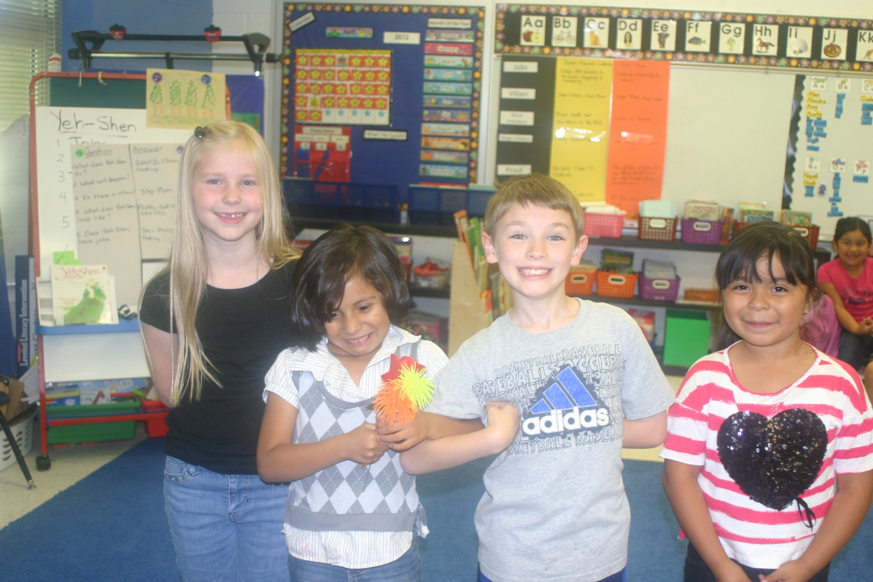
The King and Yeh-Shen get married and lived happily ever after. Yeh-Shen went to the Kingdom with the King.
Stepmother
The King
Yeh-Shen
Step Sister

