Slide 1
Retold through frozen pictures by Mrs. Felts’ class.

Slide 2
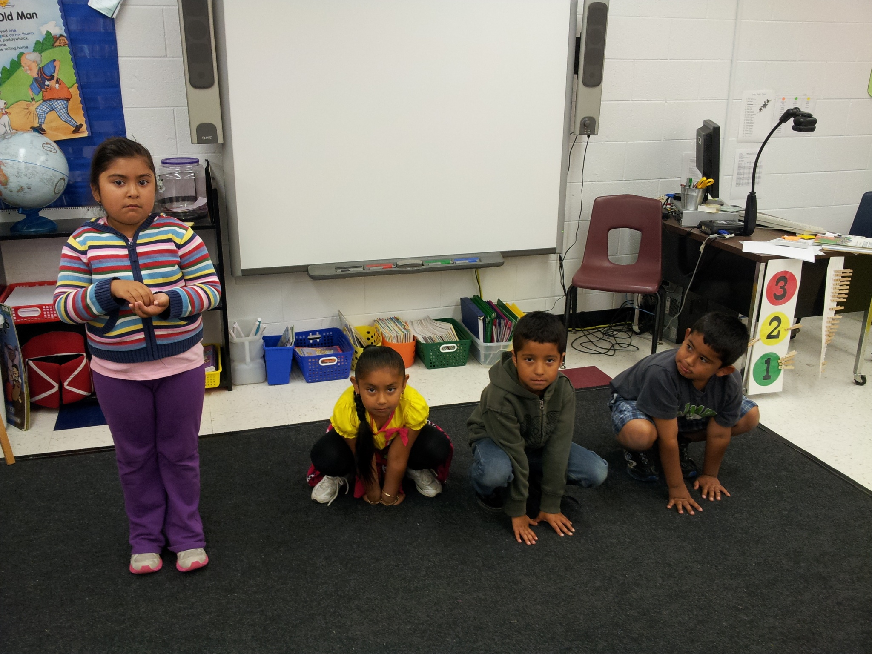
Pear Blossom cleaned and cooked. She had to lick spilled water off the floor. She had to clean and do chores.
Cricket
Cricket
Cricket
Pear Blossom

Slide 3
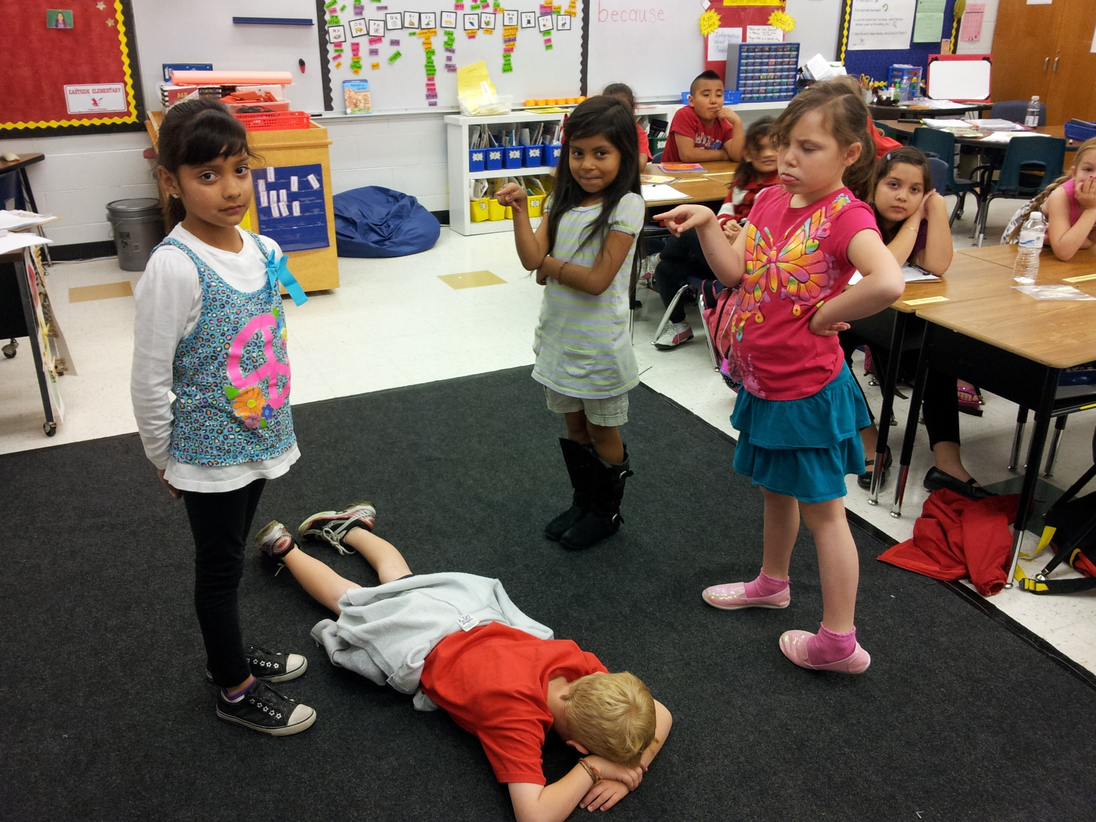
Stepmother
The stepmother and stepsister were mean to Pear Blossom. They made her do everything.
Pear Blossom
Stepsister
The floor

Slide 4
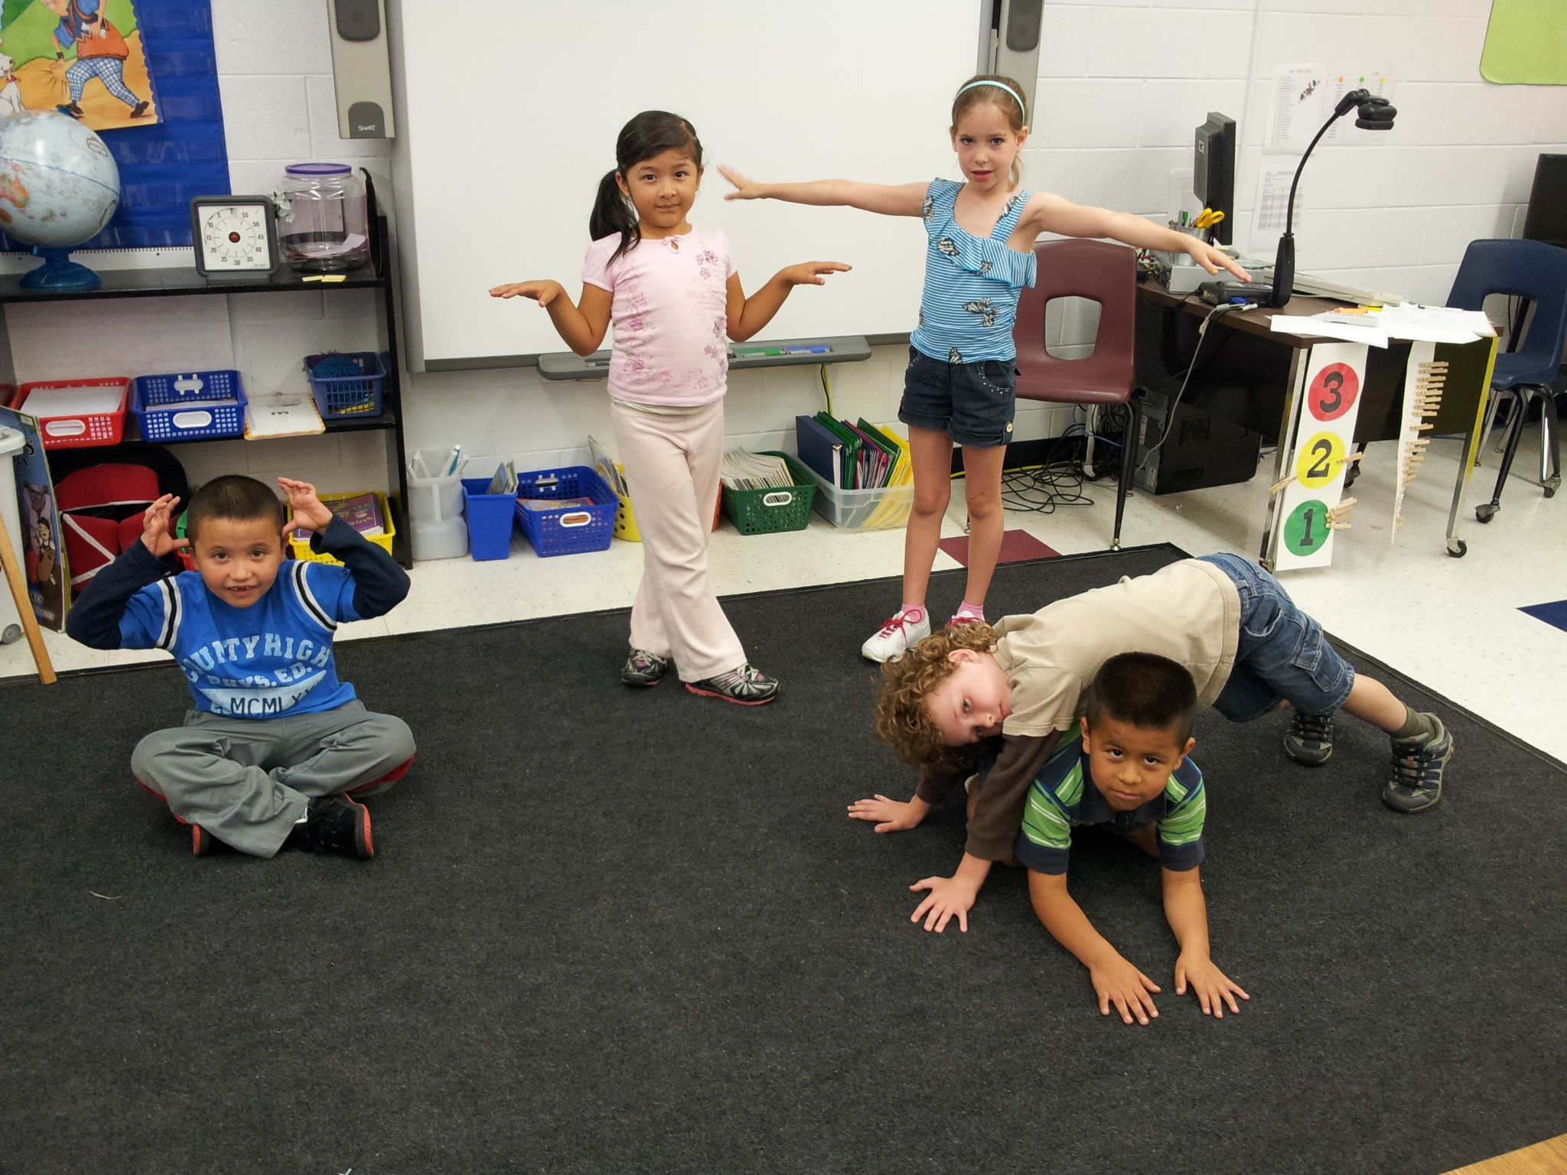
Sparrow
Sparrow
Jug
Ox
Frog
The magic helpers are the frog, ox and sparrows. They helped Pear Blossom finish her chores so she could go to the village festival.

Slide 5
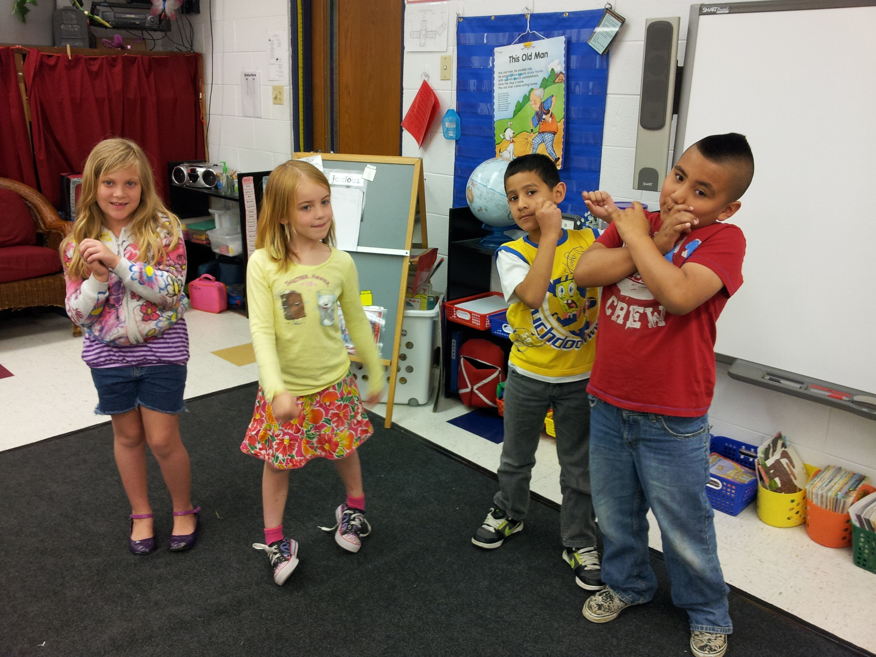
Everyone was invited to the village festival. They had fun at the festival.
Musician
Drummer
Pear Blossom
Musician

Slide 6
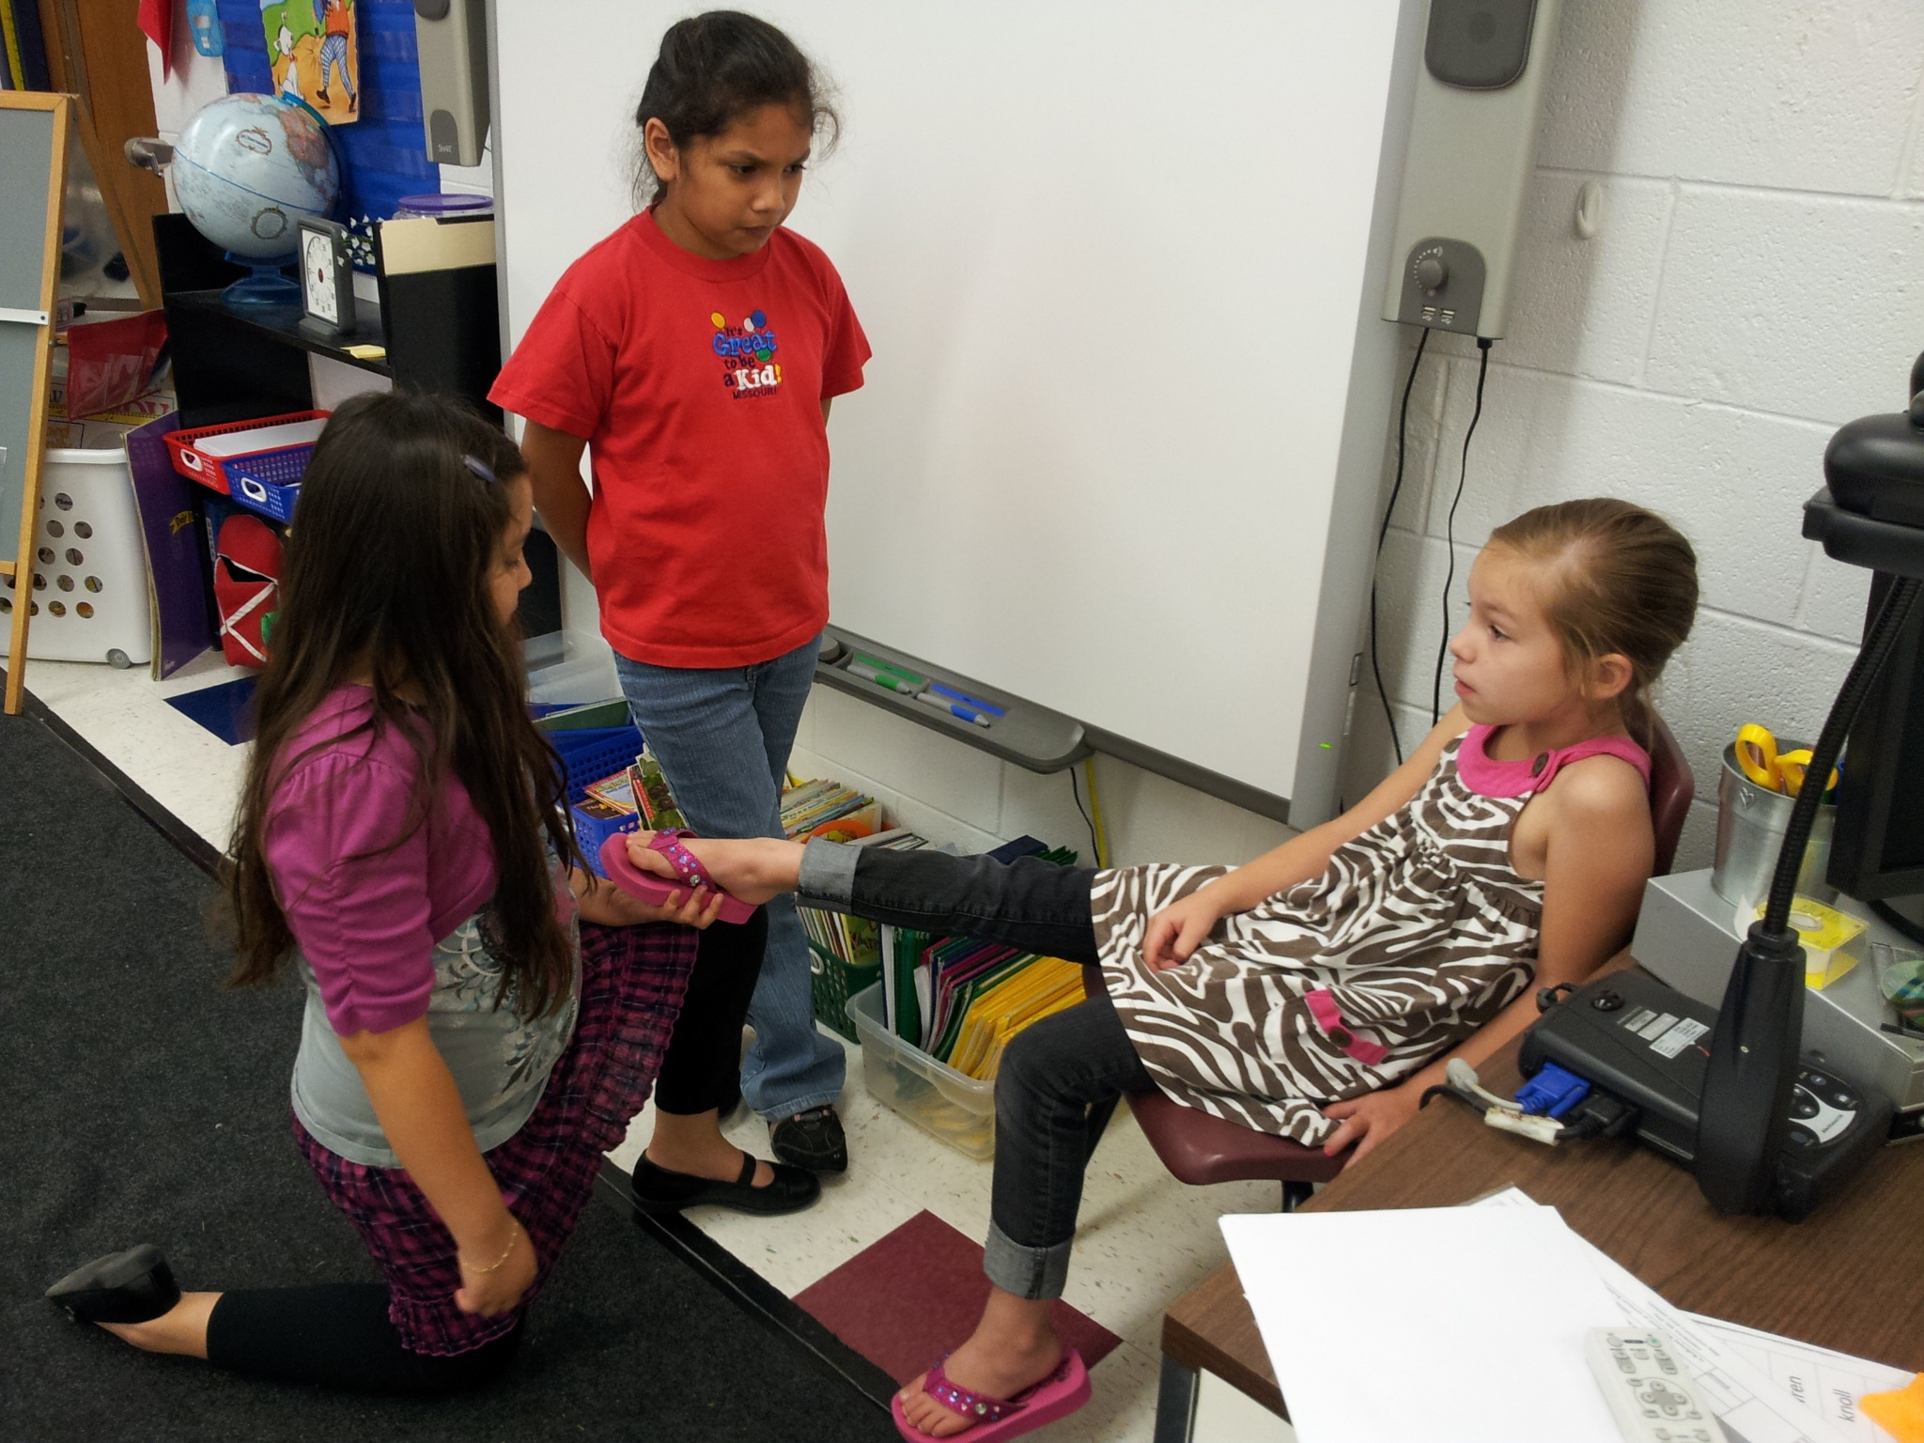
Stepmother
The straw sandal fit Pear Blossom.
Pear Blossom
Magistrate

Slide 7
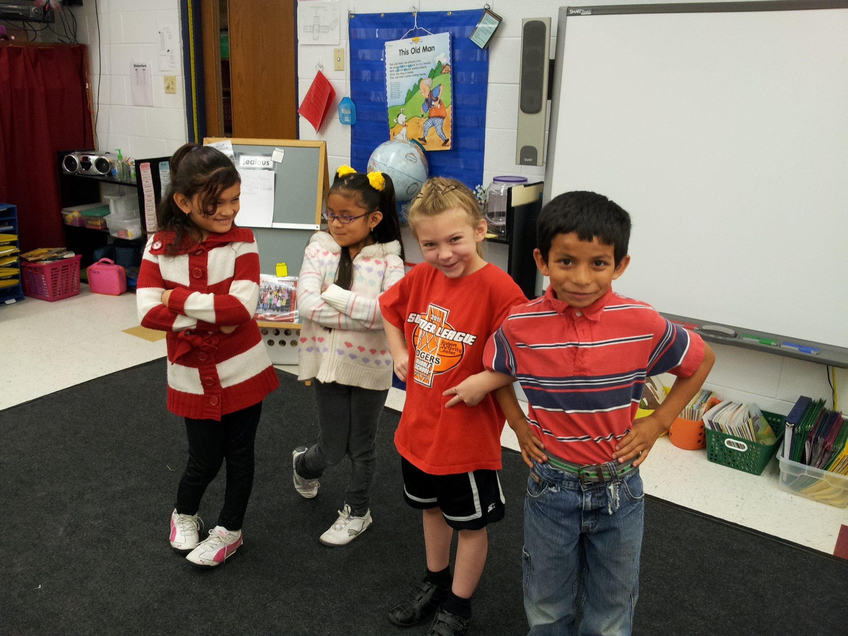
The magistrate and Pear Blossom get married and live happily ever after.
Stepmother
Stepsister
Magistrate
Pear Blossom

