Slide 1
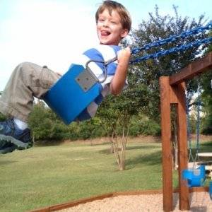
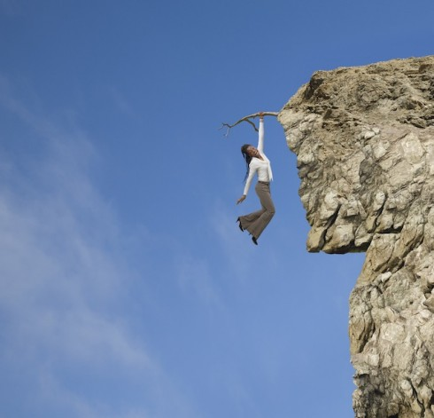
sway
to move
back
and
forth
terrifying
very
scary

Slide 2
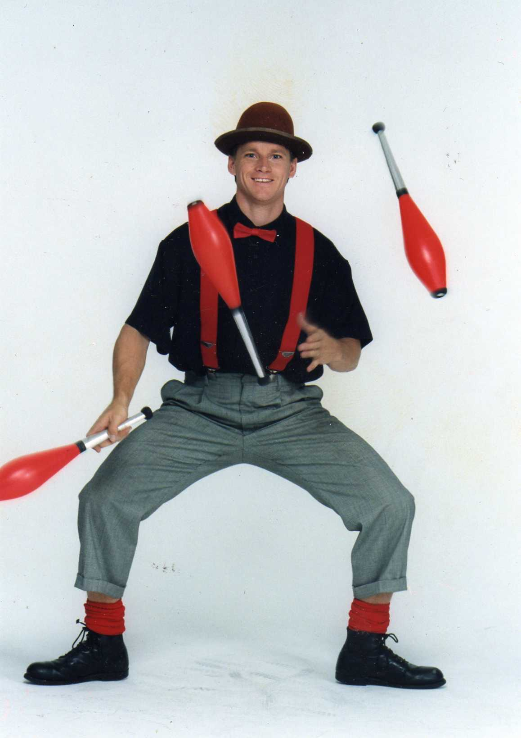
performer
someone
who
entertains
people

Slide 3
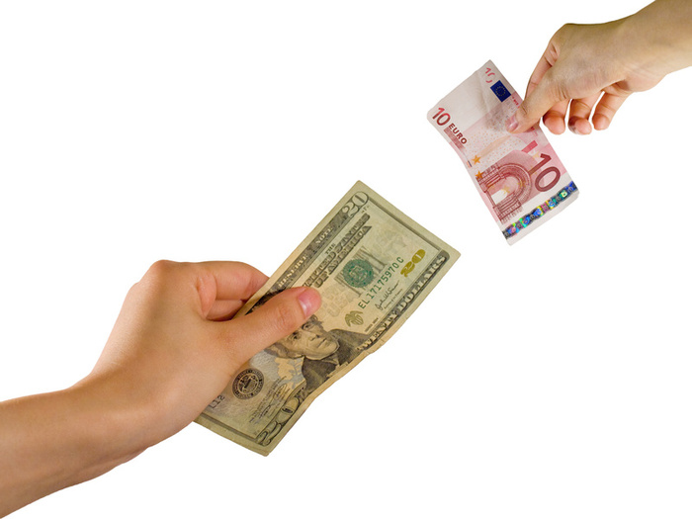
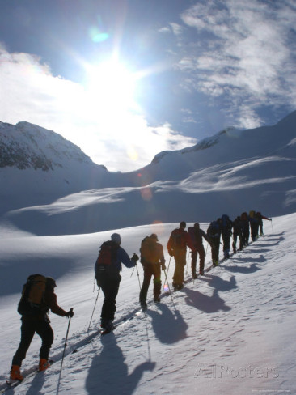
exchange
to trade something
trudge
to keep moving along with difficulty

Slide 4
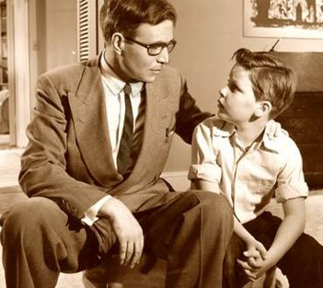
advise
to talk over
and give
an opinion

Slide 5
correctly
to do
something
right
improvements
to make
things
better

Slide 6
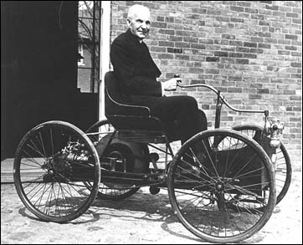
inventions
new ideas
and products
created by
someone

Slide 7
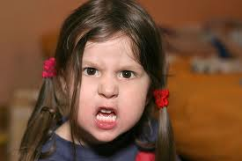
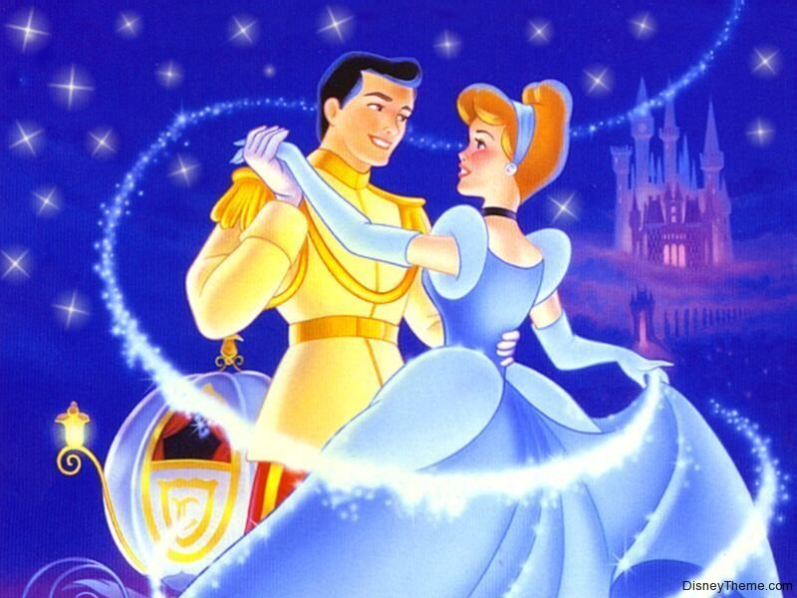
harsh
hard
or mean
charming
friendly
or
likeable

Slide 8
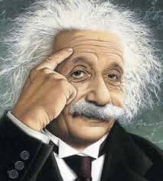
clever
smart or
quick at understanding

Slide 9
adoringly
lovingly
or to
love
deeply
sheepishly
to be
shy
or
embarrassed

Slide 10
reluctantly
concerned
or afraid

Slide 11
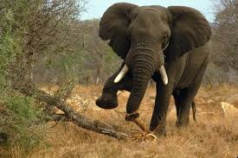
harsh
hard
or mean
tramping
to walk
with
heavy
feet

Slide 12
evenly
smoothly

