Slide 1
1st Grade Text Talk
Unit 5

Slide 2
I can use words I learn from a text.
Notes:
Goal-
Students need to engage with the goal- read it, repeat it, write it, etc.

Slide 3
Tell your partner about a new word you learned last week.
Notes:
Access Prior Knowledge- (APK)
Turn and Talk

Slide 5
evenly
Notes:
Contextualize the word- Find it in the text
Say the word together

Slide 6
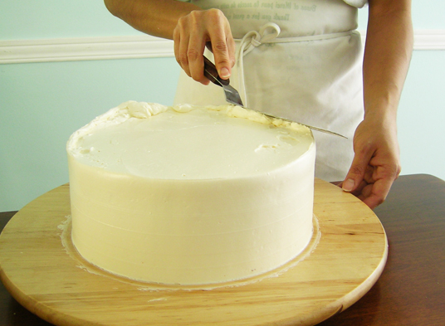
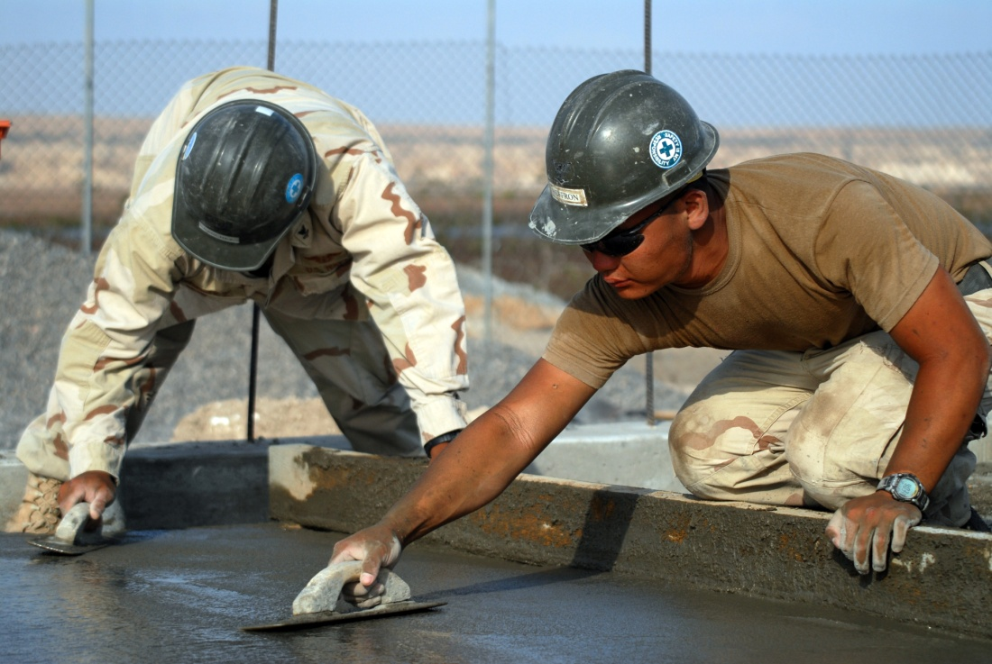
evenly
smoothly
Notes:
Give student friendly definition
Use the word in other contexts

Slide 7
Why would it be important to spread paint evenly?
Pretend like you are spreading peanut butter evenly on your sandwich.
Notes:
Engage the students with the word

Slide 8
tramping
Notes:
Contextualize the word- Find it in the text
Say the word together

Slide 9
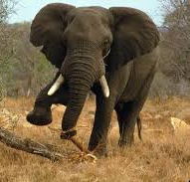
tramping
Walking with heavy feet
Notes:
Give student friendly definition
Use the word in other contexts

Slide 10
Thumbs up if this is an example of tramping. Thumbs down if not.
The little girl tiptoed down the hallway.
The children stomped through the mud puddles on their way to school.
The large dinosaur walked through the meadow making the ground shake.
Notes:
Engage the students with the word

Slide 11
dodging
Notes:
Contextualize the word- Find it in the text
Say the word together

Slide 12
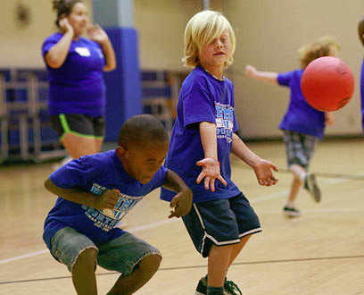
dodging
Moving quickly out of the way
Touch the football to see a video of
a football player dodging tackles.
Be sure to watch number 44.
Notes:
Give student friendly definition
Use the word in other contexts

Slide 13
What would you look like if you were dodging a ball that someone threw at you.
If a book came flying through the air towards your face, would you dodge?
Notes:
Engage the students with the word

Slide 14
Who can use all 3 words in a sentence?
evenly
tramping
dodging
Notes:
Read all three words and see if you can use them in one sentence.

Slide 15
Draw a picture to show you know what these words mean.
evenly
tramping
dodging
Notes:
Application-
Students need an opportunity to use the words they just learned from the text.

Slide 16
I can use words I learn from a text.
Notes:
Goal-
Revisit the Goal

