Slide 1
1st Grade Text Talk
Unit 5

Slide 2
I can use words I learn from a text.
Notes:
Goal-
Students need to engage with the goal- read it, repeat it, write it, etc.

Slide 3
Tell your partner about a new word you learned last week.
Notes:
Access Prior Knowledge- (APK)
Turn and Talk

Slide 4
Notes:
New Information-
Read the book- provide a brief explanation of any words that may be new or unfamiliar to the students.

Slide 5
adoringly
Notes:
Contextualize the word- Find it in the text
Say the word together

Slide 6
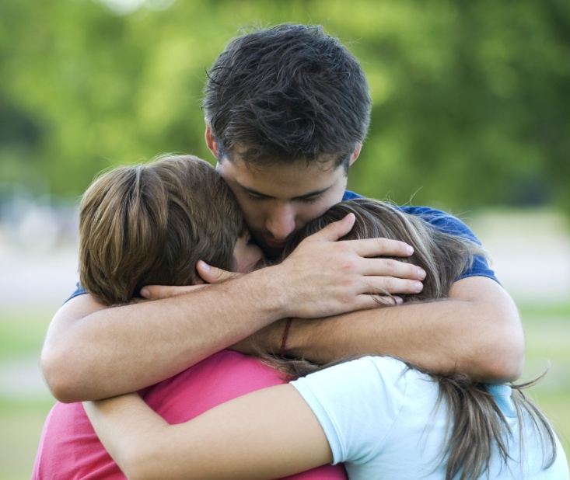
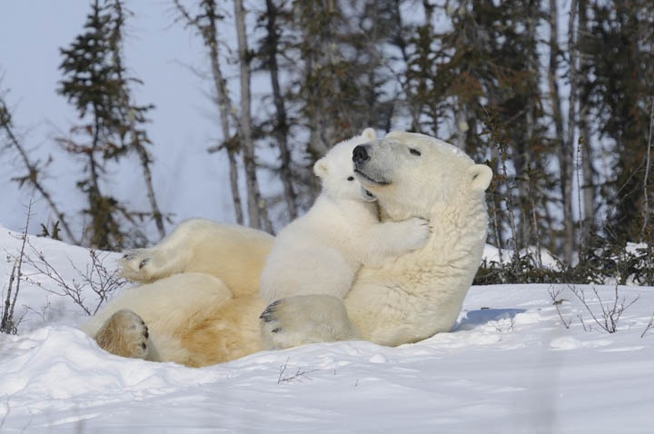
adoringly
Lovingly; to love deeply
Notes:
Give student friendly definition
Use the word in other contexts

Slide 7
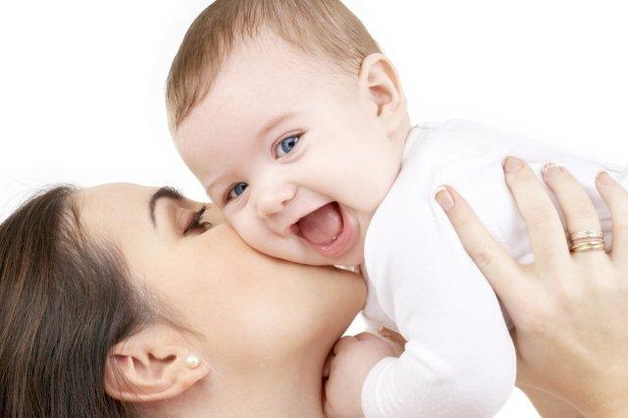
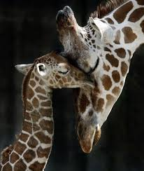
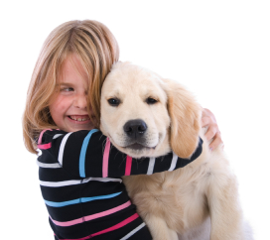
How do these pictures illustrate adoringly?
Notes:
Engage the students with the word

Slide 8
sheepishly
Notes:
Contextualize the word- Find it in the text
Say the word together

Slide 9
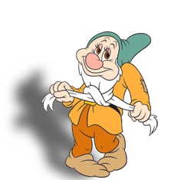
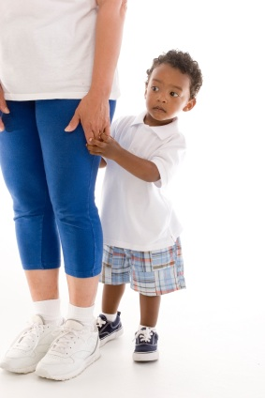
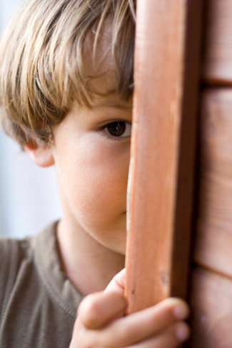
sheepishly
Shy or embarrassed
Notes:
Give student friendly definition
Use the word in other contexts

Slide 10
Thumbs up if this is an example of sheepishly. Thumbs down if not.
The boy walked onto the stage and sang a song in front of 500 people.
The little girl hid behind her mother when the stranger tried to talk to her.
The boy knew the answer to the question, but did not say the answer when asked because he was scared everyone would laugh at him.
Notes:
Engage the students with the word

Slide 11
reluctantly
Notes:
Contextualize the word- Find it in the text
Say the word together

Slide 12
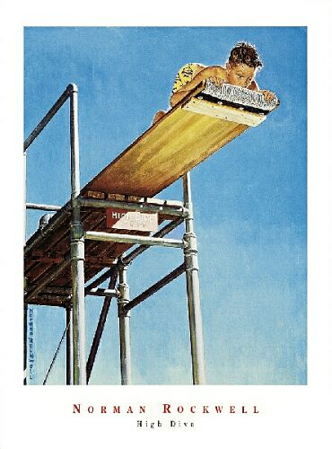
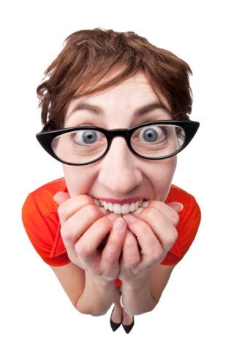
reluctantly
Concerned or afraid
Notes:
Give student friendly definition
Use the word in other contexts

Slide 13
Pretend like you are reluctant to…
touch a snake
ride a bull
swim with sharks
jump off of the high diving board
Notes:
Engage the students with the word

Slide 14
Who can use all 3 words in a sentence?
adoringly
sheepishly
reluctantly
Notes:
Read all three words and see if you can use them in one sentence.

Slide 15
Draw a picture to show you know what these words mean.
adoringly
sheepishly
reluctantly
Notes:
Application-
Students need an opportunity to use the words they just learned from the text.

Slide 16
I can use words I learn from a text.
Notes:
Goal-
Revisit the Goal

