Slide 1
1st Grade Text Talk
Unit 5

Slide 2
I can use words I learn from a text.
Notes:
Goal-
Students need to engage with the goal- read it, repeat it, write it, etc.

Slide 3
Tell your partner about a new word you learned last week.
Notes:
Access Prior Knowledge- (APK)
Turn and Talk

Slide 4
Notes:
New Information-
Read the book- provide a brief explanation of any words that may be new or unfamiliar to the students.

Slide 5
exchanged
Notes:
Contextualize the word- Find it in the text
Say the word together

Slide 6
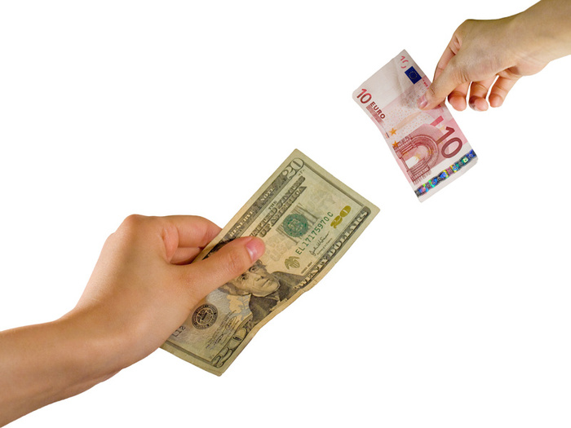
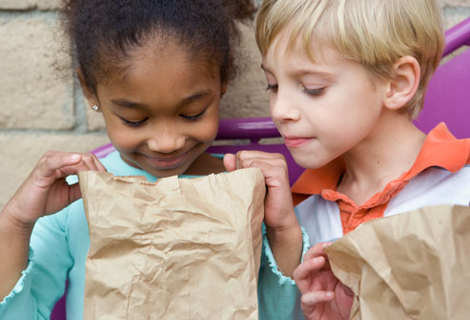
exchange
To trade something
Notes:
Give student friendly definition
Use the word in other contexts

Slide 7
Thumbs up if this is an example of exchange. Thumbs down if not.
The boys were playing with race cars. After each race, they traded cars.
The woman gave the store clerk some money in return for the food.
The toddlers were each playing with their own toys. They did not share them.
Notes:
Engage the students with the word

Slide 8
trudged
Notes:
Contextualize the word- Find it in the text
Say the word together

Slide 9
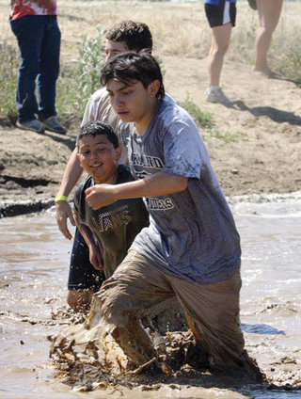
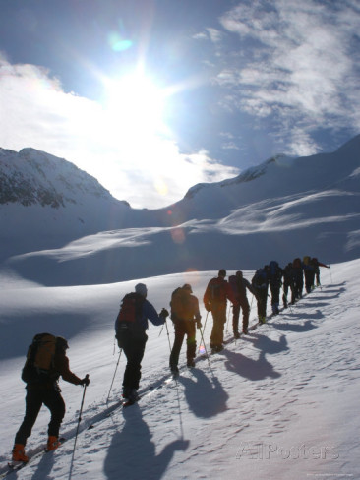
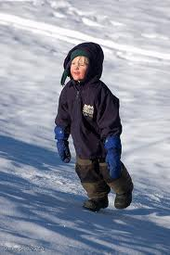
trudge
To keep moving along
with difficulty
Notes:
Give student friendly definition
Use the word in other contexts

Slide 10
Pretend like you are trudging up a mountain.
Pretend like you are trudging through super deep snow.
Pretend like you are carrying a heavy box and trudging up the steps.
Notes:
Engage the students with the word

Slide 11
advised
Notes:
Contextualize the word- Find it in the text
Say the word together

Slide 12
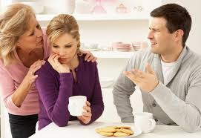
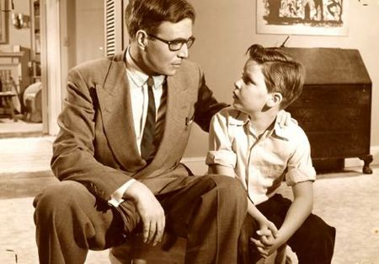
advise
Talk over and give an opinion
Notes:
Give student friendly definition
Use the word in other contexts

Slide 13
What would you advise me to take if I was planning a trip to the water park?
If I wanted to get a pet tiger, how would you advise me?
Notes:
Engage the students with the word

Slide 14
Who can use all 3 words in a sentence?
exchanged
trudged
advised
Notes:
Read all three words and see if you can use them in one sentence.

Slide 15
Draw a picture to show you know what these words mean.
exchanged
trudged
advised
Notes:
Application-
Students need an opportunity to use the words they just learned from the text.

Slide 16
I can use words I learn from a text.
Notes:
Goal-
Revisit the Goal

