Slide 1
Formative Assessment
1st Grade Live Scoring Example
Rogers Public Schools
February, 2016

Slide 2
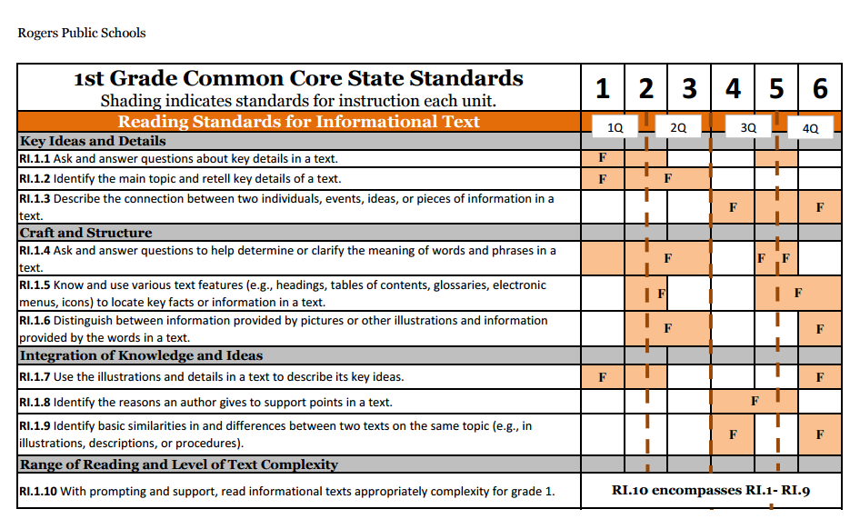
Unit 5
Documents

Slide 3
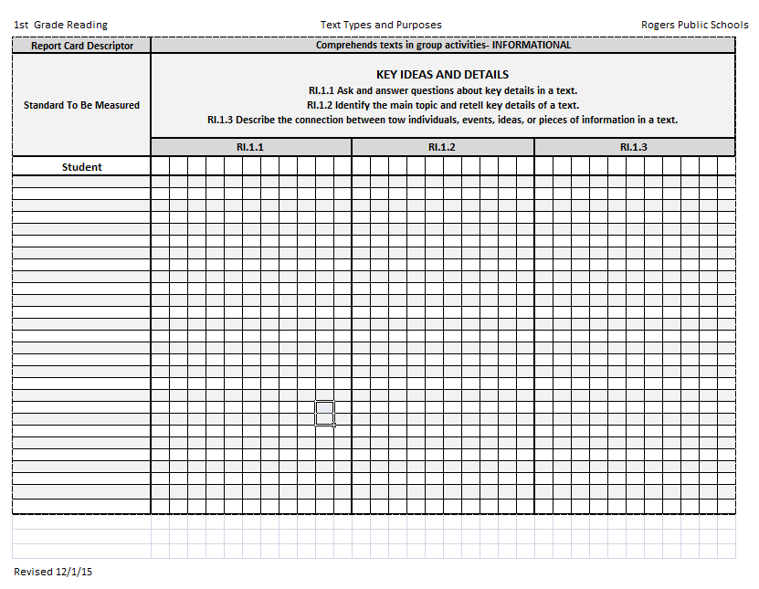
Scoring Guide

Slide 4
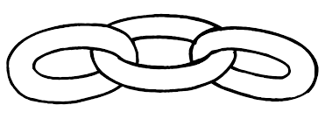
RI.3
(Analyzing how events and ideas develop over time)
Describe the Connection
Between a series of:
Historical Events
Scientific Ideas or Concepts
Steps in a Technical Procedure
2nd
Explain
Events
Procedures
Ideas
Concepts
(in historical, scientific or technical text)
Drawing on specific information to explain what happened and why
4th
Describe the Connection
Between two:
Individuals
Events
Ideas
Pieces of Information
K-with prompting
1st- no prompting
K-1
Describe the Relationship
Between a series of:
Historical Events
Scientific Ideas or Concepts
Steps in a Technical Procedure
Using language that pertains to time, sequence and cause & effect
3rd
Explain the Relationships or Interactions Between
Individuals
Events
Ideas
Concepts
(in historical, scientific or technical text)
Based on specific information in the text
5th

Slide 5
I can make a connection between people.
RI.1.3
2nd Grade | 4 | Describe the connection between a series of historical events, scientific ideas or concepts, or steps in a technical procedure in a text.
1st Grade | 3 | Describe the connection between two individuals, events, ideas or pieces of information in a text.
Kindergarten | 2 | With help from the teacher- Describe the connection between two individuals, events, ideas or pieces of information in a text.
Pre- K | 1 | Talk about a text.

Slide 6
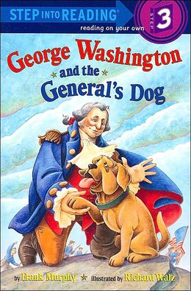
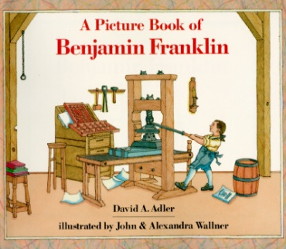
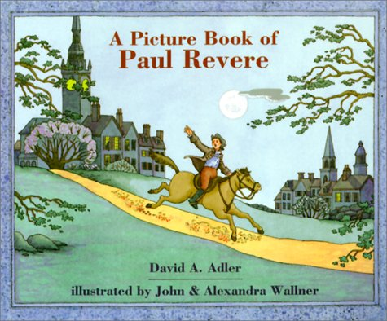
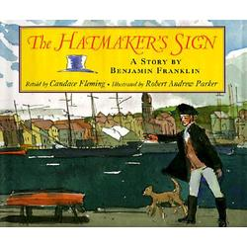
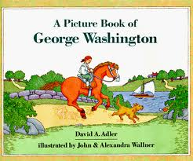
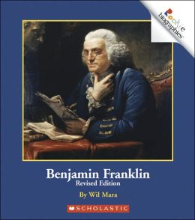
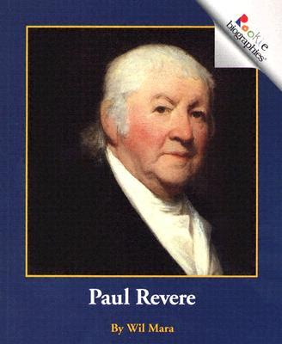
1st Grade Unit 5
Prior to this lesson, students have learned about:
George Washington
Paul
Revere
Benjamin Franklin

Slide 7
RI.1.3
G- I CAN MAKE A CONNECTION BETWEEN PEOPLE.
A- Make connection links with fingers.
Ask, “What does this hand gesture mean?”
Pair share.
N- Explain that we use this hand gesture to show a connection (reading connections,
connecting people or ideas).
Model making a connection between 2 people in the classroom.
Model using the previous timelines on George Washington, Benjamin Franklin,
and Paul Revere to make a connection between 2 of them.
A- Students will write their connections onto strips of paper and connect the links
to show the connection between the famous Americans. LIVE SCORE—formative
assessment
G- Ask, ”What did you learn about how these people are connected?”
Pair share LIVE SCORE—formative assessment
Revisit the goal: I CAN MAKE A CONNECTION BETWEEN PEOPLE.

Slide 8
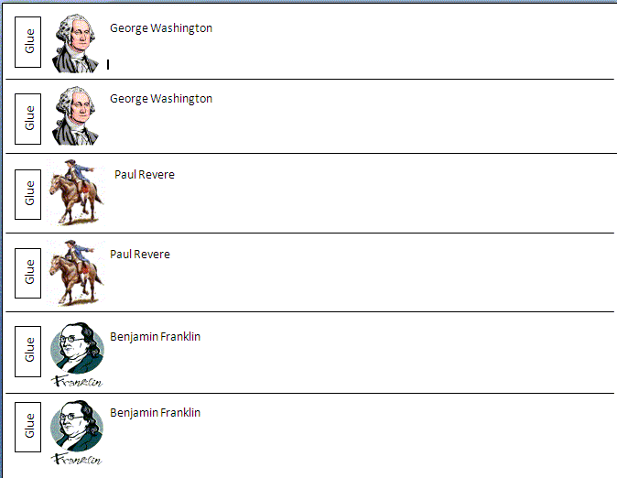
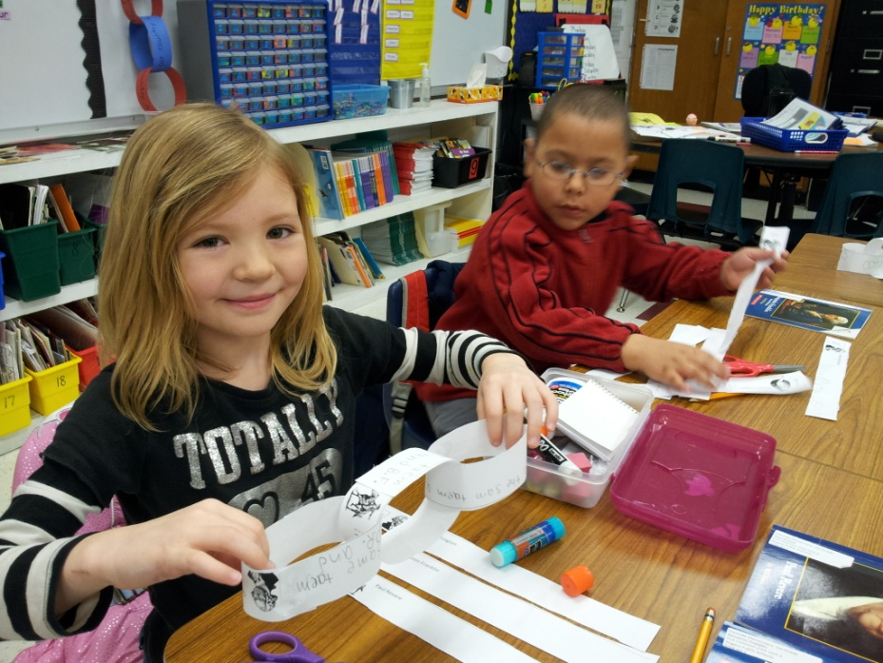
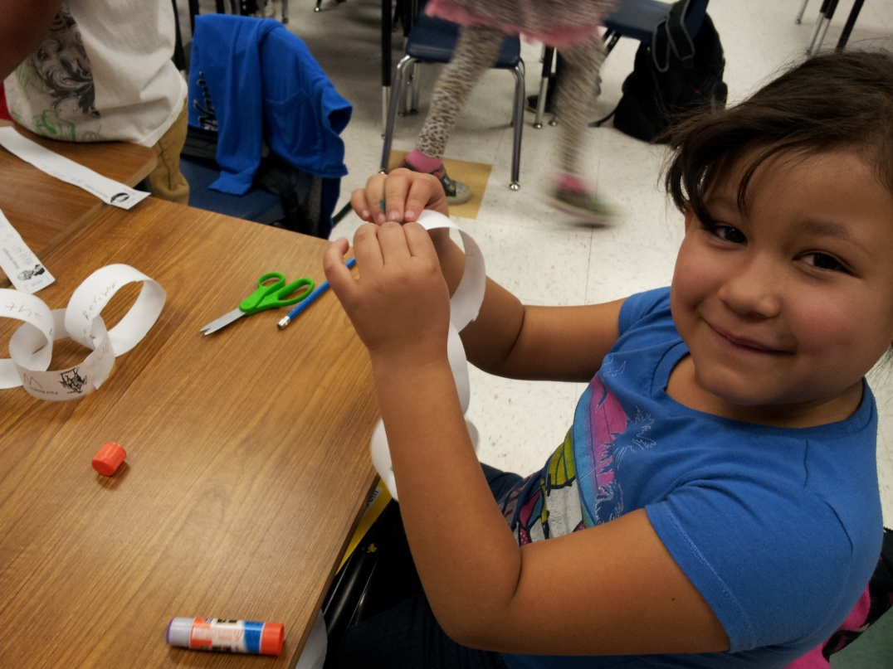
Score students as they are working on their connection links.
was alive during the American Revolution.
was alive during the American Revolution.
was alive during the American Revolution.
George Washington, Paul Revere, and Ben Franklin were alive during the American Revolution.

Slide 9
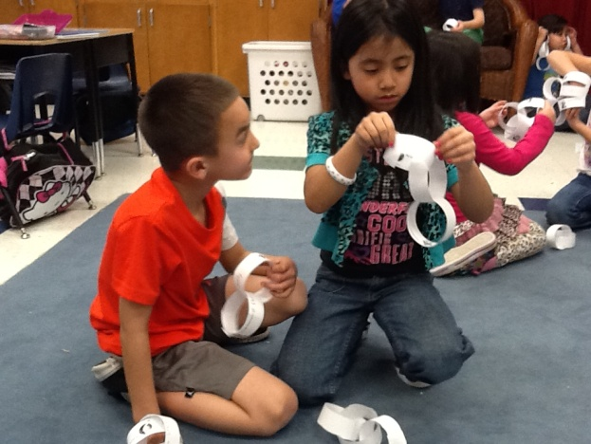
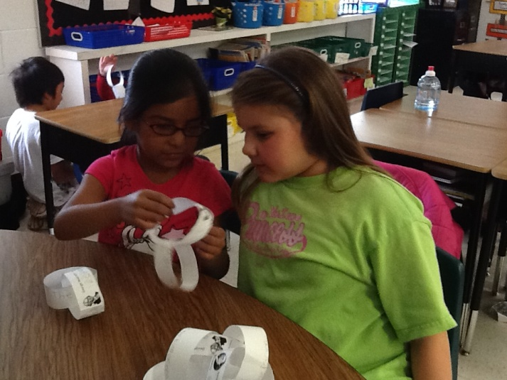
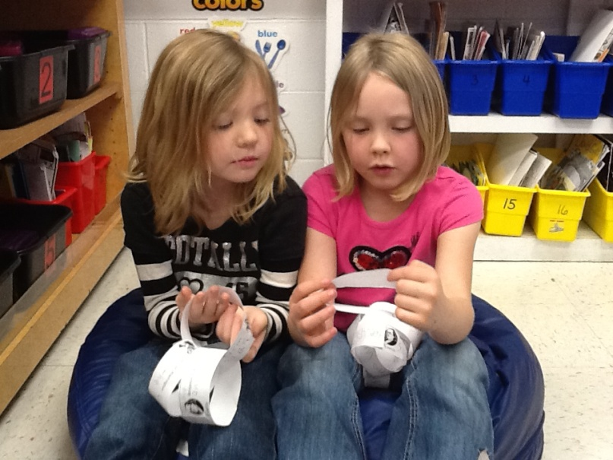
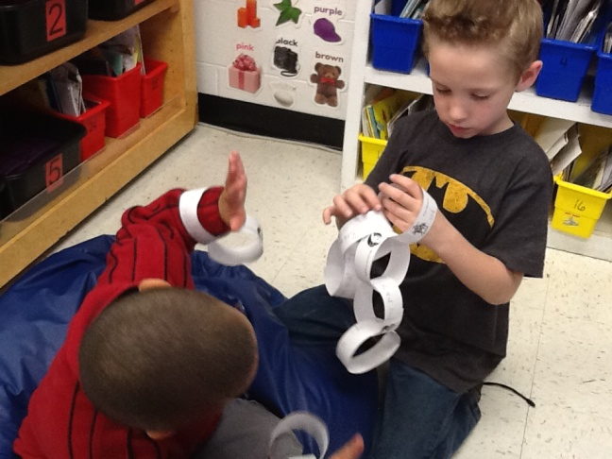
Washington, Revere, and Franklin were all born in the 1700s.
George Washington and Paul Revere were both married.
Score students at the end of the lesson
when they are sharing with a partner.

Slide 10
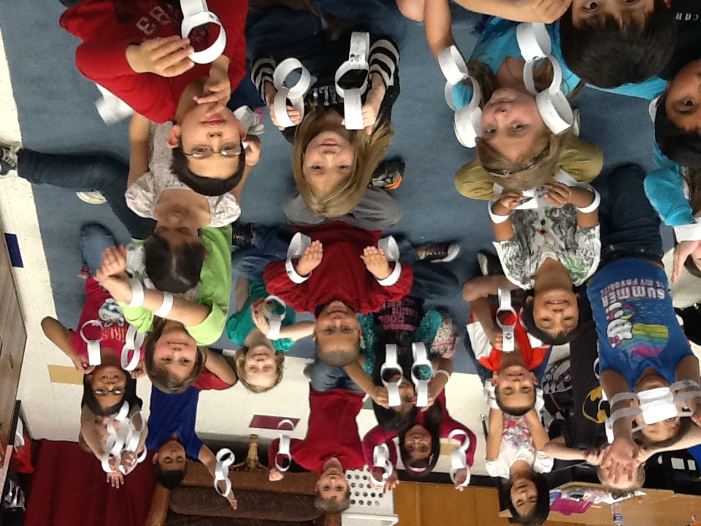

Slide 11
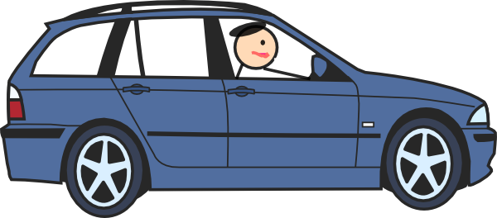
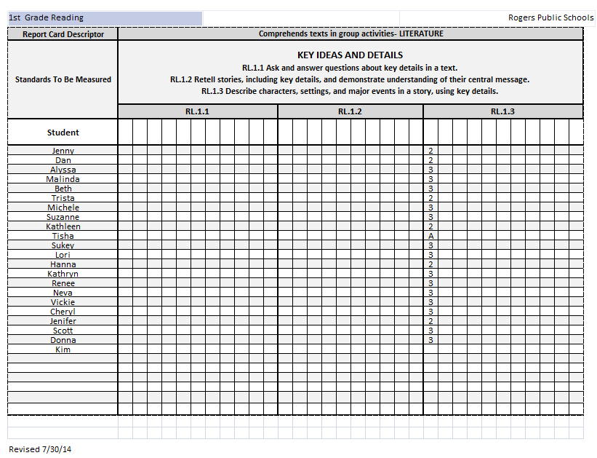
Live Formative Assessment
(Drive By)
ABSENT…
Need to focus on this student the next time this standard is taught.
Small Group Work
OR
Individual Feedback
3-6-15 Connections between 2 people

Slide 12
TEACHER
Not taking papers home to grade
I know who is able to make connection between people- and who still needs to work on this skill.
STUDENT
Students KNOW their success criteria
Timely, standards-based feedback
AFTER scoring- I can give individual or small group feedback OR have students partner up and share answers
Opportunity to self-reflect on the goal

