Slide 1
Name:_________________ Date:_________________
GOAL: I can use words I learn from a text.
B: 4 3 2 1
APK: What is a new word you have learned this week?
____________________________________________
Today’s New Book:
New Word | What it means
visible
demolish
crouch
On the back, write your own sentences/draw your own pictures of the
new words you learned today.
A: 4 3 2 1 EFFORT: 4 3 2 1

Slide 2
Name:_________________ Date:_________________
GOAL: I can use words I learn from a text.
B: 4 3 2 1
APK: What is a new word you have learned this week?
____________________________________________
Today’s New Book:
New Word | What it means
fluttering
plucked
whirled
On the back, write your own sentences/draw your own pictures of the
new words you learned today.
A: 4 3 2 1 EFFORT: 4 3 2 1

Slide 3
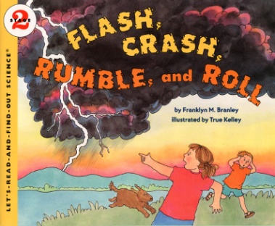
Name:_________________ Date:_________________
GOAL: I can use words I learn from a text.
B: 4 3 2 1
APK: What is a new word you have learned this week?
____________________________________________
Today’s New Book:
New Word | What it means
droop
streak
expand
On the back, write your own sentences/draw your own pictures of the
new words you learned today.
A: 4 3 2 1 EFFORT: 4 3 2 1

Slide 4
Name:_________________ Date:_________________
GOAL: I can use words I learn from a text.
B: 4 3 2 1
APK: What is a new word you have learned this week?
____________________________________________
Today’s New Book:
New Word | What it means
blurted
jerked
staggered
On the back, write your own sentences/draw your own pictures of the
new words you learned today.
A: 4 3 2 1 EFFORT: 4 3 2 1

Slide 5
Name:_________________ Date:_________________
GOAL: I can use words I learn from a text.
B: 4 3 2 1
APK: What is a new word you have learned this week?
____________________________________________
Today’s New Book:
New Word | What it means
wrinkled
cuddle
tuck
On the back, write your own sentences/draw your own pictures of the
new words you learned today.
A: 4 3 2 1 EFFORT: 4 3 2 1

Slide 6
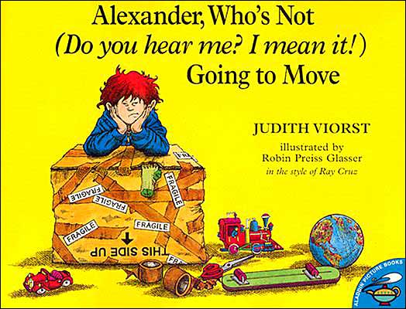
Name:_________________ Date:_________________
GOAL: I can use words I learn from a text.
B: 4 3 2 1
APK: What is a new word you have learned this week?
____________________________________________
Today’s New Book:
New Word | What it means
immature
barricade
mature
On the back, write your own sentences/draw your own pictures of the
new words you learned today.
A: 4 3 2 1 EFFORT: 4 3 2 1

