Slide 1
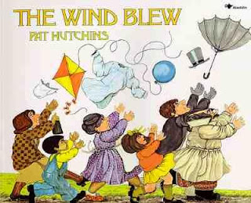
1st Grade Text Talk
Unit 4

Slide 2
I can use words I learn from a text.
Notes:
Goal-
Students need to engage with the goal- read it, repeat it, write it, etc.

Slide 3
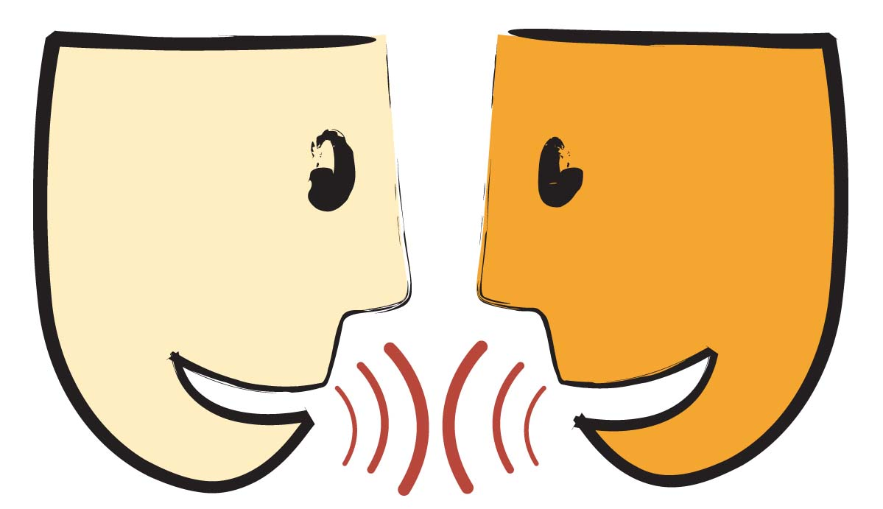
Tell your partner about a new word you learned last week.
Notes:
Access Prior Knowledge- (APK)
Turn and Talk

Slide 4
Notes:
New Information-
Read the book- provide a brief explanation of any words that may be new or unfamiliar to the students.

Slide 5
plucked
Notes:
Contextualize the word- Find it in the text
Say the word together

Slide 6
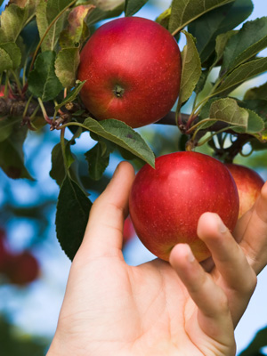
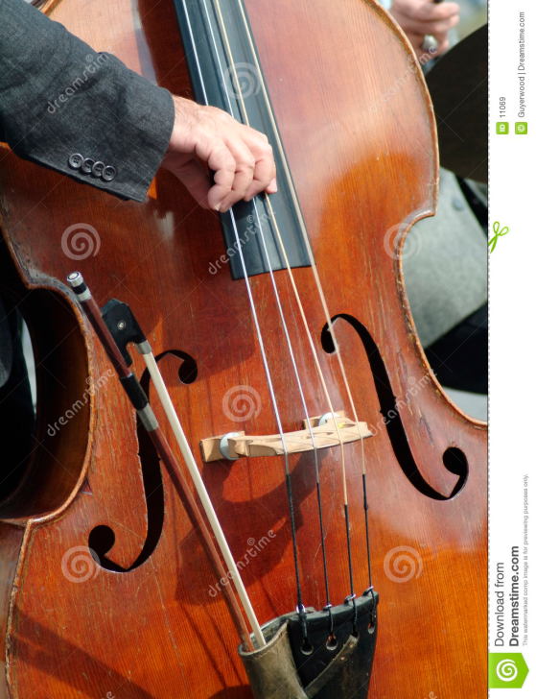
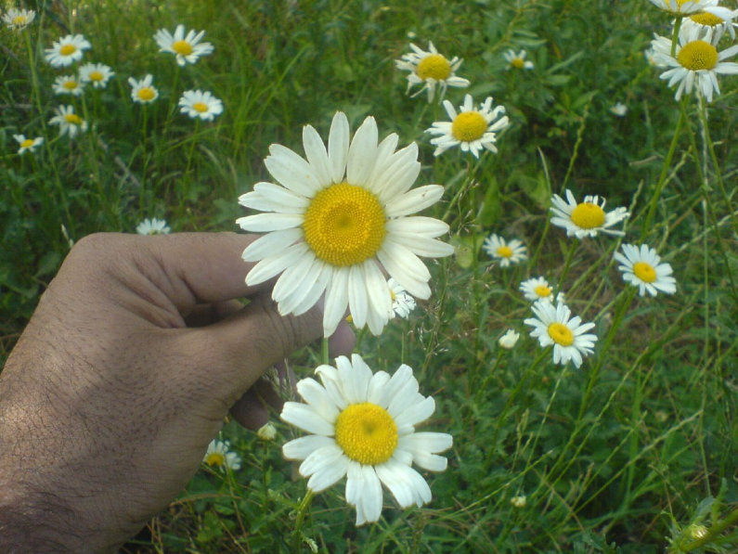
plucked
To pull quickly
Tap the picture of the double bass to watch someone pluck the strings.
Notes:
Give student friendly definition
Use the word in other contexts

Slide 7
Turn and Talk
Name something you would pluck.
Why would you need to pluck a/an______?
Where would you be when you plucked the _______?
Show me how you would look when pluck something.
Notes:
Engage the students with the word

Slide 8
whirled
Notes:
Contextualize the word- Find it in the text
Say the word together

Slide 9
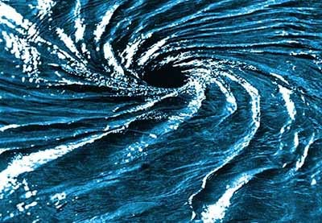
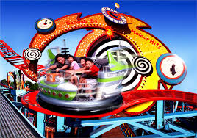
whirled
To spin; a fast
Turning motion
Touch the whirlpool to watch the ocean water whirl.
Notes:
Give student friendly definition
Use the word in other contexts

Slide 10
Thumbs up if this is an example whirled.
Thumbs down if not.
The dancers were spinning their partner around the dance floor in time to the music.
The race cars bolted from the starting line trying to win the race!
Your baseball pants were muddy and stained from sliding. Your mom rinsed them off by spinning them around in the water.
Notes:
Engage the students with the word

Slide 11
fluttering
Notes:
Contextualize the word- Find it in the text
Say the word together

Slide 12
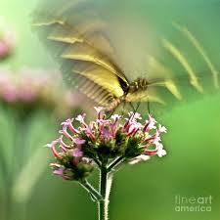
fluttering
To wave quickly and lightly
Notes:
Give student friendly definition
Use the word in other contexts

Slide 13
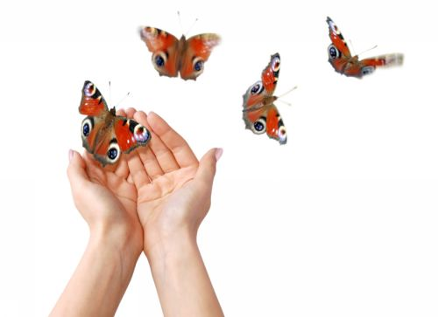
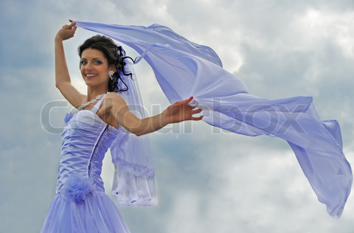
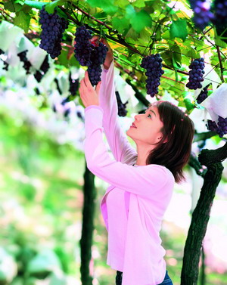
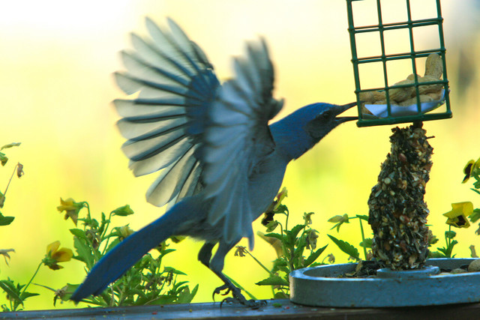
Which pictures show something fluttering?
Notes:
Engage the students with the word

Slide 14
Who can use all 3 words in a sentence?
fluttering
plucked
whirled
Notes:
Read all three words and see if you can use them in one sentence.

Slide 15
Draw a picture to show you know what these words mean.
fluttering
plucked
whirled
Notes:
Application-
Students need an opportunity to use the words they just learned from the text.

Slide 16
I can use words I learn from a text.
Notes:
Goal-
Revisit the Goal

