Slide 1
1st Grade Text Talk
Unit 4

Slide 2
I can use words I learn from a text.
Notes:
Goal-
Students need to engage with the goal- read it, repeat it, write it, etc.

Slide 3
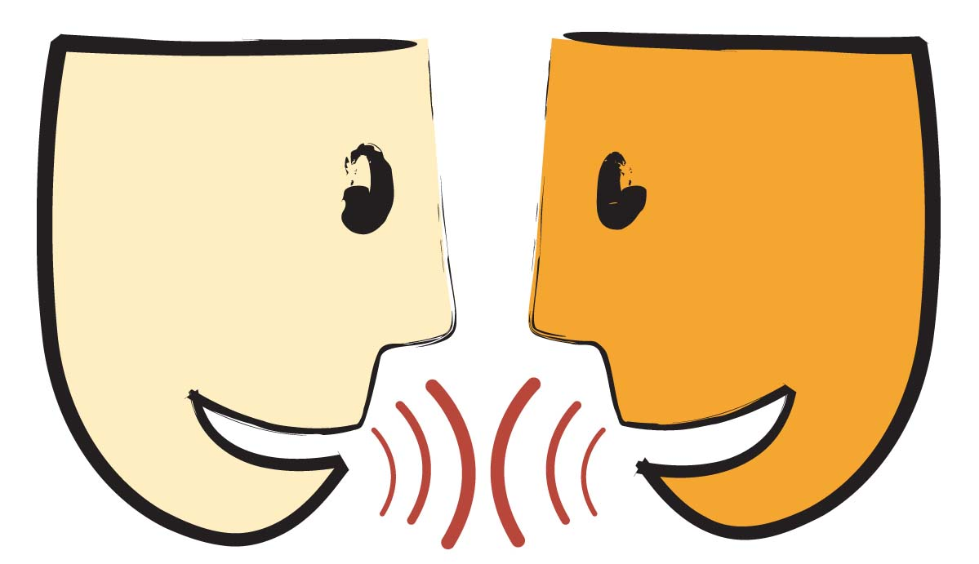
Tell your partner about a new word you learned last week.
Notes:
Access Prior Knowledge- (APK)
Turn and Talk

Slide 4
Notes:
New Information-
Read the book- provide a brief explanation of any words that may be new or unfamiliar to the students.

Slide 5
blurted
Notes:
Contextualize the word- Find it in the text
Say the word together

Slide 6
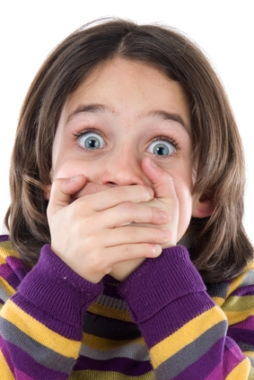
blurted
Speak out suddenly
Notes:
Give student friendly definition
Use the word in other contexts

Slide 7
Tell a friend a time when someone might blurt out.
Show a frozen picture of blurting out.
Show a frozen picture of what you would look like after you blurted out an answer.
Notes:
Engage the students with the word

Slide 8
jerked
Notes:
Contextualize the word- Find it in the text
Say the word together

Slide 9
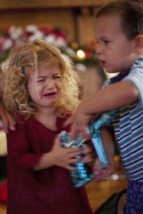
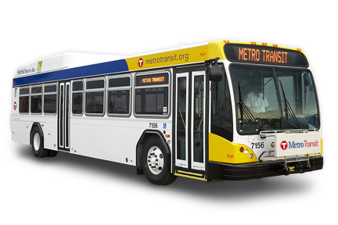
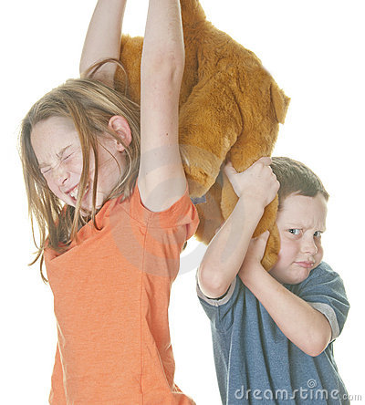
jerked
A quick sharp
pull
Notes:
Give student friendly definition
Use the word in other contexts

Slide 10
Thumbs up if this is an example jerked.
Thumbs down if not.
The brother and sister were fighting over the last Oreo. The sister grabbed the box of Oreos from her brother before he could eat one.
Your teacher was passing out papers. She handed one to you.
Our class rode the bus at the Gentry Safari. The rode was bumpy and the bus had to quickly stop.
Notes:
Engage the students with the word

Slide 11
staggered
Notes:
Contextualize the word- Find it in the text
Say the word together

Slide 12
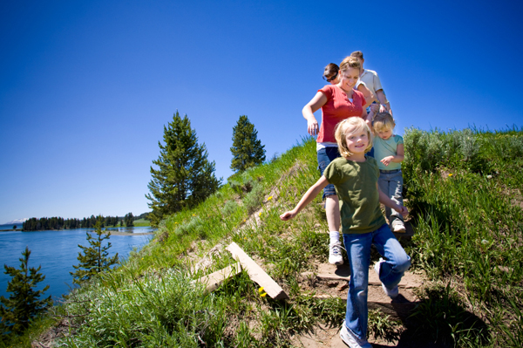
staggered
To walk unevenly
Staggered lines
Notes:
Give student friendly definition
Use the word in other contexts

Slide 13
When I say, “Go!”
Walk normally around our classroom.
Stop!
When I say, “Go!”
Stagger around our classroom.
Stop!
Notes:
Engage the students with the word

Slide 14
Who can use all 3 words in a sentence?
blurted
jerked
staggered
Notes:
Read all three words and see if you can use them in one sentence.

Slide 15
Draw a picture to show you know what these words mean.
blurted
jerked
staggered
Notes:
Application-
Students need an opportunity to use the words they just learned from the text.

Slide 16
I can use words I learn from a text.
Notes:
Goal-
Revisit the Goal

