Slide 1
1st Grade Context Clues
Unit 4

Slide 2
G: Goal
I can use words and pictures to find the meaning of a word.
L.4.1.a
Notes:
Goal-
Students need to engage with the goal- read it, repeat it, write it, etc.

Slide 3
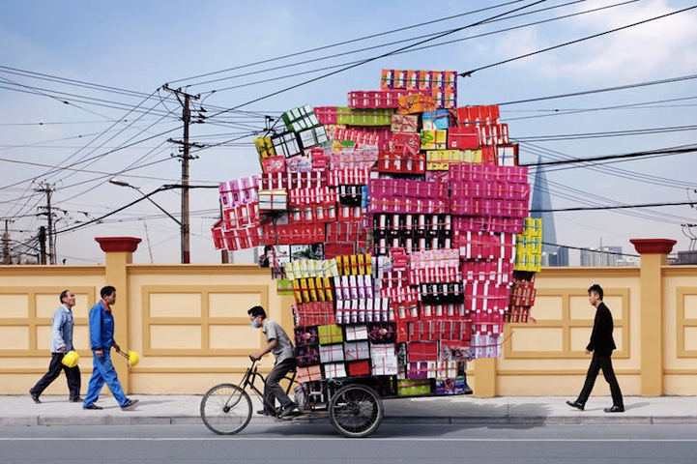
A: APK
Notes:
Access Prior Knowledge- (APK)
Turn and Talk

Slide 4
Turn and talk to your partner:
Where do you think the man is going?
What job do you think this man has?
What clues did you use from the picture?

Slide 5
N: New Information
How do I figure out what a word means when I’m reading?
I can use my context clues!
the pictures on the page
the words around it
Let’s try some out!

Slide 6
howl
Notes:
Contextualize the word- Find it in the text
Say the word together

Slide 7
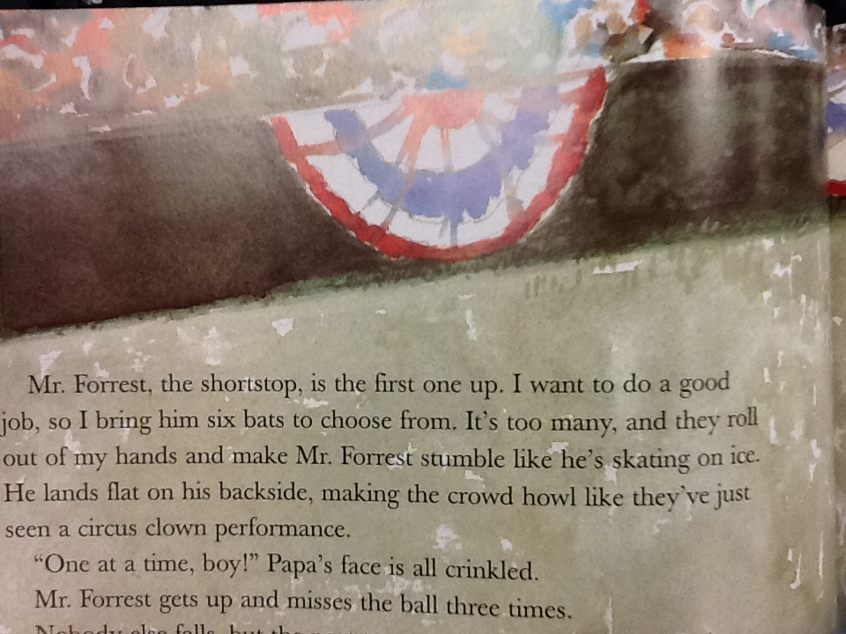
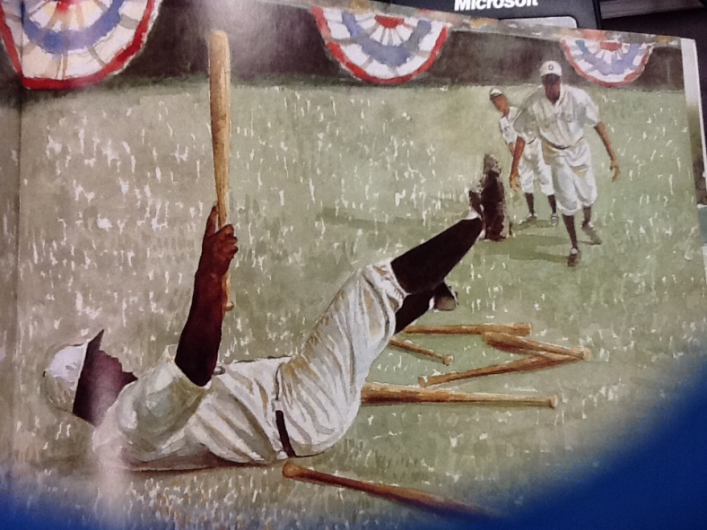
howl
Notes:
Give student friendly definition
Use the word in other contexts

Slide 8
What clues do we have to figure out the meaning of the word “howl”?
1.
2.
3.
The word howl means “to make a loud sound like a wolf or dog”.
Describe something that might (howl).
The ____ (____) because ____.
Notes:
It’s acceptable for ELL students to just describe something that howls without adding why.
Example: The dog howls. The dog howls all night.

Slide 9
clumsy
Notes:
Contextualize the word- Find it in the text
Say the word together

Slide 10
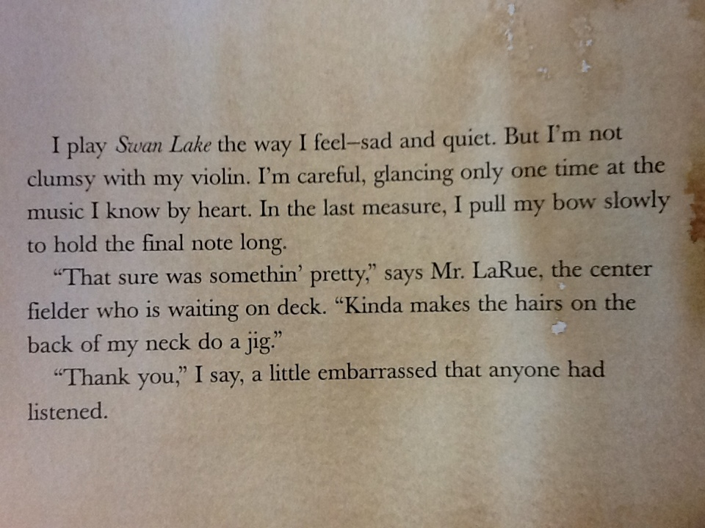
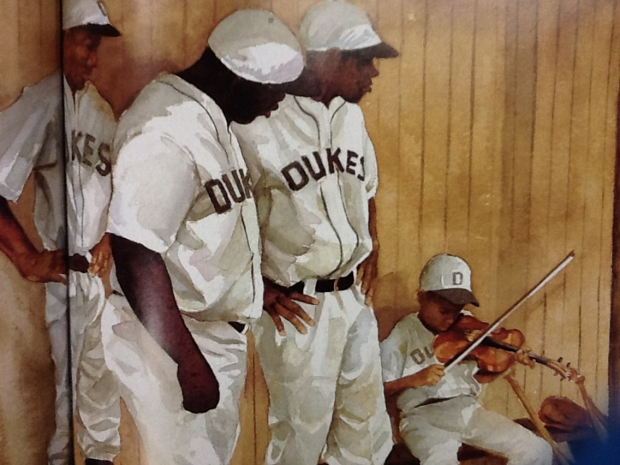
clumsy
Notes:
Give student friendly definition
Use the word in other contexts

Slide 11
What clues do we have to figure out the meaning of the word “clumsy”?
1.
2.
3.
The word clumsy means “not careful”. A clumsy person might drop, spill, or knock over things.
Describe someone that is (clumsy).
The (____) boy ____.
Notes:
For ELL Level 2 or 3 students, help them finish the sentence frame:
Example: The clumsy boy spilled his milk on the table.
For ELL Level 1 students, have them just use the word clumsy to describe someone.
Example: The girl was clumsy. The boy was clumsy.

Slide 12
A: Application
Now it’s your turn!
Use your clues to figure out the meaning of the following word.
Write the word down
2. Write what you think it means
3. Try to use it in a sentence
Notes:
This is your time to walk around and score students. Feel free to allow students to draw a picture to show the meaning of the word.

Slide 13
rickety
Notes:
Contextualize the word- Find it in the text
Say the word together

Slide 14
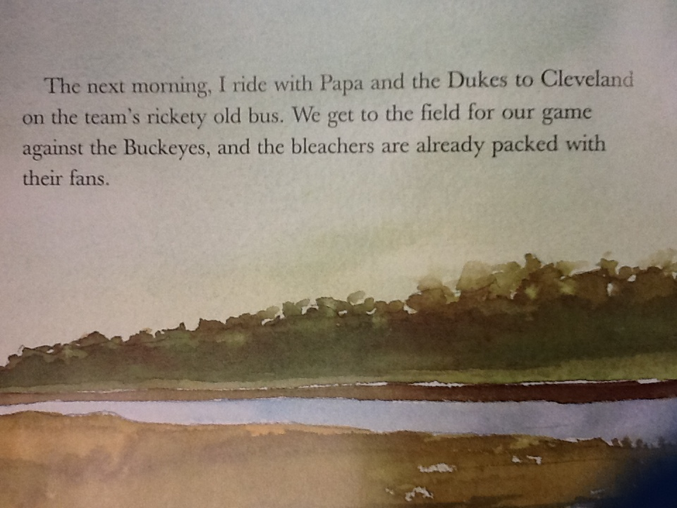
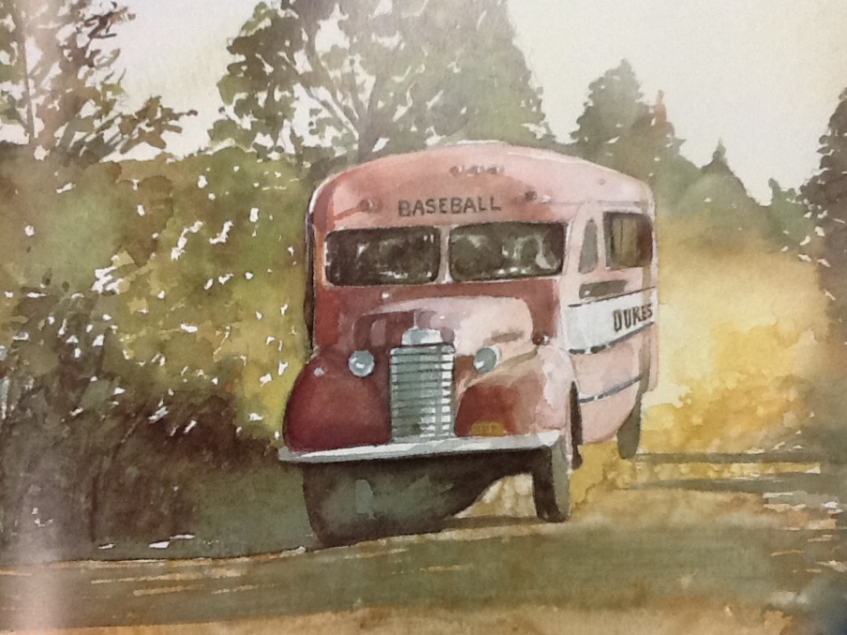
rickety
Notes:
Give student friendly definition
Use the word in other contexts

Slide 15
What clues do we have to figure out the meaning of the word “rickety”?
1.
2.
3.
The word rickety means “shaky, likely to fall apart”.
Describe something that looks (rickety).
The ____ looks (____)
because ____.
Notes:
For ELL students, it would be acceptable to just describe something that is rickety without having to explain why.
The goal here is that they can think of something that is rickety, thus showing their understanding of the meaning. ELL students who can make the connection with why something looks rickety would show a deeper meaning and connection of the word.

Slide 16
Who can use all 3 words/phrases in a sentence?
howl
clumsy
rickety
Notes:
Read all three words and see if you can use them each in a sentence.

Slide 17
G: Goal
I can use words and pictures to find the meaning of a word.
L.4.1.a
Notes:
Goal-
Students need to engage with the goal- read it, repeat it, write it, etc.

