Slide 1
1st Grade Text Talk
Unit 3

Slide 2
I can use words I learn from a text.
1 2 3 4
Notes:
Goal-
Students need to engage with the goal- read it, repeat it, write it, etc.

Slide 3
Tell your partner about a new word you learned last week.
Notes:
Access Prior Knowledge- (APK)
Turn and Talk

Slide 4
Notes:
New Information-
Read the book- provide a brief explanation of any words that may be new or unfamiliar to the students.

Slide 5
swooped
Notes:
Contextualize the word- Find it in the text
Say the word together

Slide 6
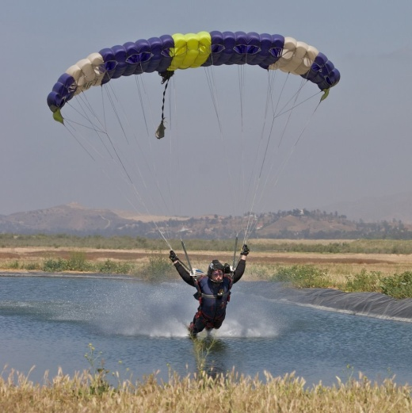
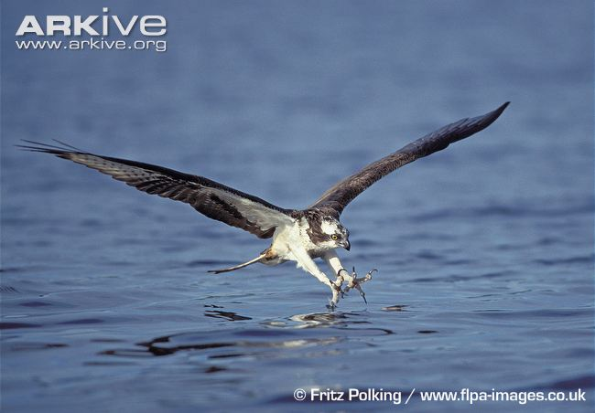
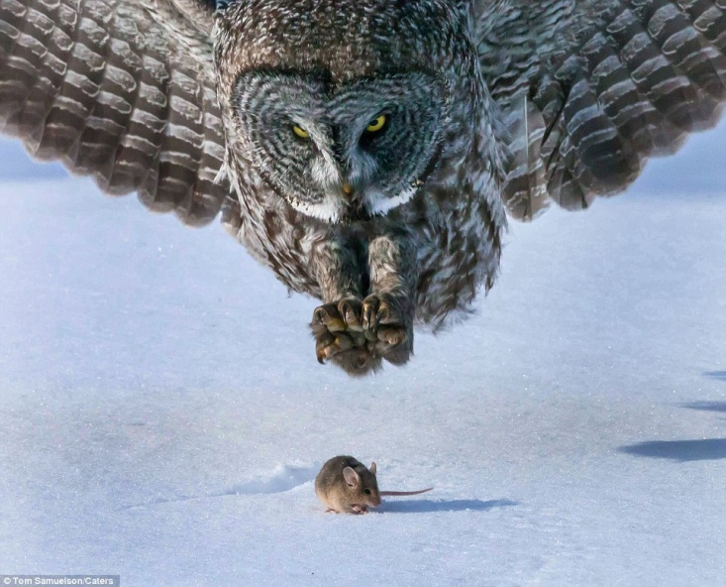
swoop
Coming down quickly to attack
Swooped is in the past tense
Notes:
Give student friendly definition
Use the word in other contexts

Slide 7
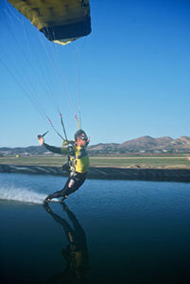
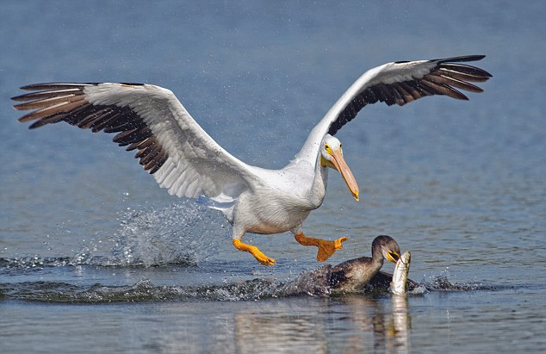
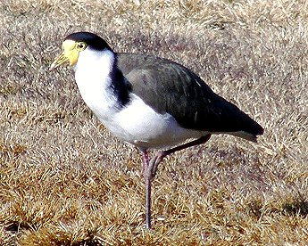
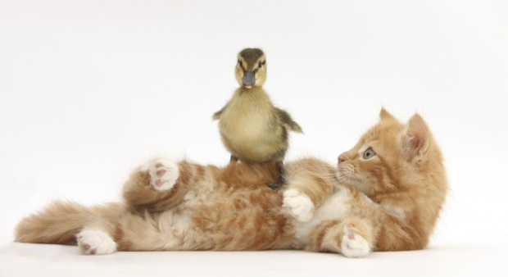
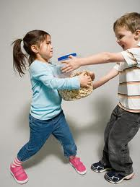
Which pictures show swooped?
Notes:
Engage the students with the word

Slide 8
gazing
Notes:
Contextualize the word- Find it in the text
Say the word together

Slide 9
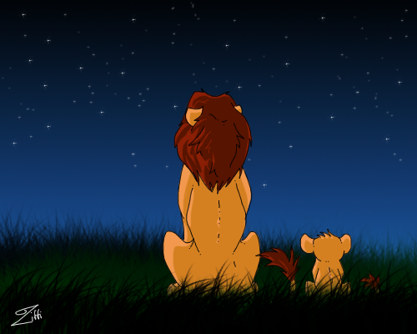
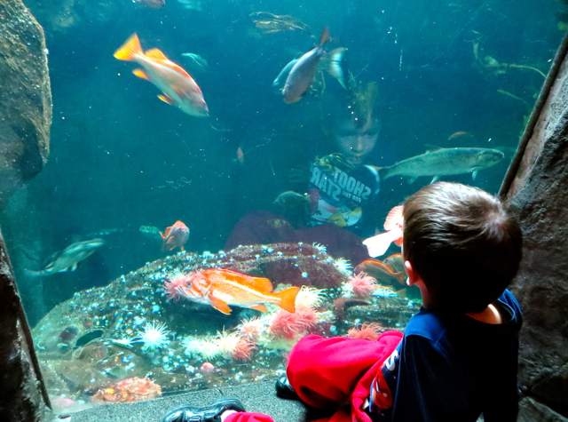
gazing
To look with surprise, astonishment or thought
Notes:
Give student friendly definition
Use the word in other contexts

Slide 10
Name a time you were gazing at something or someone.
How would your face look if you were gazing at the stars?
How would your face look if you were gazing at a shark tank?
Notes:
Engage the students with the word

Slide 11
creep
Notes:
Contextualize the word- Find it in the text
Say the word together

Slide 12
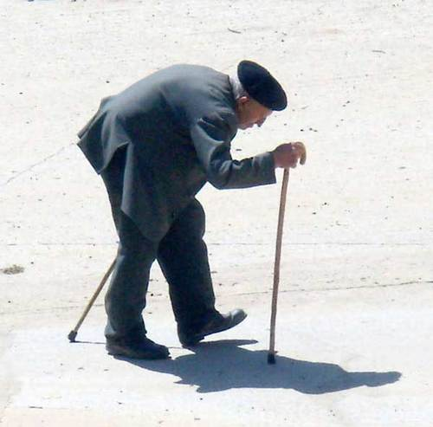
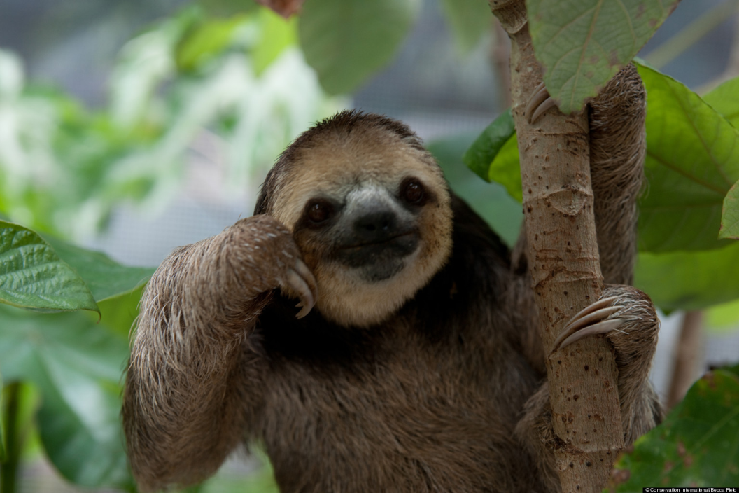
creep
To move slowly and quietly with care or fear
Touch the picture of the sloth to watch him creep across the road.
Notes:
Give student friendly definition
Use the word in other contexts

Slide 13
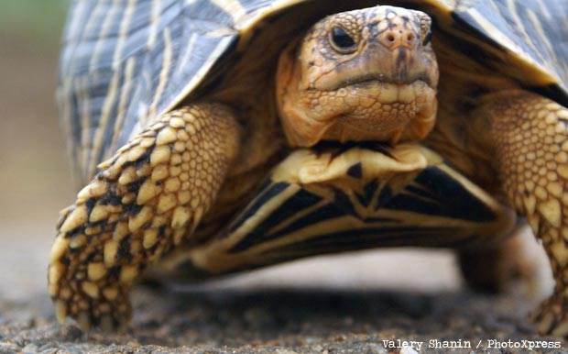
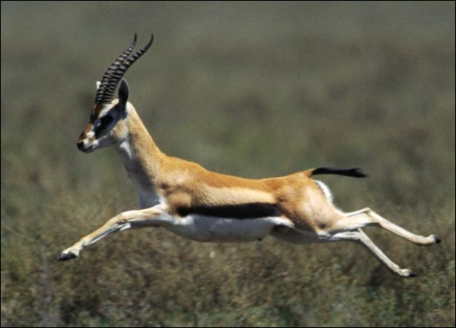
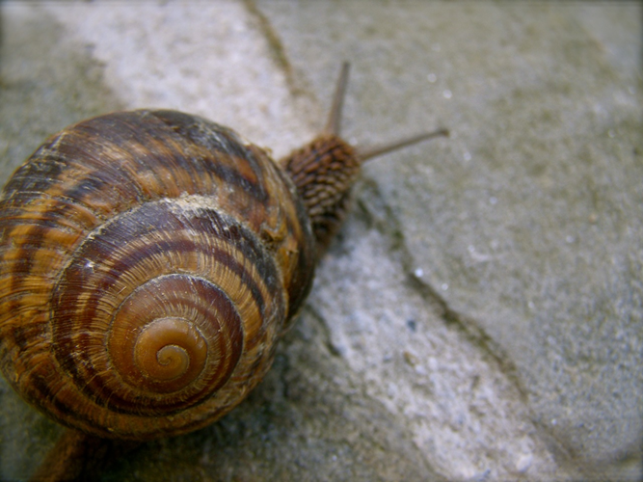
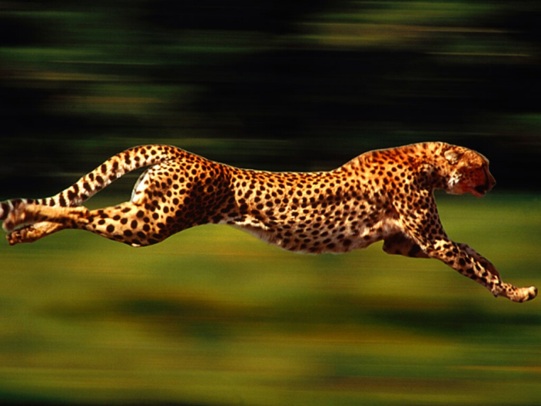
Which pictures show an animal that creeps?
Notes:
Engage the students with the word

Slide 14
graceful
Notes:
Contextualize the word- Find it in the text
Say the word together

Slide 15
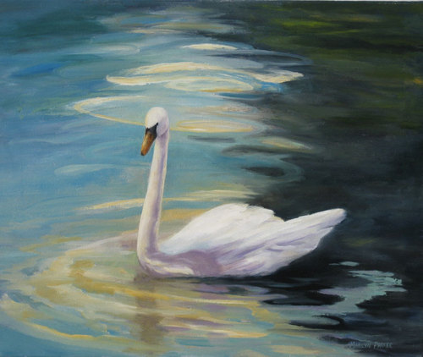
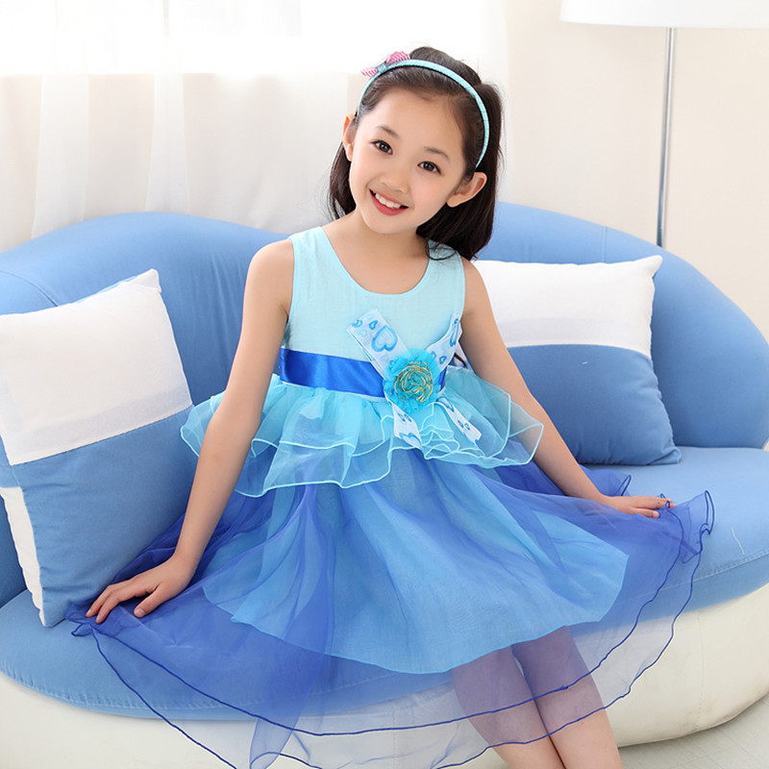
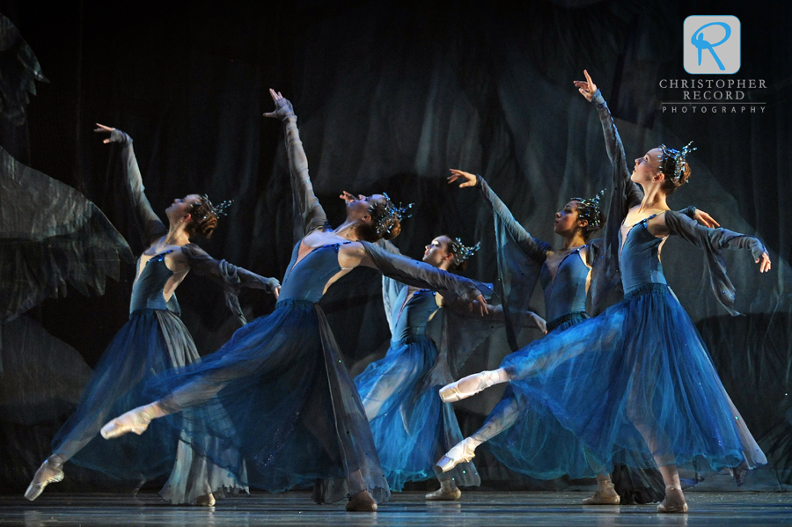
graceful
To move with beauty
To show good manners
Notes:
Give student friendly definition
Use the word in other contexts

Slide 16
Thumps up if this shows someone acting graceful. Thumbs down if not.
People admired her while she danced across the dance floor with her partner.
While eating, he sat with his legs up and yelled across the table to his friends.
Notes:
Engage the students with the word

Slide 17
Who can use all 4 words in a sentence?
swooped
gazing
creep
graceful
Notes:
Read all three words and see if you can use them in one sentence.

Slide 18
Draw a picture to show what these words mean.
swooped
gazing
creep
graceful
Notes:
Application-
Students need an opportunity to use the words they just learned from the text.

Slide 19
I can use words I learn from a text.
1 2 3 4
Notes:
Goal-
Revisit the Goal

