Slide 1
1st Grade Text Talk
Unit 3

Slide 2
I can use words I learn from a text.
Notes:
Goal-
Students need to engage with the goal- read it, repeat it, write it, etc.

Slide 3
Tell your partner about a new word you learned last week.
Notes:
Access Prior Knowledge- (APK)
Turn and Talk

Slide 4
Notes:
New Information-
Read the book- provide a brief explanation of any words that may be new or unfamiliar to the students.

Slide 5
sumptuous
Notes:
Contextualize the word- Find it in the text
Say the word together

Slide 6
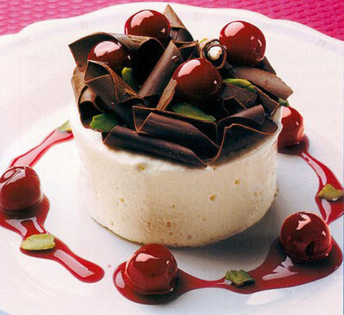
sumptuous
Rich and luxurious
Notes:
Give student friendly definition
Use the word in other contexts

Slide 7
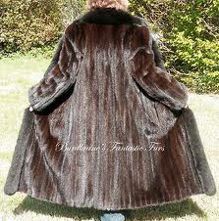
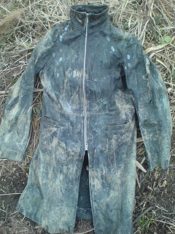
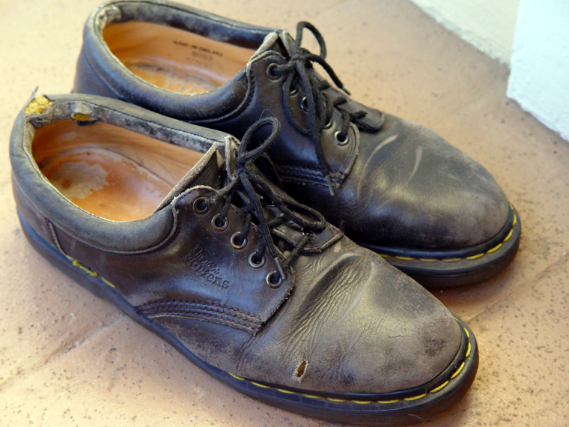
Which pictures show something sumptuous?
Notes:
Engage the students with the word

Slide 8
quaked
Notes:
Contextualize the word- Find it in the text
Say the word together

Slide 9
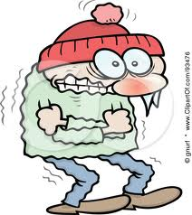
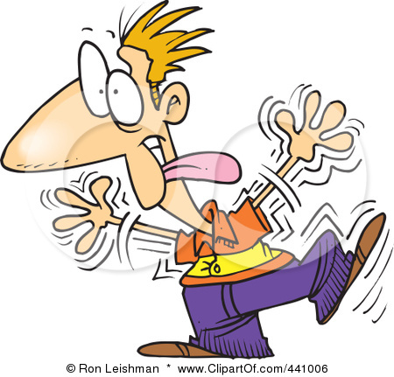
quaked
To shiver and shake
Notes:
Give student friendly definition
Use the word in other contexts

Slide 10
When have you quaked with fear?
What would you look like if you were to quake with fear?
Can you think of a different time when you were quaking?
Notes:
Engage the students with the word

Slide 11
frantically
Notes:
Contextualize the word- Find it in the text
Say the word together

Slide 12
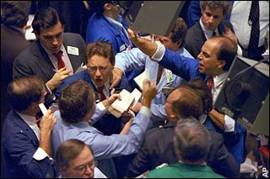
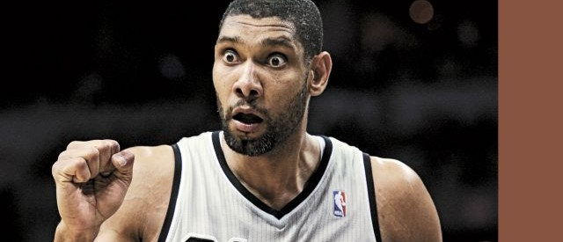
frantically
Very rushed
Touch the picture to see Tim Duncan frantically telling a teammate to shoot the ball!
Notes:
Give student friendly definition
Use the word in other contexts

Slide 13
Thumbs up if this is an example frantic.
Thumbs down if not.
Your mom told you to clean your room and you forgot! You hear her coming down the hallway and rush to put your toys away.
Your teacher told you that you will have two days to finish your writing. You take your time and use your neatest handwriting.
While swimming in the pool, your mom drops her phone into the water! You quickly jump in to save it!
Notes:
Engage the students with the word

Slide 14
Who can use all 3 words in a sentence?
sumptuous
quaked
frantically
Notes:
Read all three words and see if you can use them in one sentence.

Slide 15
Draw a picture to show you know what these words mean.
sumptuous
quaked
frantically
Notes:
Application-
Students need an opportunity to use the words they just learned from the text.

Slide 16
I can use words I learn from a text.
Notes:
Goal-
Revisit the Goal

