Slide 1

The Little Red Hen
Text Talk

Slide 2
I can use words I learn from a text.
1 2 3 4

Slide 3
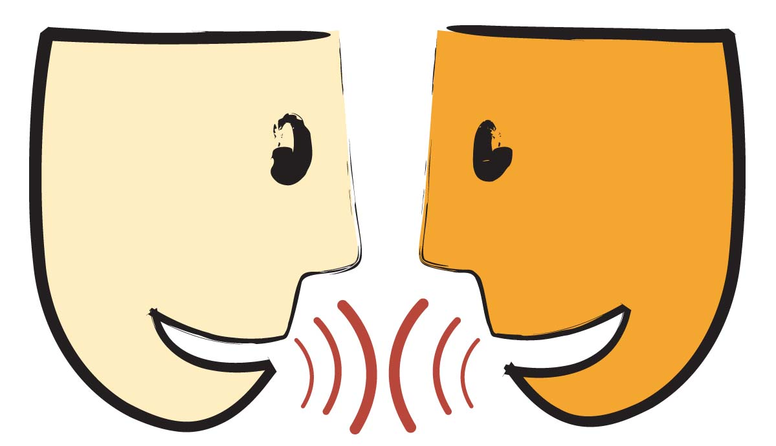
Tell your partner about a new word you learned last week.

Slide 4
The Little Red Hen
Read-Aloud
https://youtu.be/DnDtd8ZzuLE

Slide 5
Cozy

Slide 6

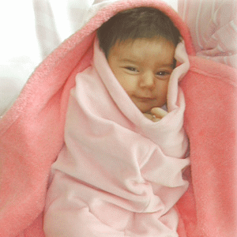
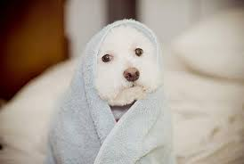
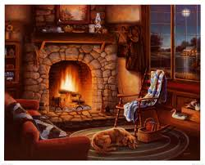
Cozy
Warm
Friendly
Comfortable

Slide 7

Thumbs up if this is a time you would be cozy, thumbs down if it is not.
You are sitting by the fire reading your favorite book.
You are at a restaurant sitting in a very uncomfortable, cold, hard chair.
You are snuggled up under your favorite blanket with your favorite teddy bear.

Slide 8
Mend

Slide 9
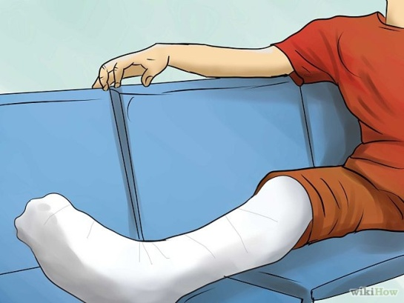

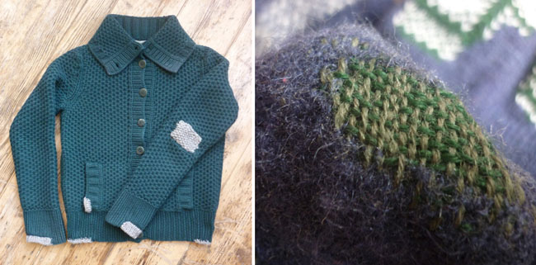
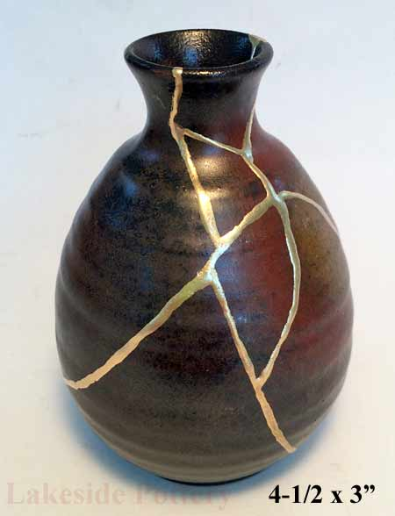
Mend
To heal
To fix something
To show better behavior
Mended is in the past tense.

Slide 10
Pretend you are mending.
What does mending look like?

Slide 11
Stroll

Slide 12
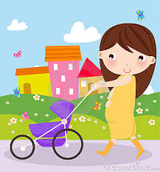
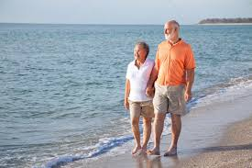
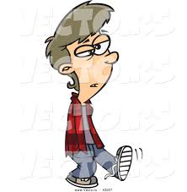
Stroll
A slow walk
A relaxed and unhurried walk
Strolled is in the past tense.

Slide 13
Thumbs up if this is a time you would stroll. Thumbs down if not.
Your house is on fire and you need to get out.
You are looking for cereal in an aisle at Walmart.
You are looking at your neighbors beautiful flowers as you are on your walk.

Slide 14
Who can use all 3 words in a sentence?
Cozy
Mend
Stroll

Slide 15


Draw a picture to show what these words mean.
cozy
mended
strolled
Notes:
Application-
Students need an opportunity to use the words they just learned from the text.

Slide 16
I can use words I learn from a text
1 2 3 4

