Slide 1
1st Grade Text Talk
Unit 3

Slide 2
I can use words I learn from a text.
Notes:
Goal-
Students need to engage with the goal- read it, repeat it, write it, etc.

Slide 3
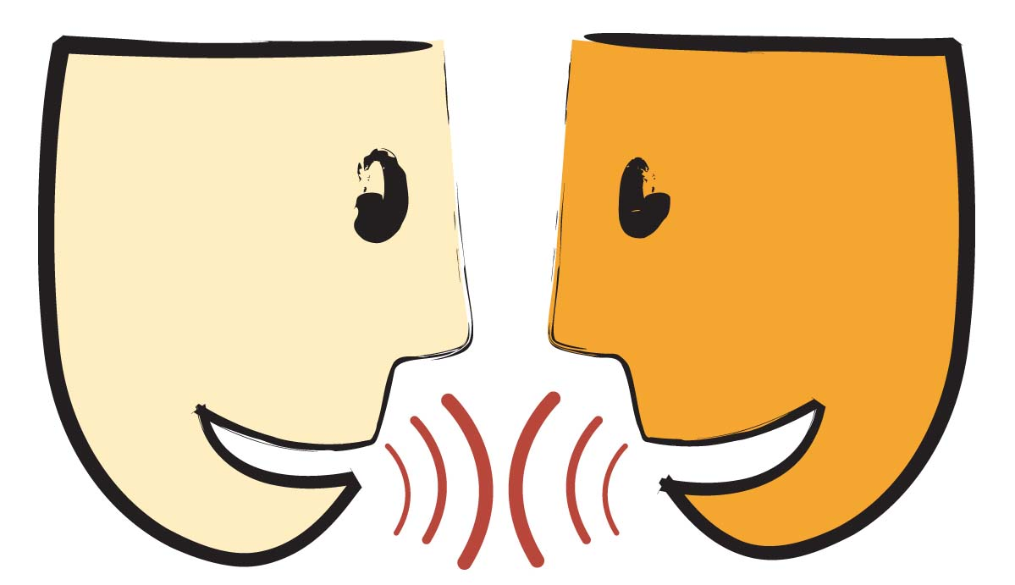
Tell your partner about a new word you learned last week.
Notes:
Access Prior Knowledge- (APK)
Turn and Talk

Slide 4
Notes:
New Information-
Read the book- provide a brief explanation of any words that may be new or unfamiliar to the students.

Slide 5
flapped
Notes:
Contextualize the word- Find it in the text
Say the word together

Slide 6
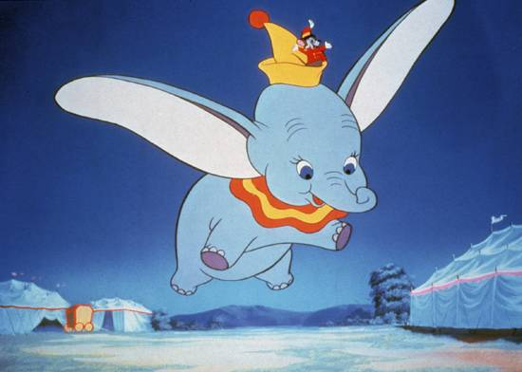
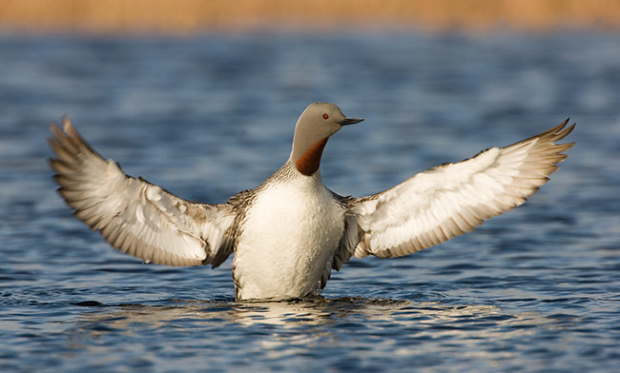
flapped
try to fly
Notes:
Give student friendly definition
Use the word in other contexts

Slide 7
Name an animal that would move by flapping.
Show a frozen picture of an animal about to flap their wings.
When I say “go,” flap around our room.
Notes:
Engage the students with the word

Slide 8
midday
Notes:
Contextualize the word- Find it in the text
Say the word together

Slide 9
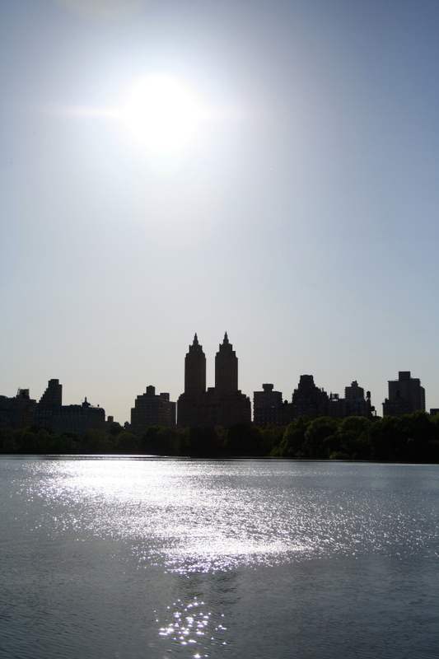
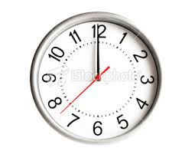
midday
In the middle of the day
Notes:
Give student friendly definition
Use the word in other contexts

Slide 10
Thumbs up if this is an example of something you would do midday.
Thumbs down if not.
You ate lunch with your friends.
You were sad when you could not play outside because it was dark.
Your mom asked your to brush your teeth and get in bed.
Recess today was super fun because we go to play on both playgrounds!
Notes:
Engage the students with the word

Slide 11
agreed
Notes:
Contextualize the word- Find it in the text
Say the word together

Slide 12
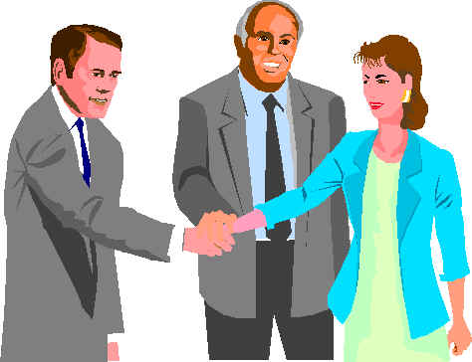
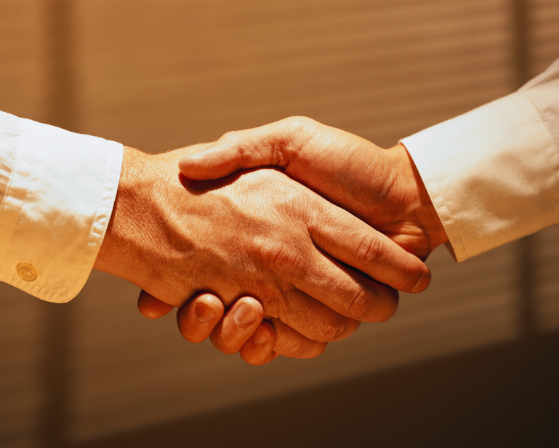
agreed
Think the same as someone else
Notes:
Give student friendly definition
Use the word in other contexts

Slide 13
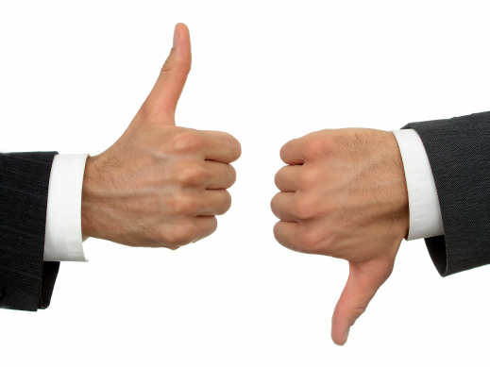
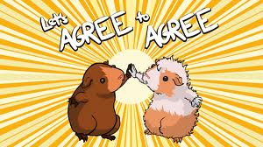
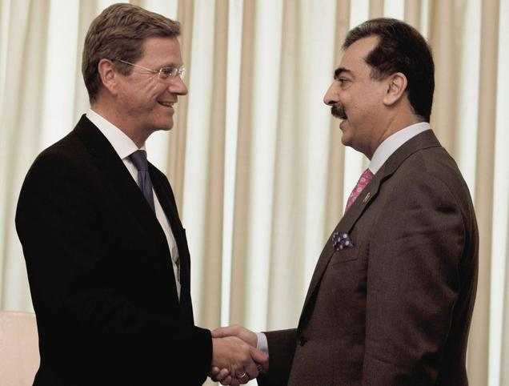
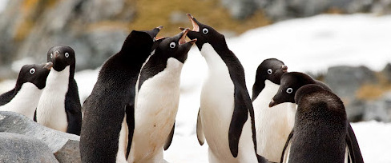
Which pictures show people who agree?
Notes:
Engage the students with the word

Slide 14
Who can use all 3 words in a sentence?
flapped
midday
agreed
Notes:
Read all three words and see if you can use them in one sentence.

Slide 15
Draw a picture to show you know what these words mean.
flapped
midday
agreed
Notes:
Application-
Students need an opportunity to use the words they just learned from the text.

Slide 16
I can use words I learn from a text.
Notes:
Goal-
Revisit the Goal

