Slide 1
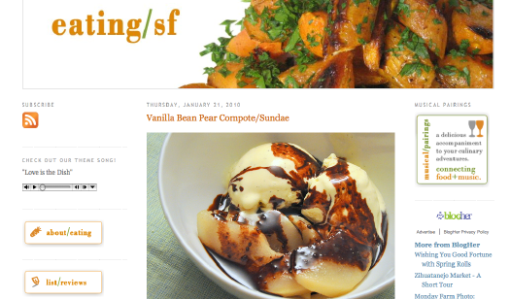
blog
Examples of blogs

Slide 2
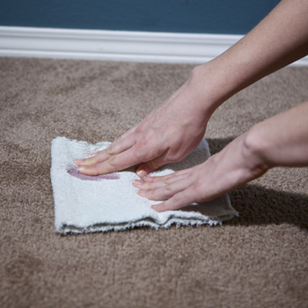
blot

Slide 3
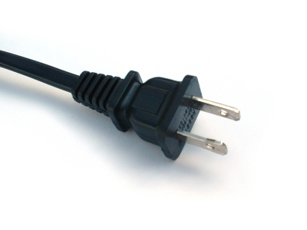
plug

Slide 4
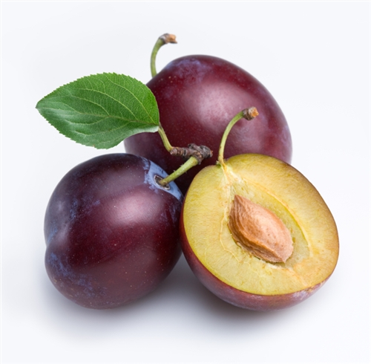
plum

Slide 5
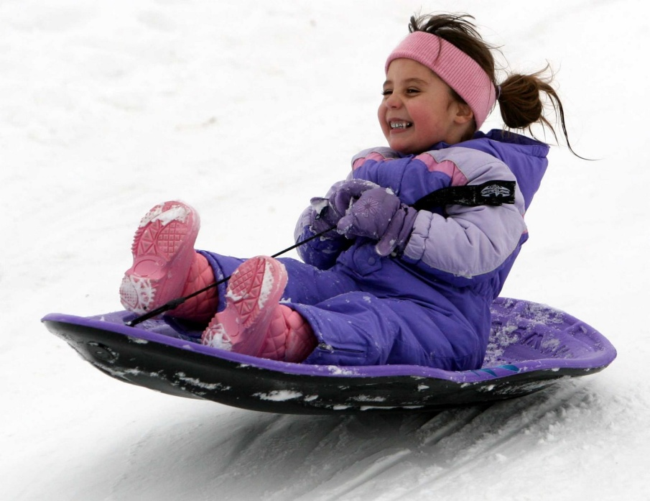
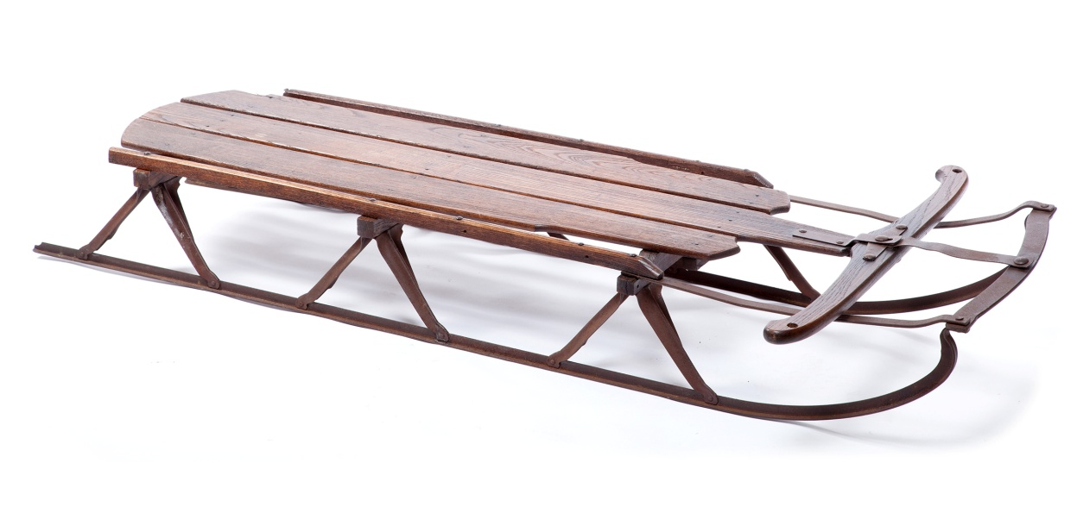
sled

Slide 6
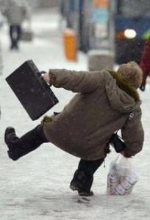
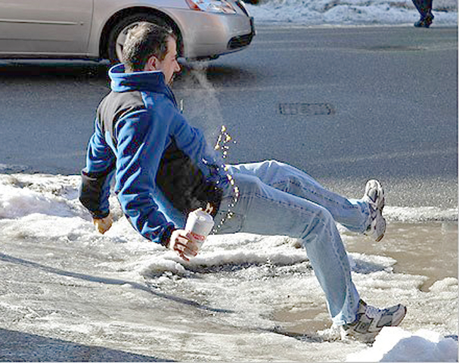
slip

Slide 7
here
Grace Hill
Elementary

Slide 8
us
You and me!

Slide 9
blog
blot
plug
plum
sled
slip
here
us

