Slide 1
Needs vs Wants
Economics
E.4.1.1 Explain ways scarcity necessitates
decision making.

Slide 2
I can tell the difference between a want and a need.
1 2 3 4

Slide 3
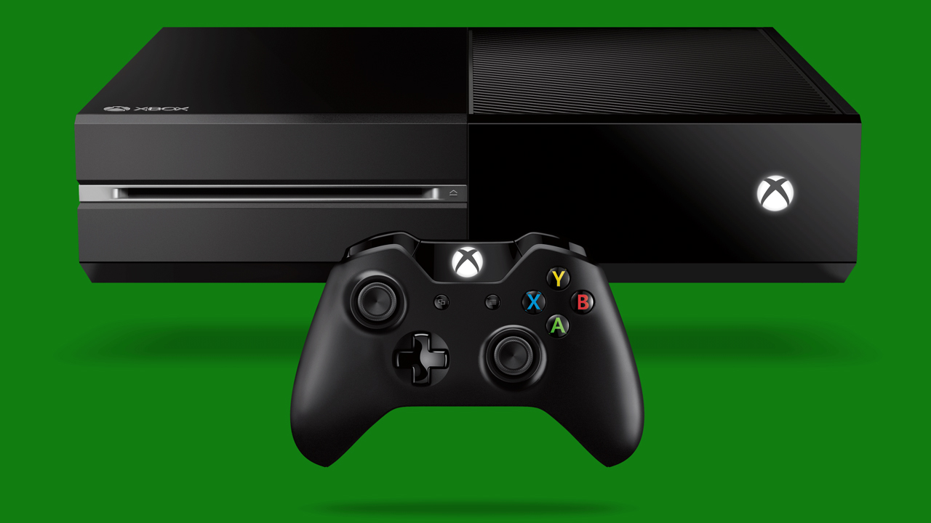

Slide 4


Slide 5
Which do you need? Which do you want?
Xbox
Glass of Water

Slide 6

“Needs and Wants” Video
BrainPop Jr.

Slide 7
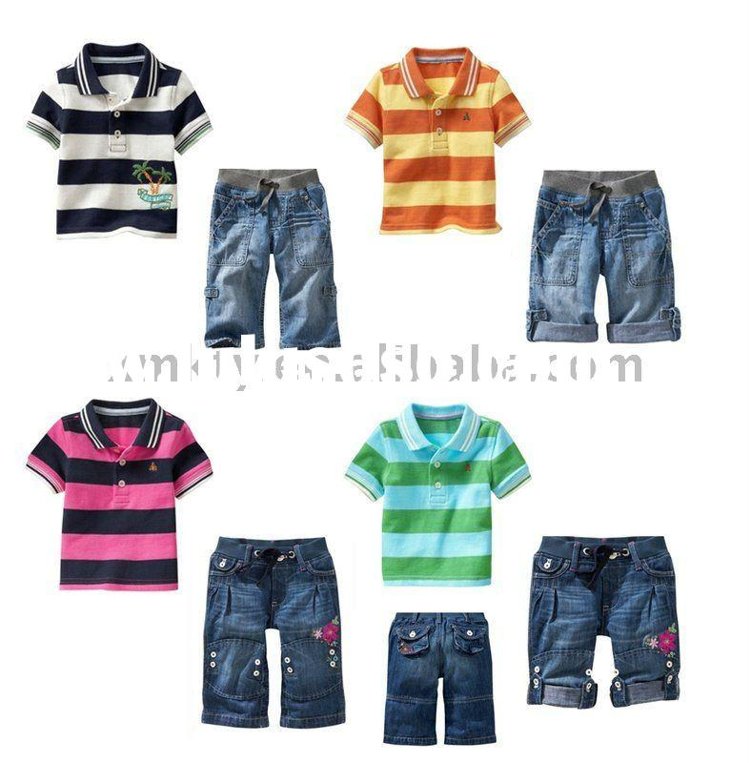

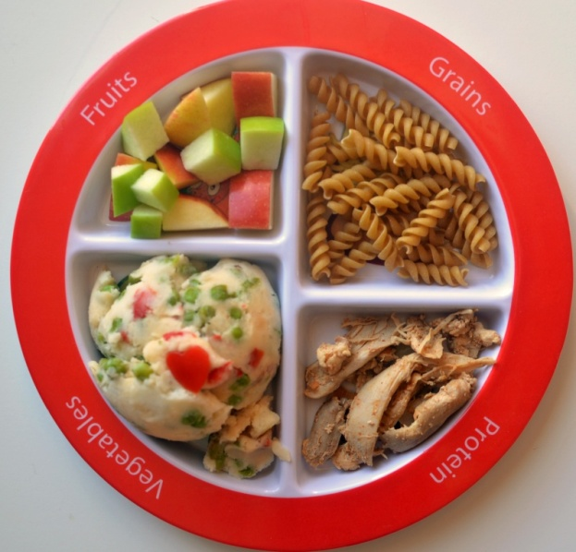
What Are Needs?
Needs are things that keep us healthy and safe.
Some examples are Food, Clothing, and Shelter.

Slide 8
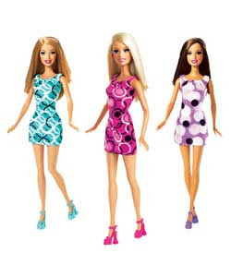

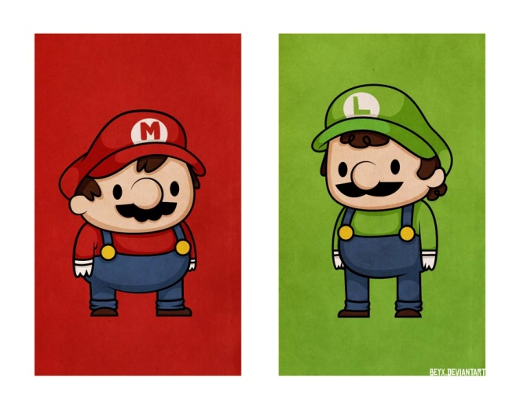
What Are Wants?
Wants are things we would like but do not need.
Some examples are Toys, Games, and Stuffed Animals.

Slide 9
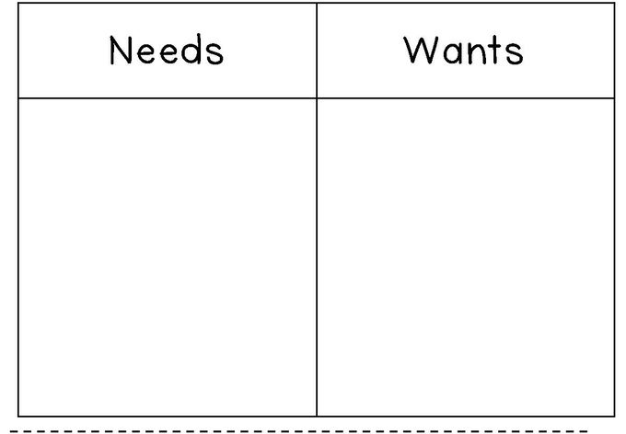
Sort
Cut, sort, and glue pictures into the correct column.
Notes:
Sort Activity from TPT https://www.teacherspayteachers.com/Product/Wants-and-Needs-Freebie-1641427

Slide 10
I can tell the difference between a want and a need.
1 2 3 4

