Slide 1
1st Grade Text Talk
Unit 2

Slide 2
I can use words I learn from a text.
Notes:
Goal-
Students need to engage with the goal- read it, repeat it, write it, etc.

Slide 3
Tell your partner about a new word you learned last week.
Notes:
Access Prior Knowledge- (APK)
Turn and Talk

Slide 4
Notes:
New Information-
Read the book- provide a brief explanation of any words that may be new or unfamiliar to the students.

Slide 5
romp
Notes:
Contextualize the word- Find it in the text
Say the word together

Slide 6
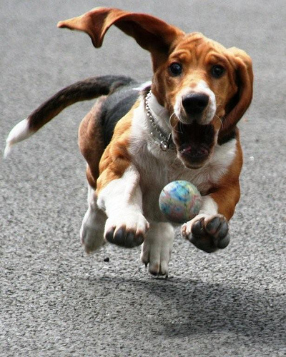
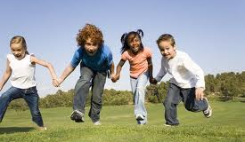
romp
To run, jump, play, and feel happy
Notes:
Give student friendly definition
Use the word in other contexts

Slide 7
Thumbs up if this is an example of romping.
Thumbs down if not.
The kittens were chasing a toy mouse around the room.
The children were reading quietly.
The boys were laughing and jumping in the big pile of leaves.
Notes:
Engage the students with the word

Slide 8
startle
Notes:
Contextualize the word- Find it in the text
Say the word together

Slide 9
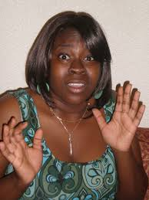
startle
To surprise someone and cause them to jump
Notes:
Give student friendly definition
Use the word in other contexts

Slide 10
What are some things that can startle people?
Notes:
Engage the students with the word

Slide 11
snatch
Notes:
Contextualize the word- Find it in the text
Say the word together

Slide 12
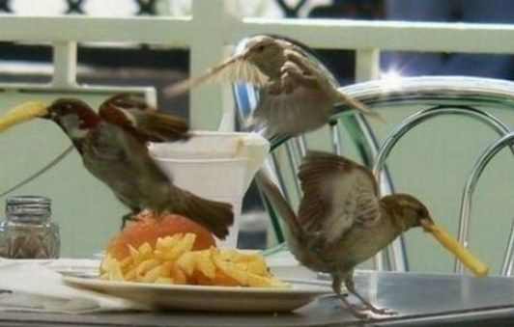
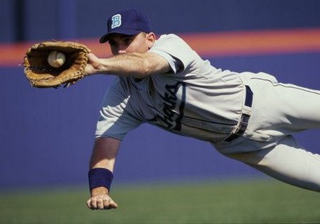
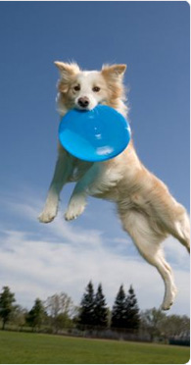
snatch
A quick grab
Notes:
Give student friendly definition
Use the word in other contexts

Slide 13
What are some things people might snatch?
Make a frozen picture with your partner showing the meaning of snatch.
Notes:
Engage the students with the word

Slide 14
Who can use all 3 words in a sentence?
romp
startle
snatch
Notes:
Read all three words and see if you can use them in one sentence.

Slide 15
Draw a picture to show you know what these words mean.
romp
startle
snatch
Notes:
Application-
Students need an opportunity to use the words they just learned from the text.

Slide 16
I can use words I learn from a text.
Notes:
Goal-
Revisit the Goal

