Slide 1
1st Grade Text Talk
Unit 2

Slide 2
I can use words I learn from a text.
Notes:
Goal-
Students need to engage with the goal- read it, repeat it, write it, etc.

Slide 3
Tell your partner about a new word you learned last week.
Notes:
Access Prior Knowledge- (APK)
Turn and Talk

Slide 4
Notes:
New Information-
Read the book- provide a brief explanation of any words that may be new or unfamiliar to the students.

Slide 5
glide
Notes:
Contextualize the word- Find it in the text
Say the word together

Slide 6
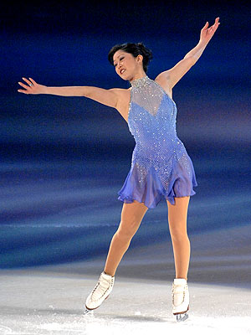
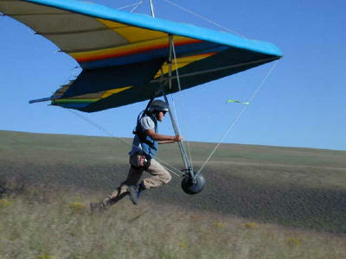
glide
Touch the picture to see a video of Kristi
Yamaguchi gliding on the ice in the 1992
Olympics
To move easily and quickly over a surface
Touch the picture to see a video of a hang
glider gliding through the air at Mount
Magazine.
Notes:
Give student friendly definition
Use the word in other contexts

Slide 7
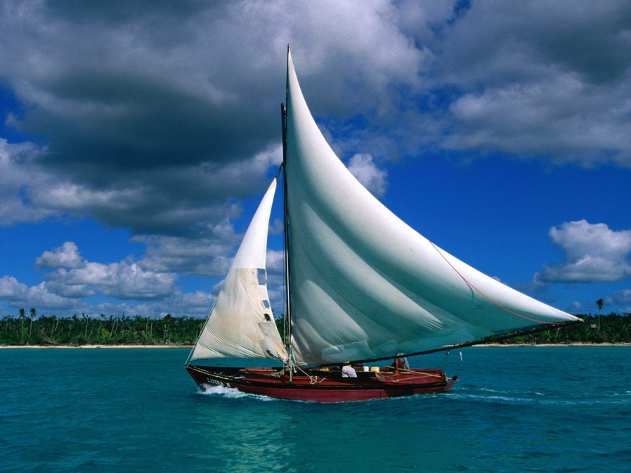
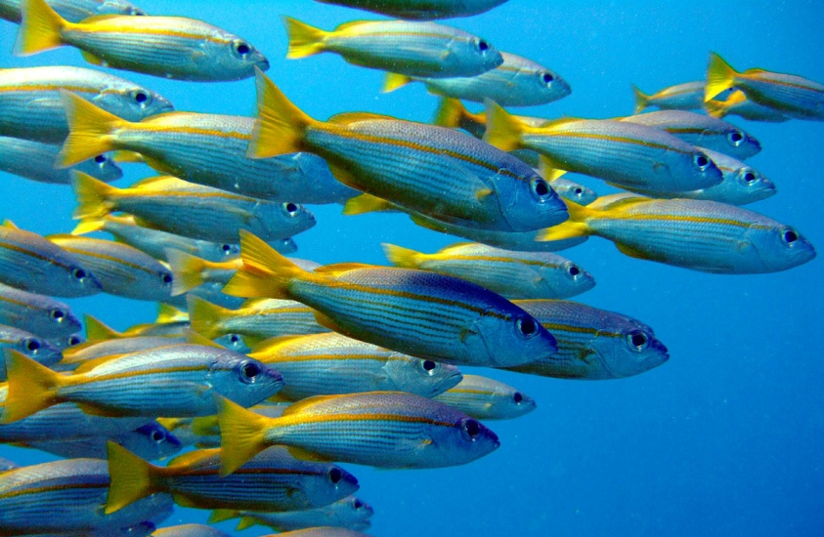
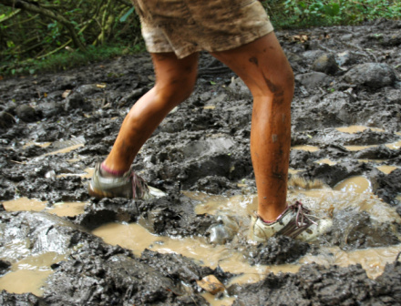
Which pictures show gliding?
Notes:
Engage the students with the word

Slide 8
sleek
Notes:
Contextualize the word- Find it in the text
Say the word together

Slide 9
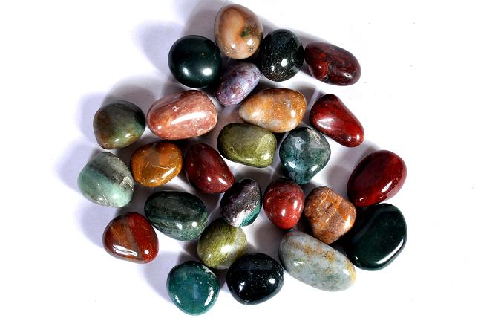
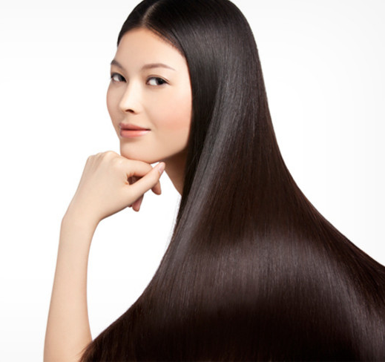
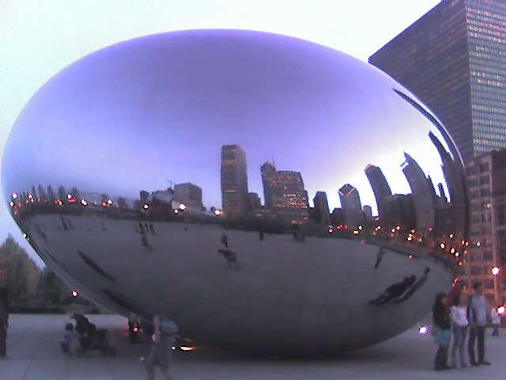
sleek
Smooth and shiny
Notes:
Give student friendly definition
Use the word in other contexts

Slide 10
Name some things that are sleek in our classroom.
Notes:
Engage the students with the word

Slide 11
seeping
Notes:
Contextualize the word- Find it in the text
Say the word together

Slide 12
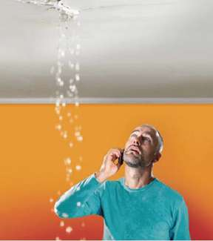
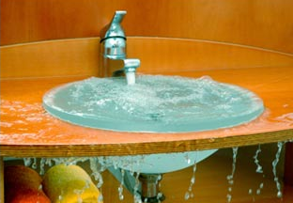
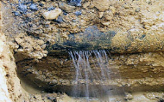
seeping
To flow slowly
Notes:
Give student friendly definition
Use the word in other contexts

Slide 13
Thumbs up if this is an example of seeping.
Thumbs down if not.
The water from my bathtub overflowed onto the floor and slowly moved across the bathroom floor and under the door.
The firemen sprayed water onto the burning house. The water came out of the hose very fast and with so much force that three firemen had to hold the hose.
Notes:
Engage the students with the word

Slide 14
Who can use all 3 words in a sentence?
glide
sleek
seeping
Notes:
Read all three words and see if you can use them in one sentence.

Slide 15
Draw a picture to show you know what these words mean.
glide
sleek
seeping
Notes:
Application-
Students need an opportunity to use the words they just learned from the text.

Slide 16
I can use words I learn from a text.
Notes:
Goal-
Revisit the Goal

