Slide 1
What Lives in a Shell?
Unit Two Text Talk

Slide 2
GOAL:
I can use words I learn from a text.

Slide 3
APK:
Tell your partner one new word that you remember from yesterday or last week.
Notes:
Access prior knowledge of words learned in previous lessons.

Slide 4
What live in a shell?
Notes:
New Information: Read the book and quickly explain and new or unfamiliar words to the students.

Slide 5
Frightened: to be afraid
Notes:
Contextualize the word- Find it in the text
Say the word together

Slide 6
Name a time that you were frightened.
I was frightened when…
Notes:
Engage students in the word.

Slide 7
Seashore : an area of sandy, stony, or rocky land bordering and level with the sea.
Notes:
Contextualize the word- Find it in the text
Say the word together

Slide 8
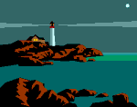
Which pictures show a seashore?
Notes:
Engage students in the word.

Slide 9
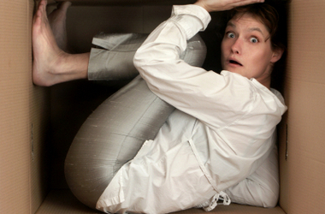
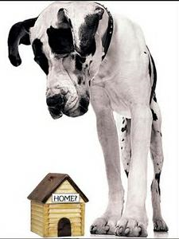
Outgrown: to grow too big for something
Notes:
Contextualize the word- Find it in the text
Say the word together

Slide 10
Name something that you have outgrown.
I have outgrown…
Notes:
Engage students in the word.

Slide 11
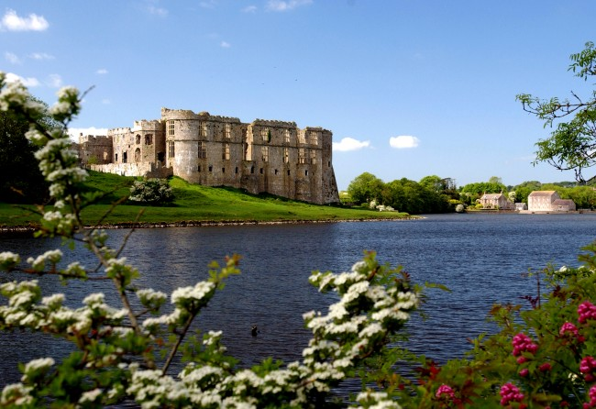
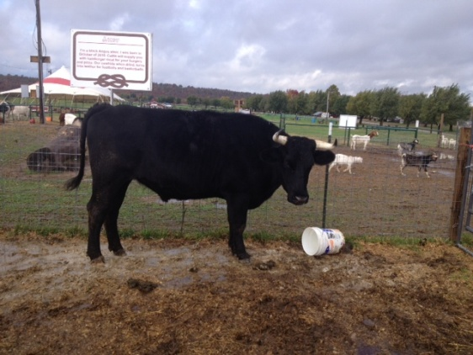
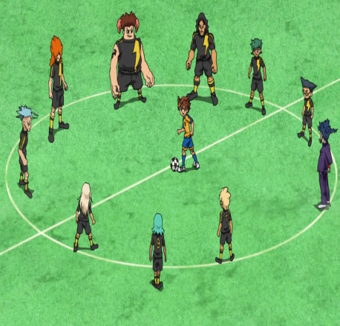
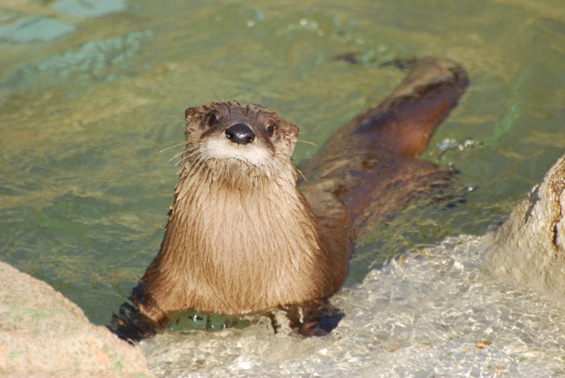
Surroundings: the things and conditions around a person, place, or thing
Notes:
Contextualize the word- Find it in the text
Say the word together

Slide 12
Look around where you are sitting. What are your surroundings?
-What are your surroundings when you are outside on the playground?
-What are your surroundings when you are at home?

Slide 13
Thumbs up if you can use all 4 words in a sentence, and would like to share?
Notes:
Students can have an opportunity to share what they have learned.

Slide 14
Draw a picture to show what each word means. Share these with a peer at your table.
Draw these in your interactive notebooks.
Notes:
Application- Students will draw a picture showing understanding of the new words.

Slide 15
Revisit Goal:
I can use words I learn from a text.

