Slide 1
1st Grade Text Talk
Unit 2

Slide 2
I can use words I learn from a text.
Notes:
Goal-
Students need to engage with the goal- read it, repeat it, write it, etc.

Slide 3
Tell your partner about a new word you learned last week.
Notes:
Access Prior Knowledge- (APK)
Turn and Talk

Slide 4
Notes:
New Information-
Read the book- provide a brief explanation of any words that may be new or unfamiliar to the students.

Slide 5
lickety-split
Notes:
Contextualize the word- Find it in the text
Say the word together

Slide 6
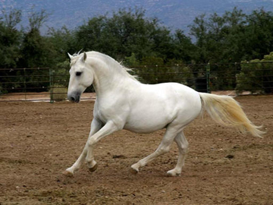
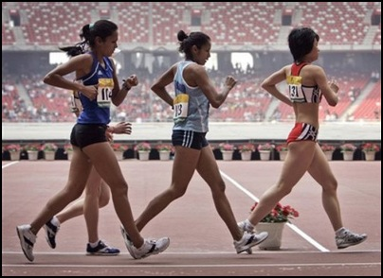
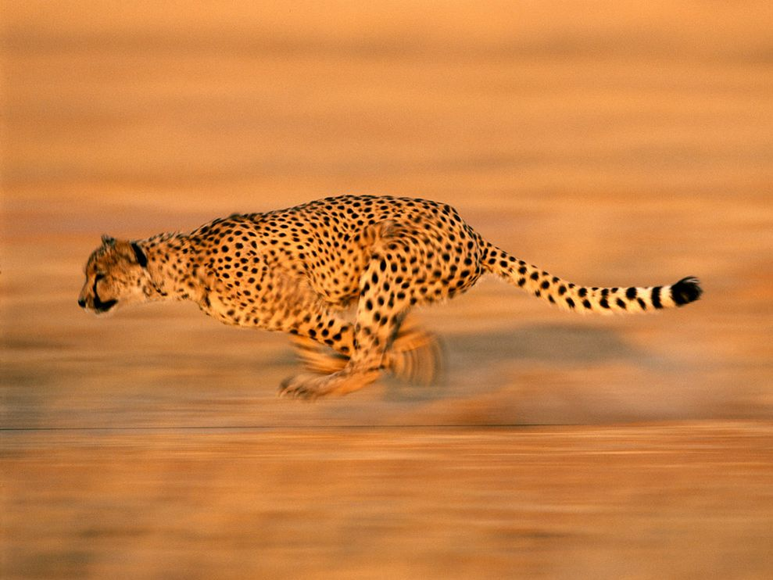
lickety-split
really fast
Notes:
Give student friendly definition
Use the word in other contexts

Slide 7
Thumbs up if this is a time you would move lickety-split. Thumbs down if not.
Your house is on fire and you need to get out.
You are running late and about to miss the bus.
You are reading the directions to learn how to play a new video game and you don’t understand them.
Notes:
Engage the students with the word

Slide 8
slithered
Notes:
Contextualize the word- Find it in the text
Say the word together

Slide 9
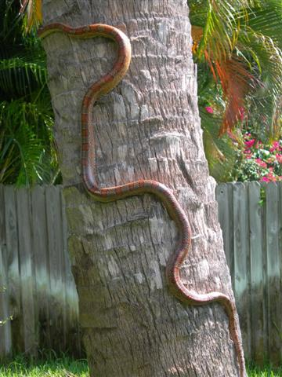
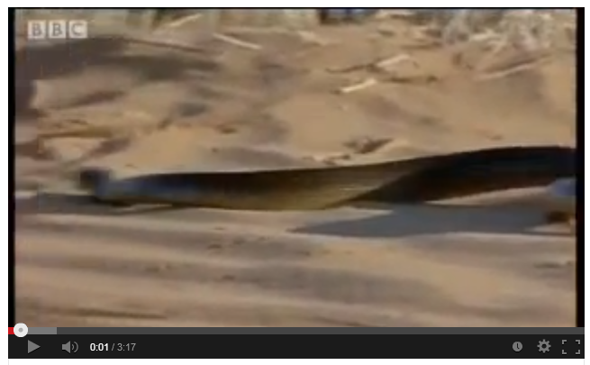
slithered
to move by sliding and making lots of turns
(click on the photo to see a snake slither)
Notes:
Give student friendly definition
Use the word in other contexts

Slide 10
Make your hand slither down your leg.
Notes:
Engage the students with the word

Slide 11
single
Notes:
Contextualize the word- Find it in the text
Say the word together

Slide 12
single
only one
Notes:
Give student friendly definition
Use the word in other contexts

Slide 13
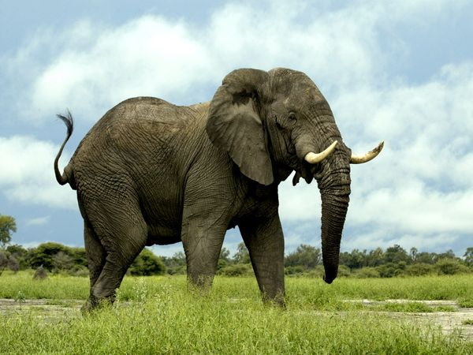
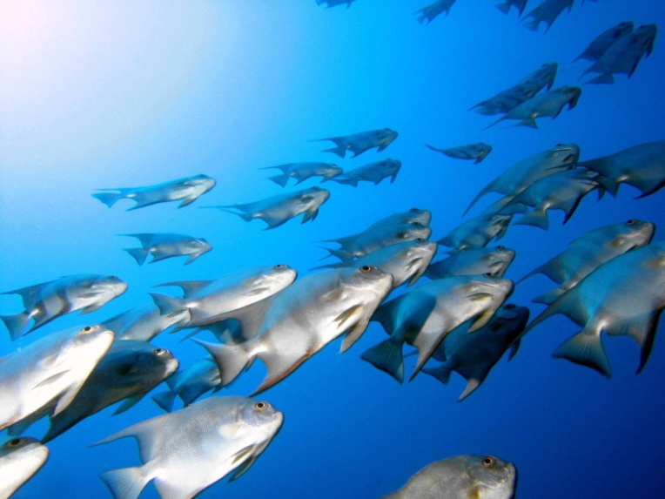
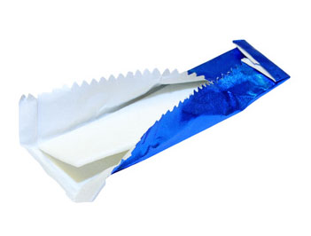
Which items are single?
Notes:
Engage the students with the word

Slide 14
Who can use all 3 words in a sentence?
lickety-split
slithered
single
Notes:
Read all three words and see if you can use them in one sentence.

Slide 15
Draw a picture to show you know what these words mean.
lickety-split
slithered
single
Notes:
Application-
Students need an opportunity to use the words they just learned from the text.

Slide 16
I can use words I learn from a text.
Notes:
Goal-
Revisit the Goal

